Slide 1

IMPROVED ROUND Robin BASED SCHEDULING ALGORITHM
TECHNIQUES TO IMPROVE LINUX PROCESS SCHEDULING
AYUSH MANGUKIA, MOHAMMED IBRAHIM, SOORYA GOLAMUDI, NISHANT KUMAR

Slide 2
INTRODUCTION
CPU or process Scheduling, which is an important part in any operating systems, allocates processes to the CPU in specific order to optimize some objective functions.
The efficiency of any operating system relies strongly on the scheduling algorithms used. Several scheduling algorithms exists. Among them, Round Robin (RR) is the most widely utilized algorithm.
RR has proved to be effective in several types of operating systems, such as time-sharing systems. This is due to the reasonable response time it gives.
However, it suffers from some shortcomings such as high average turnaround time, high average waiting time.
So, we devise an improved Round – Robin Algorithm.

Slide 3
Literature Survey
The classical methods include First Come First Serve (FCFS), Shortest Job First (SJF), Priority Scheduling and Round Robin Scheduling. The problem with FCFS is waiting times are too long if a big process comes in the Queue. Similarly, SJF causes starvation if short processes keep coming. Even Priority causes starvation when important processes keep coming and lower priority processes may be postponed indefinitely.
Round Robin Scheduling Algorithm has the drawback of causing high waiting time for each process if the quantum is set too small. The quantum is set forehand and is generally not changed. There are many papers which have some improvements on the Round Robin Algorithm. One such improvement accredited by many authors was to check if the remaining time of the process under execution is less than the Time Quantum, then the processor is re-assigned to the process for the remaining time. There was another improvement which spoke about setting the time value of Time Quantum according to the Data Set. It used the approach of setting the Quantum value as the Twice the Average of Burst Times i.e. Two Times the Mean or set the Quantum Value as the middle most burst time in the Data Set i.e. Median.

Slide 4
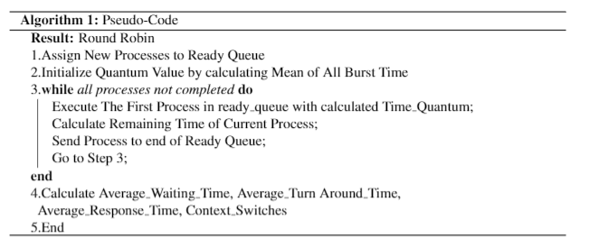
Literature Survey THE ORIGINAL
ROUND ROBIN ALGORITHM

Slide 5
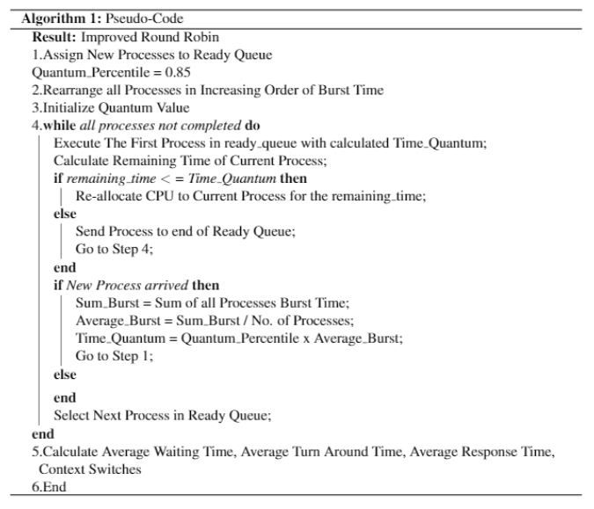
THE PROPOSED
ROUND ROBIN ALGORITHM

Slide 6
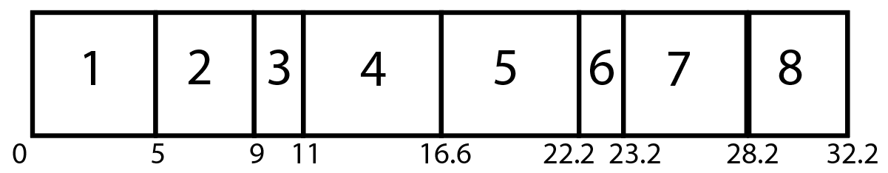
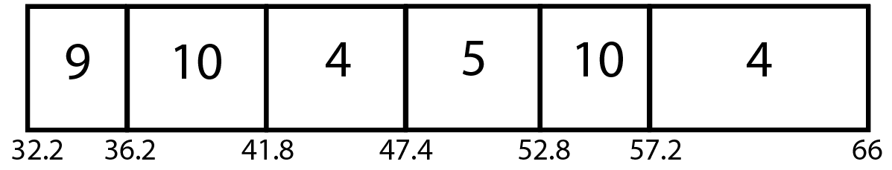
Comparison (Gantt Chart) Regular round robin
Process | Arrival Time | Burst Time
1 | 0 | 5
2 | 0 | 4
3 | 1 | 2
4 | 1 | 20
5 | 3 | 11
6 | 4 | 1
7 | 4 | 5
8 | 7 | 4
9 | 7 | 4
10 | 9 | 10
Normal Round Robin:
Quantum : 5.61 Seconds
Average Response Time: 14.771
Average Waiting Time: 21.893
Average Turn-Around Time: 28.493
Context Switches: 13

Slide 7
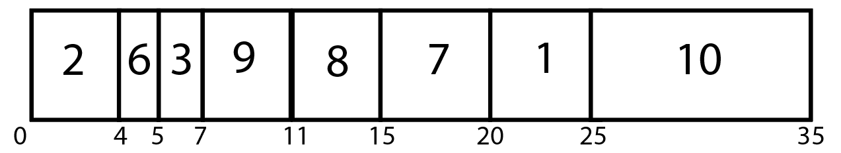
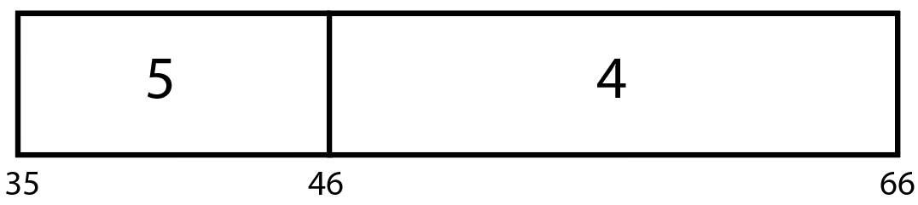
Comparison (Gantt Chart) improved round robin
Process | Arrival Time | Burst Time
1 | 0 | 5
2 | 0 | 4
3 | 1 | 2
4 | 1 | 20
5 | 3 | 11
6 | 4 | 1
7 | 4 | 5
8 | 7 | 4
9 | 7 | 4
10 | 9 | 10
Improved Round Robin:
Average Response Time: 13.200
Average Waiting Time: 13.200
Average Turn-Around Time: 19.800
Context Switches: 9

Slide 8
Improvements with the Algorithm
Using the Algorithm helps in reducing Average Waiting, Turn Around and Response Time as the Quantum Time is not fixed and is variable depending on the Tasks given to it.
Reduces number of context switches since the CPU is re-allocated to the current process if the remaining time is less than the time quantum.

Slide 9
Results for Quantum Values
Quantum | N | AWT | ART | ATT | #CS
0.1 | 50 | 165.216 | 17.461 | 171.276 | 439
0.2 | 50 | 144.522 | 31.109 | 150.581 | 198
0.3 | 50 | 126.380 | 47.674 | 132.440 | 124
0.4 | 50 | 117.690 | 58.606 | 123.750 | 97
0.5 | 50 | 111.779 | 66.769 | 117.839 | 79
0.6 | 50 | 101.700 | 81.360 | 107.760 | 64
0.7 | 50 | 97.410 | 87.870 | 103.470 | 59
0.8 | 50 | 95.408 | 90.668 | 101.468 | 56
0.85 | 50 | 93.814 | 92.374 | 99.874 | 53
0.9 | 50 | 93.120 | 93.120 | 99.180 | 49

Slide 10

Results Found
For Dataset of Size 50, we find that a Quantum of Range 0.7 to 0.95 Produce Low Average Waiting and Turnaround Time with Context Switches almost equal to Size
For Dataset of Size 100, we find that a Quantum of Range 0.8 to 0.95 Produce Low Average Waiting and Turnaround Time with Context Switches almost equal to Size
For Dataset of Size 150, we find that a Quantum of Range 0.75 to 0.95 Produce Low Average Waiting and Turnaround Time with Context Switches almost equal to Size
For Dataset of Size 200, we find that a Quantum of Range 0.8 to 0.95 Produce Low Average Waiting and Turnaround Time with Context Switches almost equal to Size

Slide 11
A New Concept Parallel Processing into Round Robin
Uses several systems or processors to run different processes in parallel
Significantly lower values of time metrics and context switching even with 2/4 processors
Better management of workload for the individual processors compared to regular parallel processing
Better turn around times for the processes also compared to regular parallel processing

Slide 12
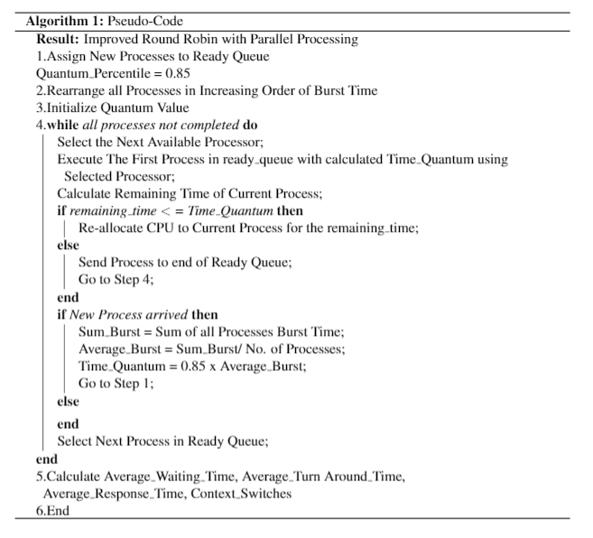
ROUND ROBIN with Parallel processing

Slide 13
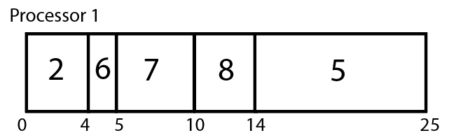
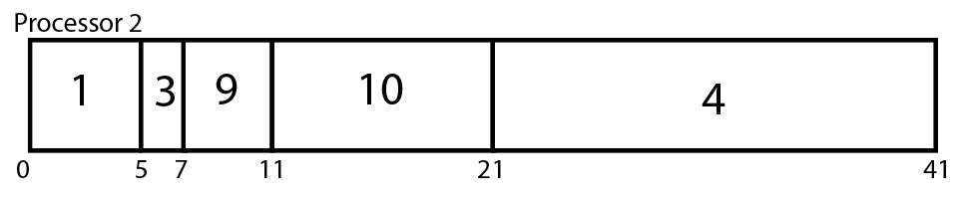
(Gantt Chart) Improved Round robin (2 cores)
Process | Arrival Time | Burst Time
1 | 0 | 5
2 | 0 | 4
3 | 1 | 2
4 | 1 | 20
5 | 3 | 11
6 | 4 | 1
7 | 4 | 5
8 | 7 | 4
9 | 7 | 4
10 | 9 | 10
Improved RR (2 cores):
Average Response Time: 4.100
Average Waiting Time: 4.100
Average Turn-Around Time: 10.700
Context Switches: 8

Slide 14
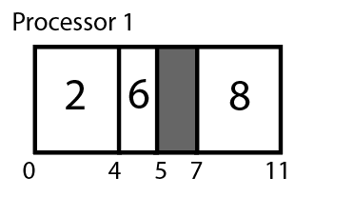
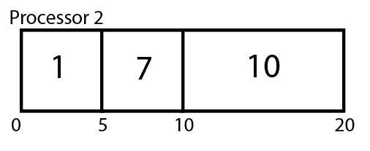
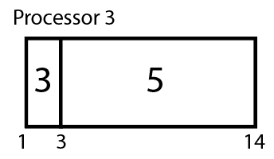
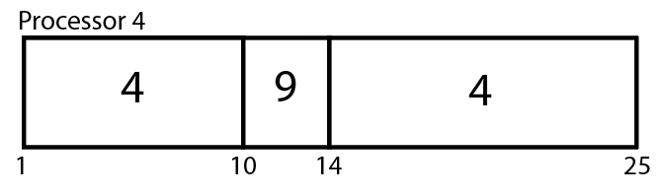
(Gantt Chart) Improved Round robin (4 cores)
Process | Arrival Time | Burst Time
1 | 0 | 5
2 | 0 | 4
3 | 1 | 2
4 | 1 | 20
5 | 3 | 11
6 | 4 | 1
7 | 4 | 5
8 | 7 | 4
9 | 7 | 4
10 | 9 | 10
Improved RR (4 cores):
Average Response Time: 0.500
Average Waiting Time: 0.900
Average Turn-Around Time: 7.500
Context Switches: 6

Slide 15
Improvements using Parallel processing
Method | N_Processes | Avg Response Time | Avg Waiting Time | Avg Turnaround Time | Context Switches
Round Robin | 50 | 94.66864 | 176.18346 | 182.24346 | 82
Improved Round Robin | 50 | 92.37462 | 93.81462 | 99.87462 | 53
Improved Round Robin Dual (2) Processor | 50 | 43.24 | 43.24 | 49.3 | 48
Improved Round Robin Quad (4) Processor | 50 | 21.2 | 21.14797 | 27.20797 | 49
Round Robin | 70 | 117.5181714 | 230.4090286 | 235.8518857 | 120
Improved Round Robin | 70 | 121.2 | 121.2 | 126.6428571 | 69
Improved Round Robin Dual (2) Processor | 70 | 56.01428571 | 56.01428571 | 61.45714286 | 68
Improved Round Robin Quad (4) Processor | 70 | 24.08571429 | 24.08571429 | 29.52857143 | 66
Round Robin | 100 | 218.596035 | 424.161765 | 431.051765 | 173
Improved Round Robin | 100 | 219.36 | 219.36 | 226.25 | 99
Improved Round Robin Dual (2) Processor | 100 | 100.69 | 100.69 | 107.58 | 98
Improved Round Robin Quad (4) Processor | 100 | 42.721415 | 42.66761 | 49.55761 | 97

Slide 16
Improvements using Parallel processing
Method | N_Processes | Avg Response Time | Avg Waiting Time | Avg Turnaround Time | Context Switches
Round Robin | 150 | 235.0491067 | 470.3493067 | 475.4759733 | 255
Improved Round Robin | 150 | 239.78 | 239.78 | 244.9066667 | 149
Improved Round Robin Dual (2) Processor | 150 | 106.0133333 | 106.0133333 | 111.14 | 148
Improved Round Robin Quad (4) Processor | 150 | 40.78876333 | 40.76796667 | 45.89463333 | 147
Round Robin | 200 | 328.83582 | 639.1362 | 644.4512 | 332
Improved Round Robin | 200 | 329.36 | 329.36 | 334.675 | 199
Improved Round Robin Dual (2) Processor | 200 | 147.21 | 147.21 | 152.525 | 198
Improved Round Robin Quad (4) Processor | 200 | 58.005 | 58.005 | 63.32 | 196

Slide 17

Conclusion
The new algorithms devised have been developed to include the prominent features of many suggestions for improvements to a round robin algorithm. The algorithms have provided positive output in regards to the metrics and can be of use in a real-time OS. The paper also has implemented an algorithm for mass processing of processes for larger projects by improving Parallel Processing.

Slide 18
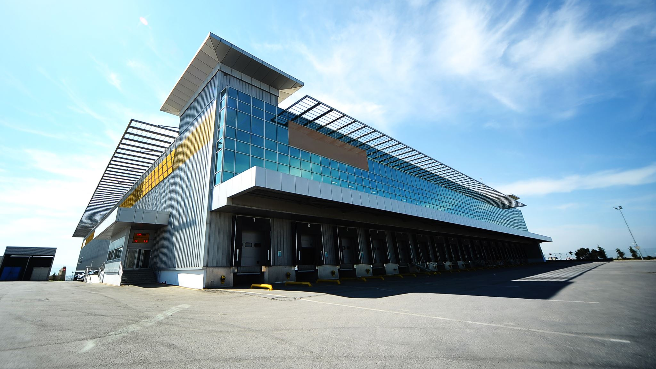
Future work
Using ML/DL concepts the prediction of the burst times of the processes can be implemented.
Splitting of large sequential processes to several smaller processes that can be run in parallel to further improve Parallel Processing.
Implementation in a real-life Operating System.
Modify the algorithm to allow more uniform distribution of processes amongst the processors to minimize their under-utilization.

Slide 19

Repository of Work Done
GitHub Repo : https://github.com/TheKillingAMD/OS-Algorithm-Improved-Round-Robin
Report :
https://drive.google.com/file/d/13YDXrcdJSkWU58PpeFFsKeib7GlmOcDk/view?usp=sharing

