Slide 1


Gamma Workdir
Statechart1
Statechart1.gsm
Statechart2
Statechart2.gsm
interfaces.gsm
.traces.md2g

Slide 2
R
STM
R
S
R
S
R
S
R
S

Slide 3

MagicDrawToGamma
Plugin
Gamma Modellek
Uppaal Modellek
Módosítot
Quey Generátor
Uppaal Modellek
Gamma Modellek
Uppaal
Query-k
Gamma Framework
Eredmények

Slide 4
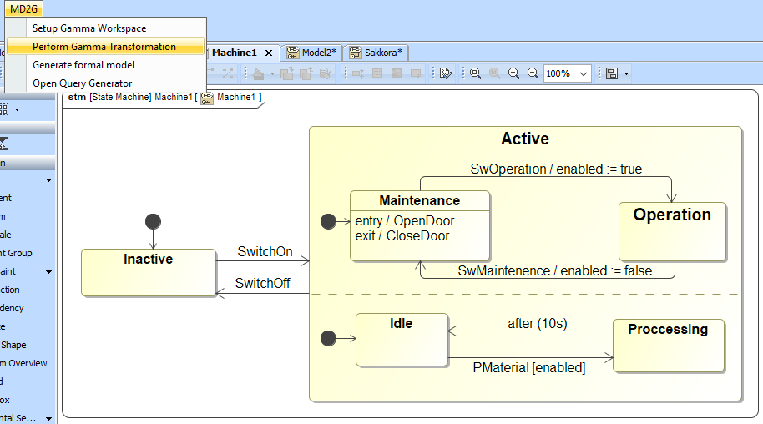

Slide 5
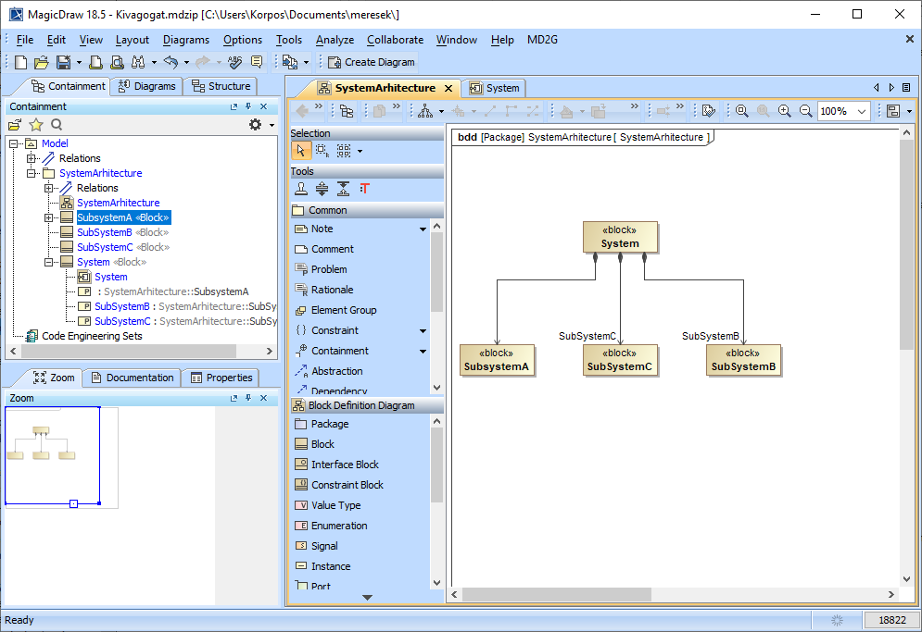

Slide 6
Active
SwitchOn
Inactive
Active
Maint.
Oper.
Idle
Proc.
SwOperation
Inactive
Active
Maint.
Oper.
Idle
Proc.
PMaterial
Inactive
Active
Maint.
Oper.
Idle
Proc.
SwMaintenance
Inactive
Active
Maint.
Oper.
Idle
Proc.
Inactive
Active
Maint.
Oper.
Idle
Proc.

