Slide 1

Song Recommender
Jack Leeper

Slide 2
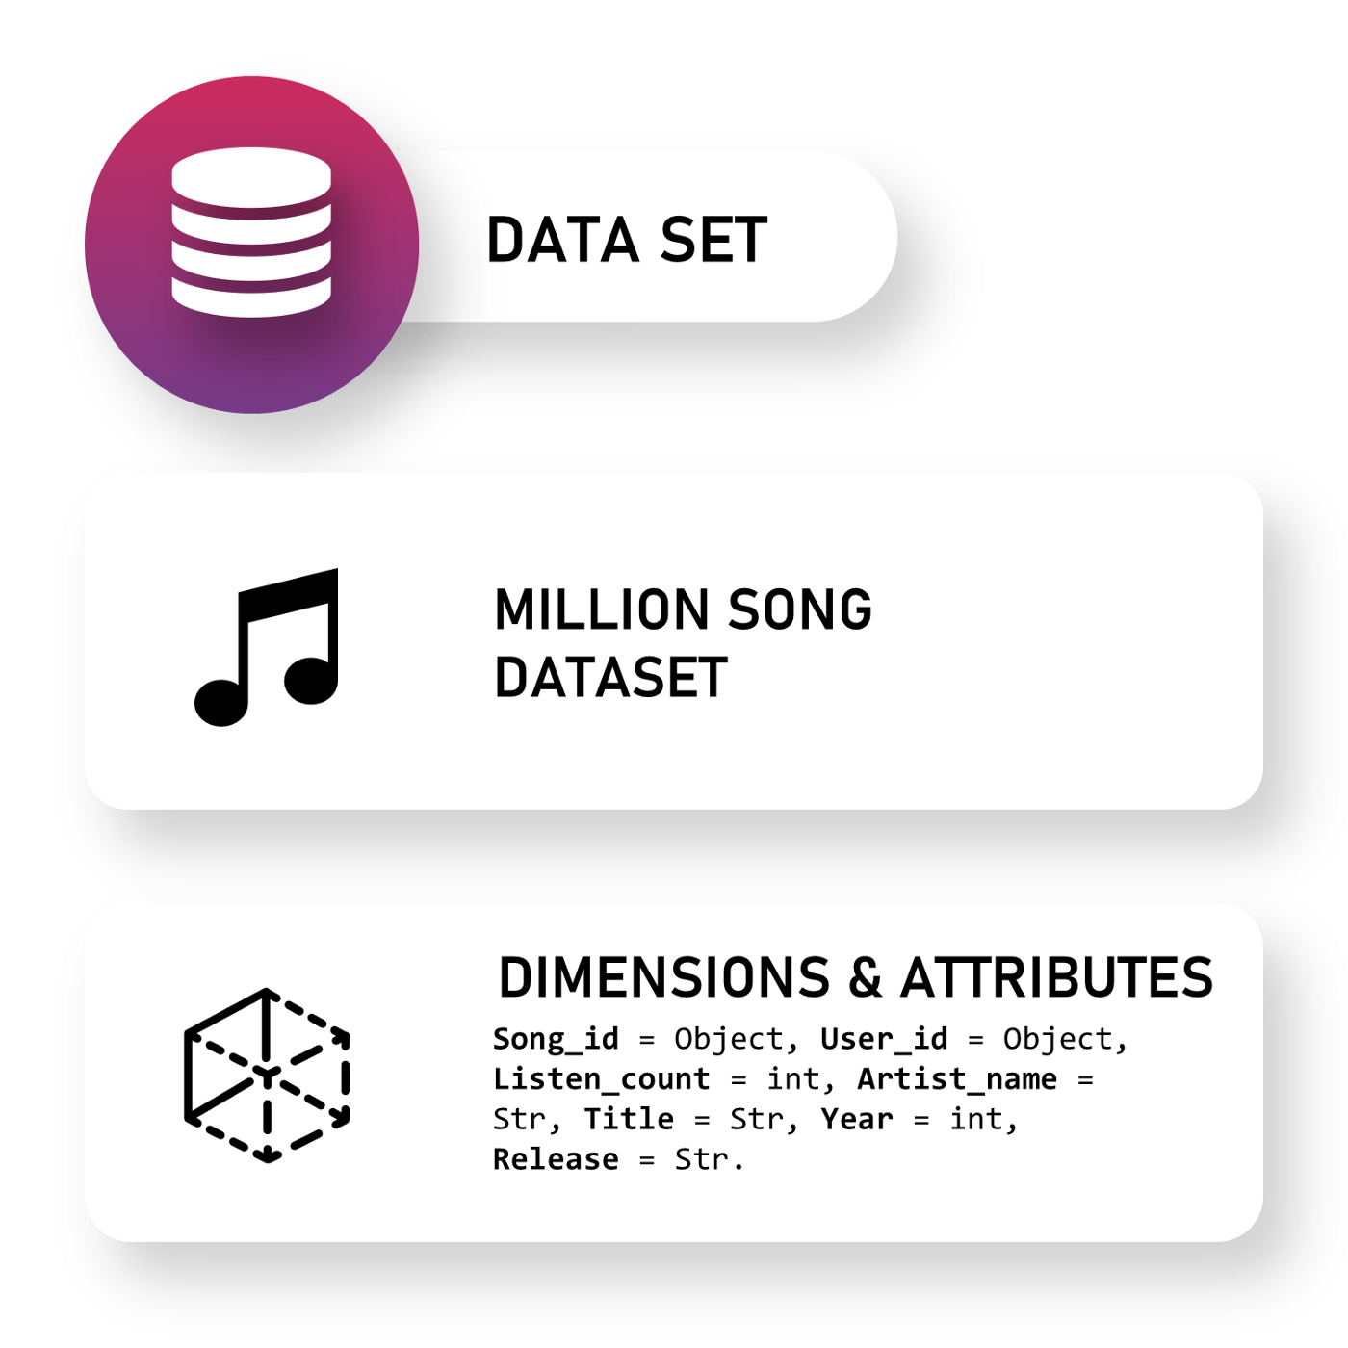
My Data mining Task
Motivation for choosing this task
Challenges of this task
The data mining task I decided to take on is a recommender system for songs. I wanted to make a program that could take a sample of user liked songs, and then based off of those songs, generate some similar songs that the user may also enjoy.
Amongst almost every modern music playing application you can probably find a song recommending system in place, I myself found Spotify’s discover weekly playlist, or just recommended songs in general to be very accurate and a heavy inspiration for me to want to recreate something similar to it.
I have a dataset with a hefty amount of songs, each of those songs come with informative attributes, every song in the dataset has these attributes, I need to be able to determine what songs the user likes based off of these attributes.

Slide 3
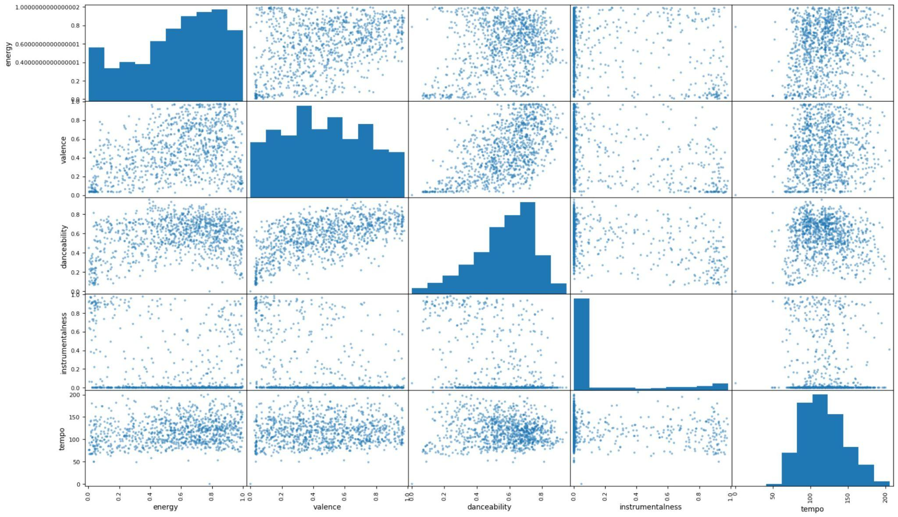
Methodology
I decided to clusterize the data set with KMeans (from SciKit/Sklearn)
This is a scatter plot of the dataset song attributes, as you can see there are a lot of varying data points, but some attributes seem to have a somewhat linear relationship with each other.
These data points representing songs with their according attributes are what I need to clusterize.

Slide 4
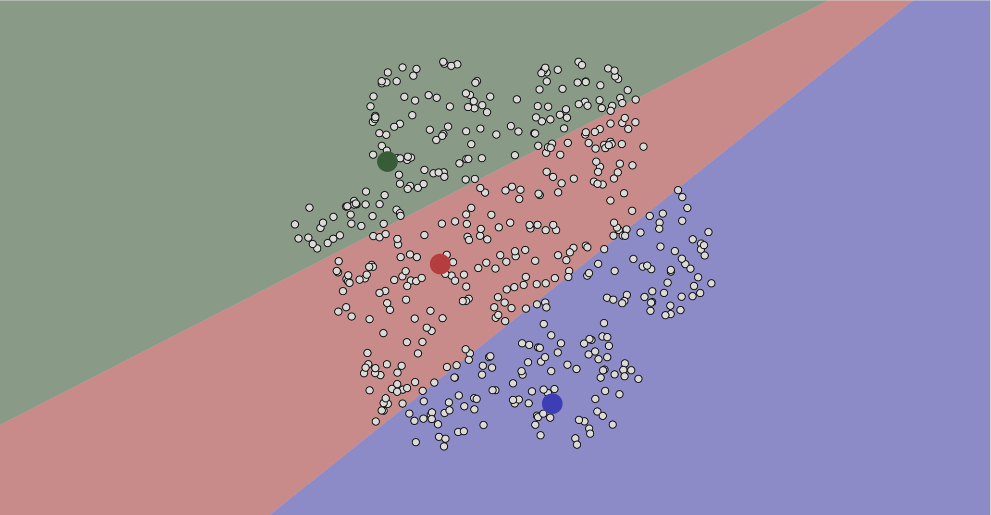
What is KMeans
KMeans clusterization is as simple as it is helpful, let’s say you have various data points, let’s say the data points in the image to the right represent each song in the dataset, their placement in the scatter plot depend entirely on their attributes, the idea is songs that are near each other will be similar because they have similar attribute numbers.
KMeans clusterization is a means to categorize the data points into sections, each section is marked by a centroid or central data point, the algorithm works on placing and replacing the centroid over and over, as well as assigning data points to certain clusters depending on how close they are to the centroid.
Before KMeans algorithm

Slide 5
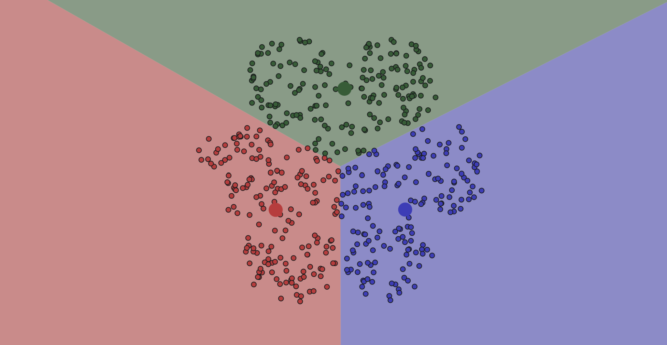
What is KMeans
Once the centroids are in the center of their cluster the algorithm stops, and so the songs should be sorted into different categories (or clusters), and songs within the same category should be similar
And so that’s how I implemented my song recommender system, I clustered the songs into 5 different clusters, then the user must input several songs in order for me to determine what kind of cluster they prefer, then you can simply offer them songs in that cluster and those songs are likely to share attributes with the user’s liked songs.
After KMeans algorithm

Slide 6

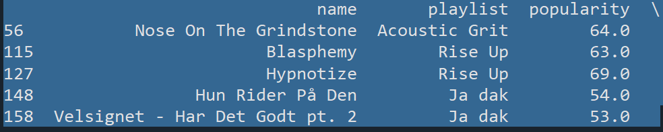
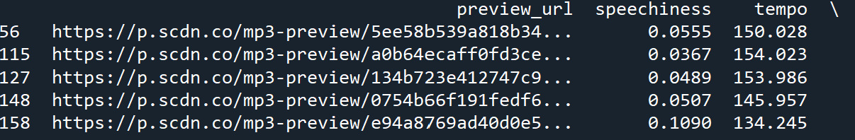
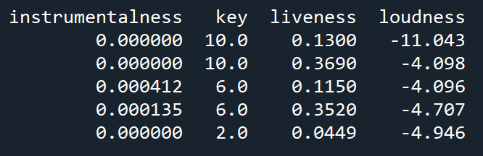
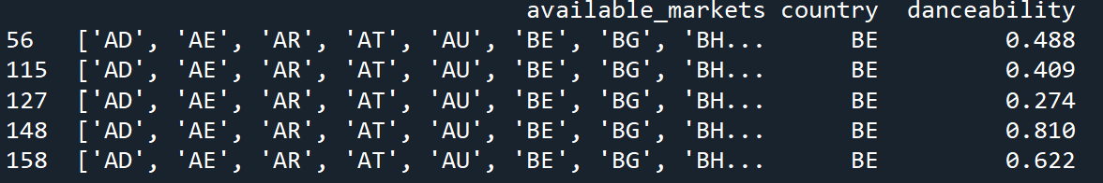
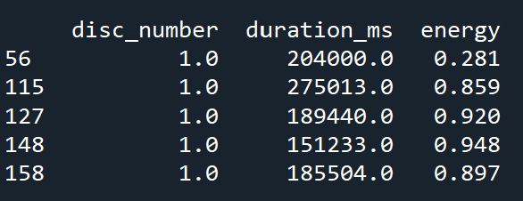
Results
User’s preferred cluster
5 songs from cluster 3 given to the user as suggestions
After completing my program I decided to test the clustering to see if songs recommended were properly categorized.
The stats among the songs in cluster 3 appear to have similar attributes
Stats of the recommended songs

