Slide 1

AI reinvention made real
Accenture Innovation Challenge 2026

Slide 2


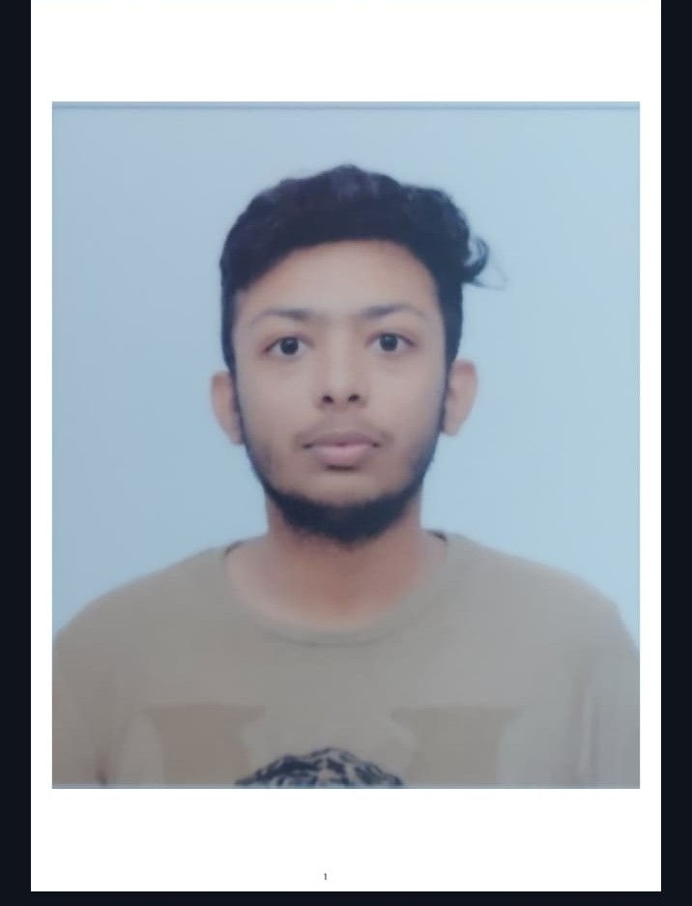
Team details
TEAM NAME: Warriors
Harsh Singh Baghel
Dhruv Maheshwari
College: IIT Patna
Stream: Engineering Physics
Year of graduation: 2028
College: IIT Patna
Stream: Engineering Physics
Year of graduation: 2028
Rathod Rudra
Photo
College: IIT Patna
Stream: Engineering Physics
Year of graduation: 2029
All fields are mandatory

Slide 3
BUSINESSINTELLIGENCE.AI · ROUND 2
Executive Problem: The Telemetry-to-Action Gap
The Operational Dilemma
Noisy Anomaly Alerts: Static dashboards flood leaders with false alarms, failing to isolate seasonal Day-of-Week swings from genuine operational breaks.
Multi-Source Data Silos: ERP SQL ledgers (daily), web session telemetry (hourly), and Jira tickets (weekly) are disconnected.
The LLM Hallucination Risk: Pure LLM analytics fabricate arithmetic totals, violate financial identities, and propose ungrounded actions.
Our Architectural Solution
Deterministic Math Core: Statistical Process Control (28-day DoW baseline) + exact 3-Factor Shapley decomposition with guaranteed $0.00 residual error.
3-Model AI Diagnostic Triad: Internal diagnostic (Model 1) + Live macro sentinel (Model 2) + Prescriptive ROI trajectory simulator (Model 3).
Governed Safe Action Engine: Explicit abstention protocol under ambiguity ($<25\%$ confidence delta) prescribing low-cost canary validation tests.

Slide 4
BUSINESSINTELLIGENCE.AI · ROUND 2
Governed Semantic Contract & Multi-Source Ingestion
Daily ERP Sales Transactions
Daily Grain (Structured SQL)
Contains transaction orders, SKU categories, quantities, unit prices, and confidential COGS.
1,420 rows · 24h SLA
Hourly Web Analytics Stream
Hourly Grain (Event Stream)
Captures visitor sessions, funnel drop-offs, bounce rates, and checkout initiation events.
696 hourly bins · 1h SLA
Weekly Support & Jira Logs
Weekly Grain (Semi-Structured)
Customer friction tickets, warehouse error logs, and shipping delay incident taxonomy.
18 incidents · 168h SLA
Governed 4-KPI Connected Equation (Strict Mathematical Lineage)
Gross Revenue (R) = Sessions (S) × Conversion Rate (CR) × Average Order Value (AOV)

Slide 5
BUSINESSINTELLIGENCE.AI · ROUND 2
Deterministic Non-LLM Analytical Core
1. Statistical Process Control (SPC)
Signal vs. Noise Filtering: Applies 28-day rolling Day-of-Week seasonality index to prevent false alarms on regular weekend volume dips.
Dynamic Control Limits: Computes UCL and LCL at $\pm 2.5\sigma$. Identifies Day 29 anomaly ($z = -20.75\sigma$) as a true operational failure.
Zero LLM Tokens: Executed purely in vectorized NumPy/Pandas in $<5\text{ms}$ with zero API cost.
2. Exact 3-Factor Shapley Decomposition
Exact Closed-Form Math: Decomposes $-\$65,600$ revenue drop across all factor permutation orderings (Sessions, CVR, AOV).
Attribution Breakdown: • Volume Impact: -$35,166 (-53.6%) • Conversion Rate: -$22,667 (-34.6%) • Basket Size (AOV): -$7,767 (-11.8%)
Zero Residual Guarantee: Sum of decomposed factors equals total revenue delta exactly: Residual $\epsilon = \$0.00$.

Slide 6
BUSINESSINTELLIGENCE.AI · ROUND 2
3-Model Cognitive AI Synthesis Triad
Model 1: Diagnostic Engine
Internal Operational Causes
Analyzes internal ERP staging queues and Jira tickets (JIRA-4819). Isolates a 30% internal backlog at warehouse WH-WEST-01.
30% Attribution Share
Model 2: Macro Sentinel
External Live Market Feeds
Ingests maritime port congestion feeds (MACRO-PORT-01). Quantifies a 70% external macro shock from West Coast labor slowdowns.
70% Attribution Share
Model 3: Prescriptive Action
ROI & Trajectory Simulator
Blends Model 1 & 2 attributions, factors in dynamic executive constraints, and simulates 30/60/90-day recovery trajectories.
4.2x Projected ROI

Slide 7
BUSINESSINTELLIGENCE.AI · ROUND 2
AI Safety: Explicit Abstention & Canary Tests (Scenario 2)
When & Why We Abstain
The Capital Allocation Hazard: Under ambiguous signals, forcing a single generative LLM prediction risks misallocating hundreds of thousands in capital.
Mathematical Abstention Gate: Triggered automatically when the confidence margin between competing root causes is $<25\%$ (observed: $16\%$ delta).
Dual Competing Hypotheses: • Hypothesis 1 (60%): Payment Gateway 504 Timeout on iOS Checkout. • Hypothesis 2 (40%): Competitor Viral TikTok Flash Sale.
Prescribed Low-Cost Discovery Tests
CANARY TEST 1: Synthetic iOS Checkout Probe Simulate 500 programmatic checkout requests through iOS gateway corridor. Cost: $150 | Duration: 2.0 hours | Decision Gate: Timeout Rate > 5%
CANARY TEST 2: Competitive Ad & Social Scraping Run Ingest competitor TikTok and Instagram ad feeds across ASEAN. Cost: $300 | Duration: 4.0 hours | Decision Gate: Competitor Share of Voice Spike > 25%

Slide 8
BUSINESSINTELLIGENCE.AI · ROUND 2
Persona Prescriptive Storytelling & RBAC Security
Executive / VP Persona
Tailored Decision Lens: High-level strategic trade-offs, financial risk exposure, capital ROI, and supply chain corridor reallocation.
Prescribed Interventions: • Authorize 35% maritime freight reroute to Seattle port corridors. • Authorize $45,000 expedited drayage budget to clear high-margin inventory.
Unmasked Financial Data: Full numeric transparency over unit COGS, gross margin amounts, and margin percentages.
Operations / Category Manager
Tailored Decision Lens: Tactical SOPs, warehouse triage playbooks, system container codes, and ticket resolution.
Prescribed Interventions: • Execute automated inventory reallocation for SKU-ELEC-409. • Triage Jira incident JIRA-4819 at Long Beach Berth 4. • Trigger customer delivery ETA updates to enterprise accounts.
Enforced RBAC Masking: Unit COGS and Gross Margins are strictly redacted with [RESTRICTED-EXEC].

Slide 9
BUSINESSINTELLIGENCE.AI · ROUND 2
Human-in-the-Loop Feedback & Telemetry Audit
Continuous Learning Loop
Governed Human Corrections: Analysts submit star ratings, categorical tags, and operational driver corrections.
Cognitive Interpretation: AI classifies feedback type, identifies target layer, and generates learning signals.
Bayesian Calibration Weights: Updates operational driver ranking weights over time.
Quantitative Lock Principle: Closed-form formulas, variance math, and SPC thresholds remain strictly immutable.
Runtime Telemetry & Cost Accounting
Total Pipeline Latency: < 2,000 ms (Ingest 1.5ms | SPC & Tree Math 4.2ms | AI Synthesis 1,600ms).
Deterministic Math Tokens: 0 Tokens consumed (100% Non-LLM Closed-Form Python/NumPy).
AI Narrative Tokens: 630 Tokens (450 prompt + 180 completion tokens).
Cost Transparency: $0.001035 estimated cost per execution (with $0.00 offline fallback).

Slide 10
BUSINESSINTELLIGENCE.AI · ROUND 2
Complete 4-Scenario Validation Matrix
Scenario 1: Multi-Factor Disruption
Compound Drivers
70% External West Coast port strike + 30% local warehouse backlog. 4.2x projected ROI recovery.
Scenario 2: Low-Confidence Ambiguity
Explicit Abstention
Conflicting evidence (60% vs 40%). Engine abstains and prescribes $150 canary validation experiments.
Scenario 3: Sparse History / Launch
Cold Start Prior
New SKU launch with N=7 days history. Blends Bayesian category benchmark ($5,000 base) and staged pilots.
Scenario 4: Role-Based Security
RBAC Entitlements
Enforces column/row masking on unit COGS and margins for Analysts while showing system IDs.

Slide 11
BUSINESSINTELLIGENCE.AI · ROUND 2
Summary: Production-Grade KPI Intelligence Engine
Key Architectural Differentiators
1. Mathematical Rigor First: Zero reliance on LLM calculation. SPC anomaly detection and Shapley causal attribution are 100% deterministic with $0.00 residual.
2. Multi-Model Context Synthesis: Combines private ERP/Jira operational context with live macro market shocks into actionable, persona-tailored playbooks.
3. Enterprise Guardrails: Explicit abstention under ambiguity, dynamic RBAC masking, and governed human feedback calibration.
4. Verified & Ready: 93 / 93 automated tests passed. 8 / 8 scenario-persona combinations validated. Deployed live on Streamlit Cloud.

Slide 12
BUSINESSINTELLIGENCE.AI · ROUND 2
3-Model Cognitive AI Synthesis Triad
Model 1: Diagnostic Engine
Internal Operational Causes
Analyzes internal ERP staging queues and Jira tickets (JIRA-4819). Isolates a 30% internal backlog at warehouse WH-WEST-01.
30% Attribution Share
Model 2: Macro Sentinel
External Live Market Feeds
Ingests maritime port congestion feeds (MACRO-PORT-01). Quantifies a 70% external macro shock from West Coast labor slowdowns.
70% Attribution Share
Model 3: Prescriptive Action
ROI & Trajectory Simulator
Blends Model 1 & 2 attributions, factors in dynamic executive constraints, and simulates 30/60/90-day recovery trajectories.
4.2x Projected ROI

