Slide 1
Multisequence brain tumour classification using deep learning
Simon Jorstedt
Linköping University

Slide 2
Paediatric Brain Tumours
Particularly dangerous disease
Tumours in children behave differently than in adults
Diagnostics: Invasive operation or with non-invasive imaging

Slide 3
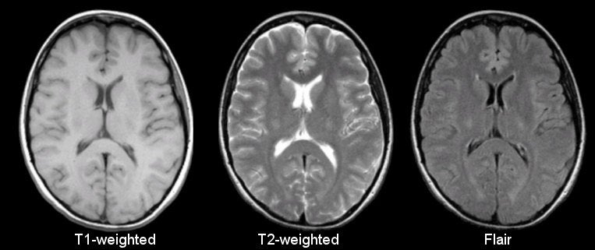
Magnetic Resonance Imaging
Non-invasive (safe)

Slide 4
Motivation
Classify tumor type
This will lessen the burden on radiologists

Slide 5
The ”core”
Radiologists use several different sequences
Previous model architectures use single image (easy setup, good starting point) they use 2d and one seq. Name the 3 articles.
We will use multiple! This also makes the model much more complicated.

Slide 6
Aim
Classify tumour type, using …
a 2D or 3D based foundation model
Multisequence Deep learning methods
Radiologists use multiple sequences
All previous work use only one sequence
We will combine multiple sequences (T2, ADC, etc)

Slide 7
Data
Latest BRATS and U-PENN-GBM
Total of 8 diagnoses, notably (DPIG, ATRT, Medulloblastoma)
We have from 18 to 290 patients per diagnose.

Slide 8
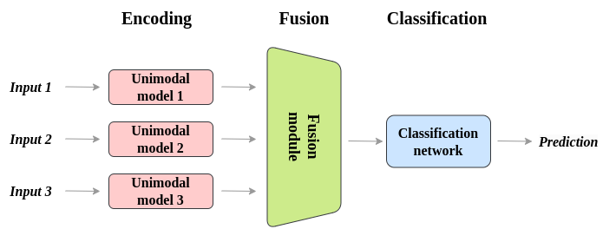
Fusion of modalities (images)
Examples of multimodality data
Image + text
Image + patient meta data
Context + prompt
Early, Intermediate, late fusion

Slide 9
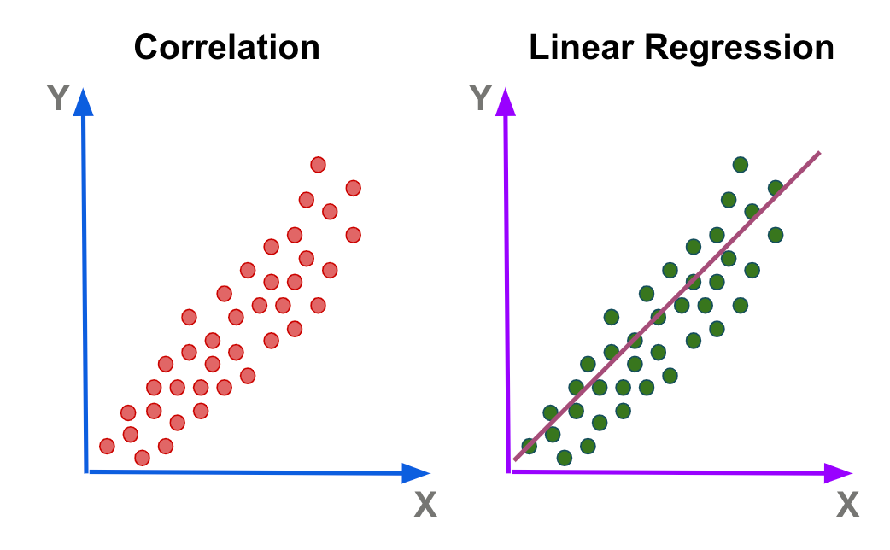
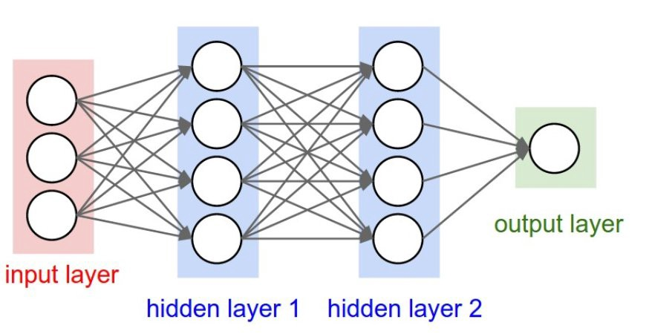
Deep Learning
Linear regression, made more complicated
Every node in the network is doing linear regression, wrapped in a nonlinear function.
Neural Network
Notes:
Kommer gömmas sen.

Slide 10
Foundation models
Huge models, made for solving many different tasks.
ChatGPT (LLM)
ResNet50 (Images)
BERT (early LLM), sort of a back-end model. It produces embeddings that can be configured for whatever task you have. Text summarization, sentiment analysis.

Slide 11
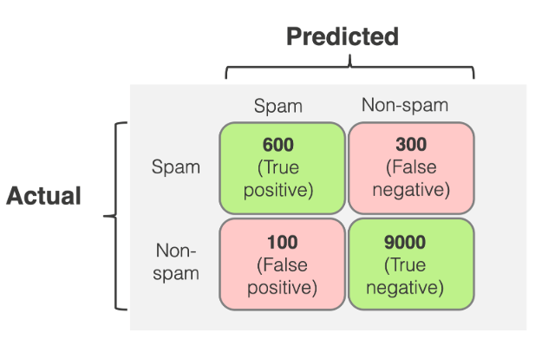
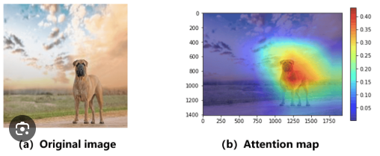
Model Evaluation
Quality of fit
Confusion matrix
Accuracy, Precision, Recall, F1 score
ROC-AUC
Training time
Carbon emissions
Uncertainty
Model and data uncertainty
Attention maps
Grad-CAM
Notes:
This slide is very large right now. I will likely split it into two later.

Slide 12
Statistical significance testing
Wilcoxon, wilcoxon signed rank test
Nonparametric bootstrapping tests

Slide 13
Thank you for listening ☺

