Slide 1
Multisequence Fusion for brain tumour classification using deep learning
Simon Jorstedt
Linköping University
Supervisor: Anders Eklund
Examinator: Krzysztof Bartoszek
External Supervisor: Neda Haj-Hosseini

Slide 2
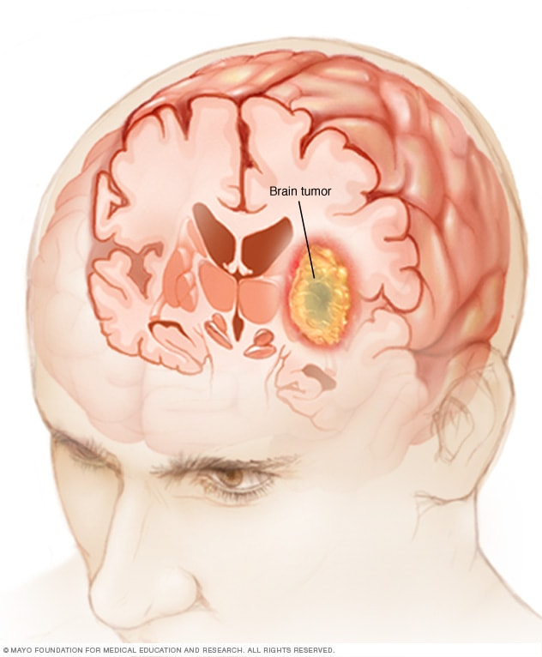
Paediatric Brain Tumours
Severe disease
Treatment varies for diagnoses
Radiotherapy
Chemotherapy
Surgery
Diagnostics
Non-invasive imaging
Notes:
Might mention that child tumors are different from adult tumors. Say that one typical approach is an invasive operation to remove the tumor. Mention that it's important to quickly detect and classify.

Slide 3
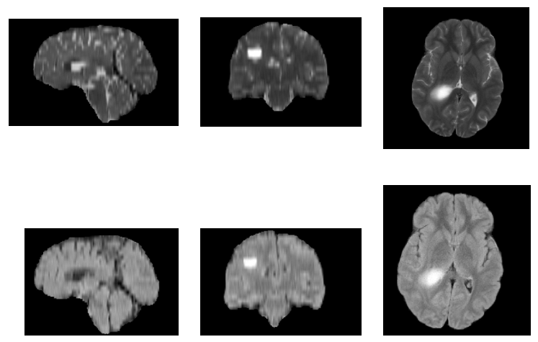
Magnetic Resonance Imaging (MRI)
Customisable
Many sequences
Radiologists use several
T1w, T2w, FLAIR, ADC, …
Recent deep learning projects
Use only one for classification
I will combine multiple
Fusion
Notes:
When performing diagnostics, one technique is the MRI.
It is very customizable, we can produce many different sequences (images) revealing various aspects.
Many layered images are produced.

Slide 4
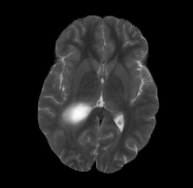
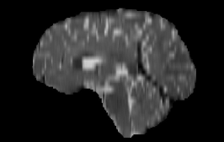
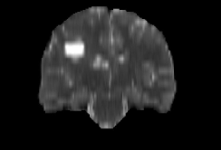
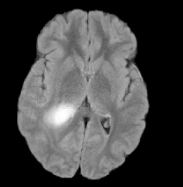
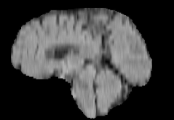
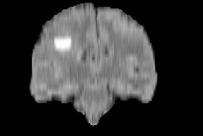

Slide 5
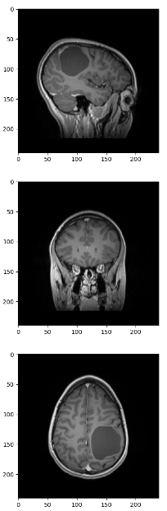
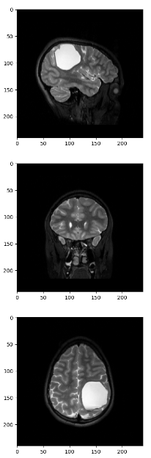
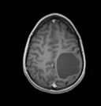
T1w
T2w

Slide 6
Related works
Ensemble of single-sequence predictors (T2w 3D)
Tumor detection as good as radiologists (Sensitivity 0.96)
Tumor classification equal or significantly outperforms radiologists
Rudimentary sequence combinations
Raw concatenation
Possibly mixed sequences
Notes:
First one: Deep Learning for Pediatric Posterior Fossa Tumor Detection and Classification: A Multi-Institutional Study

Slide 7
Research Questions
Can we achieve a multisequence model that significantly outperforms a baseline single-sequence model?
At least two fusion strategies will be statistically compared
Will incorporating a foundation model for feature extraction significantly improve the performance?
Notes:
What is "reasonable" feature extraction?

Slide 8
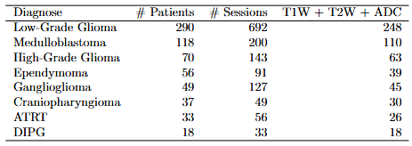
Data
3D-Sequences and stacked 2D-slices
Sagittal, Coronal, Axial

Slide 9
Fusion of modalities
Combine multiple inputs
Extract more knowledge
Examples of multimodal data
ChatGPT: Context + Prompt
Drone: Image + Windspeed + Sound
Tumor Classification: Sequence + Sequence
Notes:
Multimodal data: We have multiple distinct inputs. Mention that in the real world, everything is multimodal. The fusion strategy refers to when in the training the fusion is done.

Slide 10
Fusion techniques
Early
Modalities are treated separately
Intermediate
Modality dependencies
taken into account
Late
Train separate classifiers
Data
Concatenate
Feature Extraction
Classifier
Trained
Data
(Separate)
Feature Extraction
Concatenate
Classifier
Trained
Data
(Separate)
Feature Extraction
(Separate)
Classifiers
Concatenate
Trained
Notes:
Early: Concatenate, sort of like channels in a CNN.

Slide 11
Foundation models
Generalised
Requires lots of training data
Self-Supervised learning
Very expensive
Transfer Learning
Task-specific
Parameter fine tuning
Less data
Notes:
Expensive beyond our resources.
Self-Supervised learning means that there is less requirement for manual annotation.
Transfer Learning: the model has already learnt to identify shapes, lines etc.

Slide 12
Foundation model candidates
ResNet
Residual CNN
ViT
Vision Transformer
Vista3D
Medical segmentation
MAISI
Medical Synthesis
Notes:
All these models produce a latent representation in the pipeline.
ResNet and ViT are originally 2D, and would need configuring for 3D.
Vista3D and MAISI are 3D.

Slide 13
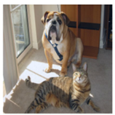
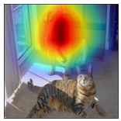
Model Evaluation
Metrics
Confusion matrix
Balanced Accuracy
Precision, Recall, F1 score
Matthews Correlation Coefficient
Additional
ROC-AUC
Training time
Carbon emissions
Attention maps
Grad-CAM
Notes:
This slide is very large right now. I will likely split it into two later.

Slide 14
Statistical significance testing
Model uncertainty
Nonparametric bootstrapping
Tensorflow probability
Model comparison
Wilcoxon signed rank test
DeLong test (ROC curves)

Slide 15
Challenges
Foundation model configuration
2D/3D mismatch
Channel mismatch
Computationally expensive training
Parallell feature extraction
Parallell models
Notes:
Some foundation models are originally made for 2D.
They typically have three channels (for RGB), but MR Images are grayscale.

Slide 16
Thank you for listening ☺

