Slide 1
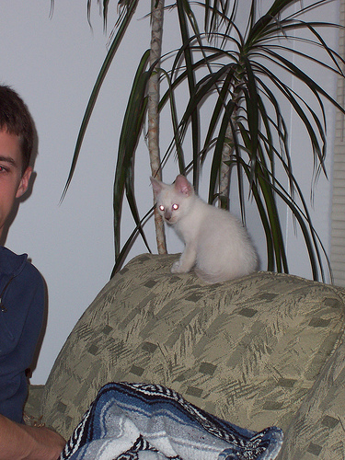
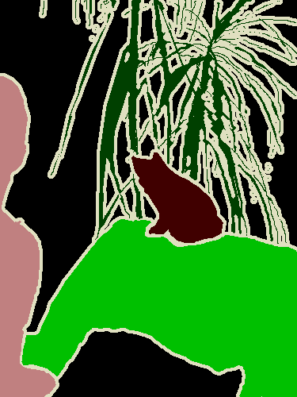
Deep Convolutional
Neural Network
Loss
Image
Pixel annotations

Slide 2
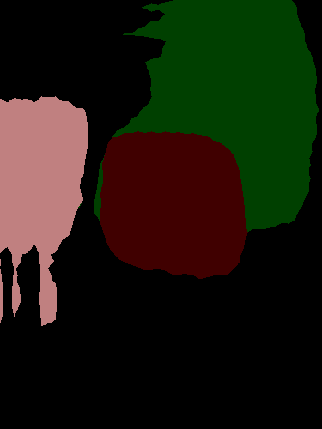
Deep Convolutional
Neural Network
Loss
Image
Score map
1. Cat
2. Person
3. Plant
4. Sofa
Label
Suppression
argmax
Image annotations
Weakly-Supervised E-step

Slide 3
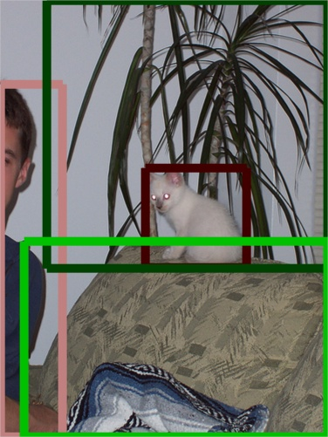
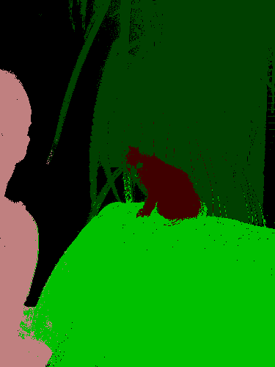
Deep Convolutional
Neural Network
Loss
Image
Dense
CRF
argmax
Bbox annotations
Ground-Truth Estimation

Slide 4
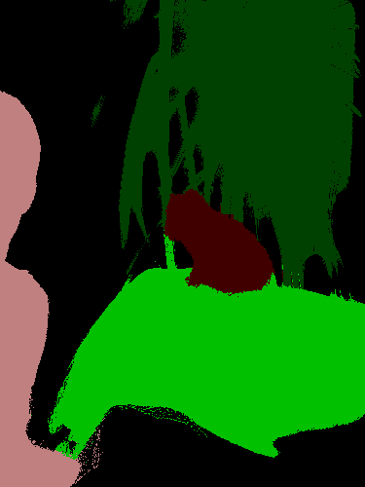
Deep Convolutional
Neural Network
Dense
CRF
Image
Result

Slide 5
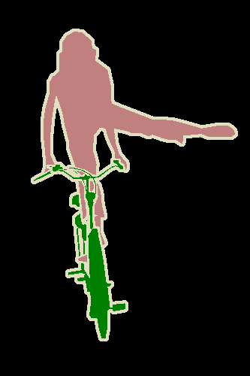
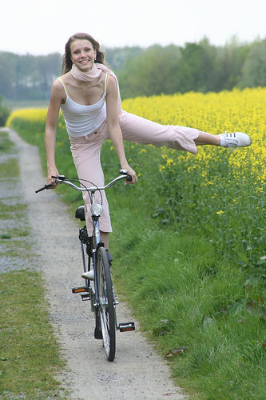
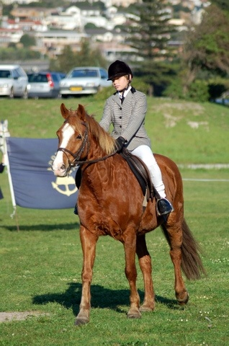
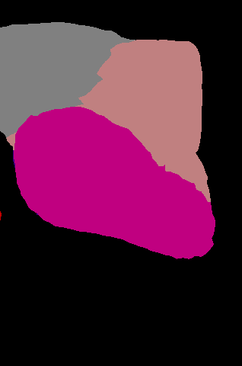
Pixel Annotations
Deep Convolutional
Neural Network
Loss
+
Deep Convolutional
Neural Network
Loss
Score map
1. Car
2. Person
3. Horse
Label
Suppression
argmax
Image Annotations
Weakly-Supervised E-step

