Slide 1
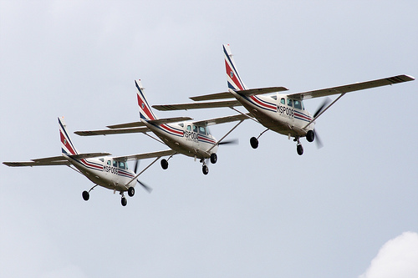

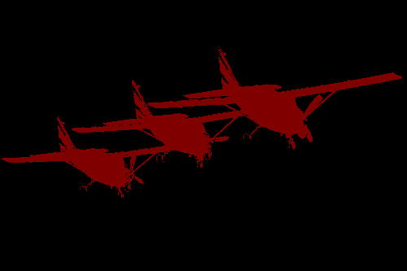

Input
Coarse
Output
Bi-linear Upsampling
Fully Connected CRF
Final Output
Deep
Convolutional
Neural
Network

Slide 2
Input
Coarse
Output
Deep
Convolutional
Neural
Network
Final Output
Fully Connected CRF
Bi-linear Interpolation

Slide 3

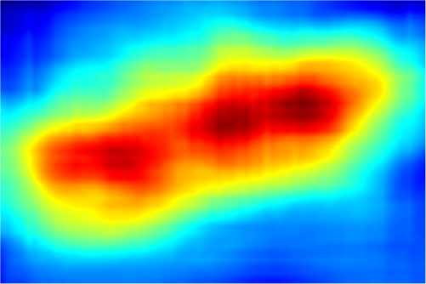
Input
Aeroplane
Coarse Score map
Deep
Convolutional
Neural
Network
Final Output
Fully Connected CRF
Bi-linear Interpolation

