Slide 1
CS 60047 Autumn 2020
Advanced Graph Theory
Instructor
Bhargab B. Bhattacharya
Lecture #24, #25: 28 Oct. 2020
Indian Institute of Technology Kharagpur
Computer Science and Engineering
Notes:
Good Morning!
The title of today’s talk is “On some Planar Partitioning Problems”.

Slide 2
Connectedness
An undirected graph G is connected if there exists is a path between every pair of vertices in G
v₄
v₄
v₁
v₃
v₁
v₃
v₂
v₅
v₆
v₂
v₅
v₆
G is connected;
# connected components c(G) = 1
G is not connected;
# connected components c(G) = 2

Slide 3
Connectedness
Basic Idea:
Reachability among vertices via edges
Removal of one or more vertices will break the graphs into several components
Example:
- In a road-network, if one city can be reached from another city
- whether a message can be sent between two computers using intermediate links
- plays an important role in reliability of networks (node failure, edge or link failure)
- route planning for Internet

Slide 4
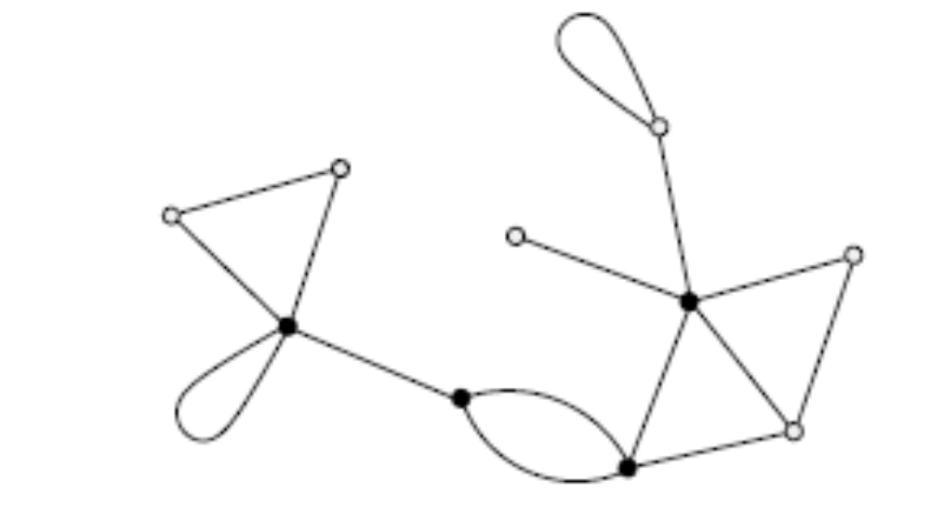
Cut-Vertex and Bridge
a separating vertex
not a cut-vertex
cut-edge, or bridge
# cut-vertices = 4
cut-vertex (cut-point or articulation point): a vertex, deletion of which disconnects the graph (increases the number of components); every cut-vertex is a separating vertex as well
bridge (cut-edge): removal of which increases the number of components; cut-vertices and bridges may correspond to vulnerabilities in a network

Slide 5
Cut-Vertex and Bridge
u
v
u
v
both u and v are cut-vertices, and edge (u, v) is a bridge
both u and v are cut-vertices but edge (u, v) is not a bridge
u
v
neither u and v is a cut-vertex, yet edge (u, v) is a bridge
u
v
u is a cut-vertex, v is not a cut-vertex; edge (u, v) is a bridge

Slide 6
Cut Vertices and Bridges
Cut-vertex: its deletion disconnects the graph;
  End vertices cannot be cut-vertices
A deletion of such a vertex increases the number of components of G
i.e., if v is a cut-vertex then c(G − v) > c(G)
Bridge (cut-edge): Removal of such an edge increases the number of components.
  Every edge of a tree is a bridge

Slide 7
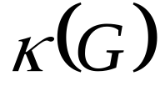
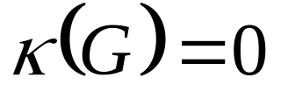
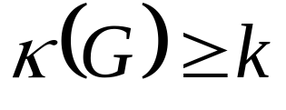
Vertex Connectivity (a.k.a. Connectivity)
Denote by , the minimum number of vertices whose deletion disconnects G or makes G trivial
If G is disconnected then
A vertex cut-set (a.k.a. separating set S) contains vertices whose removal disconnect the graph.
A graph G is called k-connected for some positive integer k if its connectivity is at least k, i.e.,
G has a cut-vertex if and only if κ(G) = 1 (for n > 3)
κ(G) is the size of the minimum separating set S, i.e., c(G –S) > c(G), or G -S is trivial (comprises a single vertex)

Slide 8
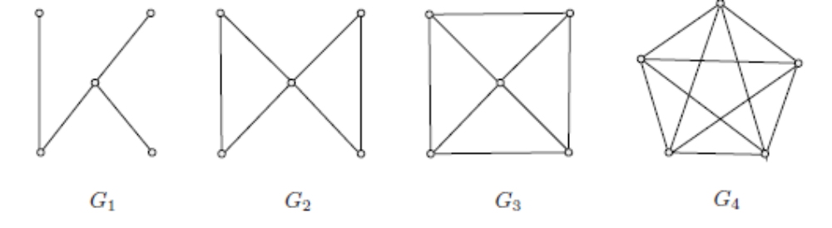
Vertex Connectivity
×
×
×
×
×
×
×
×
×
×
×
×
×
×
×
κ(G₁) = 1
κ(G₂) = 1
κ(G₃) = 3
κ(G₄) = 4

Slide 9
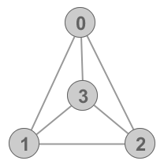
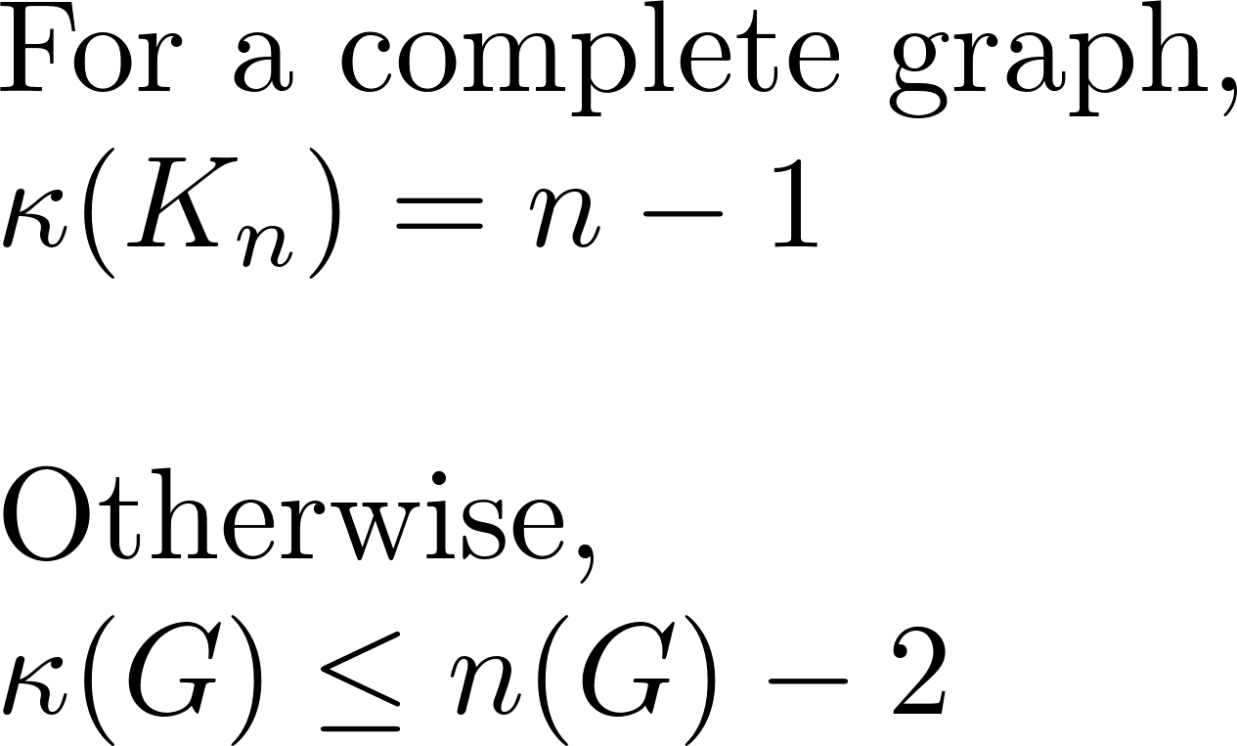
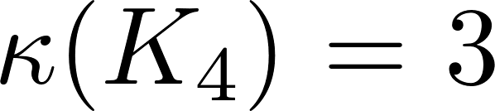
Examples

Slide 10
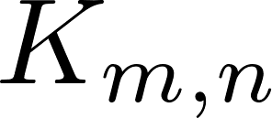
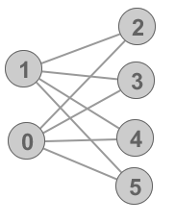
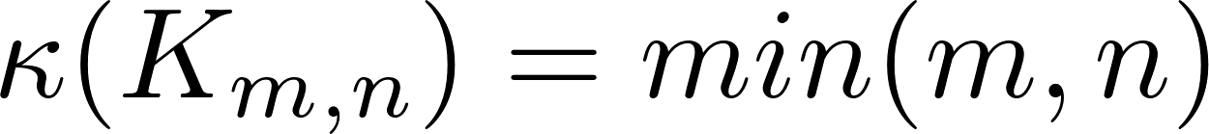
Examples
Consider a bipartition X, Y of
Since every separating set contains either X or Y which are themselves a separating set

Slide 11
Edge Connectivity
Let G be graph of two or more vertices
Denote by λ(G), the minimum number of edges whose deletion disconnects G or makes G trivial
λ(G): edge-connectivity of G
An disconnecting set contains edges whose removal disconnects the graph; thus, λ(G) is the size of the minimum disconnecting set of edges
If G is disconnected, λ(G) = 0
A connected graph G has a bridge if and only if λ(G) = 1
We say G is r-edge connected if r < λ(G)

Slide 12
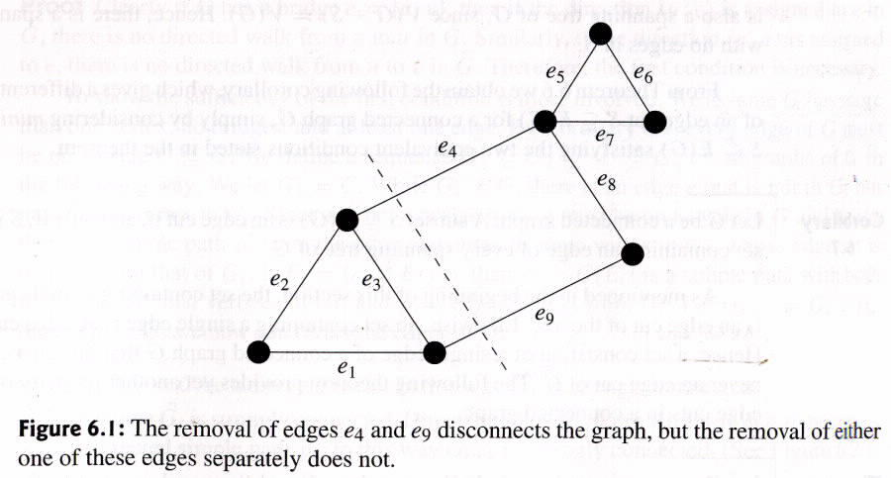
Edge Connectivity
An edge cut-set contains edges whose removal disconnects the graph.
Minimal edge cut-set = {e₄, e₉}

Slide 13
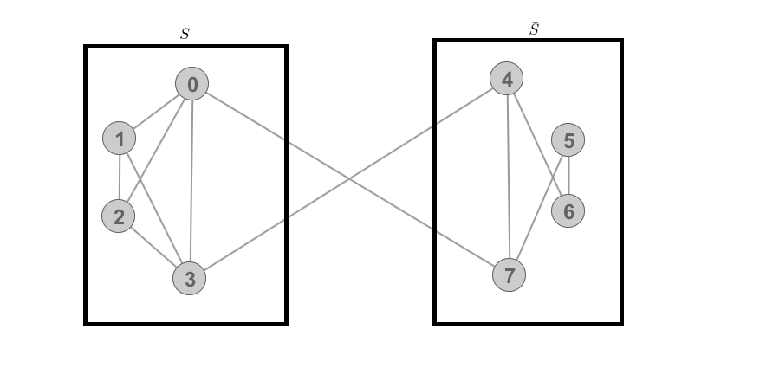
Example of Edge-Cut

Slide 14
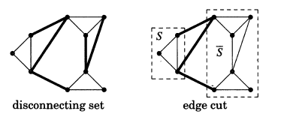
Disconnecting set and edge-cut
An disconnecting set contains edges whose removal disconnects the graph, i.e. increases the number of components; such a set may contain extra edges
Edge-cut:
Every minimal disconnecting set of edges is an edge-cut; every edge-cut is a disconnecting set but the converse is not always true

Slide 15
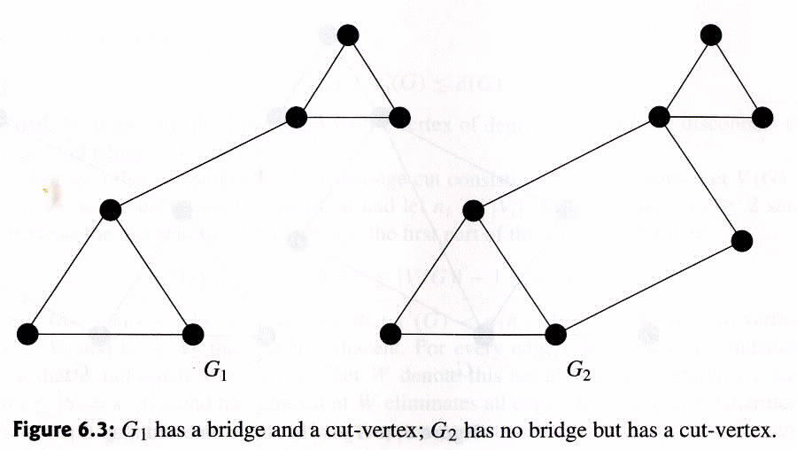
More examples
κ(G₁) = 1
κ(G₂) = 1
λ(G₁) = 1
λ(G₂) = 2

Slide 16
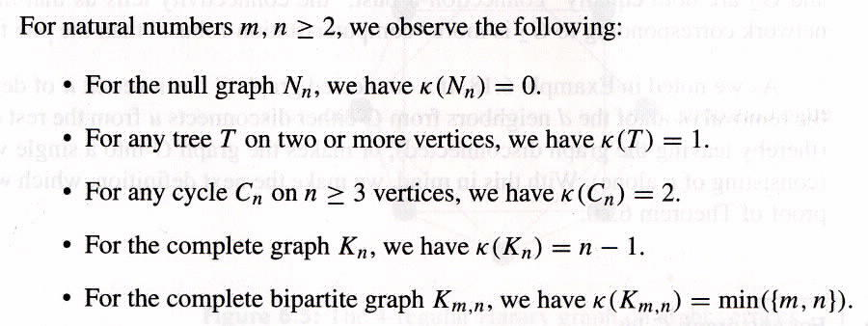
Facts
Every non-trivial connected graph G (V, E) with |V| > 2, has at least two vertices, which are not cut-vertices.
Proof: In a cycle, there are no cut-vertices; otherwise consider two end-points of the diameter.

Slide 17
Exercise
Find a minimal vertex cut-set of order 1 and 2, and minimal edge cut-set of size 2 and 4
a
minimal edge-cut
d
×
×
c
×
×
e
b
×
h
×
f
g
j
i
minimal vertex-cut

Slide 18
Facts: Cut-vertices
x
Let G be graph of three or more vertices
The following statements are equivalent:
v is a cut-vertex in G
∃ two vertices u and w other than v, s.t. every (u ⎯w)-path in G passes through v
(V − v) has two components S₁ and S₂ such that
∀ u ∈ V(S₁) and ∀ w ∈ V(S₂), every (u ⎯w)-path passes through v
Note: If the graph is not simple, then a separating vertex may not be a cut-vertex; for example vertex x is a separating vertex (two connected subgraphs having only one vertex in common) but not a cut-vertex (deletion of which must increase # components). However, all cut-vertices are separating vertices.
v

Slide 19
Facts: Bridges
Let G be graph of three or more vertices
The following statements are equivalent:
e is a bridge in G
e is not on any cycle in G
∃ at least two vertices u and v in V(G) s.t. every (u ⎯v)- path in G passes through e
(G − e) has two components S₁ and S₂ such that
∀ u ∈ V(S₁) and ∀ v ∈ V(S₂), every (u ⎯v)-path passes through e
e

Slide 20
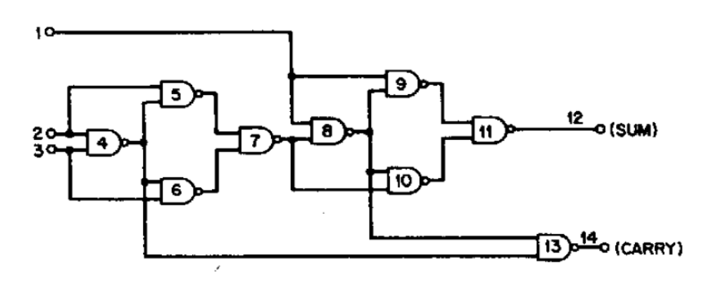
Applications: Circuit Decomposition
Cut-edge
×
×

Slide 21
Result: Cut-Vertices
Let G be graph of three or more vertices
Theorem: G will have no cut-vertices if and only if every vertex lies on a cycle, i.e., iff G is 2-connected. In other words, between any two vertices there exist two vertex-disjoint paths (excepting the end vertices)
Question: Let G be graph which has no cut vertices. Is G necessarily 2-connected?
=> No, consider K₁ and K₂; they do not have any cut-vertex, yet not 2-connected! Note that in these cases, n < 3.

Slide 22
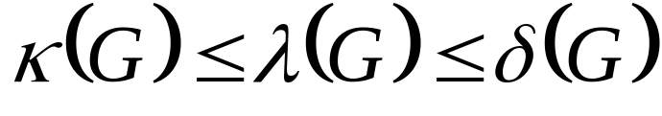
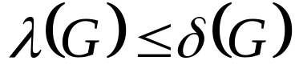
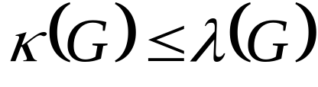
Relationship among κ(G), λ(G), and δ(G)
Theorem (Whitney): DW, Textbook 4.1.9
Given a connected simple graph G, we have
Proof:
  To see , we can simply remove the edges of the vertex with minimum degree;
  If S is the edge cut-set consisting of k edges, then removal of k suitably chosen vertices removes the edges of S. Thus

Slide 23
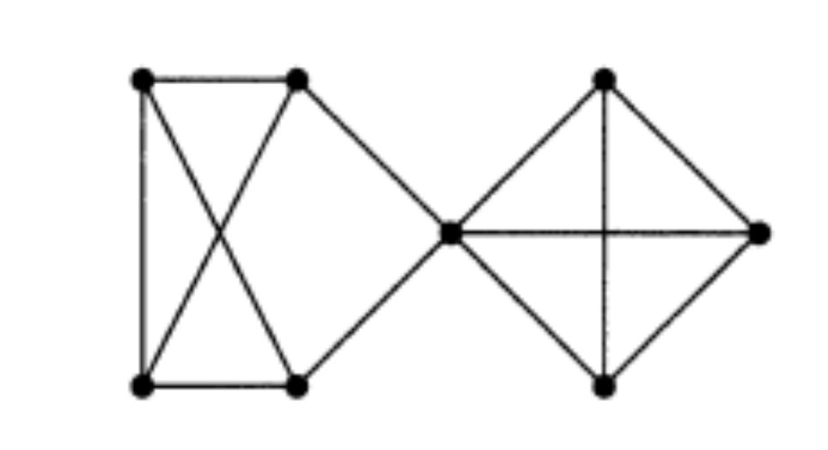
Example: κ(G), λ(G), and δ(G)
Theorem (Whitney):
Given a connected simple graph G, we have
κ(G) = 1
λ(G) = 2
δ(G) = 3

Slide 24
Example: κ(G), λ(G), and δ(G)
Theorem (Whitney):
Given a connected simple graph G, we have
If G(V, E), |V| = n, has connectivity k, then G must have at least ⎡kn/2⎤ edges, since δ(G) > k
Note that κ(Q_{k}) = k (see DW: 4.1.3);
Thus k-dimensional hypercube achieves the lower bound on the number of edges, given its connectivity

Slide 25
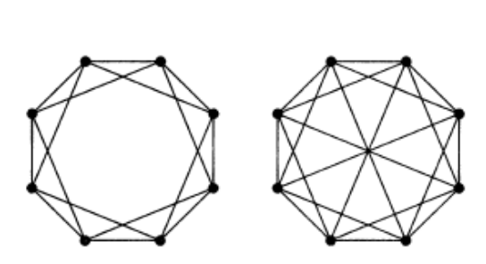
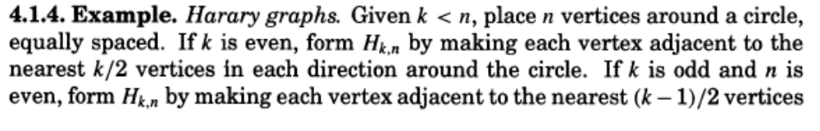
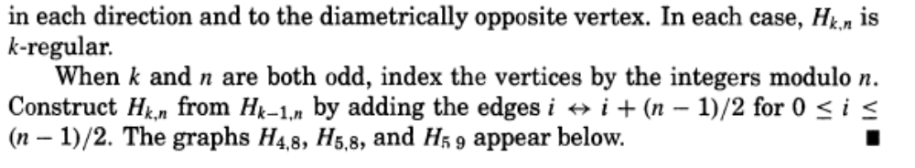
Example: Harary Graphs
If G(V, E), |V| = n, has connectivity k, then G must have at least ⎡kn/2⎤ edges, since δ(G) > k
Note that κ(H_{k,n}) = k (see DW: 4.1.4); the number of edges is thus ⎡kn/2⎤;
Thus Harary graphs achieve the lower bound on the number of edges
H_{4, 8} H_{5, 8}

Slide 26
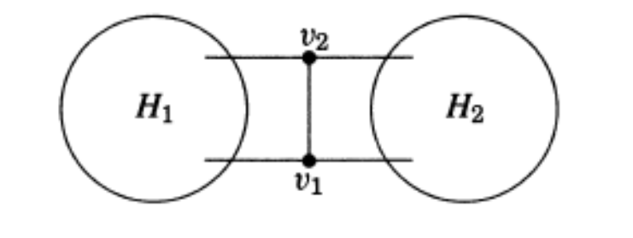
Example: 3-Regular Graphs
Theorem (DW: 4.1.11)
If G is a 3-regular graph then κ(G) = λ(G).
Each v ∈S must have a neighbor in H₁ and a neighbor in H₂, but cannot have two neighbors in both H₁ and in H₂. To create an edge-cut, delete the edge which connects v to its single neighbor. Thus |S| edges will break all paths between H₁ and H₂, except the case shown on the left. In this case, we delete two edges towards H₁ or H₂, corresponding to the two vertices in S.
v
Let S be the minimum vertex-cut, i.e., |S| = κ(G); we thus need to show λ(G) = |S|

Slide 27
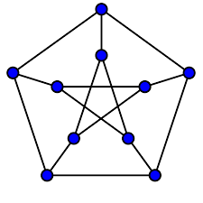
Example: 3-Regular Graphs
If G is a 3-regular graph then κ(G) = λ(G).
×
×
×
×
κ(G) = λ(G) = 1
smallest 3-regular graph where both κ(G) and λ(G) are 1
κ(G) = λ(G) = 3
κ(PG) = λ(PG) = 3

Slide 28
Blocks
A block is a maximal connected subgraph of G with no cut-vertices. If G is connected and no cut-vertices, then G itself is a block.
What are the blocks for the graph below?

Slide 29
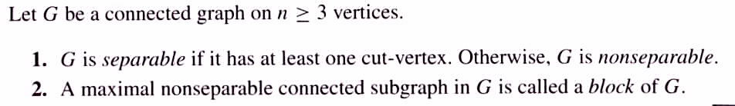
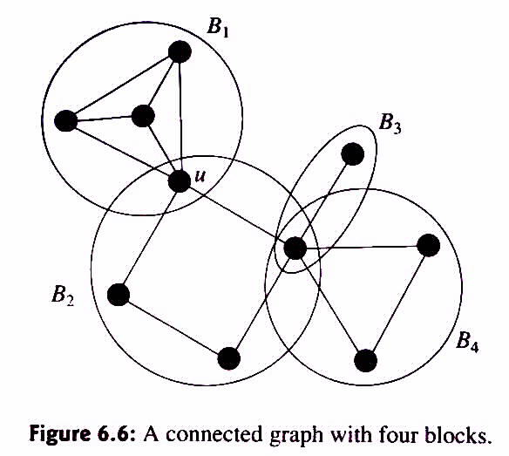
Apart from K₁ and K₂, the most basic non-separable graphs are the cycles. Whitney (1932) showed that non-separable connected graphs may be characterized in terms of their cycles:
A connected graph is non-separable if and only if any two of its edges lie on a common cycle.

Slide 30
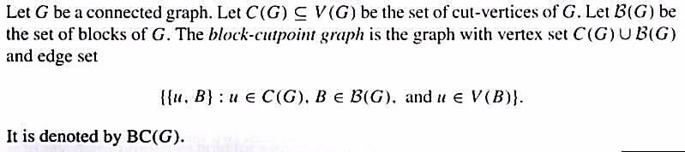
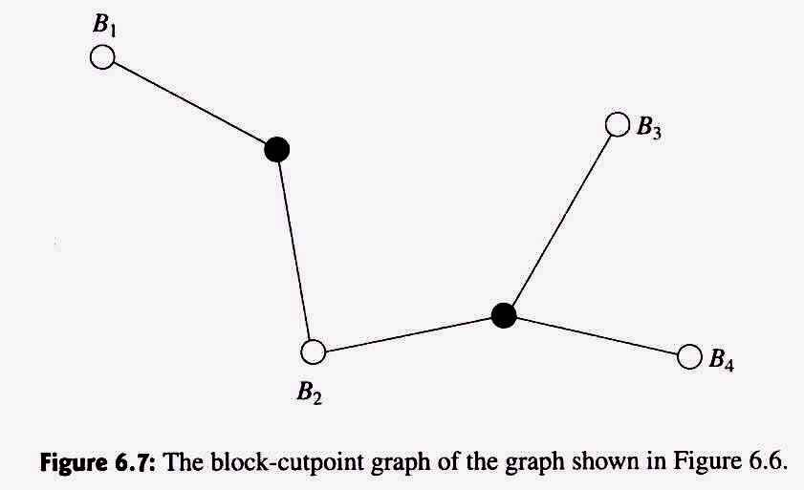
Lemma
(Block-Cut-Point Graph)
Blocks can be identified via DFS of G
BC(G) must be a tree
⇒
All cut-points must be internal nodes

Slide 31
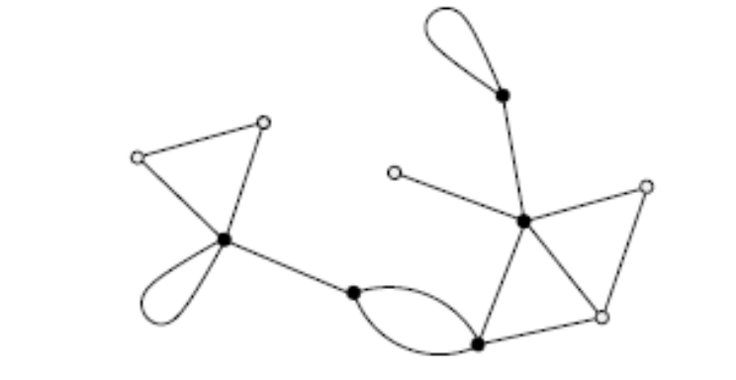
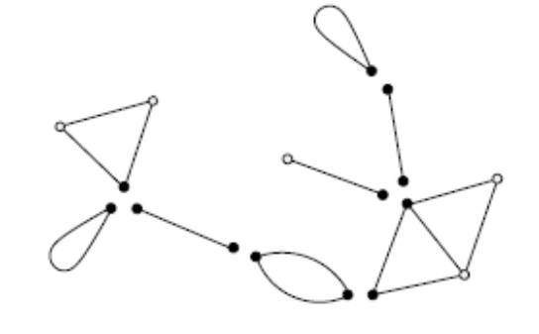
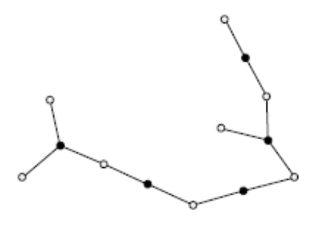
Blocks …
G
blocks in G
BC(G)
Let G be a graph. Then:
a) any two blocks of G have at most one vertex in common
b) the blocks of G form a decomposition of G
c) each cycle of G is contained in a block of G

Slide 32
k-connected graphs
A graph G is called k-connected for some positive integer k if its connectivity is at least k, i.e., if k < κ(G)
Two paths from u to v in G are called internally-disjoint if they have no common internal vertex.
Theorem (Whitney) DW: 4.2.2
A graph G having at least three vertices is 2-connected if and only if for every pair (u, v) ∈V(G), there exist internally-disjoint (u ⎯ v)-paths in G.

Slide 33
2-Connected Graphs (Textbook, DW: 4.2.4)
For a graph G with at least three vertices, the following statements are equivalent and characterize 2-connected graphs:
1. G is connected and has no cut-vertex
2. ∀ u, v ∈ V(G), there exist internally-disjoint (u ⎯ v)-paths in G
3. ∀ u, v ∈ V(G), there is a cycle through u and v
4. δ(G) > 1, and every pair of edges in G lies on a common cycle

Slide 34
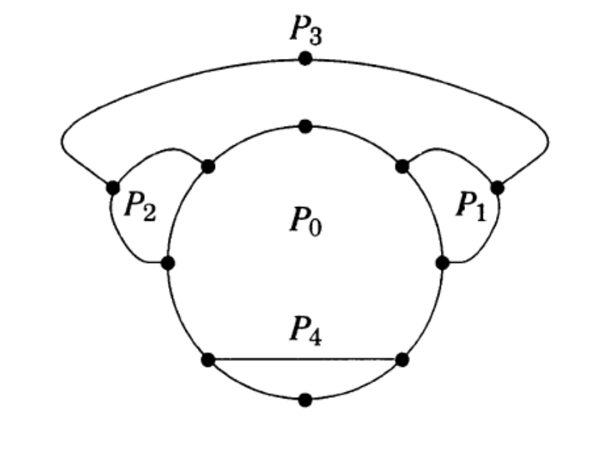
2-connected graphs (DW: 4.2.7)
An ear of graph G is a maximal path whose internal vertices have degree two in G.
An ear decomposition of G is a decomposition P₀, P₁, P₂, …, P_{k} such that is a cycle and for i > 1, P_{i} is an ear

Slide 35
2-connected graphs (DW: 4.2.7)
Theorem (Whitney) DW: 4.2.8
A graph G is 2-connected if and only if G admits an ear decomposition.

Slide 36
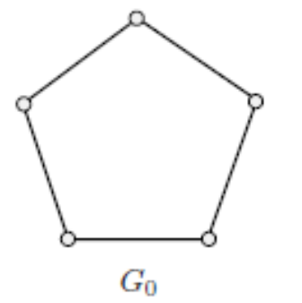
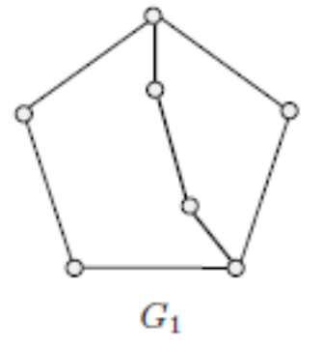
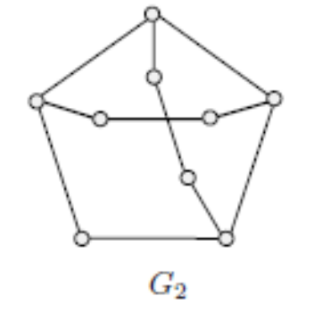
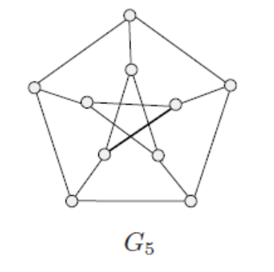
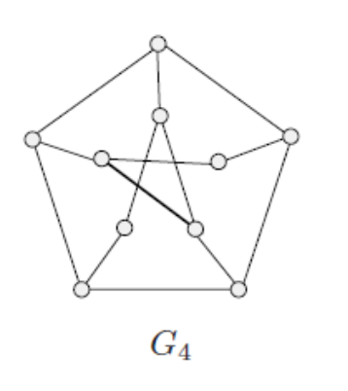
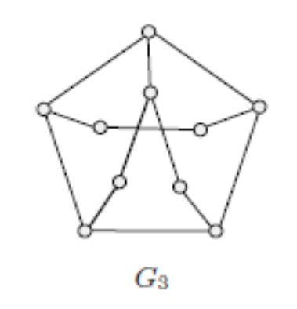
Ear Decomposition of Petersen Graph
A graph G is 2-connected if and only if G admits an ear decomposition

Slide 37









Strong Orientation
Assigning a direction to each edge is orienting the graph
If the resulting graph becomes strongly connected, it is strong orientation
strong orientation not possible because of the bridge
strong orientation

Slide 38
Strong Orientation
Theorem (Robbins) DW: 4.2.14:
A connected undirected graph G has a strong orientation if and only if it contains no bridges;
In other words, every edge lies on some cycle, i.e., G is 2-connected

Slide 39
Menger’s Theorem (DW: 4.2.17)
Menger showed that the connectivity of a graph is related to the number of disjoint paths joining two vertices.
Two paths connecting u and v are internally-disjoint u-v paths if they have no vertices in common other than u and v.
Two paths are edge-disjoint if they have no edges in common.
A set S of vertices or edges separate u and v if every path connecting u and v passes through S.

Slide 40











Vertex- and Edge-Disjoint Paths
Two paths P₁, P₂ connecting u and v are internally-disjoint u-v paths if they have no vertices in common other than u and v, i.e., V(P₁) ∩ V(P₂) = {u, v}
Two paths are edge-disjoint if they have no edges in common, i.e., E(P₁)∩ E(P₂) = ∅
u
v

Slide 41
Menger’s Theorem (DW: 4.2.17)
Let u and v be distinct non-adjacent vertices in G. Then the maximum number of pairwise internally-disjoint paths connecting u and v equals the minimum number of vertices in a set that separates u and v.
a
f
b
i
u
e
g
v
c
h
Minimum separating-set size = 3
= maximum # vertex-disjoint paths
d

Slide 42
Second Variation: Menger’s Theorem
A graph G is k-connected if and only if every pair of vertices are joined by at least k pairwise internally-disjoint paths.
a
f
b
i
u
e
g
v
c
h
Minimum separating-set size = 3
= maximum # vertex-disjoint paths
=> G is 3-connected
d

Slide 43
Third Variation: Menger’s Theorem
Let u and v be distinct nonadjacent vertices in G. Then the maximum number of edge-disjoint paths connecting u and v equals the minimum number of edges in a set that separate u and v (called minimum edge-cut).
a
f
b
i
u
e
g
v
c
h
Minimum separating-set size = 4
= maximum # edge-disjoint paths
d

Slide 44
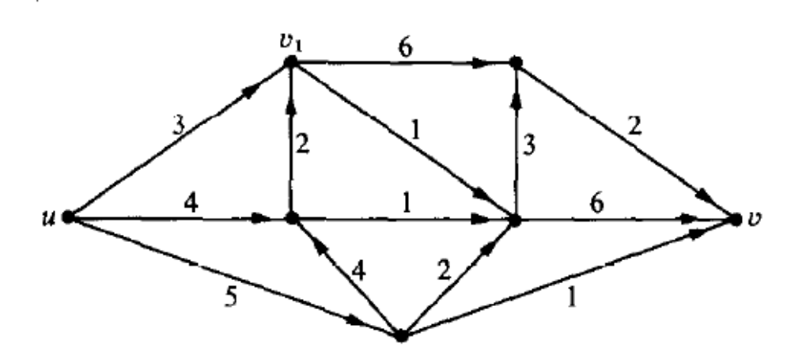
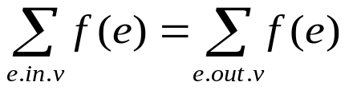
Fourth Variation with Weighted Directed Graphs
(Ford-Fulkerson Theorem) DW: 4.3.11
Max-Flow Min-Cut Theorem: In every network N where there is a directed path from node u (source) to node v (sink), and a non-negative capacity c(e) assigned to every edge e, the maximum value of a feasible flow, equals the minimum-cut capacity that separates u and v.
A flow f (real-valued function f: e → ℜ) is feasible if it satisfies
Capacity constraint: 0 < f(e) < c(e), ∀e ∈ N;
Conservation: f ⁺(x) = f ⁻(x) for each node x ∉ {u, v}
Maximum-flow between u and v = sum of weights on the minimum separating forward edge-cut (those having head in the sink side and tail in the source side)
= 2 + 0 + 1 + 1 + 2 + 1 = 7

Slide 45
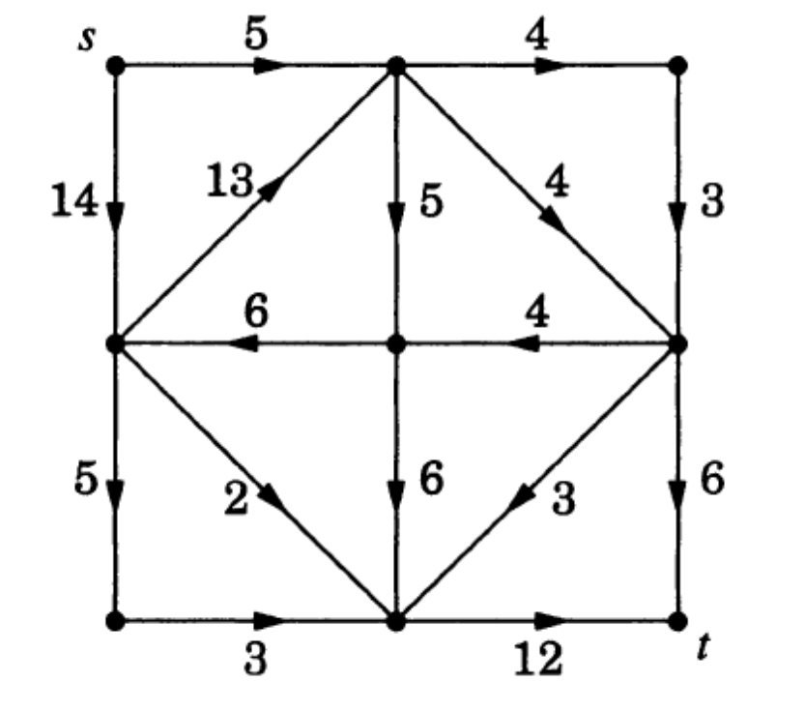
Example: Ford-Fulkerson Theorem
Find the maximum flow from s to t.
Maximum-flow from s and t = sum of weights on the minimum separating forward edge-cut
= 3 + 4 + 5 + 0 + 2 + 3 = 17

Slide 46
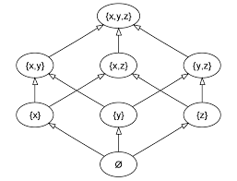
Dilworth’s Theorem for POSETS
Poset, as a set P with a partial ordering defined on its elements, i.e, for any two elements x and y of P, either x < y or y < x (x and y are comparable),
or x || y (x and y are incomparable)
A Chain is any pairwise comparable subset of P, and an Anti-chain is any pairwise incomparable subset of P
Dilworth’s Theorem: The size of the maximum anti-chain equals the minimum number of disjoint chains which include all the elements of P
anti-chain

Slide 47

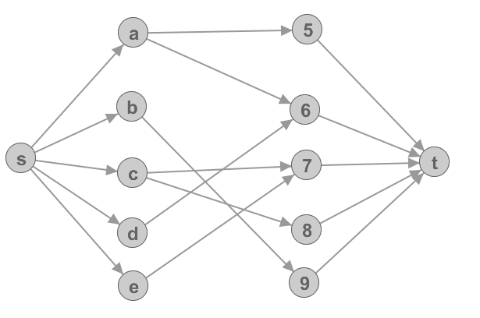
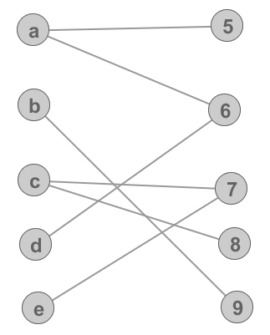
Max-Flow Min-Cut: Bipartite Matching
-Add a source and sink vertex
-Add edges going from X to X’
-Set capacity of each edge to one
-Compute the maximum flow

Slide 48
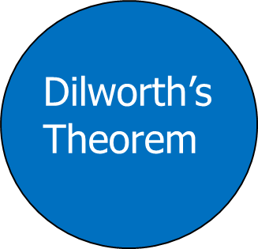
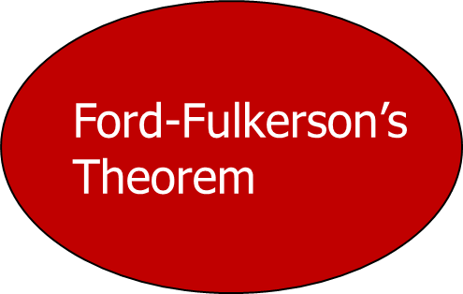
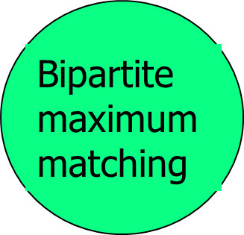
Equivalence of Four Combinatorial Theorems
Menger’s Theorem

