Slide 1
Deep Learning
Abir Das
Assistant Professor
Computer Science and Engineering Department
Indian Institute of Technology Kharagpur
http://cse.iitkgp.ac.in/~adas/

Slide 2
Agenda
Introduce the concepts of
Regularization
Dropout
Batch normalization
Resource: Goodfellow Book (Chapter 7)

Slide 3






Recap: The Bias-Variance Decomposition
$$E_{out}\left(x\right)=𝔼_{𝒟}\left[{\left(g_{n}^{𝒟}\left(x\right)−f\left(x\right)\right)}^{2}\right]$$
$$=𝔼_{𝒟}\left[{f\left(x\right)}^{2}−2f\left(x\right)g_{n}^{𝒟}\left(x\right)+{g_{n}^{𝒟}\left(x\right)}^{2}\right]$$
$$+$$
$$={f\left(x\right)}^{2}−2f\left(x\right)𝔼_{𝒟}\left[g_{n}^{𝒟}\left(x\right)\right]+𝔼_{𝒟}\left[g_{n}^{𝒟}{\left(x\right)}^{2}\right]$$
$$E_{out}\left(x\right)=$$
Bias
Variance
$$={f\left(x\right)}^{2}−2f\left(x\right)\overline{g}\left(x\right)+𝔼_{𝒟}\left[g_{n}^{𝒟}{\left(x\right)}^{2}\right]$$
$$={f\left(x\right)}^{2}−\overline{g}{\left(x\right)}^{2}+\overline{g}{\left(x\right)}^{2}−2f\left(x\right)\overline{g}\left(x\right)+𝔼_{𝒟}\left[g_{n}^{𝒟}{\left(x\right)}^{2}\right]$$
$$={\left(f\left(x\right)−\overline{g}\left(x\right)\right)}^{2}+𝔼_{𝒟}\left[g_{n}^{𝒟}{\left(x\right)}^{2}\right]−\overline{g}{\left(x\right)}^{2}$$
Bias
Variance
Slide motivation: Malik Magdon-Ismail
Notes:
Approximation: how far your prediction is on average from the actual value.

Slide 4
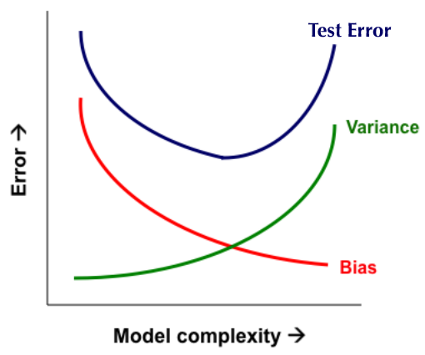


Recap: Bias-Variance Trade-off
Error
Test Error
variance
Training Error
bias
Number of Data Points, N

Slide 5
Regularization
Machine learning is concerned more about the performance on the test data than on the training data
According to the Goodfellow book, chapter 7 – “Many strategies used in Machine Learning are explicitly designed to reduce the test error, possibly at the expense of increased training error. These strategies are collectively known as Regularization”.
Also – in the book, regularization is defined as – “Any modification we make to a learning algorithm that is intended to reduce its generalization error but not its training error”.

Slide 6
Regularization Strategies
Adding restrictions on parameter values
Adding constraints that are designed to encode specific kinds of prior knowledge
Use of ensemble methods/dropout
Dataset augmentation
In practical Deep Learning scenarios, we almost do find – the best fitting model (in the sense of minimizing generalization error) is a large model that has been regularized appropriately

Slide 7
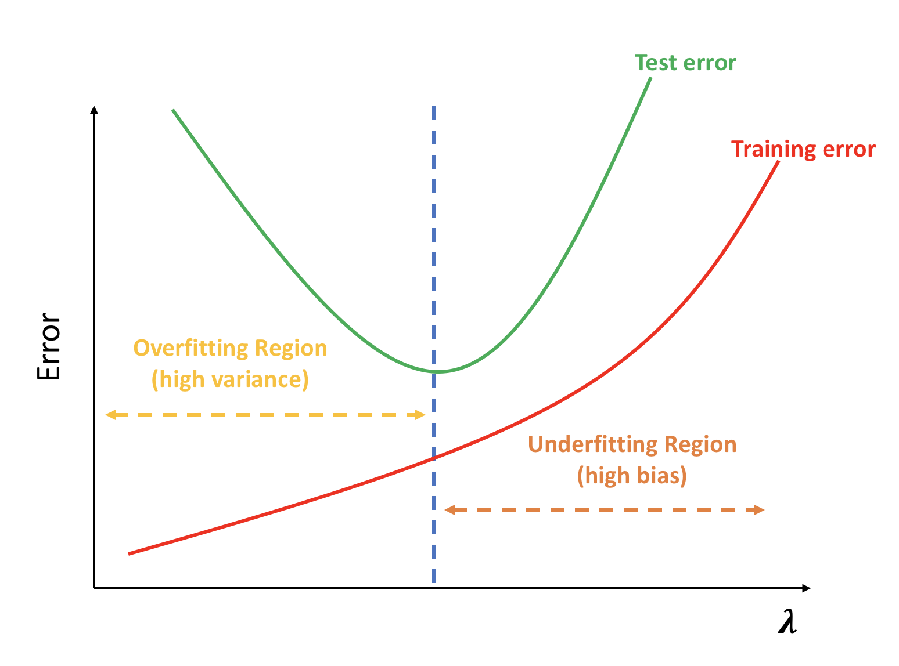
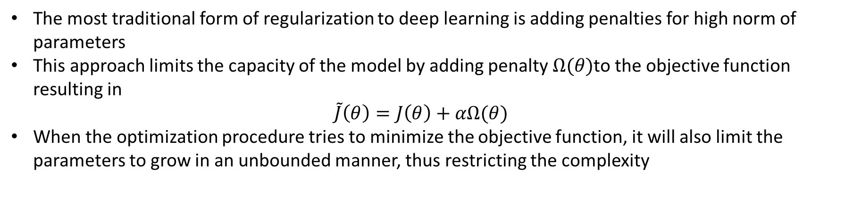

Parameter Norm Penalties
The most traditional form of regularization to deep learning is adding penalties for high norm of parameters
This approach limits the capacity of the model by adding penalty $Ω(θ)$to the objective function resulting in $\tilde{J}\left(θ\right)=J\left(θ\right)+αΩ(θ)$
When the optimization procedure tries to minimize the objective function, it will also limit the parameters to grow in an unbounded manner, thus restricting the complexity
$$α$$

Slide 8
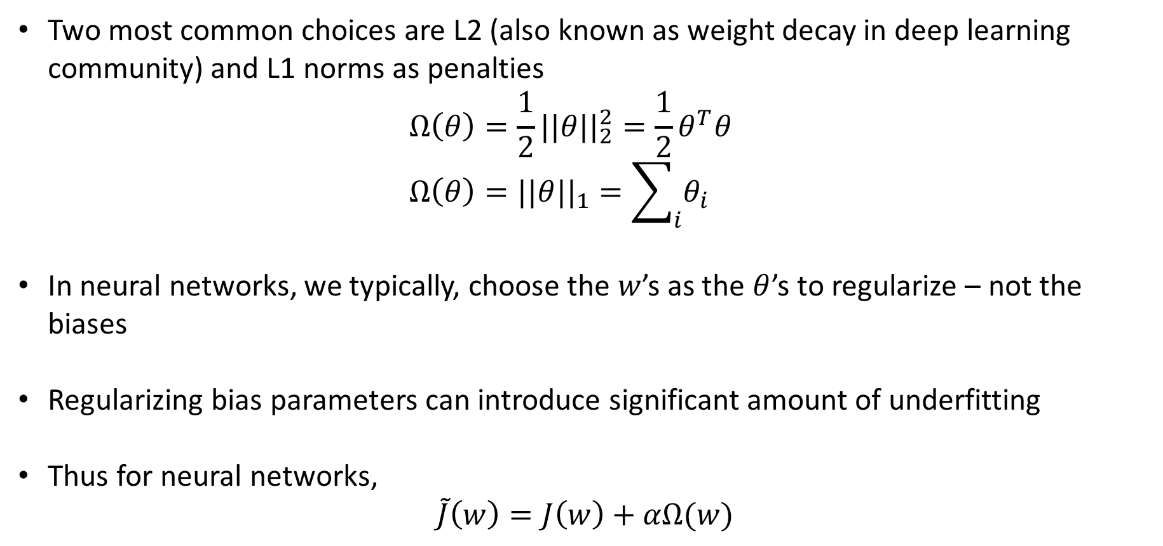
Parameter Norm Penalties
Two most common choices are L2 (also known as weight decay in deep learning community) and L1 norms as penalties $Ω\left(θ\right)=\frac{1}{2}{||θ||}_{2}^{2}=\frac{1}{2}θ^{T}θ$ $Ω\left(θ\right)={||θ||}_{1}=\sum_{i}{θ_{i}}$
In neural networks, we typically, choose the $w$’s as the $θ$’s to regularize – not the biases
Regularizing bias parameters can introduce significant amount of underfitting
Thus for neural networks, $\tilde{J}\left(w\right)=J\left(w\right)+αΩ(w)$

Slide 9
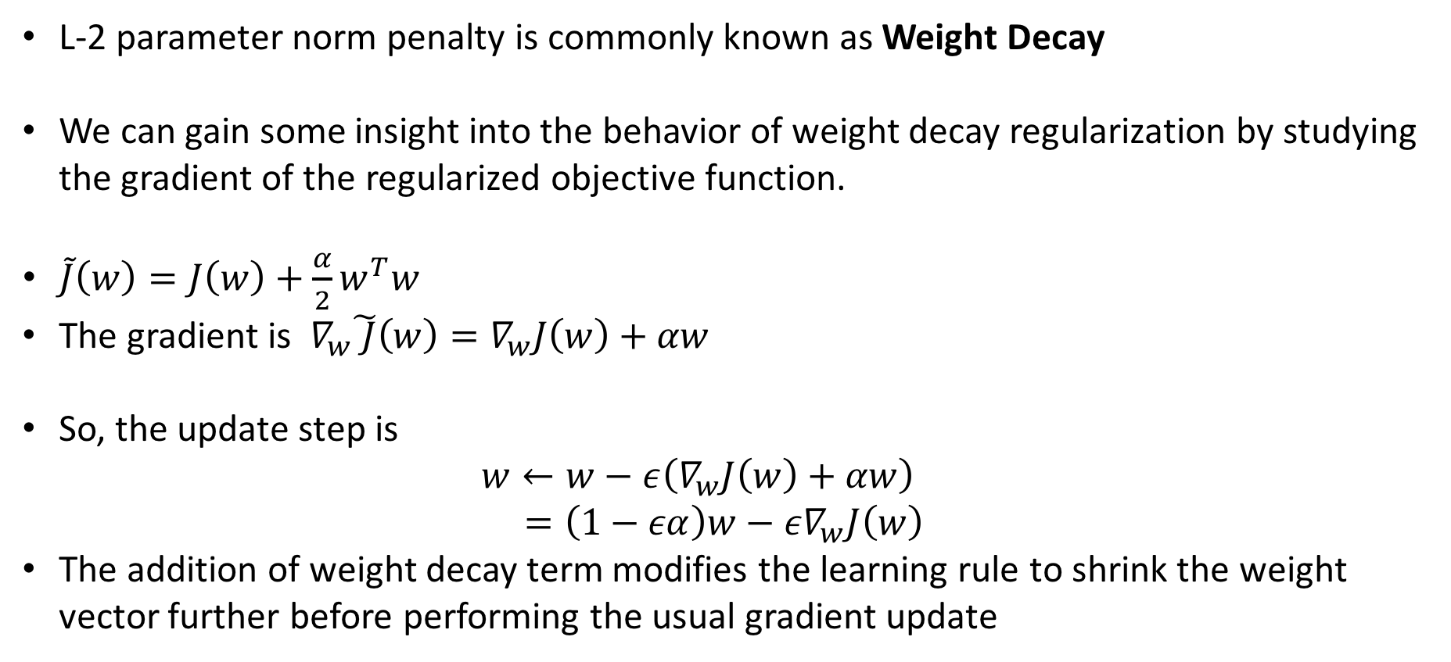
L-2 Parameter Norm Regularization
L-2 parameter norm penalty is commonly known as Weight Decay
We can gain some insight into the behavior of weight decay regularization by studying the gradient of the regularized objective function.
$\tilde{J}\left(w\right)=J\left(w\right)+\frac{α}{2}w^{T}w$
The gradient is $∇_{w}\tilde{ J}\left(w\right)=∇_{w}J\left(w\right)+αw$
So, the update step is $w←w−ε\left(∇_{w}J\left(w\right)+αw\right)$ $=\left(1−εα\right)w−ε∇_{w}J\left(w\right)$
The addition of weight decay term modifies the learning rule to shrink the weight vector further before performing the usual gradient update

Slide 10
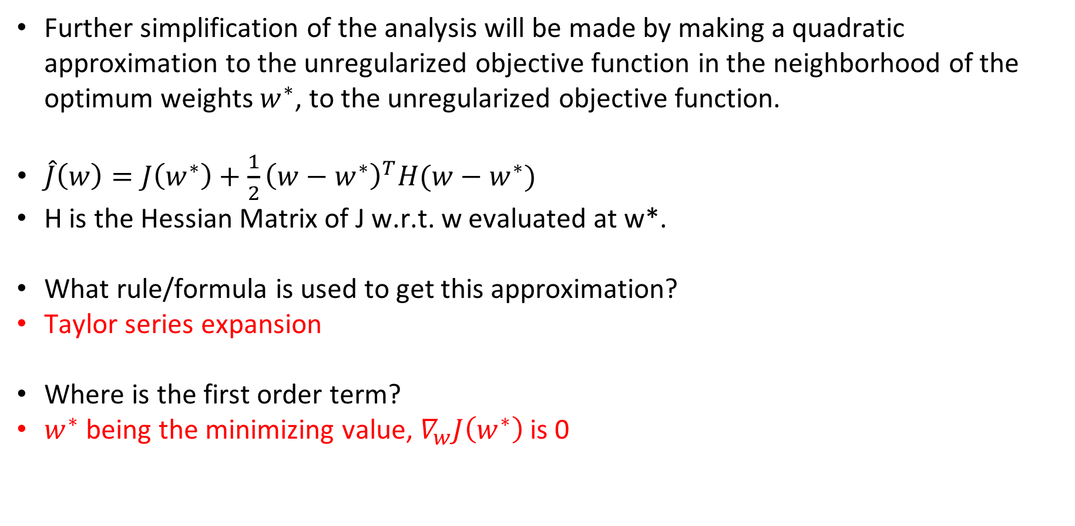
L-2 Parameter Norm Regularization
Further simplification of the analysis will be made by making a quadratic approximation to the unregularized objective function in the neighborhood of the optimum weights $w^{∗}$, to the unregularized objective function.
$\hat{J}\left(w\right)=J\left(w^{∗}\right)+\frac{1}{2}{\left(w−w^{∗}\right)}^{T}H(w−w^{∗})$
H is the Hessian Matrix of J w.r.t. w evaluated at w*.
What rule/formula is used to get this approximation?
Taylor series expansion
Where is the first order term?
$w^{∗}$ being the minimizing value, $∇_{w}J\left(w^{∗}\right)$ is 0

Slide 11
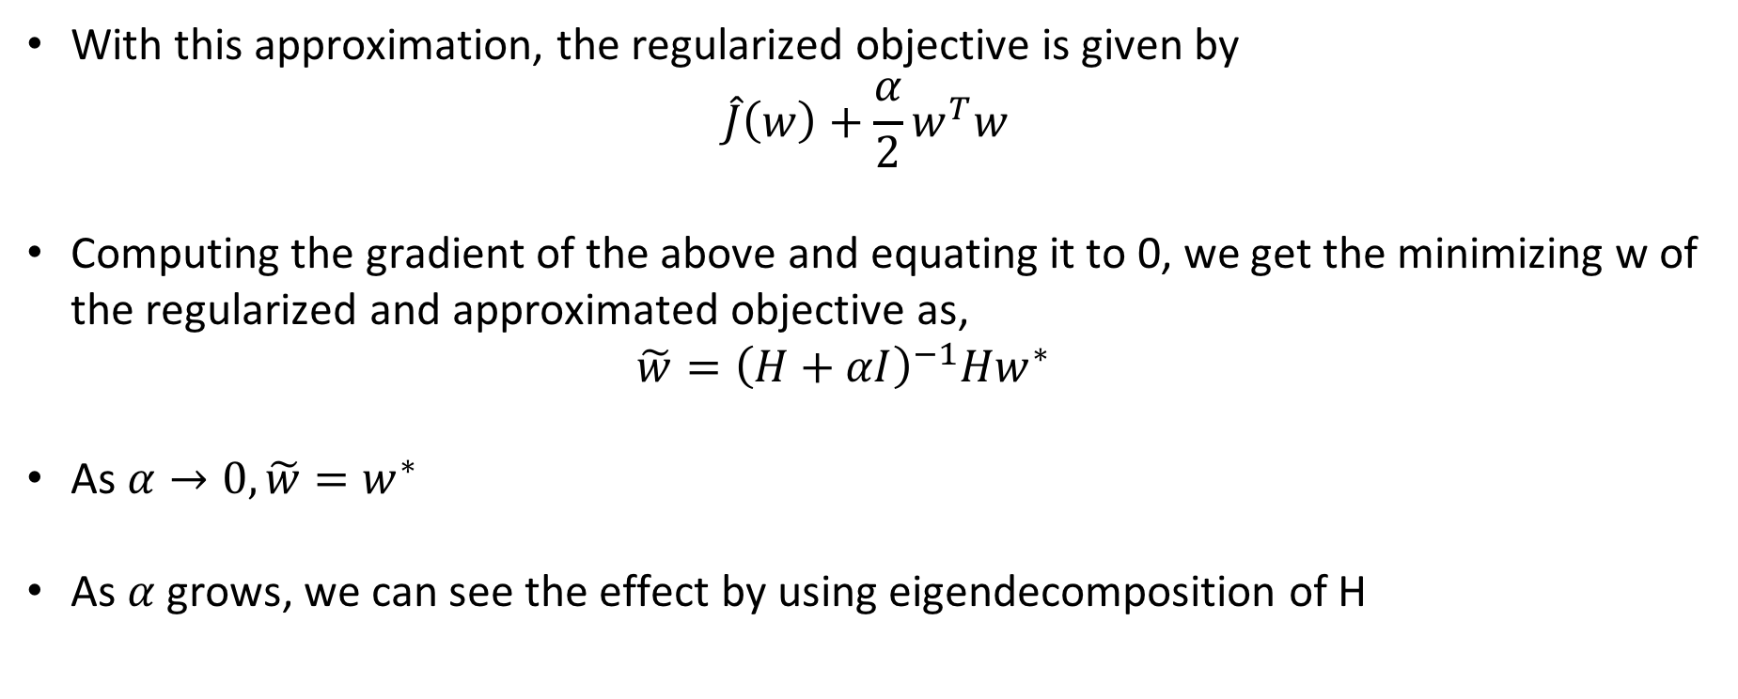
L-2 Parameter Norm Regularization
With this approximation, the regularized objective is given by $\hat{J}\left(w\right)+\frac{α}{2}w^{T}w$
Computing the gradient of the above and equating it to 0, we get the minimizing w of the regularized and approximated objective as, $\tilde{w}={\left(H+αI\right)}^{−1}Hw^{∗}$
As $α→0,\tilde{w}=w^{∗}$
As $α$ grows, we can see the effect by using eigendecomposition of H

Slide 12
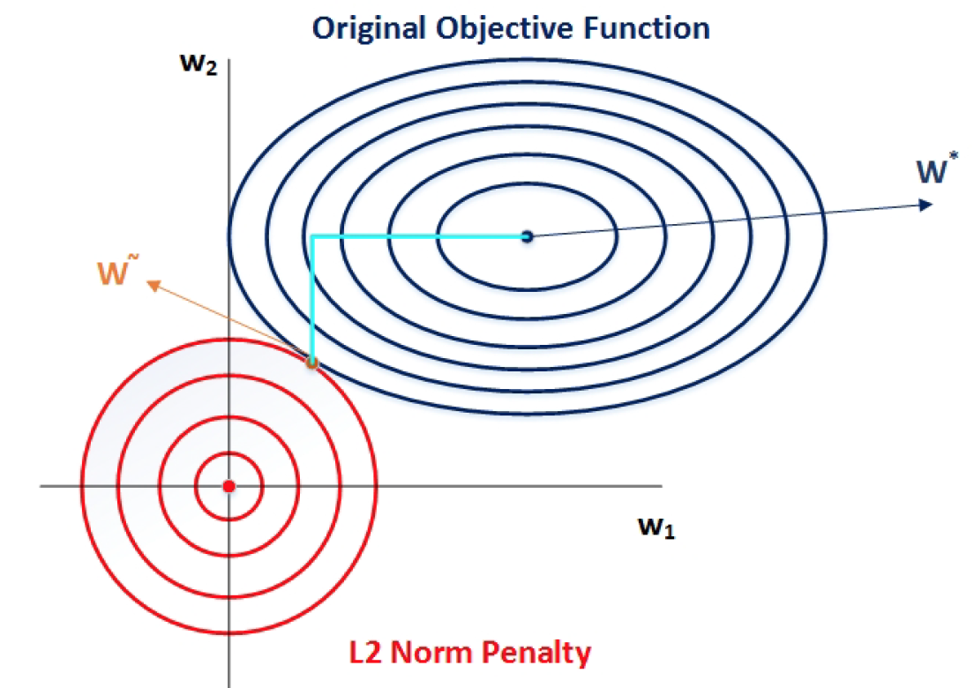
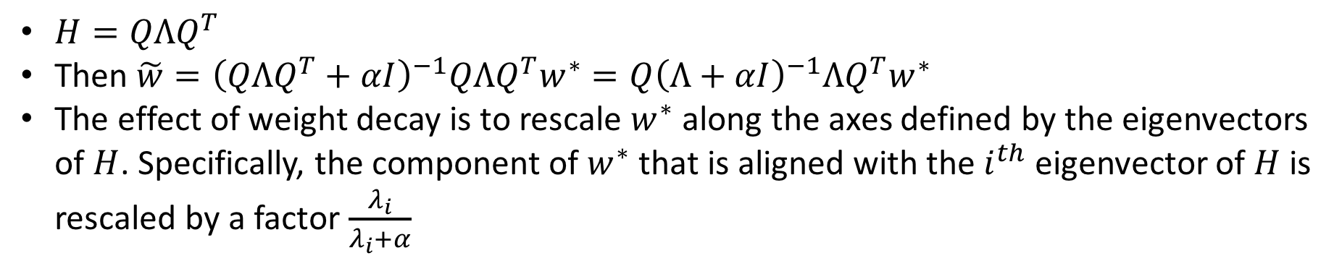
L-2 Parameter Norm Regularization
$H=QΛQ^{T}$
Then $\tilde{w}={\left(QΛQ^{T}+αI\right)}^{−1}QΛQ^{T}w^{∗}=Q{\left(Λ+αI\right)}^{−1}ΛQ^{T}w^{∗}$
The effect of weight decay is to rescale $w^{∗}$ along the axes defined by the eigenvectors of $H$. Specifically, the component of $w^{∗}$ that is aligned with the $i^{th}$ eigenvector of $H$ is rescaled by a factor $\frac{λ_{i}}{λ_{i}+α}$

Slide 13


Regularization Strategies: Dataset Augmentation
One way to get better generalization is to train on more data.
But under most circumstances, data is limited. Furthermore, labelling is an extremely tedious task.
Dataset Augmentation provides a cheap and easy way to increase the amount of training data.
Color Jitter
And many many more
Horizontal Flip

Slide 14
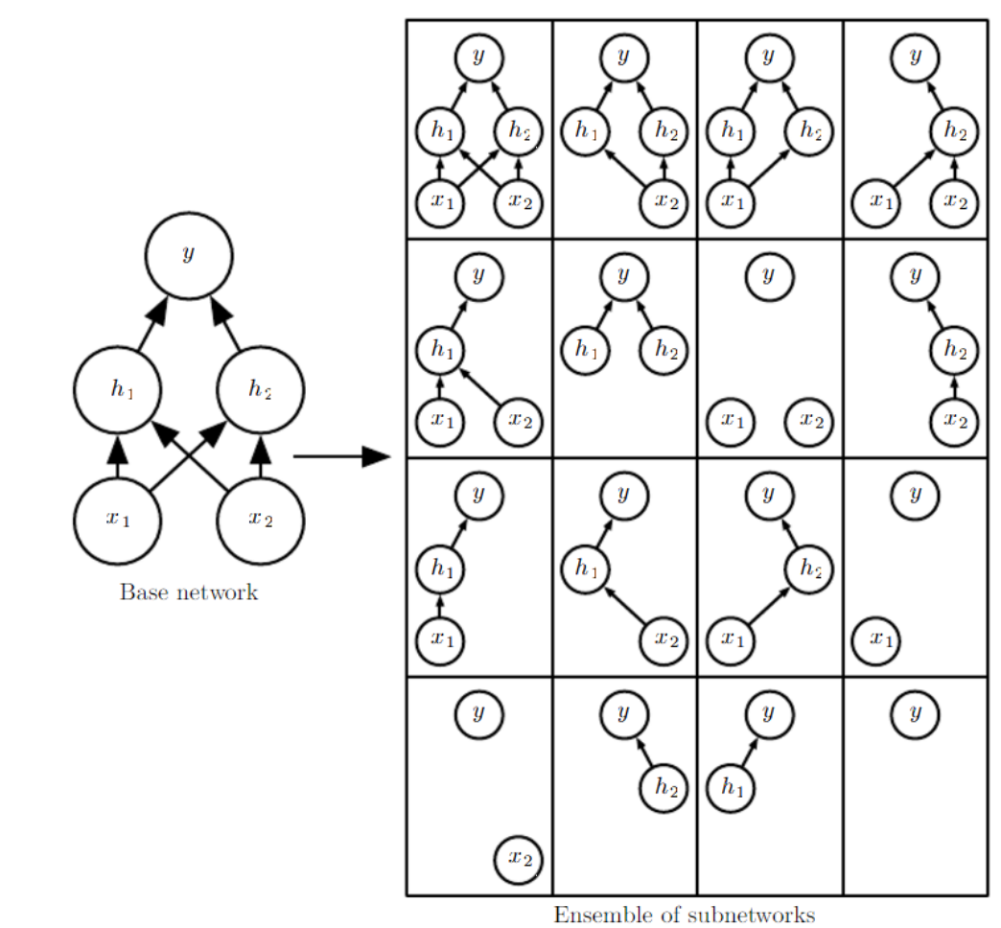
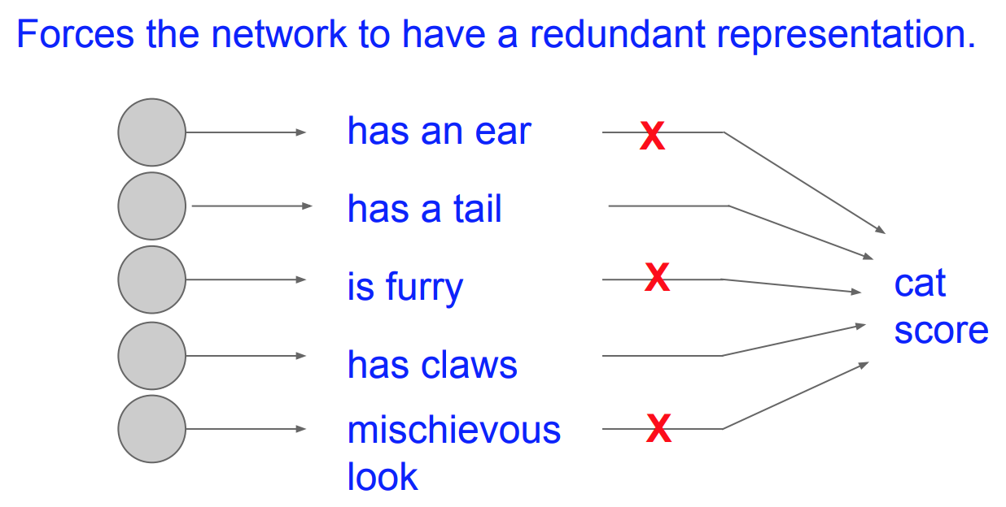
Regularization Strategies: Dropout
Bagging is a technique for reducing generalization error through combining several models (Breiman, 1994)
Bagging: (1) Train k different models on k different subsets of training data, constructed to have the same number of examples as the original dataset through random sampling from that dataset with replacement
Bagging: (2) Have all of the models vote on the output for test examples
Dropout is a computationally inexpensive but powerful extension of Bagging
Training with dropout consists of training sub-networks that can be formed by removing non-output units from an underlying base network
Images courtesy: Goodfellow et. al., Karpathy et. al.

Slide 15
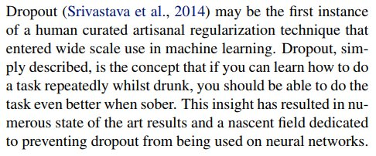
Dropout (Fun Intuition)

Slide 16

















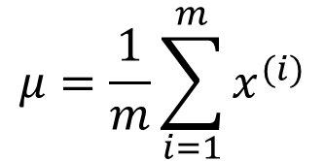
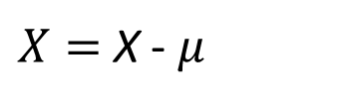
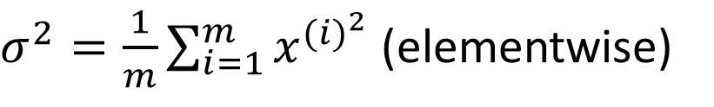
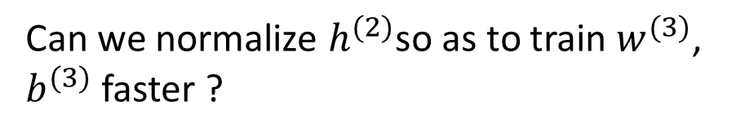
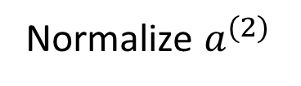






Batch Normalization
$$x_{1}$$
$$w_{1}$$
$$μ=\frac{1}{m}\sum_{i=1}^{m}{x^{(i)}}$$
$$w_{2}$$
$$a(x)$$
$$x_{2}$$
$$g(a)$$
$$y$$
$X=$ X - $μ$
$$W_{0}=b$$
$σ^{2}=\frac{1}{m}\sum_{i=1}^{m}{x^{{(i)}^{2}}}$ (elementwise)
$$x_{d}$$
$$w_{d}$$
$$1$$
$$x_{1}$$
$$a_{1}^{(2)}$$
$$a_{1}^{(1)}$$
$$h_{1}^{(1)}$$
$$h_{1}^{(2)}$$
Can we normalize $h^{(2)}$so as to train $w^{(3)}$, $b^{(3)}$ faster ?
$$x_{2}$$
$$\hat{y}$$
$$a_{2}^{(2)}$$
Normalize $a^{(2)}$
$$x_{3}$$
$$a_{2}^{(1)}$$
$$h_{2}^{(1)}$$
$$h_{2}^{(2)}$$

Slide 17
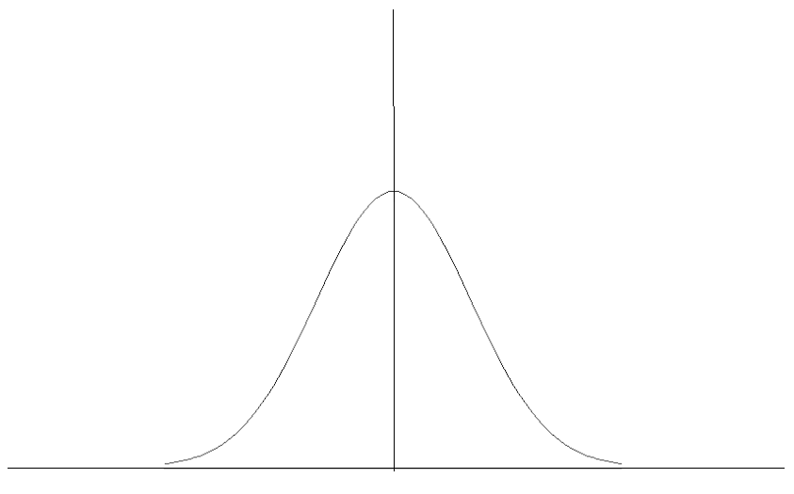
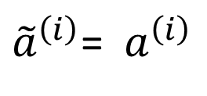
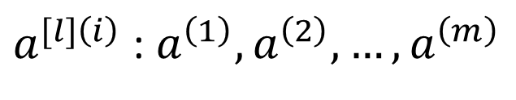
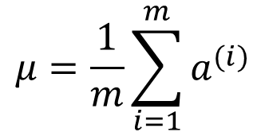
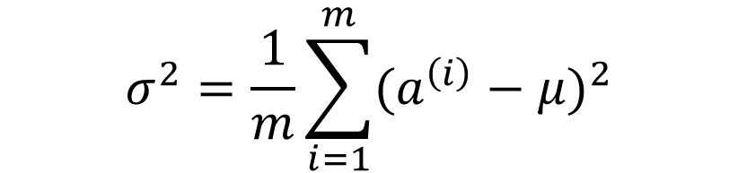
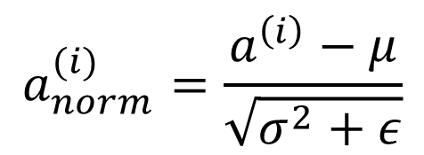
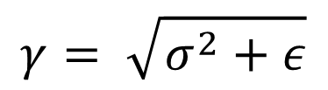

Implementing BatchNorm
$a^{[l]\left(i\right)}$ : $a^{\left(1\right)},a^{\left(2\right)}, …,a^{\left(m\right)}$
Given some intermediate values in NN,
$$μ=\frac{1}{m}\sum_{i=1}^{m}{a^{(i)}}$$
If,
$$γ= \sqrt{σ^{2}+ε}$$
$$σ^{2}=\frac{1}{m}\sum_{i=1}^{m}{{(a^{\left(i\right)}−μ)}^{2}}$$
$$β=μ$$
then,
$$a_{norm}^{(i)}=\frac{a^{\left(i\right)}−μ}{\sqrt{σ^{2}+ε}}$$
${\tilde{a}}^{\left(i\right)}$= ${ a}^{\left(i\right)}$
${\tilde{a}}^{\left(i\right)}= γa_{norm}^{(i)}+β$ , $γ and β$ are the learnable parameters of the model
Use${\tilde{a}}^{[l]\left(i\right)} instead of{ a}^{\left[l\right]\left(i\right)} in further calculations$

Slide 18


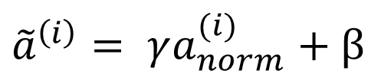
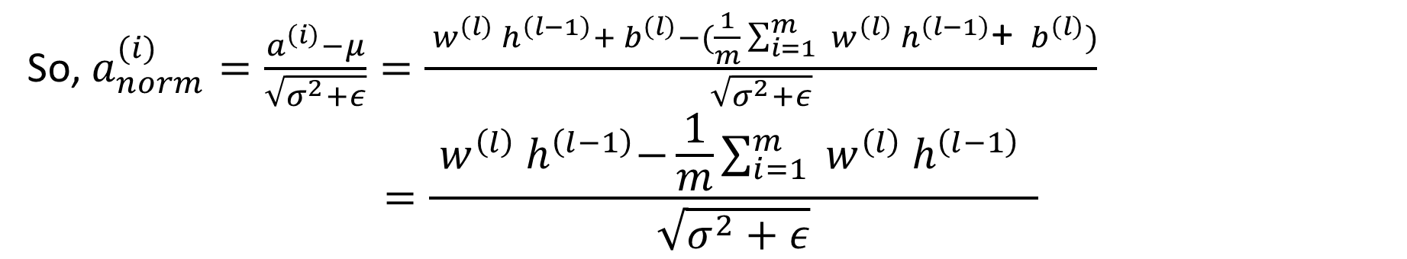
Effect of Batch Normalization on Biases
$${ a}^{\left(l\right)}={ w}^{\left(l\right)}{ h}^{\left(l−1\right)}+{ b}^{\left(l\right)}$$
We know, $μ=\frac{1}{m}\sum_{i=1}^{m}{a^{(l)}}$
$=\frac{1}{m}\sum_{i=1}^{m}{{ w}^{\left(l\right)}{ h}^{\left(l−1\right)}}$+ $\frac{1}{m}\sum_{i=1}^{m}{{ b}^{\left(l\right)}}$
$=\frac{1}{m}\sum_{i=1}^{m}{{ w}^{\left(l\right)}{ h}^{\left(l−1\right)}}$+ ${ b}^{\left(l\right)}$
So, $a_{norm}^{(i)}=\frac{a^{\left(i\right)}−μ}{\sqrt{σ^{2}+ε}}=\frac{{ w}^{\left(l\right)}{ h}^{\left(l−1\right)}+{ b}^{\left(l\right)}−(\frac{1}{m}\sum_{i=1}^{m}{{ w}^{\left(l\right)}{ h}^{\left(l−1\right)}}\text{+ }{ b}^{\left(l\right)})}{\sqrt{σ^{2}+ε}}$
$$=\frac{{ w}^{\left(l\right)}{ h}^{\left(l−1\right)}−\frac{1}{m}\sum_{i=1}^{m}{{ w}^{\left(l\right)}{ h}^{\left(l−1\right)}} }{\sqrt{σ^{2}+ε}}$$
${\tilde{a}}^{\left(i\right)}= γa_{norm}^{(i)}+β$

