Slide 1
Deep Learning CS60010
Abir Das
Assistant Professor
Computer Science and Engineering Department
Indian Institute of Technology Kharagpur
http://cse.iitkgp.ac.in/~adas/

Slide 2
Logistics
Course Name and code: Deep Learning, CS60010
Time: Wednesday (11:00-11:55 am), Thursday (12:00-12:55 pm), Friday (8:00-8:55 am)
Office Hours: Thursday (4:00-5:00 pm) at my office [Takshashila Building second floor]
Venue: NR421

Slide 3
Logistics
Course website: http://cse.iitkgp.ac.in/~adas/courses/dl_spr2020/dl_spr2020.php
Moodle Classroom: https://10.5.18.110/moodle/login/index.php and then the class name is – Deep Learning (Spring 2020)
Piazza Forum: https://piazza.com/iitkgp.ac.in/spring2020/cs60010/home
TAs: Buridi Sree Aditya (buridiaditya@iitkgp.ac.in), Vishal Gupta (ervishal@iitkgp.ac.in), Charugundla Sree Theerdha (sreetheerdha9@gmail.com), Vishesh Agarwal (vishesh0512@gmail.com), Subrata Chattopadhyay (subrata.ctj@gmail.com)

Slide 4
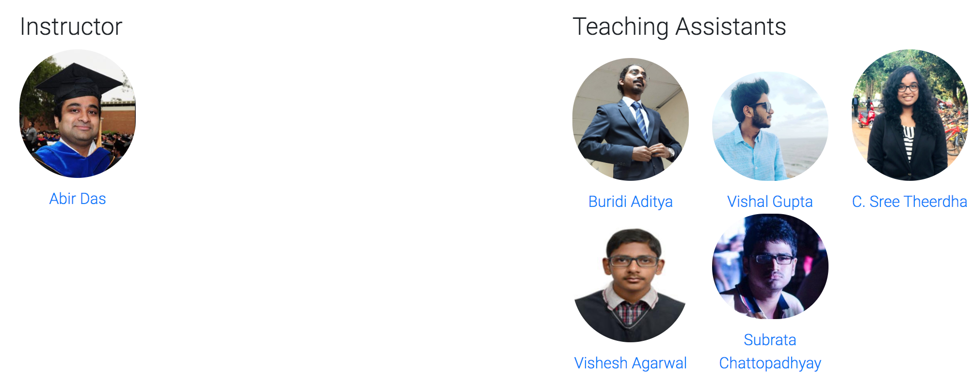
The Team
And YOU!!

Slide 5
Course Information
Prerequisites: 1. CS60050: Machine Learning
Python Proficiency: Proficiency in Python and familiarity with some Deep Learning tools (Tensorflow, Pytorch etc.) is desirable. A few links to get started.
https://docs.python.org/3/tutorial/
http://cs231n.github.io/python-numpy-tutorial/

Slide 6
Course Information
Books and References:
“Deep Learning”, I Goodfellow, Y Bengio and A Courville, 1st Edition, Free link.
More references specific to the lectures will be added in the course website as and when needed.

Slide 7
Course Information
Online lectures/Videos: The following courses will be closely followed in this course
Convolutional Neural Networks for Visual Recognition from Stanford University (Link)
Deep Learning by Efstratios Gavves (Link)
NPTEL Deep Learning by Prabir Kumar Biswas (Link)

Slide 8
Course Information
Evaluation: Homework (20%) – 2 Homeworks; mid term (30%); End-term (30%); Project (15%), Paper presentation (5%).
Homeworks
Homeworks will have a combination of Mathematical and coding problems.

Slide 9
Course Information
Evaluation: Homework (20%) – 2 Homeworks; mid term (30%); End-term (30%); Project (15%), Paper presentation (5%).
Project
Each project will be done by a 4 member team. Start forming the team.
We will try to assign one TA as mentor to each team. But its your project and the TAs will just oversee, nothing more than that.
Tentative deadline to submit project title and half a page abstract along with the team member names is [Jan 31, 2020].
Coming up with your own project idea is highly recommended. You can discuss with the TAs and mail me if you need to discuss.
The project deliverable is a 4 page report plus bibliography [ICIP Style paper] at the end of the course (Pre finals week) and a poster which needs to be presented at a poster session [The date of the poster session will be announced later]

Slide 10
Course Information
Evaluation: Homework (20%) – 2 Homeworks; mid term (30%); End-term (30%); Project (15%), Paper presentation (5%).
Paper presentation
The whole class will be divided into 2 member teams. The team will be formed by the instructor and the Tas. Papers will be assigned to each team by the instructor and the TAs.
Each Friday the class will be divided into 2 halves. The first half (approx 25 minutes) will have usual lecturing. In the second half (approx 30 minutes), 3 teams will present the papers assigned to them. The duration of each presentation will be 8 minutes (+ 2 minutes Q&A).
Each team will have to present one paper during the whole semester.
Some thumbrules:
10-12 slides in total, divide the presentation in problem definition (if required provide importance of the problem), approach (if you can motivate why the approach is good/novel it will be great), Results and what could have been done extra according to you.

Slide 11
Course Information
Evaluation: Homework (20%) – 2 Homeworks; mid term (30%); End-term (30%); Project (15%), Paper presentation (5%).
Paper presentation – Why are we doing this?
Deep Learning is a rapidly evolving field. Everyday new papers are coming out. Just check ArXiv and see (especially just after the paper submission deadlines of reputed conferences. We will see what are some good conferences in fields related to Deep Learning in a few slides).
Some of them are good, some are bad. If we divide and conquer the task of reading papers everybody will be benefitted.
Papers are BIIIIG things. How do I get started?
Fantastic tips by Andrew Ng. [Link] (First 30 minutes)

Slide 12
What about Computing Resources
We are going to use Google cloud compute services (GCP).
Cloud computing is convenient compared to a server based approach.
Google has been kind enough to provide a $50 compute credit for every student enrolled in the course.
You will be provided with instructions on how to redeem this free cloud credit.
Try to save this for your project ($200 in total for 4 members).
Homeworks can be done in your PC and Google Colab (free to use)
GCP Documentation: Link
Further details on procedure to set up a project and deep learning libraries in the VM will the discussed in due course.

Slide 13
Computer Vision Conferences
CVPR – Computer Vision and Pattern Recognition, since 1983. Held in USA (2023 is scheduled to be held in Vancouver, first time outside USA)
Google Scholar h-5 index, 2019 – 240 (Top 10 across any field, any conference or journal)
ECCV - European Conference on Computer Vision, since 1990. Held every other year, in Europe.
Google Scholar h-5 index, 2019 – 137
ICCV – International Conference on Computer Vision, since 1987. Held every other year, across the world.
Google Scholar h-5 index, 2019 – 129
Organized under the banner of CVF (Computer Vision Foundation) - Link

Slide 14
Computer Vision Conferences
ACCV – Asian Conference on Computer Vision
BMVC – British Machine Vision Conference
ICIP - International Conference on Image Processing
WACV - Workshop on Applications of Computer Vision
ICPR - International Conference on Pattern Recognition
ICVGIP – Indian Conference on Computer Vision, Graphics and Image Processing
NCVPRIPG - National Conference on Computer Vision, Pattern Recognition, Image Processing and Graphics

Slide 15
Computer Vision Journals
PAMI – IEEE Transactions on Pattern Analysis and Machine Intelligence
Google Scholar h-5 index, 2019 – 127
Impact Factor, 2018 – 17.730
TIP - IEEE Transactions on Image Processing
Google Scholar h-5 index, 2019 – 102
Impact Factor, 2018 – 6.79
IJCV - International Journal of Computer Vision
Google Scholar h-5 index, 2019 – 66
Impact Factor, 2017 – 11.541

Slide 16
Conferences in Other Application Areas
NeurIPS – Neural Information Processing Systems
Google Scholar h-5 index, 2019 – 169 (Top 30 across any field, any conference or journal)
MICCAI – Medical Image Computing and Computer-Assisted Intervention
ICLR - International Conference on Learning Representations
Google Scholar h-5 index, 2019 – 150 (Started in 2013)
ICML – International Conference on Machine Learning
Google Scholar h-5 index, 2019 – 135
IJCAI, AAAI, ACL, EMNLP, NAACL, FAT-ML, ACM-MM, ICRA

Slide 17
Journals Other Application Areas
TMM – IEEE Transactions on Multimedia
Google Scholar h-5 index, 2019 – 64
Impact Factor, 2018 – 5.452
JMLR - Journal of Machine Learning Research
Google Scholar h-5 index, 2019 – 81
Impact Factor, 2018 – 4.091
KDE- IEEE Transactions on Knowledge and Data Engineering
Google Scholar h-5 index, 2019 – 77
Impact Factor, 2017 – 3.857
TCSVT, CVIU, IJRR

Slide 18
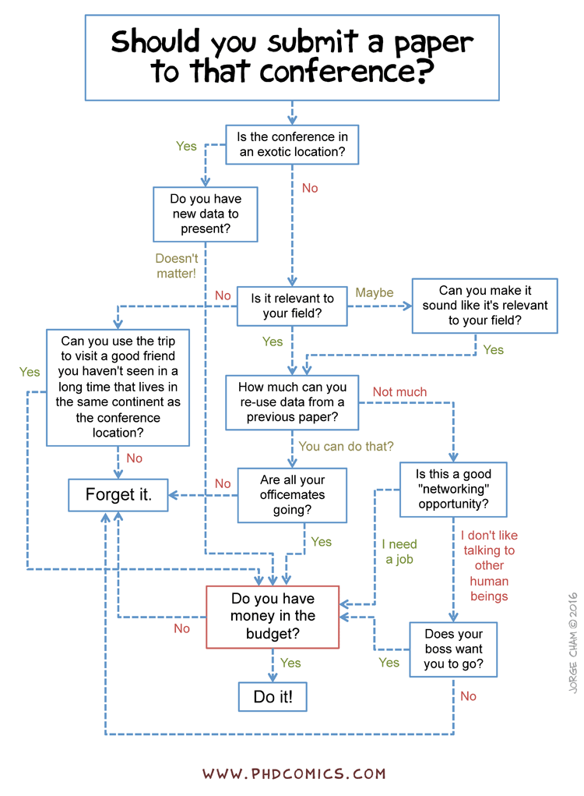
Decide Where to Submit
Taken from phdcomics

Slide 19
The Decision Process: Overview
Program Chairs
8. Program chairs finalize oral decisions based on space/time constraints
1. PCs assign papers to ACs
7. Area chairs discuss with reviewers and each other, make accept/reject decisions and oral recommendations
Primary Area Chair
Secondary Area Chair
2. Primary AC suggests reviewers
Authors
5. Authors provide rebuttal to reviewers and ACs
3. Papers are assigned to reviewers using global matching algorithm
6. Reviewers update final reviews
4. Reviewers write reviews, which are released to authors (after AC checking for quality)
Reviewers
Taken from CVPR 2020 Reviewer guidelines

Slide 20

How to Write a Good Paper
Youtube Link

Slide 21
Thank You!!

