Slide 1

Milling Processes
General Manufacturing Processes Engr.-20.2710
Instructor - Sam Chiappone

Slide 2
Milling Processes
Milling is one of the basic machining processes. Milling is a very versatile process capable of producing simple two dimensional flat shapes to complex three dimensional interlaced surface configurations.

Slide 3
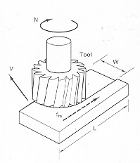
The Process
The milling process:
  Typically uses a multi-tooth cutter
  Work is fed into the rotating cutter
  Capable of high MRR
  Well suited for mass production applications
  Cutting tools for this process are called milling cutters

Slide 4
Classifications
Milling operations are classified into two major categories:
  Peripheral (side)
    Generally in a plane parallel to the axis of the cutter
    Cross section of the milled surface corresponds to the contour of the cutter
  Face
    Generally at right angles to the axis of rotation of the cutter
    Milled surface is flat and has no relationship to the contour of the cutter
    Combined cutting action of the side and face of the milling cutter

Slide 5
Related Operations
  Side milling - machining a plane surface perpendicular to the milling machine arbor with an arbor mounted tool. This tool is called a side mill.
  Straddle milling - milling two parallel surfaces using two cutters spaced apart on an arbor.
  Gang milling - milling multiple surface simultaneously using multiple cutters mounted on an arbor.
  Thread milling - milling treads using the capability of a three axis contouring CNC machine.

Slide 6
Operating Parameters
Rpm
  CS converted into Rpm based on cutter diameter
Feed rate
  Feed per tooth
  Table feed rate

Slide 7
Operating Parameters
Feed direction -- Conventional vs. Climb
  Conventional milling
    Most common method of feed
    Feed work against the rotation of the cutter

Slide 8
Operating Parameters
Feed direction - Conventional vs. Climb
  Climb milling
    Load of the cutter tends to “pull” the work into the cutter
    This results in a small feed force and about 20% less Hp than conventional milling
    Downward motion increases the load on the table ways
    This method can “pull” the work into the cutter and scrap the work and/or damage the fixture and tool.
    Machine must be very ridged to safely utilize climb milling(CNC machines)
    USE CAUTION!

Slide 9
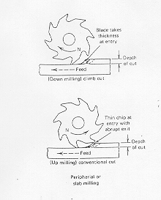
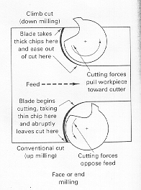
Operating Parameters
Conventional vs. Climb Milling

Slide 10
Operating Parameters
  Depth of cut
  Horsepower

Slide 11
Milling machines
Two Major Classifications - Knee & Column and Bed
  Knee & Column (Bridgeport type)
    Basic job shop type mill
    Column mounted to the base which is the major support frame.
    Construction provides controlled motion of the worktable in three mutual perpendicular directions.
    Knee moves vertically on the ways in the front of the machine
    Table moves longitudinally on the ways on the saddle
    Saddle moves transversely on the ways on the knee
    Quill moves parallel in Z axis or, if head is rotated, X axis
    Versatile general purpose machine

Slide 12
Milling Machines
  Bed
    Used extensively in production milling operations
    Rigid construction capable of heavy cuts
    Table is mounted directly to the bed
    Spindle head moves vertically to set depth of cut
    Head locks into position for cut
    Base of machine functions as a coolant reservoir

Slide 13
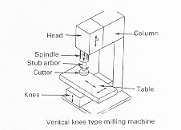
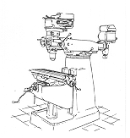
Milling Machines

Slide 14
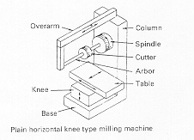
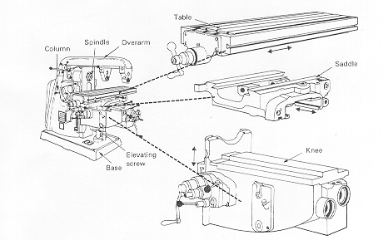
Milling Machines

Slide 15
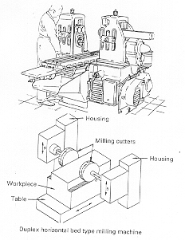
Milling Machines

Slide 16
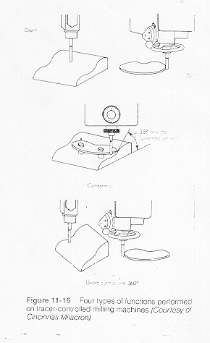
Variation of Machines
Variations include:
    Horizontal
    Vertical
    Profilers and duplicators
    CNC
    Planner

Slide 17
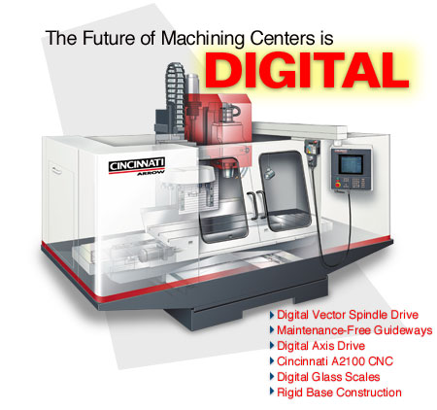
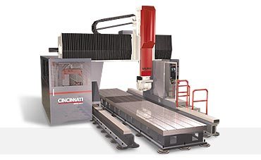
Variation of Machines
CNC
    Horizontal, Vertical,and Planner (up to 5 axis)

Slide 18
Process Accuracy
Accuracy of milling machines
    Factors to consider
      Fixture
      Rigidity of machine tool
      Accuracy of the spindle
      Cutter condition
      Coolant
        Type
        Delivery method
      Material condition

Slide 19
Process Accuracy
+/- .0005” - Optimum situation
+/- .001”-.002” - Typical
+/- .001” - Flatness

Slide 20
Milling Cutter Classifications
Arbor
Shank
Face

Slide 21
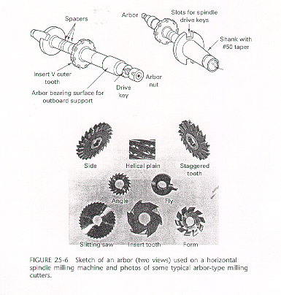
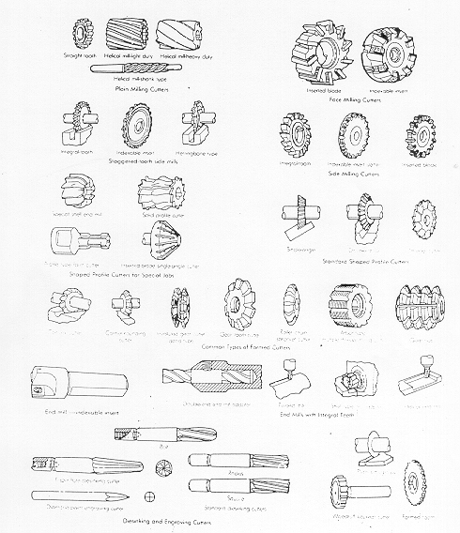
Milling Cutters

Slide 22
Workholding Devices
Vise
Chucks
Rotating tables
Angle plates
Special fixtures
Universal dividing head
Modular fixturing systems
Clamp work to table

Slide 23
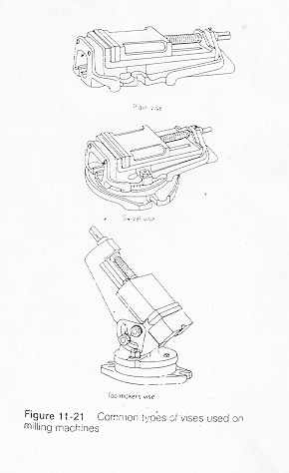
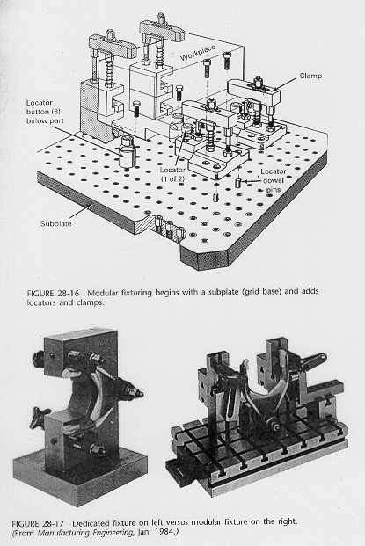
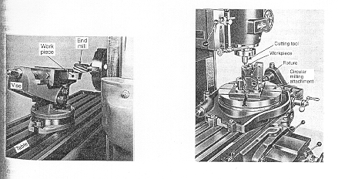
Workholding Devices

