Slide 1

Lathe Practice

Slide 2
Introduction
Lathe is a machine, which removes the metal from a piece of work to the required shape &size

Slide 3
Types of Lathe
  Engine Lathe
  The most common form of lathe, motor driven and comes in large variety of sizes and shapes.
  Bench Lathe
  A bench top model usually of low power used to make precision machine small work pieces.
  Tracer Lathe
  a lathe that has the ability to follow a template to copy a shape or contour.

Slide 4
  Automatic Lathe
  A lathe in which the work piece is automatically fed and removed without use of an operator. Cutting operations are automatically controlled by a
  sequencer of some form
  Turret Lathe
  lathe which have multiple tools mounted on turret either attached to the tailstock or the cross-slide, which allows for quick changes in tooling and cutting operations.
  Computer Controlled Lathe
  A highly automated lathe, where both cutting, loading, tool changing, and part unloading are automatically controlled by computer coding.

Slide 5
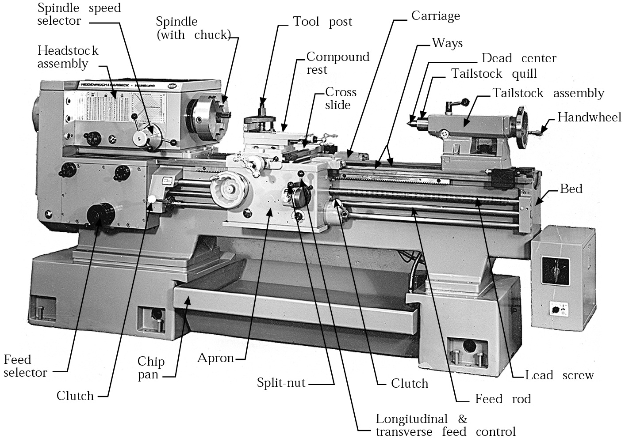
Component Description

Slide 6
Lathe Operations
Turning:produce straight, conical, curved, or grooved workpieces
Facing: to produce a flat surface at the end of the part or for making face grooves.
Boring: to enlarge a hole or cylindrical cavity made by a previous process or to produce circular internal grooves.
Drilling: to produce a hole by fixing a drill in the tailstock
Threading: to produce external or internal threads
Knurling: to produce a regularly shaped roughness on cylindrical surfaces

Slide 7
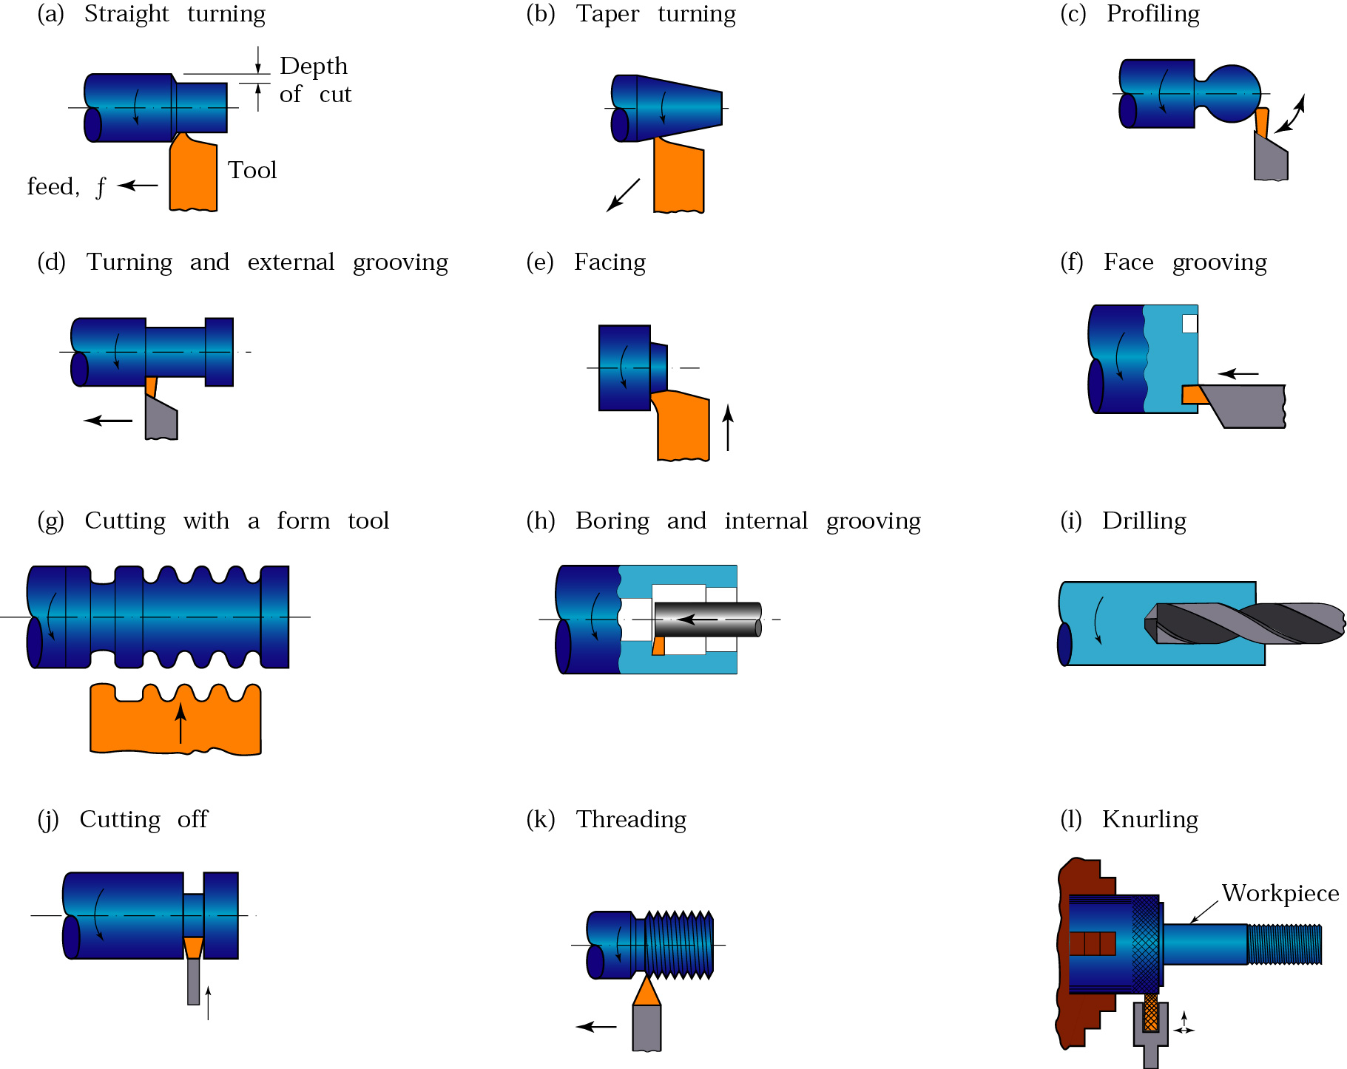
Lathe Operations

Slide 8
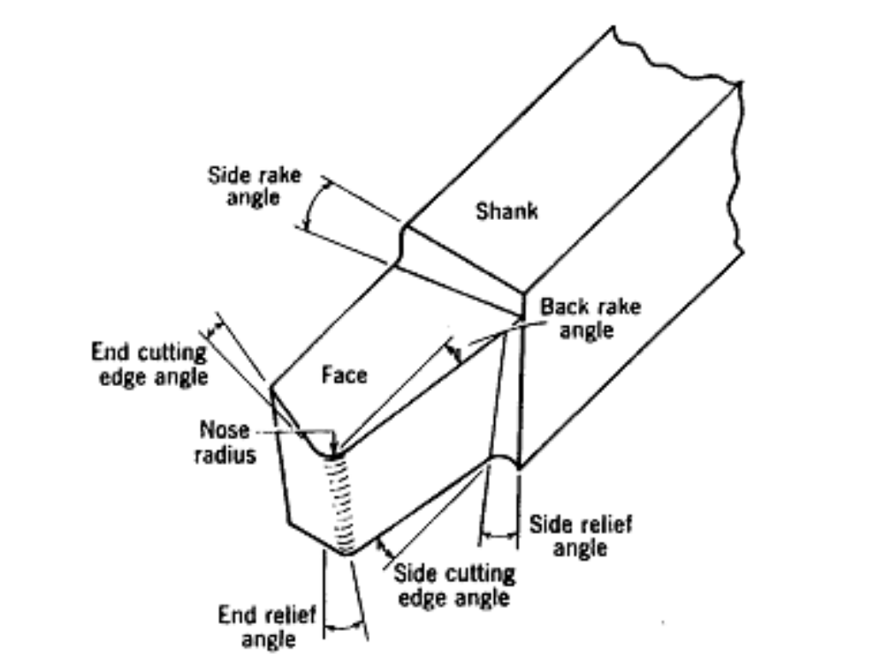
Cutting Tools
Single point cutting tool

Slide 9
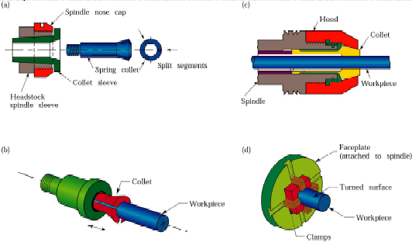
Work Holding Devices
Fig : (a) and (b) Schematic illustrations of a draw-in-type collets. The workpiece is placed in the collet hole, and the conical surfaces of the collet are forced inward by pulling it with a draw bar into the sleeve. (c) A push-out type collet. (d) Workholding of a part on a face plate.

Slide 10
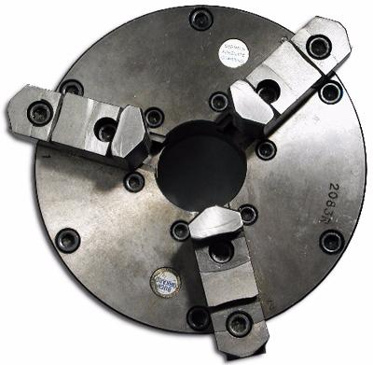
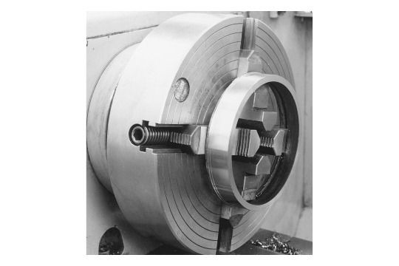
Three jaw chuck
- For holding cylindrical stock centered.
- For facing/center drilling the end of your aluminum stock
Four-Jaw Chuck
- This is independent chuck generally has four jaws , which are adjusted individually on the chuck face by means of adjusting screws

Slide 11
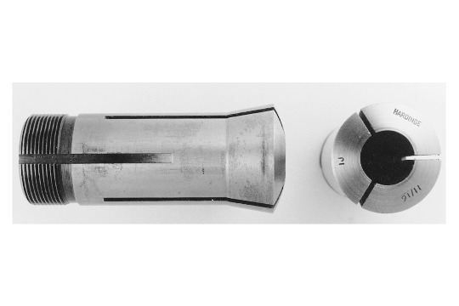
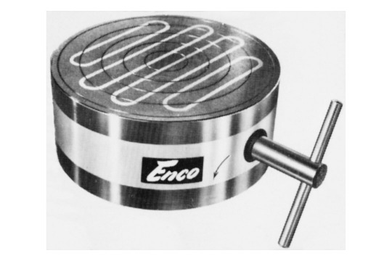
Collet Chuck
Collet chuck is used to hold small workpieces
Thin jobs can be held by means of magnetic chucks.
Magnetic Chuck
Thin jobs can be held by means of magnetic chucks.

Slide 12
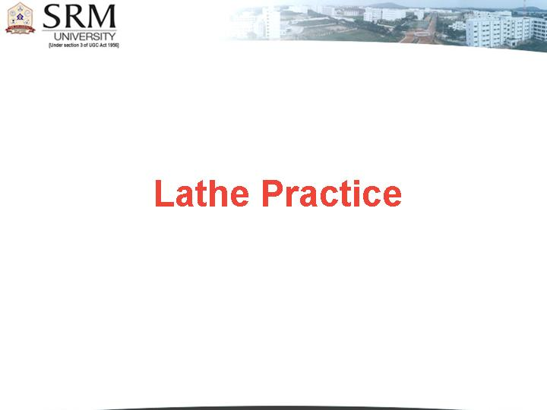
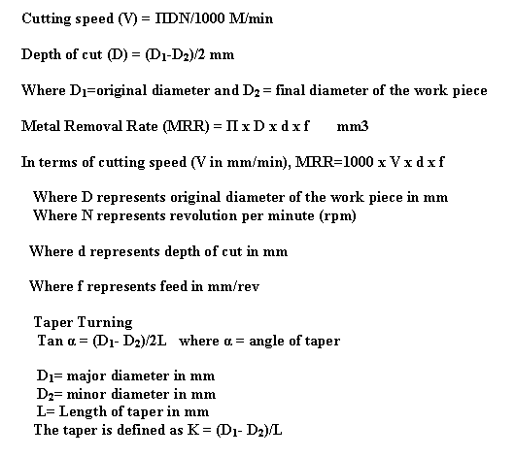
Simple formula

Slide 13
Simple Problems
Problem -1
A mild steel rod having 50 mm diameter and 500 mm length is to be turned on a lathe. Determine the machining time to reduce the rod to 45 mm in one pass when cutting speed is 30 m/min and a feed of 0.7 mm/rev is used.

Slide 14
Solution
Given data: D = 50 mm, L_{j} = 500 mm
v = 30 m/min, f = 0.7 mm/rev
Substituting the values of v and D in
V = ΠDN/1000 M/min
Required spindle speed as: N = 191 rpm

Slide 15
Simple Problems
Problem -2
Determine the angle at which the compound rest would be swiveled for cutting a taper on a work piece having a length of 150 mm and outside diameter 80 mm. The smallest diameter on the tapered end of the rod should be 50 mm and the required length of the tapered portion is 80 mm.
Solution
Given data: D1 = 80 mm, D2 = 50 mm, Lj = 80 mm (with usual notations)
tan α = (80-50) / 2×80 or α = 10.620
The compound rest should be swiveled at 10.62º

Slide 16
References
Book
work shop Technolgy by Hajra choudry
Advances in Manufacturing Technology C.J Thomas
Website
www. engbasics.com
www. efunda.com

