Slide 1
CS60064 Spring 2022 Computational Geometry
Instructors
Bhargab B. Bhattacharya (BBB)
Partha Bhowmick (PB)
Lecture #13 & Lecture #14
04 February 2022
Indian Institute of Technology Kharagpur
Computer Science and Engineering
Notes:
Good Morning!
The title of today’s talk is “On some Planar Partitioning Problems”.

Slide 2
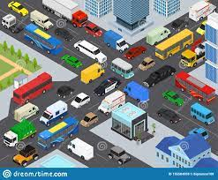

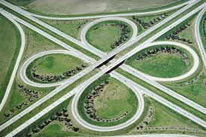
Intersection
Two roads diverged in a wood, and I -
I took the one less traveled by,
And that has made all the difference.
--- Robert Frost (1916)
Cloverleaf non-intersecting
traffic intersection (1916)

Slide 3
Compute the union and intersection of two simple polygons of n and m vertices; compute the union/ intersections of a family of rectangles

Slide 4
Map Overlay: Intersection Problems
Map overlay is needed to answer questions such as:
1. What is the total length of
roads through forests?
2. What is the total area of corn-fields within one km from a river?
3. What area of all lakes occurs at the geological soil type “rock"?
To solve map-overlay questions, we need information about the intersection points from two sets of line segments (possibly, boundaries of regions)

Slide 5
Line segment intersections
One of the most basic problems in computational geometry
■ Solid modeling
– Intersection of object boundaries
■ Overlay of subdivisions, e.g. layers in GIS
– Bridges on intersections of roads and rivers
– Maintenance duty (road network crossing state boundaries)
■ Robotics
– Collision detection and collision avoidance
■ Computer graphics
– Rendering via ray shooting (intersection of the ray with objects)

Slide 6
Intersection Test
Determine whether two line segments (p₁, p₂) and (q₁, q₂) intersect properly, i.e., the point of intersection must lie strictly to the interior of both segments
q₂
q₁
q₁
q₁
p₂
p₂
p₂
q₂
p₁
q₂
p₁
p₁
intersect iff
Orient (p₁, p₂, q₁)
Orient (p₁, p₂, q₂)
< 0
*
and
Orient (q₁, q₂, p₁)
Orient (q₁, q₂, p₂)
< 0
*

Slide 7
The Easy Problem
Given a set of of n line segments in the plane, find all intersection points efficiently
Algorithm Find_Intersections(S)
Input. A set S of line segments in the plane.
Output. The set of intersection points among the segments in S.
1. for each pair of line segments in S
2. If intersected, report their intersection point
Question: Can we improve this O(n²) bound?

Slide 8
Line segment intersections
Intersection of complex shapes ⇒ simpler intersection problems
Line segment intersection is the most
basic intersection algorithm
■ Given n line segments in the plane, report all points where
a pair of line segments intersect
■ Problem complexity
– Worst case # I = O(n²) intersections
– Practical case – only some intersections
– Can we build an output-sensitive algorithm?
• O(n log n + I) optimal randomized algorithm
• O(n log n + I log n ) Bentley-Ottmann sweep-line algorithm,
IEEE TC 1979

Slide 9
Line segment intersections
1
2
2
1
(1, 2)
1
(2, 1)
2
Two line segments can intersect only if their x- and y-spans have an overlap (i.e., necessary condition)
The converse may not be true; hence, the condition is not sufficient
1
2
1
2
Two major observations:
Intersections ⇒ swapping of order during plane sweep
Intersections ⇒ segments will be x-adjacent during y-sweep before intersection (i.e, they will be horizontal neighbors on the horizontal sweep-line)
1
2

Slide 10
Plane sweep
Imagine a horizontal line moving from top to bottom, solving the problem as it goes down; sort the y-coordinates of the vertices to guide the sweep-line
The sweep-line stops and the algorithm computes at certain positions ⇒ events in priority queue Q (segment end-points, intersection points)
The algorithm stores the relevant situation at the current position of the sweep line ⇒ status (in a tree Tree)
The algorithm knows everything it needs to know above the sweep line, and detects all intersection points (Segment intersections between neighboring segments along sweep-line)
Non-degeneracy assumptions: No line segment is horizontal; no two segments have the same y-coordinate; when two segments intersect, they intersect properly in a single point; no three line-segments are concurrent

Slide 11
Plane sweep

Slide 12
Plane sweep
sweep-line

Slide 13
Events and Sweep-Line Status
sweep-line

Slide 14
Events and Sweep-Line Status

Slide 15
Events and Sweep-Line Status

Slide 16
Events and Sweep-Line Status

Slide 17
Events and Sweep-Line Status
(s₁, s₃);

Slide 18
Events and Sweep-Line Status

Slide 19
Events and Sweep-Line Status

Slide 20
Events and Sweep-Line Status

Slide 21
Events and Sweep-Line Status
and so on …

Slide 22
Event list and status structure
The event list is an abstract data structure (priority queue Q) that stores all events in the order in which they occur (use a balanced binary tree to implement Q)
The status structure is an abstract data structure (Tree) that maintains the current sweep-line status (use a balanced binary tree to implement Tree as well)
The status is the set of currently intersected line segments in the left-to-right order

Slide 23
Status structure
We use a balanced binary search tree (Tree) with the line segments in the leaves as the status structure
each internal node is the rightmost node of its left sub-tree
sweep-line

Slide 24
Status structure
sweep-line

Slide 25
Status structure
sweep-line

Slide 26
Status structure: Insertion of segment beginning
sweep-line

Slide 27
Status structure: Insertion of segment beginning
sweep-line

Slide 28
Status structure: Insertion of segment beginning
Lemma: Two line segments s_{i} and s_{j} can
only intersect (= below) after they have
become horizontal neighbors
Proof: Just imagine that the sweep line is
slightly above the intersection point
of s_{i} and s_{j}, but below any other event
Also: some earlier (= higher) event made
s_{i} and s_{j} horizontally adjacent!
sweep-line

Slide 29
Status Structure: Event Management
■ Upper endpoint U(s) of segment s
– insert s to Tree
– check two immediate neighbors (left/right) of s for possible intersections with s and add intersections to Q, if any
■ Intersection point (s_{i}, s_{j})
– switch order of segments (s_{i}, s_{j}) →(s_{j}, s_{i})
in Tree
– for the new left (right) segment, check its intersections with nearest left (right)
neighboring segment; insert intersection points, if any, to Q
■ Lower endpoint L(s) of segment s
– delete s from Tree
– check intersections between immediate left and right neighbors of s and update Q, when any intersection is detected
Ref: 4A Textbook

Slide 30
An intersection point may be detected multiple times
Avoid testing of pairs of segments far apart;
Compute intersections of neighbors on the sweep line only
sweep-line

Slide 31
Algorithm: Line-Segment Intersections
Input: A set S of line segments in the plane
Output: The set of intersection points + pointers to segments
1. insert the segment end-points in the event queue Q;
2. status structure Tree ← ∅;
3. while Q in not empty
4. remove next event p from Q
5. handleEventPoint(p)
upper end-point; intersection;
lower end-point
*Upper end-point is used to store the
segment-ID in Q; both Q and Tree are implemented as balanced binary search tree
Ref: 4A Textbook

Slide 32
Analysis: Line-Segment Intersection Algorithm
Vertical sorting of 2n points: O(n logn)
Sweep-line halts at:
– 2n steps for end points;
– I steps for intersections;
– log n search/update in the status tree
Time Complexity:
O(n log n + I log n)
Working Space: Tree: O(n);
Queue Q: O(n + I)
Size of Q Can be made O(n) by storing intersection points between adjacent segments only;
Output size: O(I)
Ref: 4A Textbook

Slide 33
Conclusion
For every sweep algorithm:
Define the status
Choose the status structure and the event list
Figure out how events are handled
To analyze, determine the number of events and how
much time they take
Deal with degeneracies separately
Ref: 4A Textbook

Slide 34
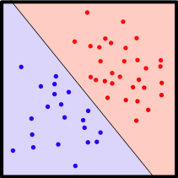
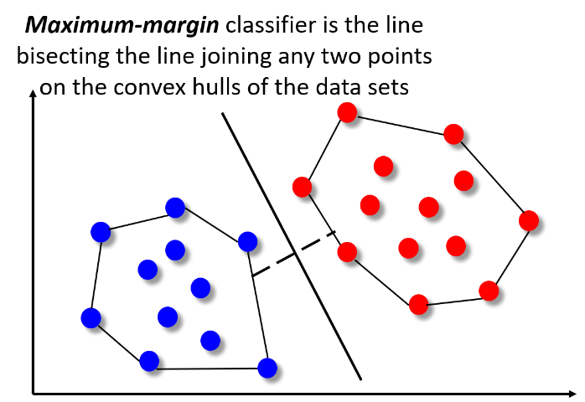
Intersections
Check if the two convex hulls are disjoint to test linear separability of bichromatic data-sets
The reason that Apple is able to create products like iPad is because we have always tried to be at the intersection of technology and liberal arts. --- Steve Jobs

Slide 35
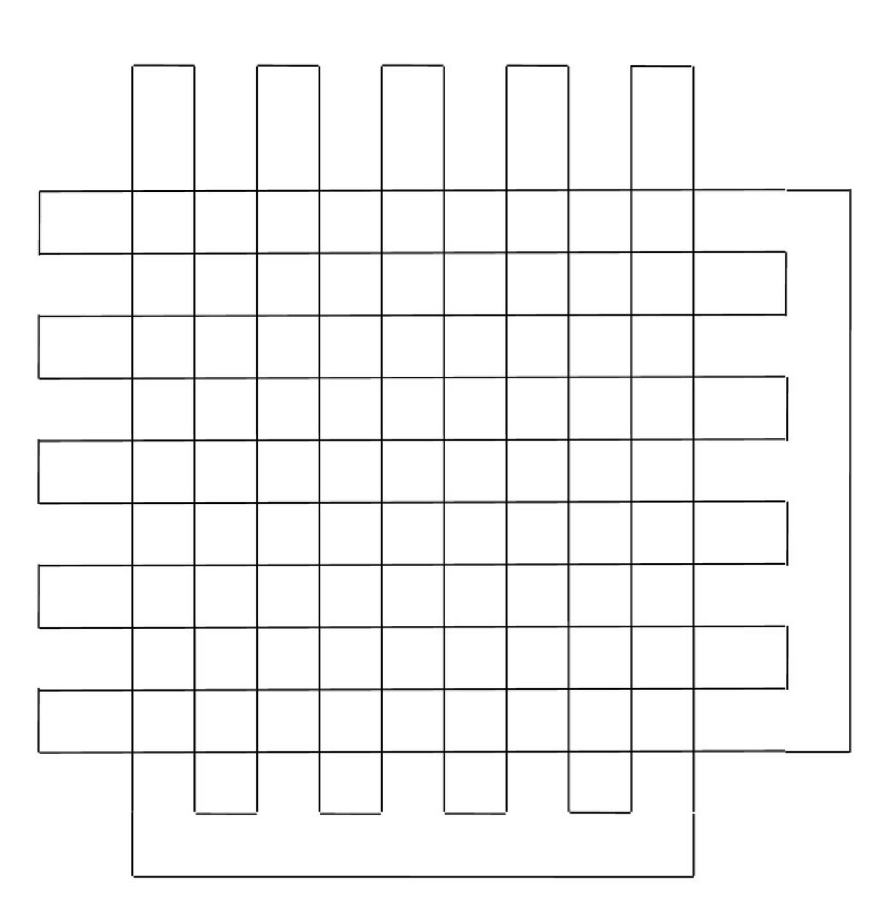
Intersection of two polygons
Determination of intersections may require
O((m + n + I)log (m + n)) time, where m and n
denote the size of the polygons and I is the number of intersections
I could be O(m.n)
Naïve time complexity by direct checking each edge-pair: O(m.n)
P
Q

Slide 36
Intersection of two convex polygons

Slide 37
Intersection of two convex polygons
Every intersection point must appear on the boundary of P∩Q
Computing intersection points is not enough; we also need to identify the “intersected” portion (golden region)

Slide 38
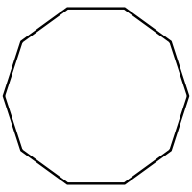
Intersection of two convex polygons
Compute R = P∩Q
Time Complexity for computing intersections of n line segments:
O(n log n + I log n); I: # intersec.
Each edge of a convex polygon can intersect with at most two edges of the other polygon
⇒ # total intersections = O(m + n)
# vertices in R is at most (m + n)
Size of the sweep-line status is at most 4
Size of the event queue is O(1); at most 8
⇒ Time Complexity for computing intersecting points of two convex polygons: O(m + n)
Q: n-gon
P: m-gon
sweep-line
Ref: David Mount’s Lecture Notes

Slide 39
Intersection of two simple polygons
Assume: intersected portion is connected (always true for convex polygons)
Start from an intersection point
Always take the rightmost move while traversing boundaries CW

Slide 40
Intersection of two simple polygons
Assume: intersected portion is connected (always true for convex polygons)
Start from an intersection point
Always take the rightmost move while traversing boundaries CW

Slide 41
Intersection of two simple polygons
Assume: intersected portion is connected (always true for convex polygons)
Start from an intersection point
Always take the rightmost move while traversing boundaries CW

Slide 42
Intersection of two simple polygons
Assume: intersected portion is connected (always true for convex polygons)
Start from an intersection point
Always take the rightmost move while traversing boundaries CW

Slide 43
Intersection of two Convex Polygons: Second Method
P∩Q can be computed in O(m + n) time
The upper and lower chains of P and Q are x-monotone; In O(m+n) time, merge four sorted vertex-lists to form an x-sorted order of m+n vertices;
Sweep a vertical line from L → R, thus partitioning the plane into m+n-1 vertical slabs; The intersection of each slab with P or Q is a trapezoid; The two trapezoids within a slab can be intersected in O(1) time; Hence, we can obtain P∩Q in O(m+n) time
A convex polygon comprises two monotone chains
slab
P
Q

Slide 44
Union of two simple polygons
Assume: unified portion does not contain a hole (always true for convex polygons)
Start from an intersection point
Always take the leftmost move while traversing boundaries CW

Slide 45
Map Overlay
⊗
⇒
To solve map overlay questions, we need to represent subdivisions
A planar subdivision is a structure induced by a set of line segments in the plane that can only intersect at common endpoints. It consists of vertices, edges, and faces
Representation: DCEL

Slide 46
Intersections and Map Overlay
How do we organize a planar subdivision for easy access to useful information?
How to tell that objects A, B, E create a hole? Which edges bound that hole?
The planar subdivision, or planar straight line graph (PSLG), is the embedding of a geometric graph

Slide 47
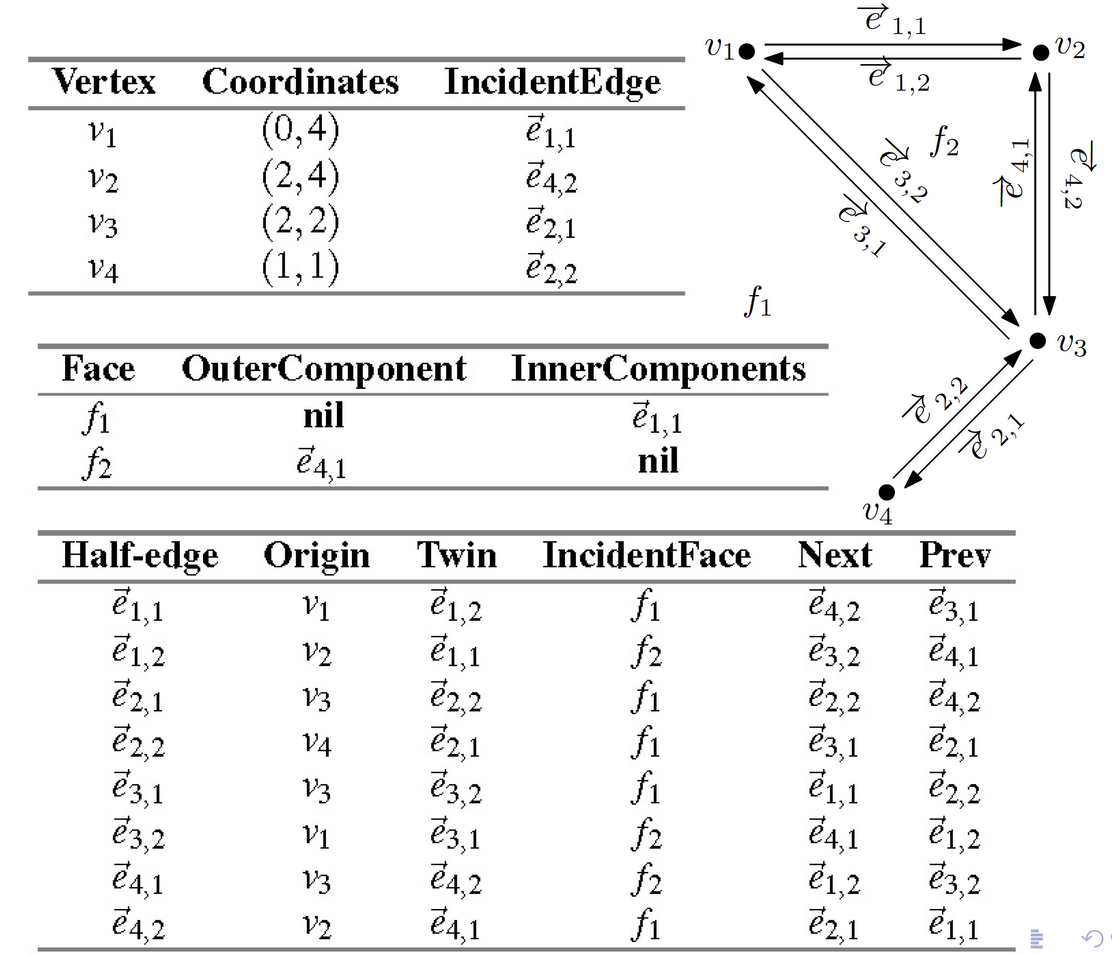
Example DCEL

Slide 48
Doubly-Connected Edge Lists (DCEL)

Slide 49
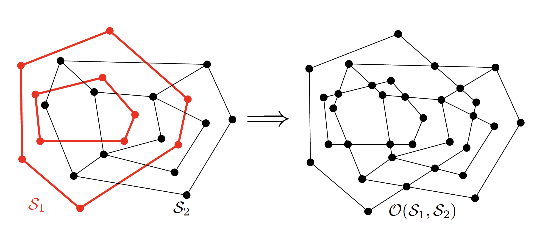
Computing the Overlay
Input: DCEL for S₁ and DCEL for S₂
Output: DCEL for the overlay of S₁ and S₂
Ref: 4A Textbook

Slide 50
Computing the Overlay
Initialization: copy the DCEL for S₁ and S₂
These are then “merged” into one

Slide 51
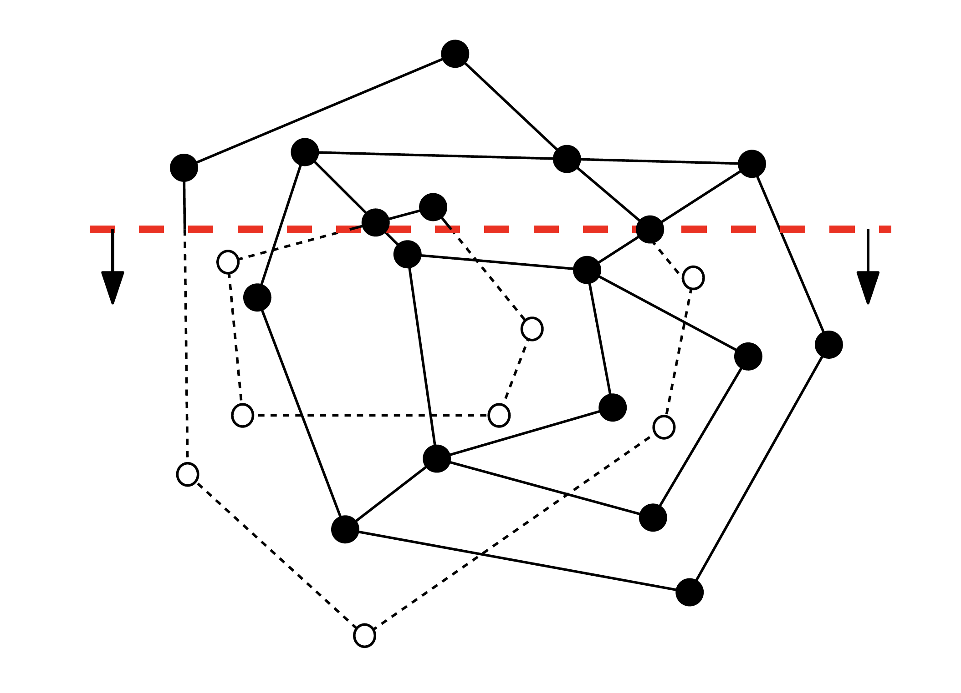
Use the plane-sweep algorithm
Plane-sweep as in line-segment intersection
Status: the edges of S₁ and S₂
intersecting the sweep line in the
left-to-right order;
Events happen:
at the vertices of S₁ and S₂;
at intersection points from S₁ and S₂

Slide 52
Event Management using DCEL
For each intersection event, add a new vertex to the merged DCEL

Slide 53
Overlay Events

Slide 54
Overlay Events

Slide 55
Overlay Events

Slide 56
Overlay Events

Slide 57
Overlay Data Structure

Slide 58
Overlay Face Updating

Slide 59
Overlay Face Updating
outer component of face f
f
inner component
of face f
Determine the leftmost vertex of each inner boundary cycle;
Determine the edge horizontally left of it, take the downward half-edge and its cycle to set InnerComponents;
Set IncidentFace for half-edges to inner-boundary cycle;
Ref: 4A Textbook

Slide 60
Analysis
n: sum of the complexities of input DCELs

