Slide 1
CS60064 Spring 2022 Computational Geometry
Instructors
Bhargab B. Bhattacharya (BBB)
Partha Bhowmick (PB)
Lecture #15
09 February 2022
Indian Institute of Technology Kharagpur
Computer Science and Engineering
Notes:
Good Morning!
The title of today’s talk is “On some Planar Partitioning Problems”.

Slide 2
Map Overlay
⊗
⇒
To solve map overlay questions, we need to represent subdivisions
A planar subdivision is a structure induced by a set of line segments in the plane that can only intersect at common endpoints. It consists of vertices, edges, and faces
Representation: DCEL

Slide 3
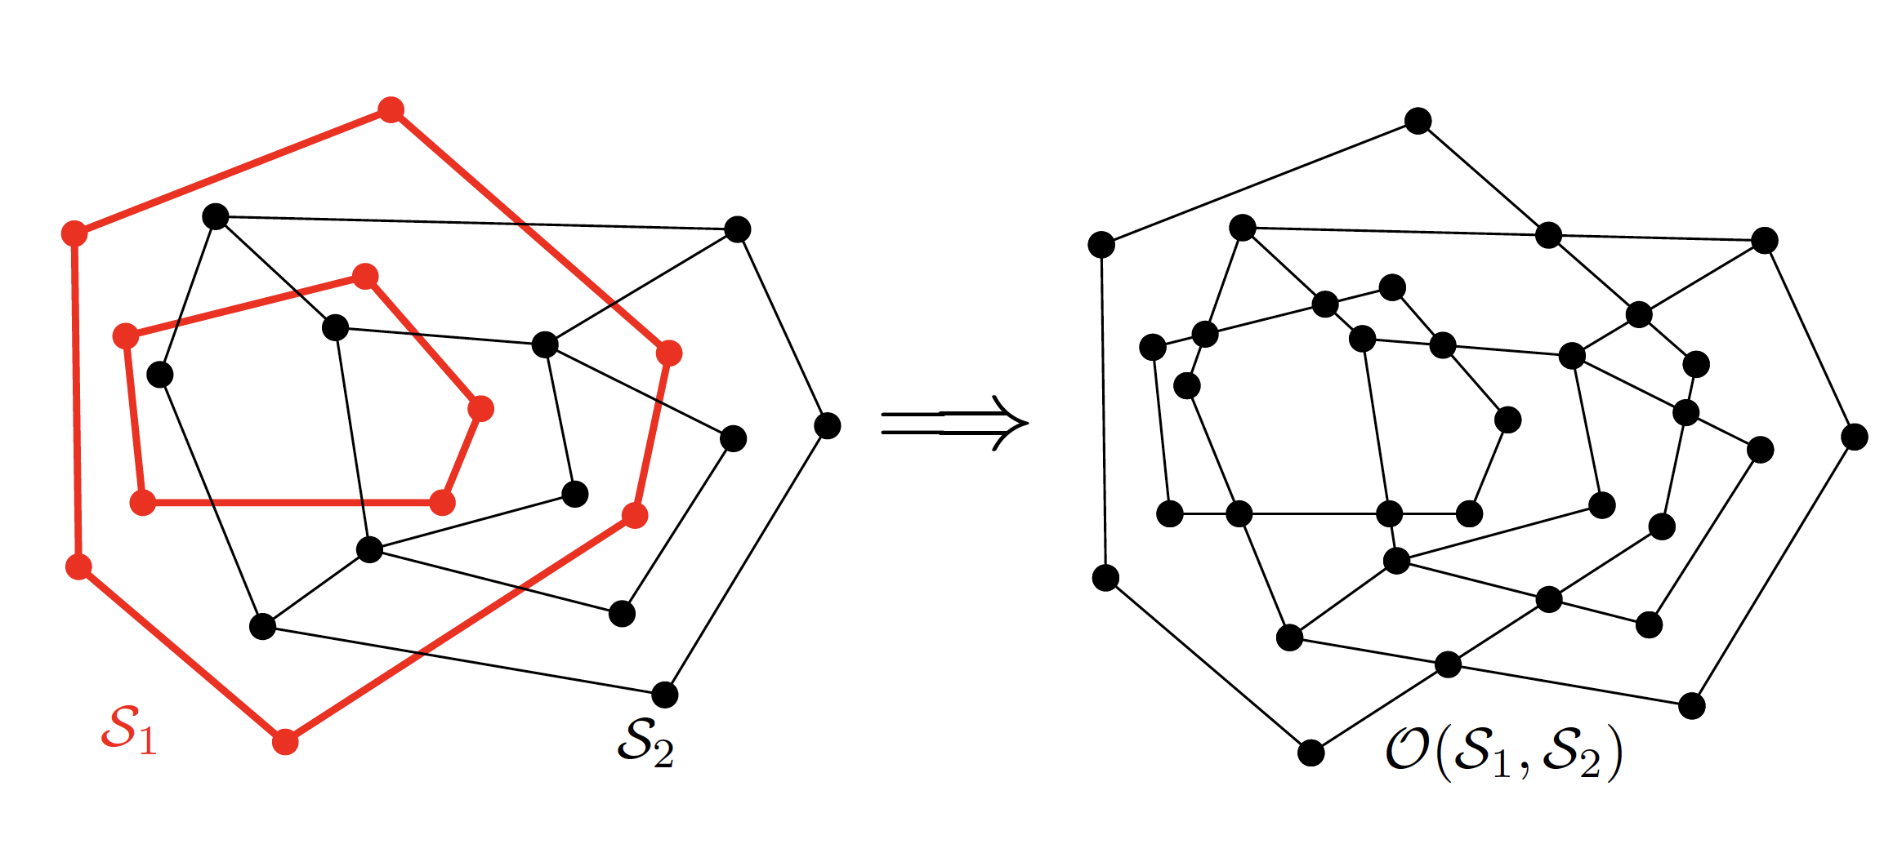
Computing the Overlay
Input: DCEL for S₁ and DCEL for S₂
Output: DCEL for the overlay of S₁ and S₂
Ref: 4A Textbook

Slide 4
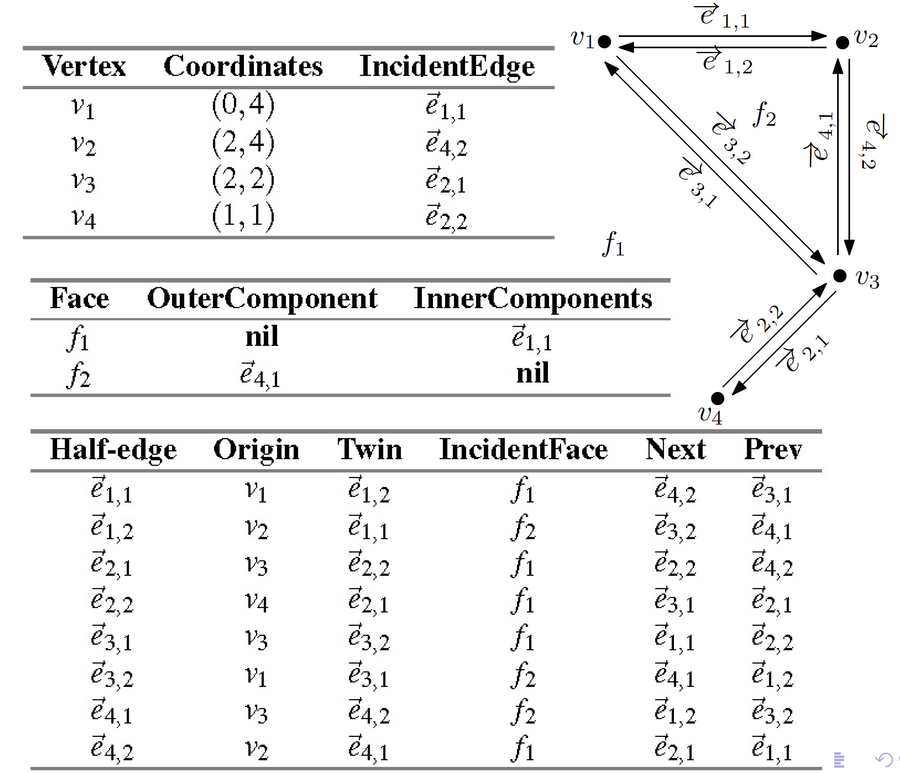
Example DCEL

Slide 5
Computing the Overlay
Input: DCEL for S₁ and DCEL for S₂
Output: DCEL for the overlay of S₁ and S₂
Ref: 4A Textbook

Slide 6
Computing the Overlay
Initialization: copy the DCEL for S₁ and S₂
These are then “merged” into one

Slide 7
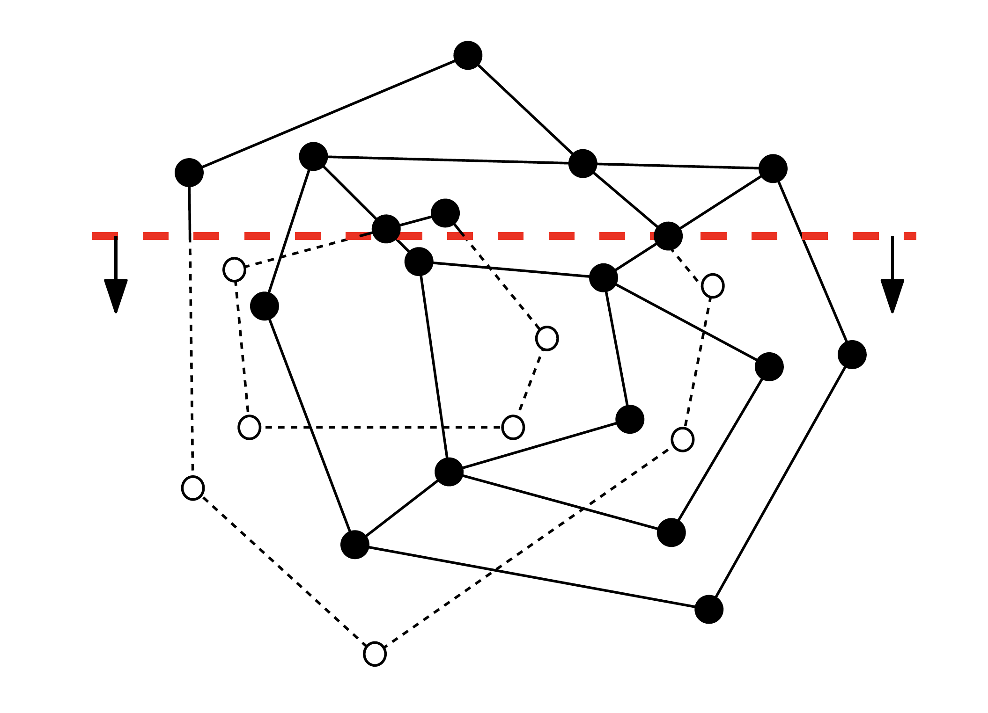
Use the plane-sweep algorithm
Plane-sweep as in line-segment intersection
Status: the edges of S₁ and S₂
intersecting the sweep line in the
left-to-right order;
Events happen:
at the vertices of S₁ and S₂;
at intersection points from S₁ and S₂

Slide 8
Event Management using DCEL
For each intersection event, add a new vertex to the merged DCEL

Slide 9
Overlay Events

Slide 10
Overlay Events

Slide 11
Overlay Events

Slide 12
Overlay Events

Slide 13
Overlay Data Structure

Slide 14
Fixing the Incident Face for a Half-Edge in the Overlay Data Structure
√
√
?
# faces = ?
= 1 + (#directed cycles)/2
Incident face for
f₂
Incident face for
f₃
How do we know whether a cycle is an outer boundary or the inner boundary of a face?
f₁
f₂
f₃
- Given a half-edge (e), determine the directed cycle following half-edges;
- Find the vertex with the least value of x (or y);
If the turning angle < π, then e is outer component of the incident face; otherwise (when > π) e is an inner component

Slide 15
Fixing the Incident Face for a Half-Edge in the Overlay Data Structure
f₁
f₂
f₃
?
How do we know whether a cycle is an outer boundary or the inner boundary of a face?
How do we know whether the incident face for the half-edge
is same as the incident face of the half-edge ? Both are f₂
For each cycle, note the leftmost and rightmost x-values. Move a vertical sweep-line from L → R; Use orientation test to decide whether an inner vertex lies within the cycle; if so merge the label of the face defined by the inner boundary; finish processing this face when the rightmost vertex of this cycle is crossed

Slide 16
Overlay Face Updating

Slide 17
Overlay Face Updating
outer component of face f
f
inner component
of face f
Determine the leftmost vertex of each inner boundary cycle;
Determine the edge horizontally left of it, take the downward half-edge; the InnerComponents of the corresponding face is set;
Set IncidentFace for half-edges accordingly;
Ref: 4A Textbook

Slide 18
Analysis
n: sum of the complexities of input DCELs

Slide 19
Boolean Operations on Polygons
The same overlay algorithm can be used for polygon operations;
Boolean operations on two
polygons with a total of n vertices take O(nlogn+klogn) time, where k is the number of intersection points
Ref: 4A Textbook

Slide 20
Problem of the Day
Problem: Given a set P of n points on the 2D plane, find the minimum-area rectangle R that encloses P
R
Claim: R must touch at least one of the edges of the convex hull of P

Slide 21
CS60064 Spring 2022 Computational Geometry
Instructors
Bhargab B. Bhattacharya (BBB)
Partha Bhowmick (PB)
Lecture #16 & Lecture #17
11 February 2022
Indian Institute of Technology Kharagpur
Computer Science and Engineering
Notes:
Good Morning!
The title of today’s talk is “On some Planar Partitioning Problems”.

Slide 22
Problem of the Day
Problem: Given nine random points on the plane in general positions, show that there always exists a convex pentagon!
1933: Budapest, Hungary
Esther Klein gave a puzzle to George Szekeres and Paul Erdős
f(3) = 3;
f(4) = 5;
f(5) = 9;
f(5) > 8;
2006: Szekeres and Peters: f(6) = 17
The value of f(N) is still unknown for all N > 6
1935 Erdős-Szekeres: f(n) < 4^{n - o(n)} 1960 Erdős-Szekeres Conjecture: f(n) > 2^{(n–2)} + 1
f(n): the smallest number of points, an arrangement of which always contains a convex n-gon
2016: Andrew Suk: f(n) = 2^{n+ 6n^(2/3) log n}
Erdős-Szekeres Problem of Convex Polygons

Slide 23
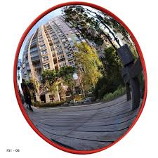

Agenda
Convex Hulls: Management of Corners
At any street corner the feeling of absurdity can strike any man in the face.
-- Albert Camus, The Myth of Sisyphus (1942)

Slide 24
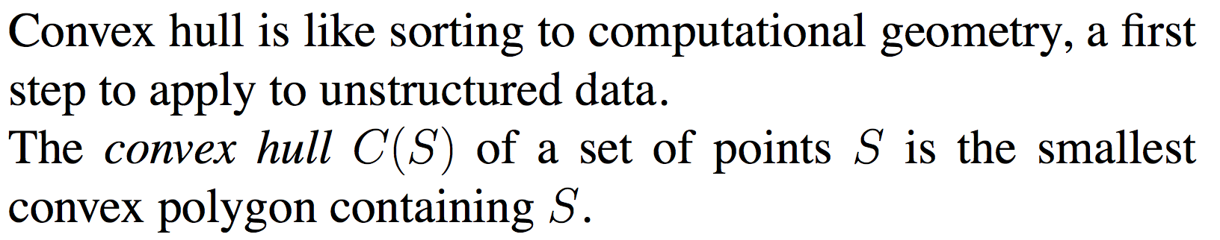
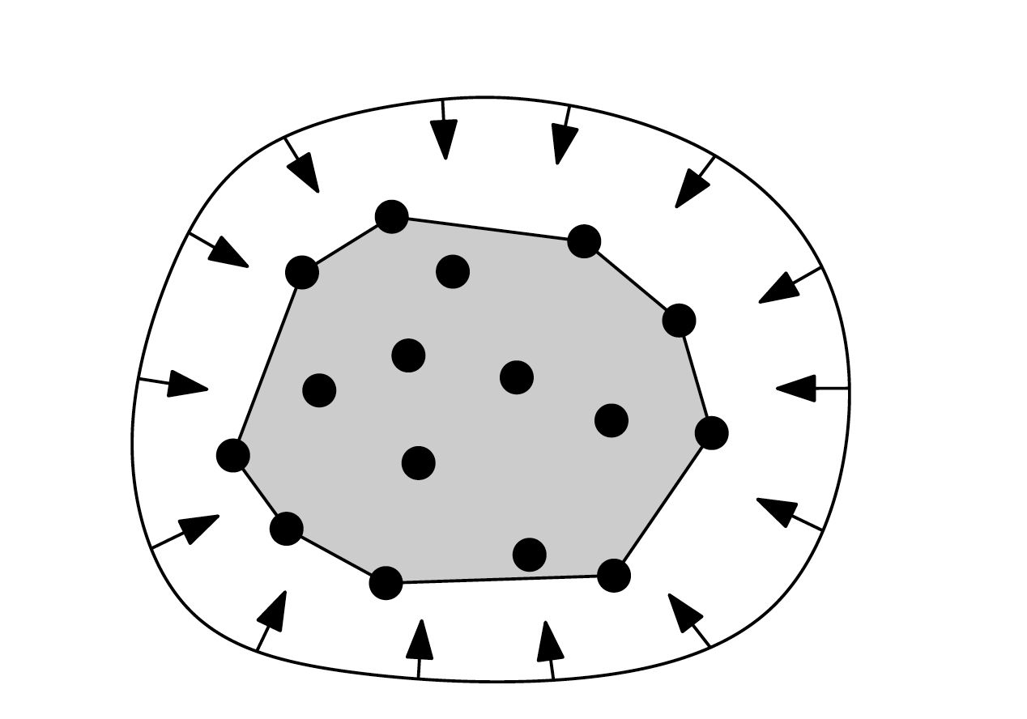
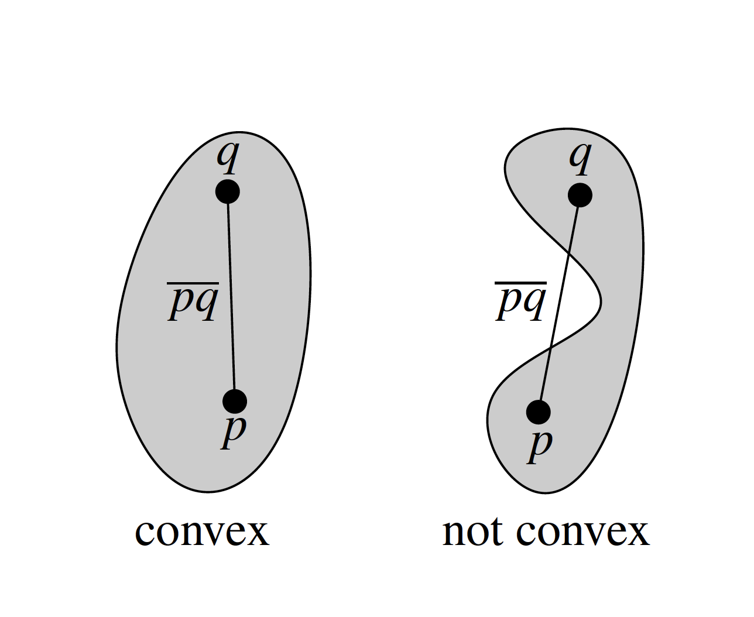
Convex Hulls
Convex hull of
a polygon
3D hull of
an object
Convex hull of
a point-set
A set C ⊆ R² is convex if for every two points p,q∈C, the line segment pq is fully contained in C

Slide 25
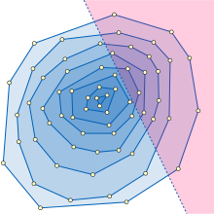
Convex Layering: Onion Peeling
q
Data depth statistics
Concentric hulls
data-depth(q) = 5

Slide 26
Convex hull as intersection of convex supersets
The convex hull CH(P) of a point set P ⊆ R² is the smallest convex set C ⊇ P. In other words CH(P) = ∩ C
C ⊇ P C convex
P
Courtesy: Carola Wenk

Slide 27
Convex hull as union of convex subsets
Let S be a set of n points on the plane

Slide 28
Convex hull as union of convex subsets
Let S be a set of n points on the plane

Slide 29
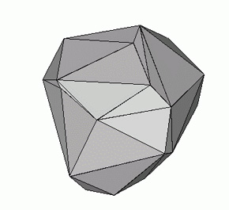
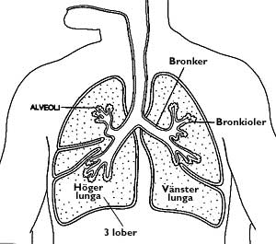
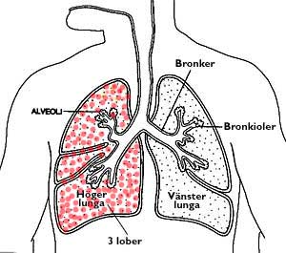
Convex Hull in Biomedical Applications
Patients are asked to inhale gaseous nano-bots ⇒ these fluorescent sensors provide their 3D coordinates via imaging ⇒ compute 3D convex hull ⇒
volume of hull ∝ lung size!

Slide 30

Moving a Sofa Through a Corridor
Sufficiency: If the convex hull of the sofa avoids collision with obstacles, so does it ⇒ robot movement avoiding obstacles

Slide 31
Convex Hulls

Slide 32
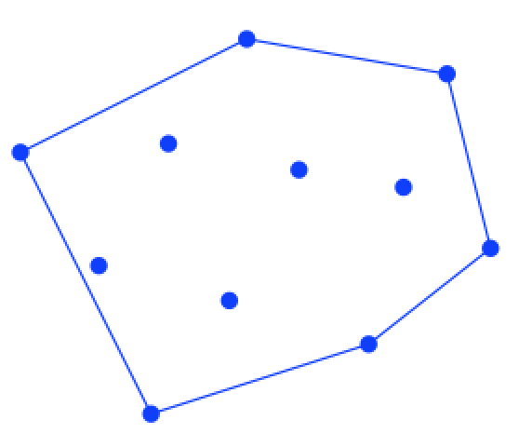
Convex Hull
Let S be a set of n points on the plane
A point p is an extreme point if ∃ a line L(p) through p such that all the remaining points strictly lie on one side of L(p);
An extreme line passes through two points such that the remaining points lie on one side
A point q is an interior point if any line through q splits the point set
A point b is a boundary point if it is not an extreme or an interior point
The vertices of Convex_Hull(S) comprises only the extreme points of S; its edges coincide with the extreme lines only
extreme point
L(p)
p
q
extreme
line
interior point
b
boundary
point

Slide 33
Convex Hull
Let S be a set of n points on the plane

Slide 34
Convex Hull
Let S be a set of n points on the plane

Slide 35
Convex Hull
Let S be a set of n points on the plane
convex-hull: polygon whose vertices are extreme points

Slide 36
Convex Hull
Let S be a set of n points on the plane
Notes:
robins

Slide 37
Convex Hull: Mechanical Analogy
Hammer nails on the points perpendicular to plane;
Stretch elastic rubber band to surround them tightly
• Shortest (perimeter) fence surrounding the points
• Smallest (area) convex polygon enclosing the points

Slide 38
Properties of Convex Hull
p_{k}
p₁
p(x, y)
p₂

Slide 39
Convex Hull: Easy Try
Observation 1:
Edges of convex hull of P connect pairs of points in P
Observation 2:
iff Orient (A, B, C)
n points
B
A
C
if Orient (A, B, C)
Complexity: O(n³)

Slide 40
Convex Hull: Easy Try
iff Orient (A, B, C)
Retain only those edges that pass the unilateral Orientation Test

Slide 41
Improved Technique: Quick Hull Algorithm
Find four extremal points (leftmost, rightmost, topmost, bottom-most) to define Q
Q
1. Form initial quadrilateral Q, with left, right, top, bottom; they will be hull vertices. discard points inside Q
2. Recursively, a convex polygon, with some points “outside” each edge
3. For an edge ab, find the farthest outside point c; c will be a hull vertex; discard points inside triangle abc
4. Split remaining points into “outside” points for ac and bc
5. Edge ab on CH when no point outside

Slide 42
Analysis: Quick Hull Algorithm
1. Initial quadrilateral phase takes O(n) time
2. T(n): time to solve the problem for an
edge with n points outside
3. Let n₁, n₂ be sizes of subproblems. Then,
4. Analogous to QuickSort; Likewise, this has expected running time complexity O(n log n), but worst-case time O(n²)
n₂
n₁

Slide 43

Gift Wrapping: Jarvis March
Main Idea
Find a point p₁ on the convex hull (e.g. the lowest point)
Rotate counter-clockwise a line through p₁ until it touches one of the other points (start from a horizontal orientation)
Repeat until you reach p₁ again
Analogous to selection sort
p₁

Slide 44
Gift Wrapping: Jarvis March
Implementation
Compute angle between current line and all remaining points;
Pick the vertex with smallest angle
Repeat until you return to the initial point
Time complexity O(n.h), where n is the input size and h is the number of vertices on the convex hull (output sensitive); 3 < h < n; Worst case O(n²).
Space: O(n)
p₁

Slide 45
Gift Wrapping: Jarvis March
Implementation
Compute angle between current line and all remaining points;
Pick the vertex with smallest angle
Repeat until you return to the initial point
p₁
delete
Some pre-processing idea that is useful for practical implementation

Slide 46
Faster Algorithm: Graham Scan
Based on the basic idea of “orientation”:
When we travel along the boundary of convex polygon in CCW (CW), we always take left (right) turn!

Slide 47
Faster Algorithm: Graham Scan
We know that the leftmost given point has to be in the convex hull
Fix the origin at the leftmost point (assume unique)
All other points have positive x coordinates
Sort the points in increasing order of y/x, i.,e., angular sorting
Incrementally construct the convex hull using a stack and
Orientation test
Complexity: O(n log n)

Slide 48
Graham Scan
Points are numbered in increasing order of y/x (angular sorting)

Slide 49
Graham Scan
start from the origin and add first two points (0, 1) on the
running hull; this edge will always be on the hull
0

Slide 50
Graham Scan
Adding point 3 causes a consecutive triple 1-2-3, with a right-turn at the concave corner 2; right-turns not allowed in CCW traversal!
this can be checked by Orientation Test; corner 2 cannot be on the hull; remove 2, add direct edge (1, 3)
0

Slide 51
Graham Scan
… add direct edge between (1, 3)
0

Slide 52
Graham Scan
Adding point 4 to the chain causes a right-turn, remove 3
0

Slide 53
Graham Scan
Remove 3 and add direct edge (1, 4)
0

Slide 54
Graham Scan
Continue adding points as long as we see left-turns, i.e., convex corners …
0

Slide 55
Graham Scan
Right-turn again, concave corner ..remove 6, add (5, 7)
0

Slide 56
Graham Scan
.. after adding (5, 7), bad corner still remains at 5; remove 5, add
edge (4, 7)
0

Slide 57
Graham Scan
… remove 5, add edge (4, 7)
0

Slide 58
Graham Scan
Continue adding edges … all convex .. Done!
0

Slide 59
Main Idea: Graham Scan
We will construct a convex chain of the given points
– For each i, do the following:
– Append point i to the current chain
– If the new point causes a concave corner, remove it from
the chain
– Repeat until the new chain becomes convex

Slide 60
Algorithm: Graham Scan
Set the leftmost point as the origin, and angularly sort the rest of the points in increasing order (of y/x)
Initialize stack S: push p_{i} in stack, for i = 0, 1;
For i = 2, . . . , n – 1,
– Let A be the second topmost element of S, B be the topmost
element of S, and C be the i ^{th} point
– If Orient(A,B,C) < 0, pop S and go back
– Push C to S
Return S; Points in S form the convex hull
Complexity: O(n log n) for sorting, O(n) for the rest;
Each point is pushed onto the stack once, and popped out of it at most once! Space: O(n)

Slide 61
Sort-Hull Algorithm: Same time complexity
sweep-line
Sort the vertices w.r.t. x-coordinates and use a vertical sweep-line; construct convex chains for the upper hull and lower hull in two passes
– For each i, do the following:
– Append point i to the current chain
– If the new point causes a concave corner, remove it from
the chain
– Repeat until the new chain becomes convex
– Use stack as before for implementation; time complexity: O(nlog n)

Slide 62
Divide and Conquer
x-sort all points ⇒ O(nlog n)
Recurrence for time complexity:
T(n) = 1 if n < 3
= c.n + 2T(n/2), otherwise
T(n) = O(nlog n)
Assuming computation of upper and lower tangents and unification of the two can be done in O(n) time at every step
upper tangent
lower tangent
Main idea:
Divide a set of points into two subsets by a vertical line at the median x-coordinate of the points;
Compute the convex hull for each subset recursively;
Merge the two convex hulls into one convex polygon;
- Find two external tangent lines to merge them
Analogous to merge sort

Slide 63
Divide and Conquer
A step required in the divide-and-conquer algorithm:
Given a polygon P and a line L joining a point q and a vertex v of P, determine whether L is a tangent to P at v
O(1) by Orientation Test
Note:
Two tangents must be distinct for non-trivial cases
The two tangents can also be discriminated using Orientation Test
L
v
convex n-gon P

Slide 64
Merging
separating
tangent
B
A
Find upper and lower tangent (outer tangents)
CH(A∪B) can be computed from CH(A) and CH(B) in O(n) time

Slide 65
Finding the outer tangents
Finding the lower tangent:
a = rightmost point of A
b = leftmost point of B
while L= ab not lower tangent to both convex hulls of A and B do{
while L not lower tangent to convex hull of A do{ a = a -1 } while L not lower tangent to convex hull of B do{ b = b + 1 } }
B
3
A
4: b
2
4
3
5
5
a: 2
6
1
7
1
0
0
check with orientation test O(1)
Tangent finding and merging: O(n)

Slide 66
Divide and Conquer
x-sort all points ⇒ O(nlog n)
Recurrence for time complexity:
T(n) = 1 if n < 3
= c.n + 2T(n/2), otherwise
T(n) = O(nlog n)
Note that the computation of upper and lower tangents and unification of the two can be done in O(n) time at every step
B
A
Main idea:
Divide a set of points into two subsets by a vertical line at the median x-coordinate of the points;
Compute the convex hull for each subset recursively;
Merge the two convex hulls into one convex polygon;
- Find two external tangent lines to merge them
Analogous to merge sort

Slide 67
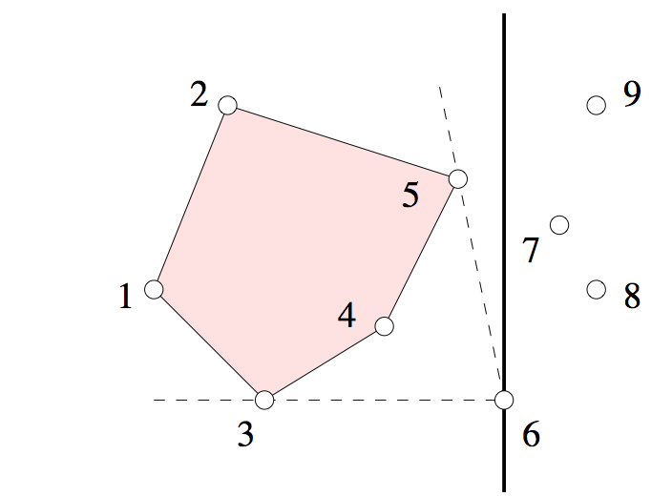
Incremental Convex Hull (also online algorithm)
x-sort n points and move a vertical sweep-line halting at points ⇒ O(nlog n)
We have CH on k – 1 points and now processing the k-th point (e.g. p₆); initially draw Δ123
Draw tangents on CH(k-1) from point k; delete all interior points (e.g. 4) that lie in the pocket
Update the convex hull
tangent from p₆
tangent
from p₆
sweep-line

Slide 68
Analysis: Incremental Convex Hull
x-sort n vertices and move a vertical sweep-line halting at points ⇒ O(nlog n)
We have CH on k – 1 points and now processing the k-th vertex (e.g. p_{k});
Draw tangents on CH(k-1) from point p_{k}; delete all interior points that lie in the pocket
Update the convex hull
v_{t}
succ(p_{k-1})
p_{k}
L
p_{k-1}
pred(p_{k-1})
v_{b}
Analysis:
Draw a line L passing through p_{k} and p_{k-1}; If L is a tangent, record it and find the other tangent by following either pred(p_{k-1}) or succ(p_{k-1}); otherwise traverse along the direction of both pred(p_{k-1}) or succ(p_{k-1}) until you find the two tangents;
While performing tests for tangency (O(1) per vertex) and delete the points which do not satisfy tests;
Total number of checks for tangency and deletions from pockets over all iterations is at most (n -3); Overall time complexity ⇒ O(nlog n) + O(n) ⇒ O(nlog n)

Slide 69
Lower bound on convex hull time complexity
s²
Algorithm CH_Sort(S):
/* Sorts a set of numbers using a convex hull algorithm
Converts numbers to points, runs CH, converts back to sorted sequence */
Input: Set of numbers S ⊆ R
Output: A list L of numbers in S sorted in increasing order
P = ∅
for each s∈S insert (s, s²) into P
L’ = CH(P) // compute convex hull
Find point p’∈P with minimum x-coordinate
for each p=(p_{x},p_{y})∈L’, starting with p’, add p_{x} into L
return L
s
-4
-2
1
4
5
Goal: sorting of numbers
Map a number s → (s, s²) in 2D
Construct the convex hull
Traverse L → R along the lower chain ⇒ sorted sequence
Thus, sorting ⇒ CH; since all other operations need linear time, any convex hull algorithm has to take Ω(n log n) time in the worst case;
More refined bound: Ω(n log h), where h: #hull vertices

Slide 70
Convex Hull: Summary So Far
Brute force algorithm: O(n³)
Quick-Hull: O(n²)
Jarvis’ march (gift wrapping): O(nh)
Incremental insertion: O(n log n)
Divide-and-conquer: O(n log n)
Graham’s scan: O(n log n)
Lower bound: Ω(n log n)
Can you improve it further (output-sensitive), e.g. O(n log h), where h: #hull vertices ?

Slide 71
Homework Set - 03

Slide 72
Announcement of Online Test - 01
Friday, 25 February, 2022; 11:05 am - 12:50 pm
Coverage: Polygons, point-inclusion queries, orientation test, robustness issues, polygonization, diagonals, triangulation, convex partition, art-gallery problems, DCEL, intersections, map overlay, convex hull, related algorithms, data structures, and complexities (material covered until 18 February 2022);
Questions will be made available through Moodle and answers should also be submitted via Moodle. The submission server will open at 10:55 am and close at 1:05 pm, 25 February 2021.
Credit: 25%

