Slide 1
CS60064 Spring 2022 Computational Geometry
Instructors
Bhargab B. Bhattacharya
Partha Bhowmick
16 February 2022
Lecture #18
Indian Institute of Technology Kharagpur
Computer Science and Engineering

Slide 2
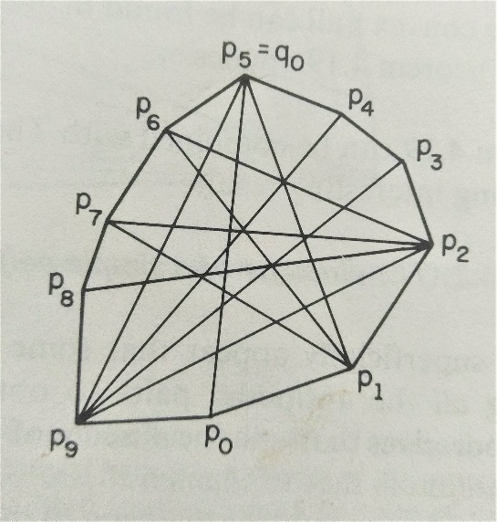
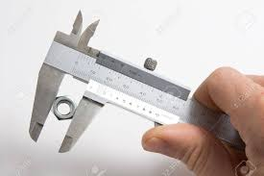
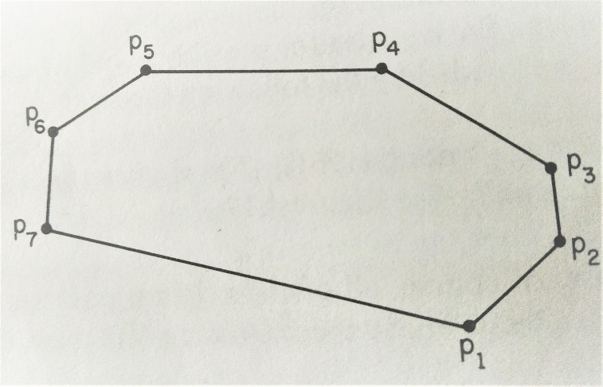
Problem of the day:
Find the farthest pair of points
diameter of a point set (|n|)
Claim: Farthest pair on a convex hull must be antipodal points
O(n)
O(nlog n)
Naïve: O(n²)
unlike circles, a tangent to a polygon through a vertex is not unique
Rotating-calipers algorithm
not antipodal
(p₄, p₆)
antipodal pairs (p₁, p₄), i.e, they admit parallel tangents (lines of support)

Slide 3
Antipodal Points
Antipodal pairs of a set S must be extreme points and therefore must be the vertices of CH(S)
Rotating Calipers (Shamos)
by marching along the hull
L₁ or L₂ is rotated
Farthest or nearest pairs between two parallel lines of support can thus be found in O(n) time

Slide 4
2D Convex Hull: Summary
Brute-force algorithm: O(n³)
Quick hull: O(n²)
Jarvis’ march (gift wrapping): O(nh); output-sensitive
Incremental hull: O(n log n)
Divide-and-conquer: O(n log n)
Graham’s scan: O(n log n)
Lower bound: Ω(n log n)
Chan’s algorithm: O(n log h);
output-sensitive;
Convex hull of a simple polygon/poly-chain with n vertices: ?

Slide 5
CH of a simple polygonal chain
A. Melkman, On‐line Construction of the Convex Hull of a Simple Polyline,
Information Processing Letters, Vol. 24, pp. 11‐12, 1987; O(n)-time algorithm

Slide 6
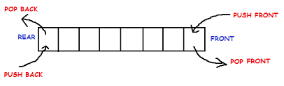
Melkman’s Algorithm: Key Ideas
v_{i}
remove
Double-ended queue (deque)
Process the poly-chain/polygon sequentially:
v₀ , v₁, …, v_{i – 1}… , and construct incremental hull;
let d_{b} = d_{t} = last vertex that is added to the hull;
let the next vertex be v_{i}; can we draw tangents and proceed as in incremental hull? partial hull is stored as “deque”
Q1: Where can v_{i} appear??
Q2: Why deque??
push
v_{i}
bottom
top
pop
insert
d_{b} = d_{t}
v_{i – 1}
v_{i}
Maintain the current hull in a queue;
Consider the last vertex that is added to the hull (i,e., d_{b} = d_{t})
Use Orientation tests w.r.t. two edges (d_{t-1}, d_{t}) and (d_{b}, d_{b+1}) only, to check the position of the current vertex v_{i};
If v_{i} lies in the interior, do nothing;
Else keep on popping/deleting from the queue based on the test, and update the hull by pushing/inserting v_{i} when tests flag convexity;
Repeat until the last vertex is processed
v_{i}
push v:
pop d_{t} : t ← t-1
insert v:
remove d_{b} : b ← b +1

Slide 7
Melkman’s Algorithm: Snapshots
remove
push
bottom
top
Double-ended queue (deque)
pop
insert
2
< 2, 0, 1, 2 >
< 2, 1, 0, 2 >
< 4, 2, 1, 0, 4 >
< 2, 1, 0, 2 >
deque
< 7, 0, 4, 5, 7 >
< 5, 1, 0, 4, 5 >
< 5, 1, 0, 4, 5 >
Final hull vertices in CCW
Courtesy: Joe Mitchell

Slide 8
Melkman’s Algorithm
If i = n, Exit
; If i = n, Exit
Assume all vertices are in general positions
On termination, the content of the deque read from L → R would provide the CCW-ordering of vertices on the CH; each vertex is processed O(1) times. Hence, time complexity: O(n)

Slide 9
CS60064 Spring 2022 Computational Geometry
Instructors
Bhargab B. Bhattacharya
Partha Bhowmick
18 February 2022
Lecture #19 & Lecture #20
Indian Institute of Technology Kharagpur
Computer Science and Engineering

Slide 10
Agenda Today
Problem of the day: Maximum-Containment Problem or MaxRS (Maximum Range-Search Query)
Convex hull: Chan’s Method
Bi-chromatic non-crossing matching using convex hull
Proximity problem: Closest-pair of points

Slide 11
Problem of the Day: Maximum-Containment Problem
F: A rectangle comprising n random points in general positions
P: A smaller rectangle with given aspect ratio
Max-containment: Find an isothetic position of P in F that encloses the maximum number of points (MaxRS)
Min-containment (MinRS): P should be fully contained in F and should enclose minimum number of points
P
F
Maximum containment of P: # points = 6
Assume: only translation of P is allowed
Minimum containment of P: # points = 2

Slide 12
Maximum-Containment Problem (MaxRS)
(Max-containment): find an isothetic position of P that encloses the maximum number of points in F
P
Naïve: O(n³) time
F
How?
Use line-sweep algorithm and determine
intersections of rectangles
Max-enclosure: find the maximum clique of the rectangle intersection graph ⇒ O(n log n)
Helly property

Slide 13
Convex Hull: Summary So Far
Brute force algorithm: O(n³)
Quick-Hull: O(n²)
Jarvis’ march (gift wrapping): O(nh)
Incremental insertion: O(n log n)
Divide-and-conquer: O(n log n)
Graham’s scan: O(n log n)
Lower bound: Ω(n log n)
CH for simple polygons/poly-chains: O(n)
Longstanding open question:
Is it possible to improve the time complexity of a convex-hull algorithm to O(n log h), where h: #hull vertices ?

Slide 14
Faster Algorithms (Output-Sensitive)
Kirkpatrick‐Seidel (1986): an O(n log h) worst-case algorithm
n: # vertices; h: # vertices on the hull
Chan (1996)*: O(n log h) algorithm - combines two slower methods (Jarvis March and Graham Scan)
Note:
Jarvis’ is good when h << n;
Graham’s is good when h ≈ n (i.e., reduces backtracks)
*Timothy Chan, “Output‐sensitive results on convex‐hulls,
extreme points, and related problems”, Discrete & Computational Geometry, Vol. 16, pp. 369‐387, 1996

Slide 15
Timothy Chan’s Algorithm (DCG, 1996)
Objective: Can we implement CH for an n-set
in O(n log h) time, where h denotes the number
vertices on the hull?
Note: Full sorting cannot be done!
Main Idea:
Integrate: Divide-and-Conquer (D&C), Graham Scan, and Jarvis March
Suppose we shatter (D&C) the point-set into r = ⎡n/m⎤ groups each having size “m”, m ≈ h
(convex hulls of these groups may not be disjoint)
Run Graham scan on each group ⇒ “log h” factor
Wrap these groups using Jarvis March
random shattering
sub-hulls may be intersecting
Problem: we do not know h!
size of each group should not be two small or too large!
Observation: Interior points within the convex hull of each partition cannot appear on the final hull; only a subset of their hull points can! Two-fold reduction: Discard interior points; also the hull points that do not satisfy tangency will not appear in Jarvis-M

Slide 16
Timothy Chan’s algorithm (1996): Key Ideas
Objective: Can we implement CH for an n-set in O(n log h) time, where h denotes the number vertices on the hull?
Basic Idea: Partition into smaller groups, and combine Graham scan and
Jarvis March
Problem: we need to choose a suitable size for each group! Assume each group has size m; during execution of the algorithm, we will fix m iteratively. Note that 1 < m < n; If m is too large or too small, we have no benefit;

Slide 17
Chan’s Algorithm
⎡
⎤
s
(1)
r groups, each of size m
A tangent to a convex m-gon from an external point can be found in O(log m) by binary search
(2)
|m|
r
h: number of
points on CH(P)
(1) & (2) ⇒
Find CH of each group
Unfortunately we do not know h and hence, m. Ideas?

Slide 18

First Part of Chan’s algorithm: Partial_Hull (P, m)
As if m is known via Little Birdie!
|m|
r
Jarvis
Run Jarvis March on r hulls: for i = 1 to r, do
Draw tangent from p_{k} to r-hulls and choose the one that first hits the sweep-line when rotated CCW with pivot at p_{k};
If p_{k+1} = p₁, then return the convex hull {p₁, p₂, …, p_{k}}
else m is too small, “try again” [for success, m > h]
Fact: m = 1 ⇒ the problem reduces to full Jarvis March
m = n ⇒ the problem reduces to full Graham scan

Slide 19
Finishing Chan’s algorithm: Analysis
How to choose m? use doubly-exponential search
|m|
Partial_Hull(P, m)
r
Referring to Exp. (2): Jarvis-M is being wrapped m times ⇒ thus for each value of t, the time including Graham’s and Jarvis’ becomes O(n log m)
⎡lg lg h⎤,
[Note that for success, m > h]
Hence, the running time
(ignoring constant factors) =
⇒ O(n log h)
Ref: David Mount’s Lecture Notes

Slide 20
Chan’s Algorithm: Example
24 points
4 groups each containing 6 points
CH
m = 6, h = 8
One iteration of gift wrapping: find tangents to convex hulls and take the one with the least slope; since m = 6, continue wrapping six times; however, Jarvis-M will not take you to the start vertex in six steps. More wraps are needed. Instead, m should be incremented, Graham’s and Jarvis’ be redone so as to construct the hull in m > h steps and to achieve the intended complexity results.

Slide 21
Non-Crossing Matching
Given n red and n blue points in the plane (no three collinear), compute a red-blue non-crossing matching
reduces matching cost
A non-crossing matching always exists;
Matching with minimum total length must be non-crossing

Slide 22
Non-Crossing Matching
Given n red and n blue points in the plane (no three collinear), compute a red-blue non-crossing matching
compute CH(R) and CH(B)
find a common tangent, say, rb
output (r, b) as a matching edge
remove points r, b
update convex hulls and iterate
Courtesy:
Subhash Suri, UCSB

Slide 23
Non-Crossing Matching
What if Red, Blue CHs are nested? No tangents can be drawn!
Split by a vertical line, creating two smaller, intersecting or disjoint hull problems; select tangents and iterate as before
[Hershberger-Suri ’92] gives optimal O(n log n) solution

Slide 24
Proximity Problem: Closest Pair of Points
Given n points on the plane determine the closest pair
l (median of x-values)
Can it be made in O(n log n)?
Naïve: O(n²) time
1D problem is easy; sort and check
2D problem: use Divide-and-Conquer
Courtesy:
Subhash Suri, UCSB

Slide 25
Closest Pair of Points
Given n points on the plane determine the closest pair
l (median of x-values)
interval {(l - δ), (l + δ)}
Is it
? Complexity still remains O(n²)!

Slide 26
Closest Pair of Points
R can contain at most six points!
⇒ # Overall tests < 6 × n/2 distance comparisons
l
P₂
Use some properties from discrete geometry: packing
Courtesy:
Subhash Suri

Slide 27
Closest-Pair Problem: Analysis
l
Ref: Preparata and Shamos, Computational Geometry
Analogous to merge sort

Slide 28
Announcement of Online Test - 01
Friday, 25 February, 2022; 11:05 am - 12:50 pm
Coverage: Polygons, point-inclusion queries, orientation test, robustness issues, polygonization, diagonals, triangulation, convex partition, art-gallery problems, DCEL, intersections, map overlay, convex hull, related algorithms, data structures, and complexities (material covered until 18 February 2022);
Questions will be made available through Moodle and answers should also be submitted via Moodle. The submission server will open at 10:55 am and close at 1:05 pm, 25 February 2021.
Credit: 25%

