Slide 1
CS60064 Spring 2022 Computational Geometry
Instructors
Bhargab B. Bhattacharya
Partha Bhowmick
02 March 2022
Lecture #22
Indian Institute of Technology Kharagpur
Computer Science and Engineering

Slide 2
Question: Given n points in the plane, do we have three points that are collinear?
Naive: O(n³) time
How about O(n² log n)?
Can we do better?
Is it do-able in O(n²) time?
Is this optimal?
Still open
3-Sum Hard:
Given n integers, does there exist a three-tuple whose sum is zero?
Today’s Topics
Arrangement
Duality

Slide 3
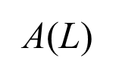
Problem of the Day: Smallest Isothetic Bounding Box
Given a set L of n straight lines in general positions, find the smallest axis-parallel rectangle B that encloses all intersection points.
This configuration is also called an arrangement A(L)
B
L: set of through lines, not line-segments
Complexity: Naïve O(n²)
Can we do better?
Sort the slopes of n lines;
Pick up consecutive pairs of lines on the sorted sequence (including the pair formed by the first and last one) and determine their intersection points ⇒ S′ ; |S′ | = n (including replicates);
Find the minimum and maximum x and y-values among them;
⇒ O(nlog n)

Slide 4
Defining Arrangements
The subdivision of the plane induced by a finite set L of lines is called the arrangement A(L);
All cells (faces) are convex;
A line arrangement is simple if no two lines are parallel and no three lines meet in a point;
Although lines are unbounded, A(L) may be imagined as a bounded object, e.g., a rectangular box B that contains all intersection points (vertices or points of A(L))
Arrangement A(L)

Slide 5
Arrangements and Duality
Arrangement A(L)
Duality of lines and points
“Only in love, are unity and duality not in conflict.”
-- Rabindranath Tagore

Slide 6
Arrangements
Representation: DCEL
Arrangements are useful in solving many problems in CG
simple arrangement A(L)
Let L be a set of n lines in 2D
L subdivides the plane into several regions, called cells (or faces) ⇒ polygonal subdivision of the plane; all faces are convex!
The edges of this subdivision are line segments
The vertices are intersection points between two lines of L
Such a subdivision, with vertices, edges and cells, is called the arrangement A(L) of L
Can also be defined for curves or in higher dimension

Slide 7
Simple Arrangements in 2D
Non-degeneracy assumptions
No two lines are parallel
No three lines intersect at one point
No line is vertical
The combinatorial complexity of an arrangement A(L) is the total number of vertices, edges, and faces in A(L)
Clear;
Clear;
Follows from Euler’s formula for planar graphs;

Slide 8
Constructing and Storing Arrangements
A(L): arrangement of n lines in general positions

Slide 9
CS60064 Spring 2022 Computational Geometry
Instructors
Bhargab B. Bhattacharya
Partha Bhowmick
04 March 2022
Lecture #23 & Lecture #24
Indian Institute of Technology Kharagpur
Computer Science and Engineering

Slide 10
Construction of Arrangements
Representation?
DCEL
Arrangement A(L)

Slide 11
Implementation of Arrangement A(L)
Consider incremental construction
of A(L):
L = {l₁, l₂, …, l_{i}, .. l_{n}}
A new line l_{i} arrives
Previous (i – 1) lines partition the
boundary of box B into 2(i – 1)
half-edges
Find the half-edge on B intersected by l_{i}
Face where l_{i} enters A(L): found in O(i) time
Trace through the boundary of the cell CCW to determine where l_{i} exits; Continue ….
l_{i}
l_{i} ∈ L
Bounding box B
Ref: DM Lecture Notes
Concern: At the i-th iteration, each facial traversal may take O(i) time, and covering O(i) faces ⇒ O(i²) ⇒ O(n³) for n lines!
Is it really cubic??

Slide 12
Zone of an Arrangement
Zone:
The zone of a line l ∉ L is the set of
cells in A(L) that intersect l
Understanding of the complexity of Zone(l) leads to an efficient construction of A(L)
Question:
What is the combinatorial complexity of the zone of a line l ∉ L in an arrangement A(L) of n lines? In other words, what is total number of
edges of all the cells in the zone intercepted by l ?
Is it linear or quadratic?
Note: Some lines of L may appear in several cells of the zone

Slide 13
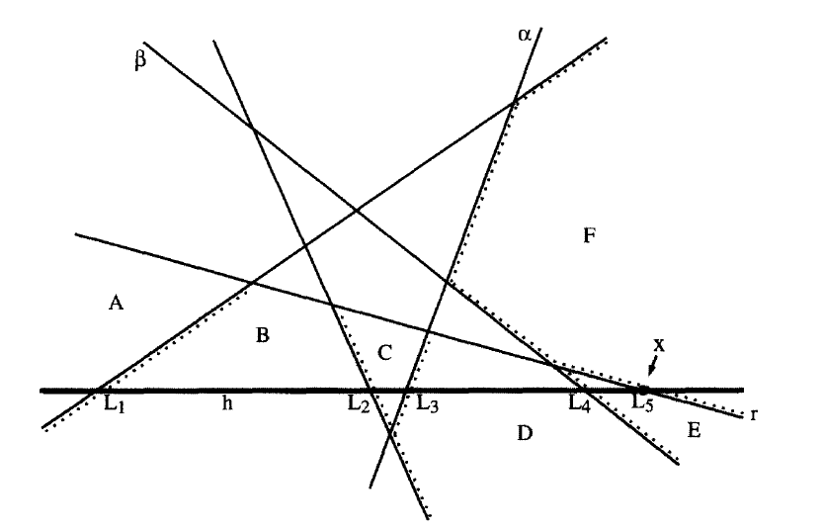
Zones in Arrangements: Example
Q. What is total number of edges of all the cells in the zone intercepted by l in an arrangement L of n lines?
Cells intercepted by line l ∉ L: Zone (l) = A, B, C, D, E, F
Edges that separate adjacent cells are counted twice
line l ∉ L
# edges in these cells =
2 + 4 + 3 + 4 + 2 + 4 = 19

Slide 14
Zone Theorem
Left-bounding and right-bounding edges are edges that bound a cell of the zone of L from the left and from the right, respectively

Slide 15
Zone Theorem: Proof
Consider incremental construction of A(L); L = {l₁, l₂, …, l_{i}, .. l_{n}}
l_{n} ∈ L; l ∉ L;
Complexity of Zone (l): ?
l ∉ L
Imagine l ∉ L is already there and we are
adding l_{i} ∈ L incrementally for i = 1, 2, .. , n;
When we insert l_{i} in A(L), two existing
left-bounding edges are split and one new
edge is created (depending on the slope of l_{i})
Additional at most 3 left-bounding edges (shown with red arrows)
Similarly, at most 3 right-bounding (shown with blue arrows)
l_{i} ∈ L
Thus, l_{i} contributes to Zone (l)
at most 6 new edges
Hence, Zone (l) has at most 6n edges
Ref: David Mount’s Lecture Notes
Zone Theorem:
The total number of edges of all the cells in Zone (l) in A(L), l ∉ L, is O(n)

Slide 16
Construction of Arrangement A(L)
Consider incremental construction
of A(L):
L = {l₁, l₂, …, l_{i}, .. l_{n}}
How the data structure used to store A(L) is updated when a new line l_{i} arrives?
By zone theorem, l_{i} will introduce at most 6(i – 1) edges
DCEL needs O(1) time for updating one cell (i.e., cell splitting)
i-th line l_{i} can be inserted in O(i) time
l_{i}
l_{i} ∈ L
Ref: David Mount’s Lecture Notes
Theorem: A(L) of n lines in the plane can be constructed in Θ(n²) time and space!

Slide 17
Implementation of Arrangement A(L)
l_{i}
l_{i} ∈ L
Bounding box B
Find the half-edge on B intersected by l_{i}
Face where l_{i} enters A(L): found in O(i) time
Trace through the boundary of the cell CCW to determine where l_{i} exits;
Zone theorem ⇒ # edges in all cells of Zone(l_{i} ) = 6(i-1)
⇒ update time O(i)
Ref: DM Lecture Notes
A(L) of n lines in the plane can be constructed in Θ(n²) time and space!

Slide 18
Incremental Construction of Arrangement A(L)
A(L) of n lines in the plane can be constructed in Θ(n²) time and space!
Ref: 4A Book

Slide 19
Generalized Zone
3-Zone(l)
2-Zone(l)
1-Zone(l)
0-Zone(l)
1-Zone(l)
2-Zone(l)

Slide 20
Introducing Duality of Lines and Points in 2D
The concept of duality can also be seen in
Hough Transform (due to P.V.C. Hough): used extensively in image analysis, computer vision, and digital image processing
Question:
In a set of n points, are there three collinear points?
Naive: tests all triples in O(n³) time;
Using point-pairs/slope: can be done in O(n² log n) time
Faster algorithm: O(n²)-time using arrangement and duality
Computational Geometry

Slide 21
Duality of Lines and Points in 2D
Primal plane
Dual plane
p_{x}
1
point ⇔ non-vertical line: x-coordinate ⇔ slope
y-coordinate ⇔ negative intercept
Property (Self inverse)
For any point p in the primal plane, (p*)* = p
For any line l of the primal plane, (l*)* = l

Slide 22
Incidence Preserving
p ⇒ (p_{x}, p_{y})
p* ⇒ y = p_{x}x - p_{y}
(l')*
l ⇒ y = slope(l)x + intercept
l'
p_{y} = slope(l)p_{x} + intercept
l* ⇒ (slope(l) , - intercept)
Property (Incidence Preserving)
For any point p on a line l in the primal plane, point l* will lie on line p* in the dual plane
Intersection of two lines in the primal ⇔ two dual points will be incident on the dual line p* of the intersection point p

Slide 23
Corollary: Incidence Preserving
dual
primal
l
l*
If points p₁, p₂, p₃, are collinear in the primal, there dual-lines
p₁*, p₂*, p₃* will be concurrent in the dual plane
Collinearity test:
Given a set of n points in 2D, determine whether any three are collinear;
n points ⇒ n lines in the dual ⇒ DCEL ⇒ O(n²)-time, O(n²)-space; or ⇒ O(n) space using topological plane sweep, without constructing the entire arrangement;
Alternatively, run line-intersection algorithm and report intersections of more than two lines: O(n log n + #I)-time ⇒ O(n log n + n²) ⇒ O(n²)-time;

Slide 24
Order Preserving, Vertical Distance Preserving
Point p lies below (above) line l if and only if point l* lies below (above) line p*
Duality preserves vertical distance

Slide 25
Geometry in the Primal and the Dual
p₃*
p₂*
p₄*
p₁*
x-coordinate of l* is the slope of l;
y-coordinate of l* is 0 because the intercept of l is 0
Mark the dual lines and dual points in the dual plane

Slide 26
Dual of a line segment
Primal plane
Dual plane

Slide 27
Extremal Levels in an Arrangement
L₀
primal
dual
(upper envelope)
p
q
l
Upper and lower levels (envelopes) in A(L) can be identified in O(n log n) time, and so the half-plane intersections!
L_{n-1}
(lower envelope)
X: the set of lines that define the upper envelope in an arrangement L of n lines
X* defines the lower chain of the convex hull defined on L* in the dual!
Y: the set of lines that define the lower envelope in A(L)
Y* defines the upper chain of the convex hull defined on L* in the dual!

Slide 28
Upper and Lower Levels in an Arrangement ⇔ Convex Hull in the Dual
Example
primal
dual

