Slide 1
CS60064 Spring 2022 Computational Geometry
Instructors
Bhargab B. Bhattacharya
Partha Bhowmick
16 March 2022
Lecture #26
Indian Institute of Technology Kharagpur
Computer Science and Engineering

Slide 2
Arrangements and Duality
Arrangement A(L)
Duality of lines and points

Slide 3
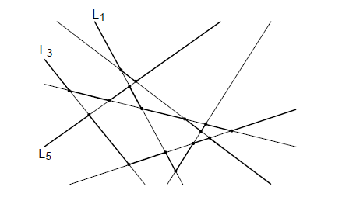
Levels in an arrangement
Identify the rightmost line with negative slope or the leftmost line with positive slope to determine the start of the upper envelope; then switch lines at intersections as you walk on a line
Level of an edge e : #lines strictly above “open” e
Level in an arrangement: locus of edges with the same level
level(v): #lines strictly above vertex v
level(v) = minimum of incident edge-levels
L₁
L₀
level(e) = 1
L₂
L₃
e
Median level
Pointer to the median level can be identified in O(n) time (median slope); Construction of levels ⇒ O(n²) time; size of the median level ⇒ O(n^{4/3}); De, DCG (1997)
v
L₄
L₆
level(v) = 3
L₅
each level of A(L) is a x-monotone polygonal chain

Slide 4
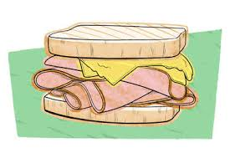





Ham-Sandwich Cut
3D: Cutting by a 2D hyperplane: translation, rotation, and tilt
Ham-Sandwich Theorem: Given n measurable objects in n-dimensional Euclidean space, it is possible to divide them in half each, by a single (n -1)-dimensional hyperplane
(related to Borsuk–Ulam Theorem as well)

Slide 5
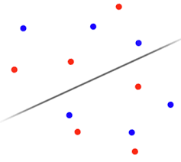
Ham-Sandwich Cut
Discrete version of 2D Ham-Sandwich Cut (Pancake-Cut)
Given a bichromatic set of points, one with m points and other with n points,
determine a single line that simultaneously bisects both sets

Slide 6
2D Discrete Ham-Sandwich Theorem
Theorem: There exists a line l that partitions both sets into two equal halves, each.
P: set of red points; Q: set of blue points
l

Slide 7
Ham-Sandwich Theorem
Find a line l such that on each side of l there are at most |P|/2 points of P.
Then rotate l counter-clockwise in such a way that there are always at most |P|/2 points of P on each side of l.

Slide 8
Rotation
Goal: Rotate the knife from 0° to π, in discrete steps, but at every step, we need to maintain the balance. Is it possible?
α = 0°
Left: 4 Right: 4
*only the red points are shown for the time being

Slide 9
Rotation
Left: 4 Right: 3
Rotate around this point now

Slide 10
Rotation
Left: 4 Right: 4

Slide 11
Rotation
Left: 3 Right: 4
rotate

Slide 12
Rotation
Left: 3 Right: 4
rotate

Slide 13
Rotation
Left: 3 Right: 4
rotate

Slide 14
Rotation
Left: 4 Right: 3
rotate

Slide 15
Rotation
Left: 3 Right: 4
rotate

Slide 16
Rotation
Left: 4 Right: 3
rotate

Slide 17
Rotation
Left: 2 Right: 4
Rotate around this point now

Slide 18
Rotation
Left: 4 Right: 4
Rotate around this point now

Slide 19
Rotation
Left: 4 Right: 3
rotate

Slide 20
Rotation
Left: 3 Right: 4
rotate

Slide 21
Rotation
Left: 4 Right: 3
rotate

Slide 22
Rotation
Left: 4 Right: 4
α = π

Slide 23
Finding the Ham-Sandwich Cut
P: set of red points;
Q: set of blue points
l
HS-Cut
CCW rotation with shifting
pivots
l
Initial
Left: |P|/2 red; Right: |P|/2 red
Left: b blue points;
Right: |Q| – b blue points
Final
Left: |P|/2 red; Right: |P|/2 red
Right: b blue points;
Left: |Q| – b points
Throughout the rotation, there are always |P|/2 red points on each side of l;
Since the number of blue points change sides after 180° rotation, there must have been one orientation of l during the rotation when there are |Q|/2 blue points on each side of l; at that angle, l partitions both P and Q into equal halves (e.g., the line shown in pink color)

Slide 24
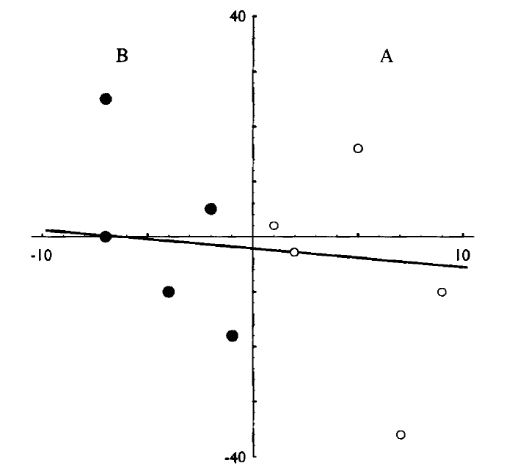
Implementation of a special case of Ham-Sandwich Cut Two-colored points separated by a line (e.g., y-axis)
x < 0
Ham-Sandwich cut
5 black points,
5 white points;
x > 0
Idea: Can arrangement and duality be of help?

Slide 25
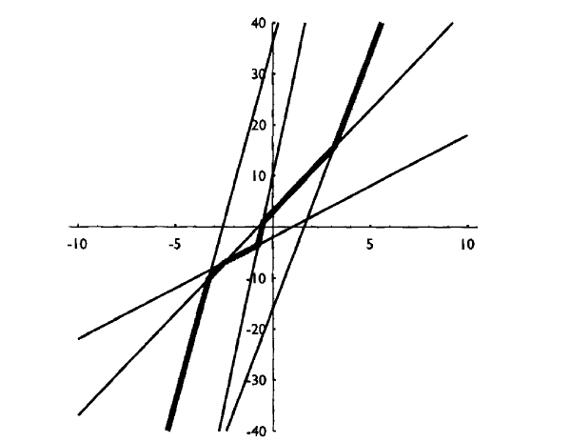
Ham-Sandwich Cut
Lemma: The bisector of a set a points P in the primal, corresponds to a point on the median level in its dual, i.e., in A(P*)
median level
median level will also be y-monotone
dual of points for which x > 0 (white points)

Slide 26
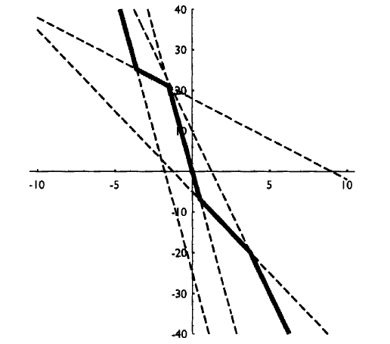
Ham-Sandwich Cut
median level
dual of points for which x < 0 (black points)

Slide 27
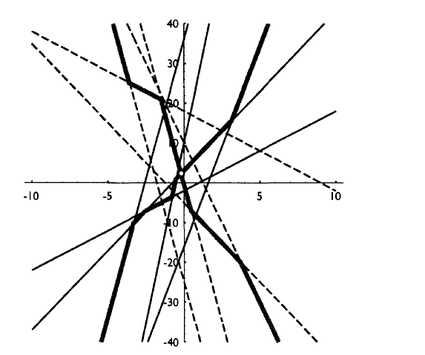
Ham-Sandwich Cut
intersection point p between the two medians in the dual plane
How about line p*
in the primal plane?
The intersection point can be found in O(m + n) time without constructing the arrangement
white and black points together in the dual: A(P*)

Slide 28
Ham-Sandwich Cut Done in the Primal!
Ham-Sandwich cut
p*
5 black points,
5 white points;
where p is the intersection point of two median-levels in the
dual arrangement of lines A(P*) for points in P

Slide 29
CS60064 Spring 2022 Computational Geometry
Instructors
Bhargab B. Bhattacharya
Partha Bhowmick
17 March 2022
Lecture #27
Indian Institute of Technology Kharagpur
Computer Science and Engineering

Slide 30
Range Searching: Kd-Trees and Range Trees

Slide 31
Range Searching: Kd-Trees and Range Trees
Find objects lying within a specified range (window)
Data structure:
-- Space?
-- Time: Construction, Update,
Query? Sub-linear?
d
c
a
b
“When we think we know, we cease to learn.”
-- Sarvepalli Radhakrishnan

Slide 32
Problem of the Day: 1D Range Searching
Range Query: [15, 71]
Return: 21, 23, 25, 45, 70
Counting Query: [15, 71]
Return: 5
Counting query should be answered in O(log n) time

Slide 33
Example: [3, 10, 19, 23, 30, 37, 49, 59, 62, 70, 80, 89, 93, 97]
Internal nodes:
rightmost leaf node of the left sub-tree
Ref: 4A Book

Slide 36

Query time?
Output: (30, 37, 49, 59, 62, 70, 80, 89)
Grey nodes: visited by the query; unclear if they lead to output
White nodes: never visited by the query
?
Black nodes: visited by the query, whole subtree is delivered as output

Slide 39
Ref: 4A Book

Slide 40
1D Range Searching: Query-Time Analysis
White nodes: never visited by the query; no time spent
Grey nodes: visited by the query, unclear if they lead to output;
Note that they occur only on two paths in the tree, and since the tree is balanced, its depth is O(log n)
Black nodes: visited by the query, data in the whole subtree is delivered as output; time depends on k, the output size;
These (sub)trees with m leaves has (m − 1) internal nodes; traversal visits O(m) nodes and finds m data-points as output
The time spent at each node is O(1) ⇒ total of O(log n + k) query time;
Data structure uses O(n) space; Preprocessing: O(n log n )

Slide 41
1D Range Query

Slide 43
Output: Count [25, 90] = 8

Slide 44
How many canonical sets could be there in an 1D range query search?
There are exactly two extreme paths; #canonical sets: O(log n)
Theorem: A set of n points on the real-line can be processed in O(n log n) time into a data structure of O(n) time so that any 1D range-counting query can be answered in O(log n) time.

Slide 46
Multi-Dimensional Data
Range searching in higher dimensions?
Kd-tree [Jon Bentley 1975]; stands for k-dimensional tree
Simple, general, and arbitrary
dimensional
Extends 1D tree, but alternates using x- y-coordinates to split
In k-dimensions, cycle through them, e.g., in 3D, x, y, z, x, y, z,…

Slide 47
Kd Tree
Idea:
Split the point set alternatingly by
x-coordinate and by y-coordinate;
X: split by a vertical line that has half the points left and half right;
Y: split by a horizontal line that has half the points below and half above;
Recurse …
Sometime, cuts may include points as well
Kd-Tree: A binary tree; each node has two values:
split dimension, and split value
When O(1) points remain, put them in a
leaf node;
Data points at leaves only; internal nodes
for branching and splitting
Courtesy: Subhash Suri, UCSB

Slide 48
Kd Tree
To get balanced trees, use the median coordinate for splitting—median itself can be put in either half;
With median splitting, the height of the tree: O(log n).
Either cycle through the splitting dimensions, or make data-dependent choices, e.g., select dimension with max spread
Construction time: O(n log n)

Slide 49
Kd Tree: Space Partitioning View
cells
kd-tree induces a space subdivision—each node introduces a x- or y-aligned cut;
Points lying on two sides of the cut are passed to two children nodes;
The subdivision consists of rectangular regions, called cells (may be unbounded);
Root corresponds to the entire space; each child inherits one of the half-spaces, and so on;
Leaves correspond to data points

Slide 50
Kd Tree: Construction

Slide 51
Ref: 4A Book

Slide 52
Searching in a Kd Tree
query rectangle R
output: p₃, p₆
time complexity?

Slide 53
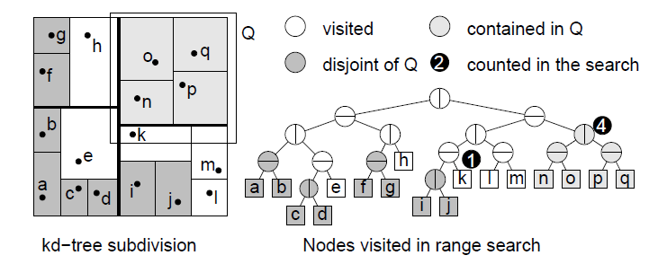
Range search in a kd-tree: More examples
query
Ref: DM Lecture Notes

Slide 54
Range query in a kd-tree: More examples
nodes visited
query
×
×
×
√
√
√
output: p₆, p₇, p₈, p₉, p₁₀, p₁₁
cells that are fully contained in the query rectangle
Ref: 4A Book

Slide 55
Searching in a Kd Tree
query rectangle R

Slide 56
Kd-tree Range Counting Query
int rangeCount(Range Q, KDNode t, Rectangle C )
if (t is a leaf)
if (Q contains t.point) return 1,
else return 0.
else (t is not a leaf)
if (C ∩ Q = ϕ) return 0.
else if (C ⊆ Q) return t.size.
else, split C along t’s cutting dimension and cutting value, letting C1 and C2 be the two rectangles;
Return (rangeCount(Q, t.left, C1) + rangeCount(Q, t.right, C2)).
Ref: DM Lecture Notes

Slide 57
Analysis of Query Time in Kd Tree
query rectangle
Question: How many grey and black nodes will be visited in the
worst case?

Slide 58
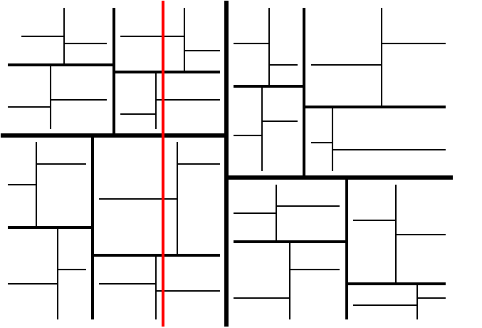
Pattern of Stabbed Cells: Complexity of kd-trees
stabbing line
query rectangle
1
2
2
4
4
8

Slide 59
Analysis of Query Time in Kd Tree
Question: How many grey and black nodes will be visited?
Computational Geometry
unary and binary nodes alternate
active unary node
visits
(at most)
active binary node

Slide 60
Summary: Kd-Tree: Construction and Query Complexity
2D Range query using kd-tree
Construction time: O(nlogn)
Space: O(n)
Reporting query time: O(√n + k), where k is the number of answers reported
Counting query time: O(√n)

Slide 61
High-Dimensional Kd Tree
d-dimensional query box, d > 2

Slide 62
2D Range Searching
Kd tree
O(log n + k)?
Improved 2D range search query:
Use Range Tree ⇒
O(log² n + k) time
Range Tree + Fractional Cascading ⇒
O(log n + k) time

Slide 63
Fractional Cascading
A Novel Data Structure for Searching in Multiple Arrays

Slide 64






Searching Mutiple Arrays with the Same Key
sorted
∧
h < n
Can we do better?

Slide 65






Improvement: Merge and use pointers
So far:
Space: O(hn)
Time: O(h log n)

Slide 66










Slide 67



Fractional Cascading: Consider the arrays … A¹, A², A³, …, A^{h}
A¹
A²
A³
4.8
ϕ
Initially ∀i, make B^{i} = A^{i}. Next, mark every second element B^{i} and insert them in the next upper level B^{i - 1} if not present there, and continue up to B¹. Clearly, B^{h} = A^{h}
Key: 4.5
How far do I need to walk backward?
Suppose 11 is not there in A²
Key: k = 7
⇒ A¹(3) = 7;
A²(4) = 11;
A³(2) = 9;
Key: k = 9
⇒ A¹(5) = 12;
A²(4) = 11;
A³(2) = 9;
Key: k = 5
⇒ A¹(2) = 6;
A²(3) = 5;
A³(2) = 9;
Overall complexity depends on the length of B^{i} ’s

Slide 68
Analysis
n
B¹
B²
…
B^{h -1}
B^{h}
x x ….. ……x …. x
A¹
A²
…
A^{h -1}
A^{h}
x x ….. ……x …. x
h
.. . ….. …… ….
x x ….. ……x …. x
x x ….. ……x …. x
Initially, B^{i} = A^{i}. Mark every second element B^{i} and insert them in the next upper level B^{i - 1} if not present there, and continue up to B¹. Clearly, B^{h} = A^{h}
Overall complexity depends
on the length of B^{i} ’s: O(n)

Slide 69
Analysis
Total number of array entries in the entire data structure O(hn);
each array entry contains at most two pointers;
size of the entire data structure O(hn);
computing B^{i} takes O(n) time;
the preprocessing and memory requirements: O(hn)
Theorem: Given h < n sorted arrays each of size n, there exists a data structure requiring O(hn) preprocessing time and memory that answers iterated search queries in O(h + log n) time

Slide 70
Summary: Searching in multiple arrays with the same key
Fractional Cascading Theorem: Given h < n sorted arrays each of size n, there exists a data structure requiring O(hn) preprocessing time and memory that answers iterated search queries in O(h + log n) time

Slide 71
Fractional Cascading
Key: 8
Special case
A¹
A²
…
A^{h -1}
A^{h}
subsets
Key: 8
Output: (5, 8), (4, 8), (3, 13), (2, 34)
Copying every second element up: not required
Horizontal links:
not required
preprocessing time and space: O(hn) queries in O(h + log n) time

Slide 72
2D Range Tree for Answering Range Queries
Kd tree: Single tree with alternating x- and y-cuts based on bisection
Range tree: Two interlinked 1D x-tree and y-tree based on bisection

Slide 73
Step 1: Construct 1D range tree on x-coordinates
x_{lo} x_{high}
superset of the required set; checking all of them increases complexity

Slide 74
Step 2: Construct 1D range tree on y-coordinates for each
subtree of x-tree
1D x-tree
superset of the required set; checking all of them increases complexity
Augmented x-tree

Slide 75
Augmented x-tree
1D x-tree
Store 1D range tree (Level 1) for all the points based on x-coordinates
Thus in O(log n) time we can find O(log n) subtrees representing the points with proper x-coordinates
How to restrict to points with proper y-coordinates?

Slide 76
y-coordinates are sorted
Augmented x-tree
1D x-tree
(Level 1)
x-coordinates are sorted
1D y-tree
(Level 2)

Slide 77
1D x-tree
1D y-tree
1D y-tree
1D y-tree
Space: for x-tree: O(n);
for y-trees: n + 2(n/2) + 4(n/4) + 8(n/8) + .. log n terms = O(n log n);
Total space: O(n log n); Construction time (pre-processing): O(n log n);

Slide 78
Summary on 2D Range Tree
Reason for log² n term? Searches in Level-2 subtrees

Slide 79
Query in2D Range Tree: Example
0
100
100
(40, 60)
x-range: (7, 40); y-range: (3, 60)
0
(7, 3)
1D x-tree
Answers: (7, 10), (8, 37), (12, 3), (21, 49), (33, 30)

Slide 80
Fractional Cascading
Special case
A¹
A²
…
A^{h -1}
A^{h}
subsets
Copying every second element up: not required
Horizontal links:
not required
preprocessing time and space: O(hn) queries in O(h + log n) time

Slide 81
Analysis
1D x-tree
0
100
100
(40, 60)
0
(7, 3)
1D y-tree
(3, 60)
x-range: (7, 40);
y-range: (3, 60)
subsets
Answers:
(7, 10), (8, 37),
(12, 3), (21, 49),
(33, 30)
Using FC, query time: O(log n + k)
Space: O(n log n)

Slide 82
2D Range Tree Plus Fractional Cascading
O(log n + k)
Ref: 4A Book, Chapter 5

Slide 83

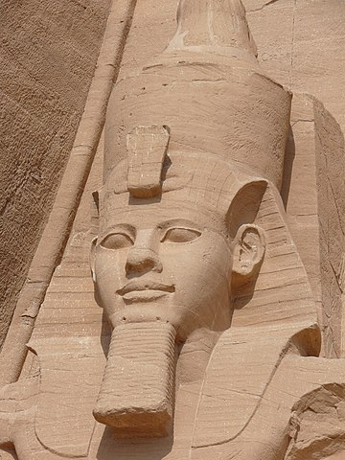

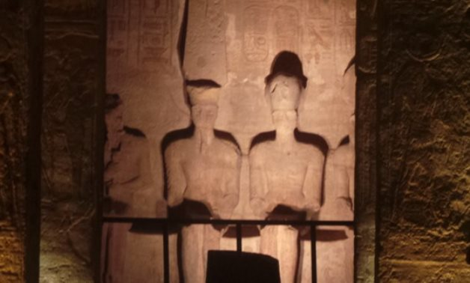
Solar Alignment in the Temple of Ramesses-II, Abu Simbel, Egypt (Circa ~ 1244 BC)
Amazing solar alignment on the temple of Ramsses II occurs twice every year on February 22 and October 22, as the sun's rays penetrate 200 meters through the front corridor of the entrance to the Temple; February 22 marks the King's birthday, and October 22 marks the day of his coronation!
Geometry everywhere!

