Slide 1
CS60064 Spring 2022
Computational Geometry
Instructors
Bhargab B. Bhattacharya (BBB)
Partha Bhowmick (PB)
Lecture 04
12 January 2022
Indian Institute of Technology Kharagpur
Computer Science and Engineering
Notes:
Good Morning!
The title of today’s talk is “On some Planar Partitioning Problems”.

Slide 2
Problem of the Day
depth(q₂) = 5
L(q₁)
depth of query point (q) in 2D:
- imagine a line L passing thru q;
- rotate L around q such that
# points appearing on one side of L is minimized over all angles;
- Output the number including q;
i.e., the smallest number of points in any closed half-plane that contains q (Tukey depth)
depth(q₁) = 11
q₂
q₁
L(q₂)
Problem: Design an efficient algorithm for computing the depth of a query point in a 2D cluster of n points
Data depth – used in analytics, M/L
Given a cluster of data comprising n points, what is the relative location of a new query point?
Other measures: use of convex hull; distance of q from the centroid (arithmetic mean) or from the Fermat point

Slide 3
Introducing Polygons
Notes:
Good Morning!
The title of today’s talk is “On some Planar Partitioning Problems”.

Slide 4
Polygonal Curves
Ref: David Mount, Lecture Notes
a
b
line segment: a subset of a straight-line contained between two end-points a, b (inclusive), denoted as ab
simple polygonal curve (open)
open polygonal curve
but not simple
closed polygonal
curve but not simple
polygon: closed and simple polygonal curve

Slide 5
Simple Polygons
q ∈ P?
Definition: A simple polygon P is the (closed) region bounded by a “simple closed polygonal curve”
P
simple polygon
no
PSLG
polygon with holes
nested polygons
no

Slide 6
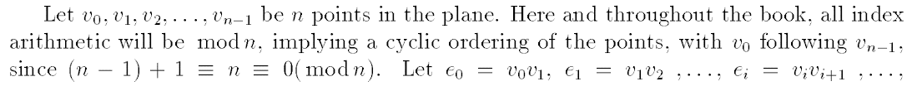
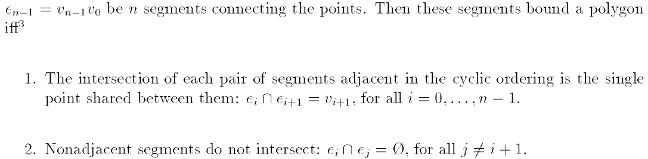
Simple Polygon
Two non-consecutive edges are disjoint
Two consecutive edges have a single common end-point
v₀
e₀
v₁
e_{j}
e_{i+1}
v_{n-1}
e_{i}
v_{i+1}
Ref: David Mount, Lecture Notes

Slide 7
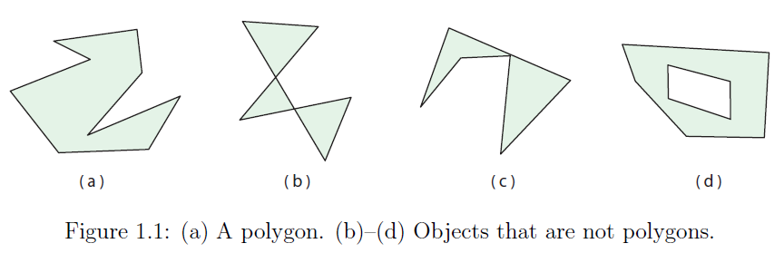
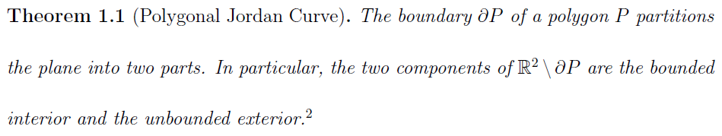
Simple Polygons
Some definitions would allow this as a “degenerate” simple polygon
yes no no
no (polygon with holes)

Slide 8

Connect-the-dots

Slide 9
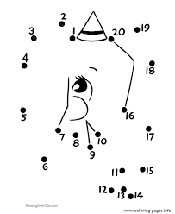
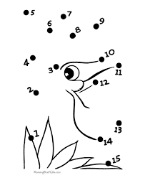
Labels of the vertices are given; draw the polygonal edges in sequence, to reveal …

Slide 10
Polygon described as an ordered sequence of vertices
3
1
2
4
Given labelled points, is it always possible to construct the polygon?

Slide 11

Connect-the-dots
8
3
8
7
1
4
3
7
1
4
6
2
5
6
2
5
normal
D, P, AD
Trail Marking Test:
Often used in testing cognitive decline in dementia, Parkinson’s, Alzheimer's disease
Q. Given points 1, 2, …, n on 2D, can you sequentially connect them with a closed curve without crossing?

Slide 12
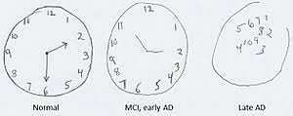

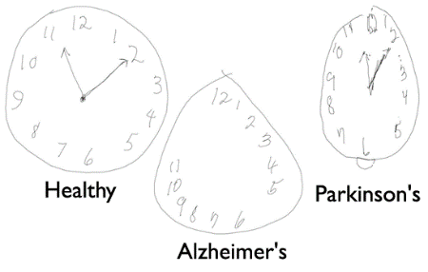
Geometric Cognition Test
Clock Drawing Test: often used in testing cognitive decline in dementia, Parkinson’s, and Alzheimer's disease
Q. Can you draw the clock with the current time?

Slide 13
Polygonization
Vertices are given but their ordering, i.e., labels are not given; the goal is to construct a simple polygon spanning all vertices
one way of polygonization
another way of polygonization

Slide 14
unordered
How?
HMK - 01
Yes!

Slide 15
Polygonization
Different polygonizations of the same set of points
Q1. Can you find the one with minimum perimeter, area?
Q2. An unordered point set P and some edges E defined on a subset of P, are given. Can you always polygonise such that it includes all edges in P?
Q3. An unordered point set P and a hole H are given. Can you polygonise P such that H appears as a hole in P?

Slide 16
Simple polygons: Convex and reflex angles

Slide 17
vertex with least y-coordinate
lowest, rightmost

Slide 18
straight-line

Slide 21
J. O'Rourke: Computational Geometry in C, Cambridge Univ. Press, 1998

Slide 22
CS60064 Spring 2022
Computational Geometry
Instructors
Bhargab B. Bhattacharya (BBB)
Partha Bhowmick (PB)
Lecture 05 & Lecture 06
14 January 2022
Indian Institute of Technology Kharagpur
Computer Science and Engineering
Notes:
Good Morning!
The title of today’s talk is “On some Planar Partitioning Problems”.

Slide 23
Problem of the Day: Magical Cut
Question: Given 2m red points and 2n blue points in the plane in general positions, is it possible to divide them in half each, by a single straight-line cut?

Slide 24

Story of Pancake and Sandwich

Slide 25






Story of Pancake
Pancake Theorem: It is always possible to cut the stack of two arbitrarily-shaped pancakes into two equal-size (area) portions each, by a single straight knife-cut, without moving them relative to each other

Slide 26





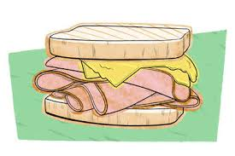

Story of Sandwich
Ham-Sandwich Theorem: Given n measurable objects in
n-dimensional Euclidean space, it is possible to divide them in half each, by a single (n -1)-dimensional hyperplane

Slide 27
Today’s Agenda
1. Orthogonal polygonization
2. Triangulation of simple polygons
Notes:
Good Morning!
The title of today’s talk is “On some Planar Partitioning Problems”.

Slide 28
Orthogonal Polygons
All edges are axis-parallel
In other words, internal turn angles are either π/2 or 3π/2
Avoid degenerate cases where internal angle is π
X
orthogonal polygonization
(from unlabelled vertices to polygon)
Polygonization: Vertices are given but their ordering, i.e., labels are not given; the goal is to construct an orthogonal polygon spanning all vertices

Slide 29
Orthogonal Polygonization
Every horizontal row or vertical column must have even number of vertices (assuming no degeneracy with internal angle π)
not sufficient
Instances which are not ortho-polygonizable

Slide 30
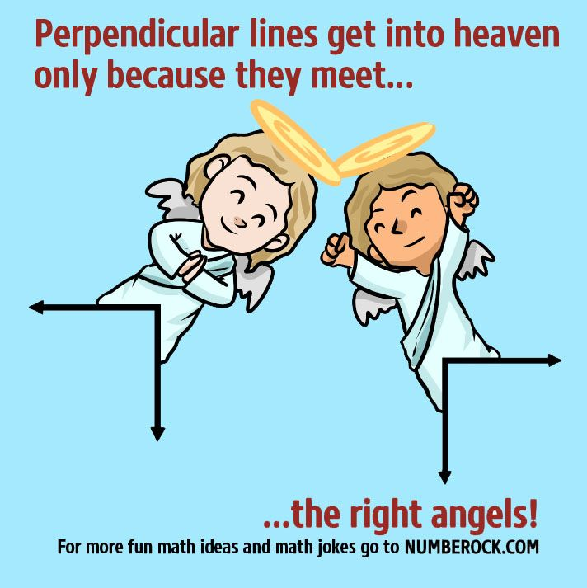
Orthogonal Polygonization
From point set to
ortho-polygonization
orthogonal polygons with holes
If polygonization is possible, then the solution is unique; may generate multiple polygons and with holes;
Can be accomplished in
O(n log n) time, where n is the number of points

Slide 31
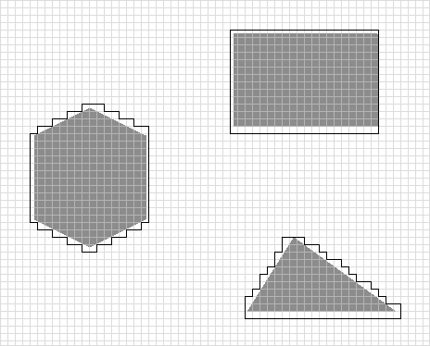
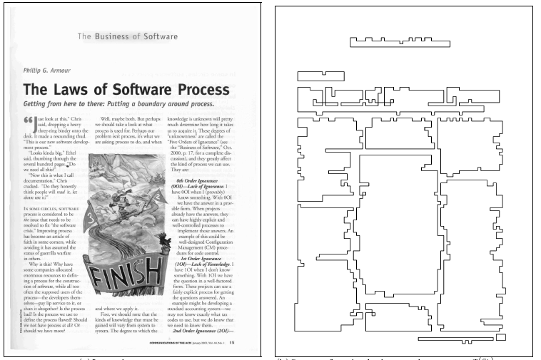



Why Orthogonal?
Robot-path configuration
Document image segmentation
huge space savings
Original Outer approximation Inner approximation

Slide 32
Triangulation of Simple Polygons
Notes:
Good Morning!
The title of today’s talk is “On some Planar Partitioning Problems”.

Slide 33
Triangulation of a simple polygon
Keep on adding diagonals so that the P is partitioned into triangles
Claim: Triangulation is always possible
Triangulation: A partition of P into triangles by a maximal set of non-crossing diagonals.

Slide 34
Triangulation is not unique
Triangulation of a simple polygon

Slide 35
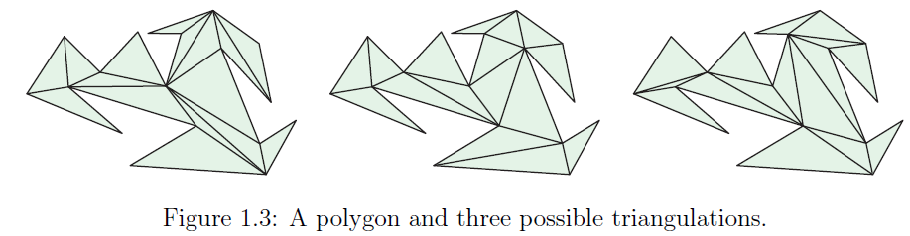
Triangulation is not unique
However, #D = n-3; #T = n-2, for all cases

Slide 37
To prove: # D = n – 3; # T = n – 2
Same argument does not hold good for polygons with holes!

Slide 39
# D = n – 3; # T = n – 2

Slide 42
Dual of a triangulated polygon
each triangle (face) → a vertex in dual graph
If two triangles share a diagonal, put an edge between the two corresponding vertices in the dual graph

Slide 44
dual is connected
# vertices(dual) = #T = n – 2;
# edges(dual) = #D = n – 3
# D = n – 3; # T = n – 2

Slide 45
Triangulations of a polygon with holes
Every triangulation of a polygon with h holes with a total
of n vertices uses n+3h−3 diagonals and has n+2h−2 triangles
The dual graph of a triangulation of a polygon with holes
must have a cycle
Self study

Slide 46
Summary and generalizations: Triangulation
Select a maximal set of non-intersecting diagonals or edges that subdivide the interior into triangles
polygon polygon point set PSLG
with hole
Triangulation is a general concept applicable to many instances

Slide 47
Summary:
A line segment l joining any two visible vertices of a polygon is called a diagonal of the polygon provided l lies completely within P
Every triangulation of a simple polygon P of n vertices uses n − 3 diagonals and has n − 2 triangles
The sum of the internal angles of a simple polygon of n vertices is (n − 2)π
The dual of a triangulation of a simple polygon P is a tree, while that of a polygon with holes contains cycles

Slide 48
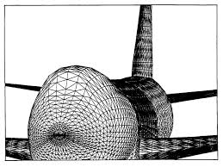
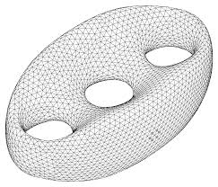
Surface Triangulation
Surface triangulation of 3D objects, mesh generation, 3D modeling, visualization, computer graphics

Slide 49

Surface Triangulation

Slide 50
Algorithms for triangulation
O(n)-time fan algorithm for convex polygons

Slide 52
simple
^
Interesting Fact: Triangulation algorithm time complexity
O(n⁴) → O(n³) → O(n²) → O(nlogn) → O(n)

Slide 53
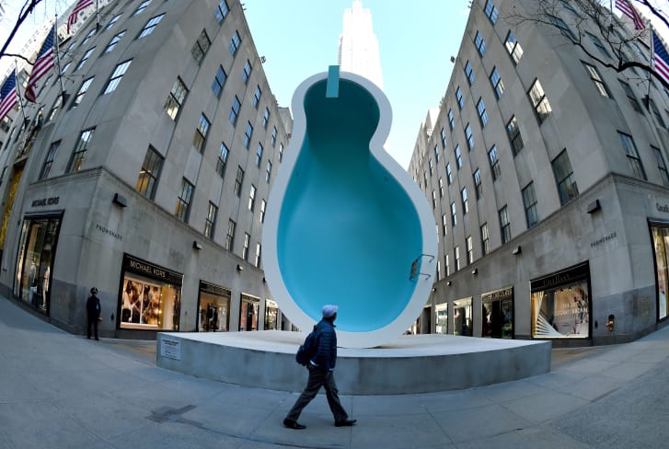


Room where van Gogh chopped off his own ear (1888)
Self-Portrait by
Vincent van Gogh (1853-1890)
Polygon Triangulation by
Ear-Clipping Algorithm

Slide 54
Ears in a Polygon
Three consecutive vertices v_{i-1} v_{i} v_{i+1} of a polygon is an ear if v_{i-1}v_{i+1} is a diagonal; and v_{i} is the ear-tip of the triangle
There are at most n ears
(a convex polygon has exactly n ears)
v_{i-1}
v_{i+1}
v_{i}
not an ear

Slide 55

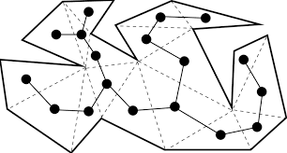
Meister’s Two-Ear Theorem
Every polygon with n > 4 vertices has at least two non-overlapping ears
The dual of a polygon is a tree
A tree has at least two leaves
The face (triangle) containing a leaf must be an ear
J. O'Rourke: Computational Geometry in C, Cambridge Univ. Press, 1998

Slide 56
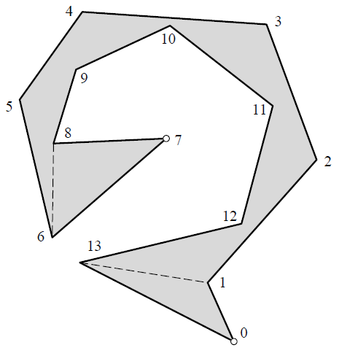
How many ears?

Slide 57
Triangulation: Ear-Clipping Algorithm
Every polygon has at least two ears!
Find an ear, fix a diagonal, chop the ear and iterate

Slide 58
Triangulation by ear-clipping
u v w
v
w
u
There are O(n) ear candidates; checking each for ear O(n); (n – 3 ) diagonals; Total time complexity O(n³)
Can we improve it to O(n²)

Slide 59
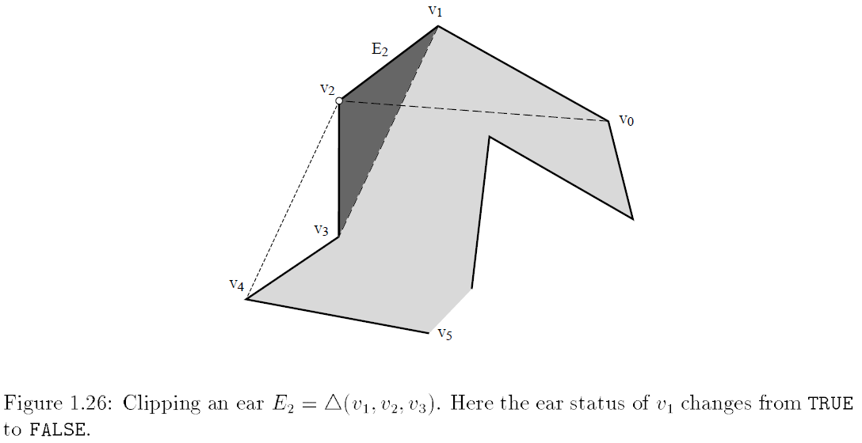
Smarter approach
When clipping ear with tip v_{i} the only ear tip statuses that can change are at v_{i-1} and v_{i+1}
Both v₁ and v₂ are possible ear-tips;
When v₂ is clipped and the diagonal is inserted, v₁ no longer remains an ear-tip. So, only the two neighbors of v₂ need to be checked for change of status. “Ear”-ities of other vertices are not affected. Thus, only O(1) updates are needed after inserting one diagonal!
Naive: O(n³)
There are O(n) ear candidates; checking each for ear O(n); Total ⇒ O(n²)
Update O(1); There will be O(n) iterations
Total: O(n²)

Slide 60
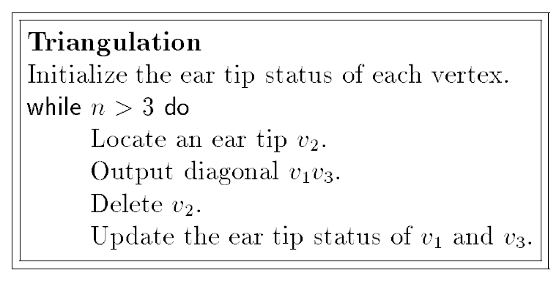
Ear-clipping algorithm
Initially determine “ear-tip status” of each v_{i} , O(n²)
Update of each ear status requires O(1); ear-tip tests
@ O(n) per test; n – 3 diagonals
Total: O(n²) worst-case
J. O'Rourke: Computational Geometry in C, Cambridge Univ. Press, 1998

Slide 61
After inserting one diagonal, the search for the next ear may take O(n) time
Total: Ω(n²)

Slide 62
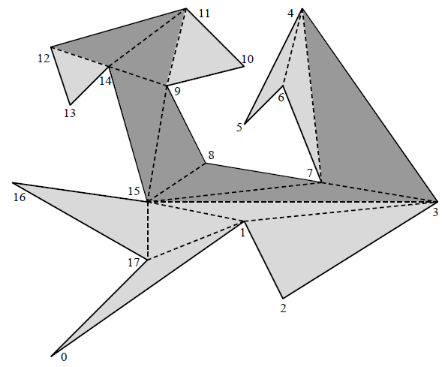
Example: Triangulate
Courtesy: Joe Mitchell
J. O'Rourke: Computational Geometry in C, Cambridge Univ. Press, 1998

Slide 63
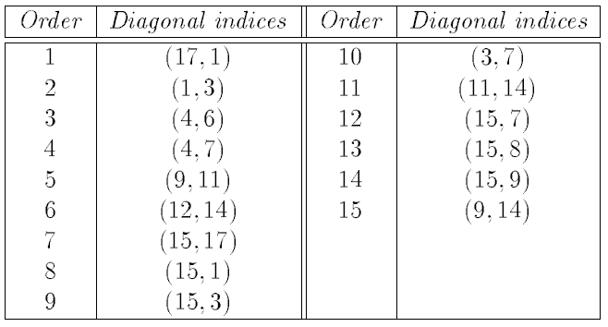
Example: Output
Courtesy: Joe Mitchell

