Slide 1
CS 60047 Autumn 2020 Advanced Graph Theory
Instructor
Bhargab B. Bhattacharya
Indian Institute of Technology Kharagpur
Computer Science and Engineering
Notes:
Good Morning!
The title of today’s talk is “On some Planar Partitioning Problems”.

Slide 2
Online Class Schedule
Wednesday: 12:00 – 12:55
Thursday: 11:00 – 11:55
Friday: 9:00 – 10:55
Additional Slots
Saturday: 12:00 pm – 1:30 pm
Can we merge the classes on Wednesday and Thursday into a 2-hour slot on Wednesday?
Notes:
Good Morning!
The title of today’s talk is “On some Planar Partitioning Problems”.

Slide 3
Mode of Online Classes
May be conducted in real-time or using pre-recorded lectures
Tutorials and doubt-clearing sessions will be held in
real-time during class hours
Notes:
Good Morning!
The title of today’s talk is “On some Planar Partitioning Problems”.

Slide 4
Textbook:
1. D. A. Patterson and J. L. Hennessy, Computer Organization and Design - the Hardware
Software Interface, 5th Edition, Elsevier, Morgan Kaufmann, 2014.
2. Older Editions of the same book [2nd Ed. (1998), 3rd Ed. (2005), 4th Ed. (2012)], and newer
RISC V (2018) Edition may also be referred to while discussing some topics).
Textbooks
Douglas B. West: Introduction to Graph Theory, Second Edition, Pearson, Singapore, 2000.
Arthur Benjamin, Gary Chartrand, and Ping Zhang: The Fascinating World of Graph Theory, Princeton University Press, 2015.

Slide 5
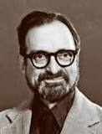
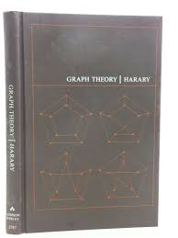
Textbook:
1. D. A. Patterson and J. L. Hennessy, Computer Organization and Design - the Hardware
Software Interface, 5th Edition, Elsevier, Morgan Kaufmann, 2014.
2. Older Editions of the same book [2nd Ed. (1998), 3rd Ed. (2005), 4th Ed. (2012)], and newer
RISC V (2018) Edition may also be referred to while discussing some topics).
First Book on Graph Theory
Frank Harary: Graph Theory, CRC Press, 2018 (originally published in 1969)
Dedication
Kazimierz Kuratowski
K₅
K_{3,3}
Frank Harary
(1921 -2005)
K₅: A complete graph of five vertices
K_{3,3}: A complete bipartite graph having
three vertices in each partition
https://mathshistory.st-andrews.ac.uk/Biographies/Harary/

Slide 6
Further Reading
Benny Sudakov: Graph Theory (Electronic Lecture Notes), 2016
Narsingh Deo: Graph Theory with Applications to Engineering & Computer Sciences, Prentice Hall, 1974.
J. A. Bondy and U.S.R. Murty: Graph Theory, Springer, 2008.
Reinhard Diestel: Graph Theory, Springer, 2000.
Anany Levitin and Maria Levitin: Algorithmic Puzzles, Oxford, 2011.
M. C. Golumbic: Algorithmic Graph Theory and Perfect Graphs, North Holland, Second Edition, 2004.

Slide 7
Grading Policy
No Mid-Sem or End-Sem Examination
Continuous evaluation at regular intervals
Homework for practicing
Online exams/quizzes – 40%
24-hour take-home tests – 20%
Lecture scribing – 10%
Term-papers - 30%

Slide 8
Term Paper (30%)
Writing a Term Paper provides you a unique opportunity to work independently and showcase your creative ideas.
This involves the following components:
(i) The students are requested to form disjoint teams, each team comprising two students. Each team should select a distinct topic for term paper. A student may work individually as well, if so desired.
(ii) select a problem in the area of graph theory that is approved by the teacher (you may select your own problem or choose one from the list given in class); (iii) conduct literature survey;
How to form good 2-member teams?
This is itself a graph-theoretic problem!
(Maximum Matching)
(iv) study possible solutions, explore new methods if possible (innovation highly encouraged), implement relevant codes, if applicable, create sample instances, and produce results; (v) write a report and give a presentation on your work.

Slide 9
Textbook:
1. D. A. Patterson and J. L. Hennessy, Computer Organization and Design - the Hardware
Software Interface, 5th Edition, Elsevier, Morgan Kaufmann, 2014.
2. Older Editions of the same book [2nd Ed. (1998), 3rd Ed. (2005), 4th Ed. (2012)], and newer
RISC V (2018) Edition may also be referred to while discussing some topics).
Textbook
Douglas B. West: Introduction to Graph Theory, Second Edition, Pearson, Singapore, 2000.
Preface
Graph Theory is a delightful playground for the exploration of proof techniques in discrete mathematics, ……..

Slide 10
Goal is to learn….
Fundamentals of graph theory
Undirected and directed graphs
Representation of graphs
Mathematical properties
How graphs can be used for problem solving
Extremal problems in graphs
Optimization problems related to various engineering applications , e.g., VLSI, transportation design, GIS
Graph Theory
Advanced Graph Theory
Graph Algorithms

Slide 11
History, Anecdotes, and Multi-disciplinary Applications of Graph Theory

Slide 12
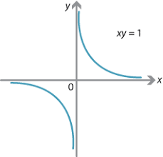
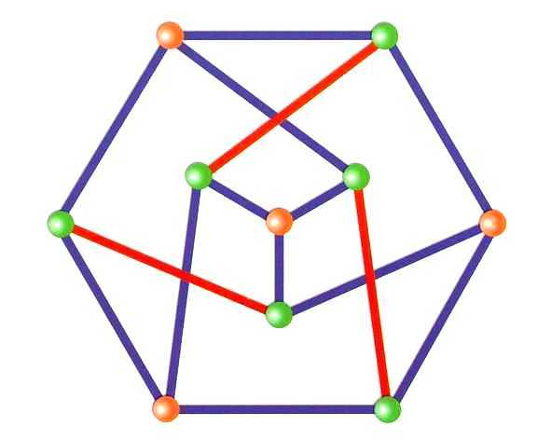
What is a graph?
V, a set of vertices (nodes);
E, a set of edges connecting two vertices, i.e., E ⊆ (V × V)
V = (A, B, C, D, E);
E = {(A,B), (A,C), (B,C), (B,D), (B,E)
How to represent this graph?
Adjacency matrix M of size (|V| × |V|)
A B C D E
A 0 1 1 0 0
B 1 0 1 1 1
C 1 1 0 0 0
D 0 1 0 0 0
E 0 1 0 0 0
M(i, j) = 1, if nodes i and j are adjacent;
= 0, otherwise.
For undirected graph, this will be a symmetric matrix across the diagonal
A set of nodes (vertices)
A
A
B
C
B
C
D
E
D
E
vertices may represent some objects;
an edge shows a relationship between a pair of vertices
A set of edges, each edge
joining two vertices
M: Translation, rotation, scaling, shear, rubber-sheet stretching invariant?

Slide 13
Does the drawing of a graph matter?
Would adjacency-matrix representation of G suffice?
embedding, planarity,
graph drawing
crossover
A
E
A
A
B
C
B
B
C
C
Graph G3
Graph G2
D
E
D
TSP/Road network
D
E
Question: Are G1, G2, G3 same?
Graph G1
In general, they are same (isomorphic). However, if they represent geometric graphs, or when embedding/drawing/ neighborhood is an issue, they are different from each other!

Slide 14
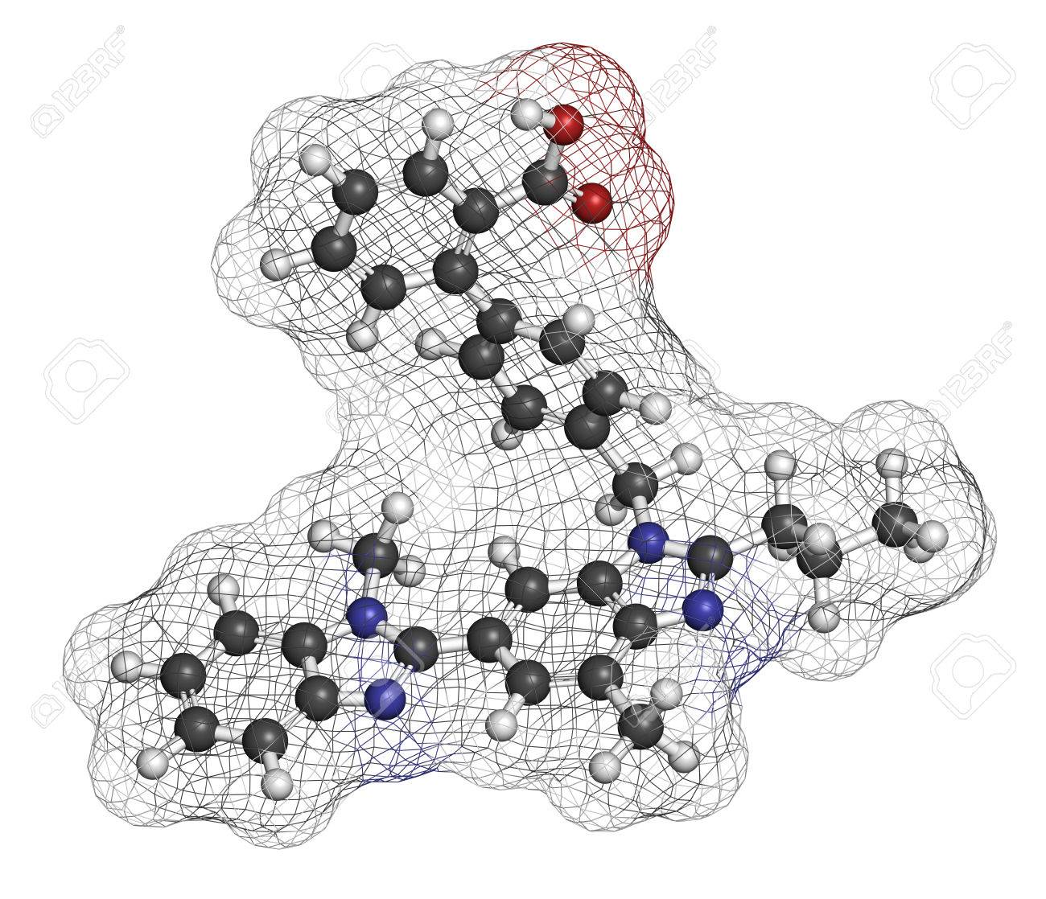
Telmisartan: hypertension drug molecule as a geometric graph
C₃₃H₃₀N₄O₂
C
N
H
O
Graph theory in computational drug design

Slide 15
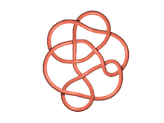
Can you represent Conway Knot with a graph?
crossing
Introduced by John Conway 50 years ago
Comprises 11 crossing
An open problem related to this knot has been recently solved by a graduate student Lisa Piccirillo (Annals of Mathematics, 2020)

Slide 16
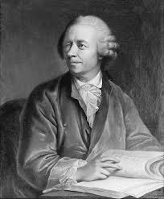
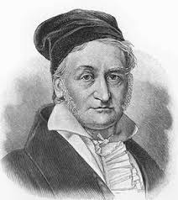
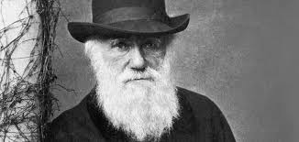
Historical Presence
Carl Friedrich Gauss 1777 -1855
Charles Darwin 1809 -1822
Leonhard Euler 1707 -1783

Slide 17
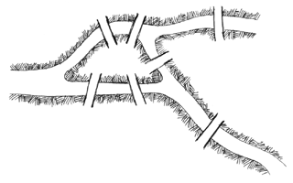
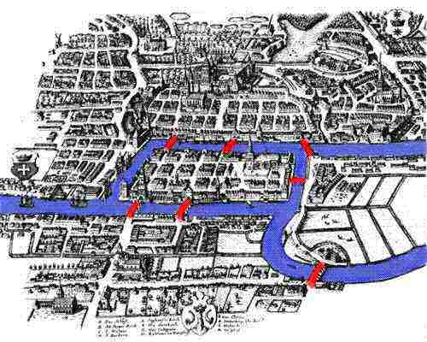
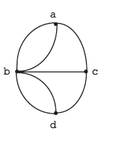
Königsberg Bridges Problem (Euler 1736)
Can you cross every bridge exactly once and return to your starting point?
A
B
C
bridge
A
D
The answer is “No”
B
D
A
C
B
C
regions A, B, C, D → 4 nodes;
a bridge between two regions → an edge;
Seven bridges → 7 edges in the graph. Note that this is a multi-graph, as there are multiple edges between a given pair of vertices, e.g, between A and B
D
Euler’s Traversability Theorem

Slide 18
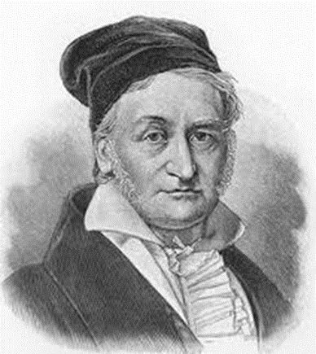
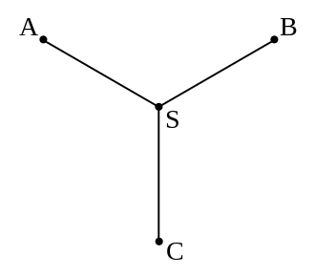
Steiner-Tree Problem
Carl Friedrich Gauss studied the Steiner-tree problem in 1836
120°
Steiner-tree
120°
Interconnect three cities A, B, C using minimum-cost road network;
Interconnect three pins electrically (equipotential points, e.g., ground)
extra vertex
Jakob Steiner (1796 - 1863)

Slide 19
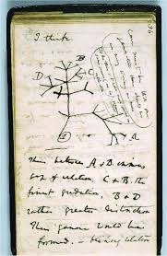
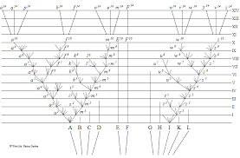
Darwin: The Origin of Species (1859)

Slide 20
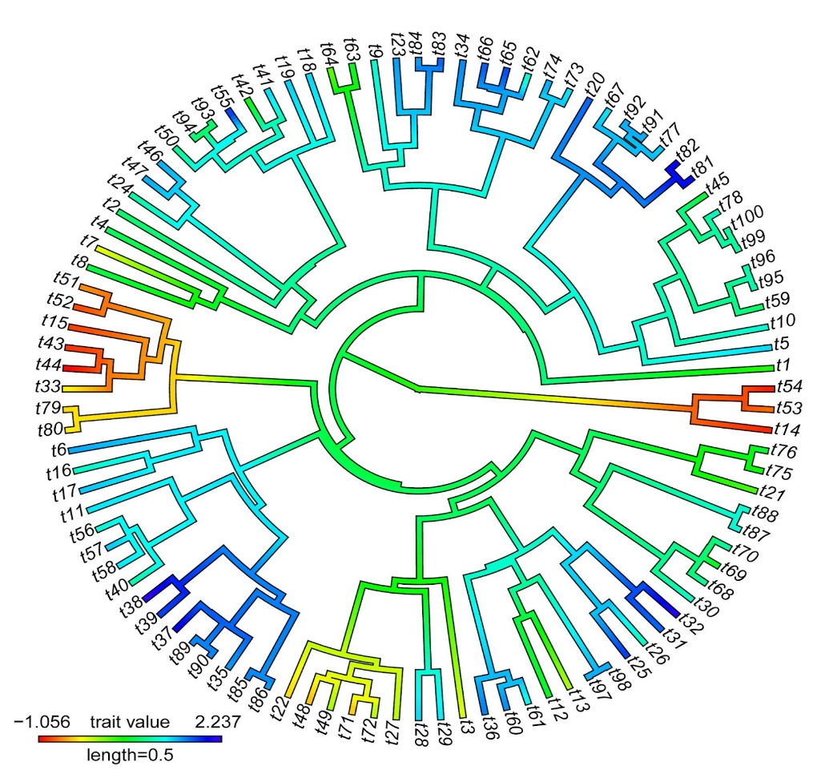
Evolutionary Biology: Phylogenetic Tree
A phylogenetic graph is a tree that depicts evolutionary
relationships among biological
species based on their physical or genetic characteristics
This is a problem of graph drawing: should be non-crossing; circular embedding of a tree reduces layout area!
All life on earth may be perceived as a single phylogenetic tree, indicating common ancestry (root)!

Slide 21
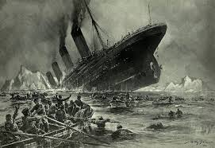
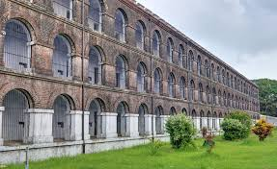
Morse Code (1837)
… - - - … (SOS) Save Our Souls­­
Andaman Cellular Jail, Port Blair (1930)
Titanic sinking (1912)
wireless distress call: SOS
around 700 people survived
Confined freedom fighters talked to each other by knocking Morse code on walls

Slide 22
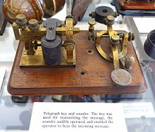
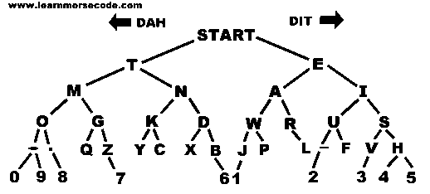
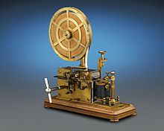
Morse Code and Telegrams (1837)
Morse-code message comprises dots (small gaps in two consecutive relay keys) and dashes (long gaps), essentially 0’s and 1’s;
This encodes alphabets uniquely on the basis of a graph (binary tree)
Morse-code sounder
dashes (1’s) on left branches
dots (0’s) on right branches
1
0
1
0
1
0
1
1
0
Telegram receiver
… - - - … (SOS) Save Our Souls­­

Slide 23
Food-Web Directed Graph (Predator-Prey)
Question: Are such graphs acyclic?
Sea otters eat sea urchins and large crabs, etc.
Polar bear and arctic birds are top predators and competitors
Courtesy: M. Cozzens, Food Webs and Graphs, Algebraic and Discrete Mathematical Methods for Modern Biology. http://dx.doi.org/10.1016/B978-0-12-801213-0.00002-2, 2015

Slide 24
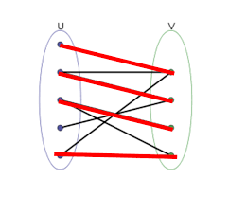
Graph Theory in Economics and Social Sciences
Matching theory: Gale-Shapley algorithm
Nobel Prize in Economics 2012
students
S1
S2
S1
S2
students
jobs
J1
J2
J1
J2
jobs
minimum matching:
only one student got placed
maximum matching: both got placed

Slide 25
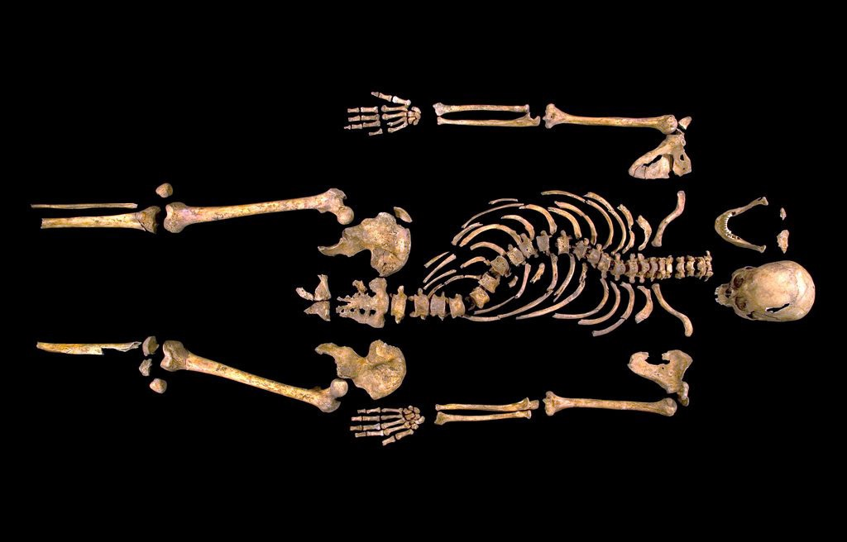
Solving a 500-year old problem of missing king Courtesy: https://towardsdatascience.com/the-king-that-graph-theory-discovered-8cce31a3cd26
In August 2012, a skeleton was found while digging into a car park in Leicester. It was believed that this was Richard III — the crooked-backed English king who was killed in the Battle of Bosworth in 1485, and dumped there.
Only mitochondrial DNA (mtDNA) that is passed down through maternal lines in families, remains unchanged from generation to generation. Looking into the ancestry graph database, a search is made to identify a living descendent of a sister of Richard-III through a 500-year old family tree of females, and they found Michael Ibsen, who is currently alive. Michael’s mtDNA was compared to that extracted from the skeleton, and it was a perfect match. In 2015, the exhumed body of King Richard-III was cremated in full honor.
Graph theory in forensics

