Slide 1
CS 60047 Autumn 2020
Advanced Graph Theory
Instructor
Bhargab B. Bhattacharya
Lecture #16, #17: 30 Sept. 2020
Indian Institute of Technology Kharagpur
Computer Science and Engineering
Notes:
Good Morning!
The title of today’s talk is “On some Planar Partitioning Problems”.

Slide 2
Today’s Topics
- Tutorial on Chinese Postman Problems
- Tutorial on Hamiltonian graphs
- Trees and Distances
- Prüfer Code
- Homework Problem Solving

Slide 5
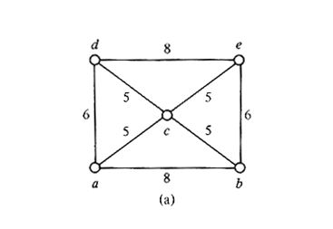
Tutorial: CPP – Example 1
vertex | degree
a | 3
b | 3
c | 4
d | 3
e | 3
PO

Slide 6
Solution: CPP
List all vertices that have odd degree
vertex | degree
a | 3
b | 3
d | 3
e | 3

Slide 7
Solution: CPP
Find least-cost path between pairs of odd-degree vertices
{ab, de, ad, be, ae, bd}

Slide 8
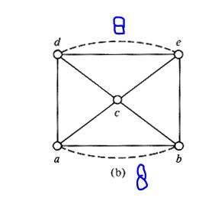
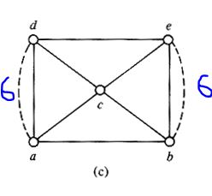
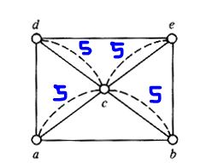
Solution: CPP
Find min-cost perfect matching
8+8 = 16
6+6 = 12
5+5+5+5 = 20

Slide 9
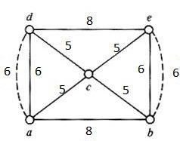
Solution
In the original graph, add the paths between matched pairs
PO
Length of an optimal postman’s route:
Fixed cost= 48; Additional cost (dotted edges) =12;
Optimal cost for CPP = 48 + 12 = 60
Actual route: a -> b -> e -> d -> a -> c -> e -> b -> c -> d -> a

Slide 10
Tutorial: CPP – Example 2
: odd-degree vertex
additional cost = 16
additional cost = 16
PO
additional cost = 10
least additional cost = 10;
postman’s route should be determined accordingly

Slide 11
Homework: CPP

Slide 12
Tutorial: Hamiltonian
done
Is this graph Hamiltonian?
This is a cubic graph of order 16
another solution

Slide 13
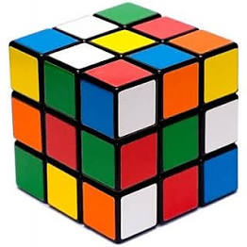

Tutorial: Hamiltonian - Cheese and Mouse Problem
G' = G∪ (000, 111)
Also, 000 and 111 lie in different partitions of G
Given (3 × 3 × 3) cheese cube;
Mouse starts eating the unit sub-cube (0, 0, 0)
She will eat the next cheese subcube that touches it and so on ..
Question: Can she finish eating all subcubes and ending her meal at the centremost subcube (1,1,1)?
(0,0,0)
G(V, E): subcube → vertex; touching subcubes → edge
Claim: G is bipartite
Question: Does there exist a HP from (0,0,0) to (1,1,1)?
|V| = 27, G' cannot be equi-partitioned! HC/HP Not Possible!
No
G

Slide 14
If |X| > |Y|, HP possible if you start and end up in the bigger partition X

Slide 15

Tutorial: Hamiltonian - Knight’s tour in chessboard
independent
sets
(4 × n) chessboard
Delete S = 2n white cells from the two middle rows (independent set); |S| = 2n;
Left with 2n isolated black cells that occupy topmost and bottommost rows, and additional white cells → at least (2n + 1) components;
G - S has more than |S| components!
Hamiltonian cycle cannot exist!
Can a knight travel through every cell exactly once and return to the starting point?
No

Slide 17
- Trees and Distances
- Prüfer Code

Slide 22
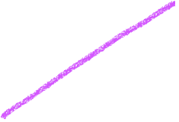




Slide 25
1

Slide 27
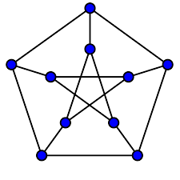

Slide 32


Slide 33
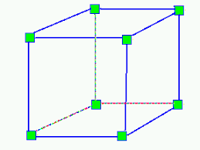
Homework 1: Fleury’s Algorithm
Label the vertices of the following graph with 0, 1, 2, …, 13.
Run Fleury’s algorithm to determine an Eulerian open trail.
Show the trail.

Slide 34
Homework 2: Trees and Line Graphs
Draw the line graph of a full binary tree of height 3
Next, characterize such line graphs

Slide 35
Homework 3: Traversability of Line Graphs
If a simple graph G is Eulerian, then show that L(G) is both Eulerian and Hamiltonian

Slide 36
Homework 4: Forbidden subgraph of line graphs
Show that the graph (K_{1,3}) shown here cannot be a line graph
Possible connected graphs with four edges; line graphs of these do not match with K_{1,3}

Slide 37
Homework 5: Hypercube
Show that the line graph of Hypercube Q₃ is Hamiltonian
Next, argue that the line graph of Hypercube Q_{k},
k > 3 is also Hamiltonian
1
12
2
6
11
7
3
For Q_{k}, k > 3,
use recursive argument
5
8
9
4
10

