Slide 1
CS 60047 Autumn 2020 Advanced Graph Theory
Instructor
Bhargab B. Bhattacharya
Lecture #18, #19: 07 Oct. 2020
Indian Institute of Technology Kharagpur
Computer Science and Engineering
Notes:
Good Morning!
The title of today’s talk is “On some Planar Partitioning Problems”.

Slide 2
Today’s Topics
- Graceful labeling of graphs and trees
- Prüfer code and tree enumeration
- Huffman coding
- Homework problem solving

Slide 3
Graceful Labeling of Graphs and Trees
Given a simple graph G(V, E), |V | = n, |E| = m
A graceful labeling of G is the following:
For each v ∈ V, attach a label f(v) → L={0, 1, 2, .. m}, such that for all (u, v) ∈ E, | f(u) – f(v)| is distinct. G is said to be graceful if there exists such a labeling.
0
3
1
2
6
1
3
3
2
1
3
0
4
2
4
|E| = 3
L = {0, 1, 2, 3}
|E| = 4
L = {0, 1, 2, 3, 4}
|E| = 6
L = {0, 1, 2, 3, 4, 5, 6}

Slide 4
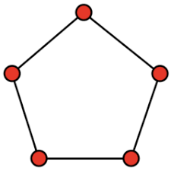
Graceful Labeling of C₅?
|E| = 5;
L = {0, 1, 2, 3, 4, 5};
0
5
4
5
4
Possible difference values
= {1, 2, 3, 4, 5}
2
3
Since there are five edges, each of these difference values must appear on an edge after labeling the vertices of the graph.
Labeling not possible preserving
distinctness of differences
C₅ is not graceful!

Slide 5
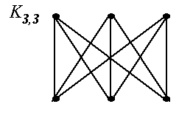
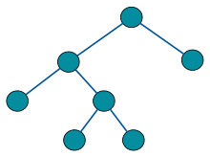
Graceful Labeling of K_{3,3} and Trees
0
1
2
|E| = 9;
L = {0, 1, 2, 3, 4, 5, 6, 7, 8, 9};
3
7
Binary Tree
3
6
9
0
difference values appearing on
each of the nine edges are distinct
5
6
5
4
3
6
1
2
1
2
K_{3,3} is graceful!
3
4
This tree is graceful!
|E| = 6;
L = {0, 1, 2, 3, 4, 5, 6};

Slide 6
Graceful Labeling of Trees
4
4

Slide 7
|E| = 14;
L = {0, 1, 2, 3, 4, 5, 6, 7, 8, 9, 10, 11, 12, 13, 14};

Slide 9
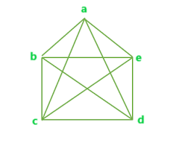
Tree Enumeration and Prüfer code
How many labeled trees are there on n nodes?
How many distinct spanning trees are there in a labeled K_{n}?
Cayley: the number of labeled trees on n nodes is n^{n−2}
Ernst P. H. Prüfer (1896 - 1934)
Prüfer code (1918): Compact representation of a tree T_{n} using a sequence of (n – 2) integers

Slide 10
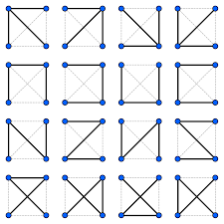
2
3 4
Number of distinct spanning trees in a labeled K₄

Slide 11
Tree encoding
It is a 100-year old concept
In 1918, H. Prüfer introduced a sequence in order to prove a combinatorial result on graph enumeration
*H. Prüfer. “Neuer beweis eines satzes uber permutationen”, Arch. Math. Phys. 27 (1918), pp. 742–744

Slide 12
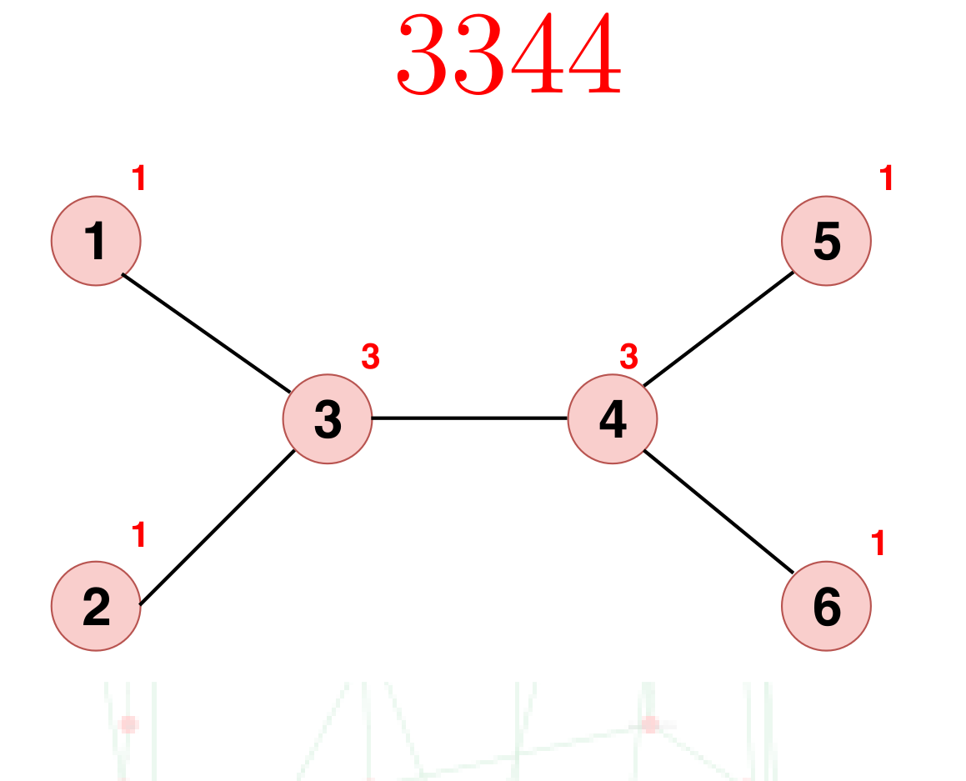
Prüfer Sequence for a tree
Assumes that nodes of a tree are labelled as 1, 2, · · , n
For a given Prüfer sequence of length m:
The number of vertices n = m + 2
The degree of each vertex is the number of times it appears in the code plus 1
Labels of pendant vertices do not appear in the code
The tree can be reconstructed from the sequence (lossless encoding)
Example

Slide 13
Highlights
A Prüfer sequence offers the following benefits:
Has size in the order of |V|
The structure of the tree can be uniquely recovered from the code
Can be encoded and decoded in linear time*
*Xiaodong Wang, Lei Wang, and Yingjie Wu. 2009. An Optimal Algorithm for Prüfer Codes, JSEA 2 (2009), 111–115

Slide 14
Prüfer code (sequence) algorithm (DW: Textbook 2.2.1)
Input: A labeled tree with n vertices; Output: Its Prüfer code
Idea: Remove the endpoint with the smallest label and output the label of the unique node (a₁) which was adjacent to it. Delete endpoint & edge. Repeat this process to find a₂, a₃ and so on until a tree on two nodes has been found.
Algorithm (Prüfer code)
Input: A labeled tree T with vertex set V , |V | = n
Output: f(T) = (a₁,a₂,…,a_{n-2}), a sequence from V
Iteration: Iterate i = 1, …, n-2.
At the ith step, delete the least remaining leaf, and let a_{i} be the neighbor of this leaf.
Length of the Prüfer code = n – 2

Slide 15
Prüfer Code: Construction
2
7
1
4
3
Delete 2,
a₁=7
7
1
4
3
6
8
5
6
8
5
Tree T
Delete 3,
a₂=4
Delete 4,
a₄=1
Delete 5,
a₃=4
7
1
7
1
4
7
1
4
6
8
6
8
6
8
5
Delete 6,
a₅=7
Output: f(T) = 744171
7
1
Delete 7,
a₆=1
1
8
8

Slide 16
Prüfer code property
Fact. If T has vertices {1,…,n} and Prüfer code a₁a₂…a_{n-2}, then the leaves of T are {1,…,n} ─ {a₁,a₂,…,a_{n-2}}.
Fact: If the degree of a vertex v in T is d(v), then label v appears in the Prüfer sequence d(v) – 1 times.
2
7
1
4
3
Output: f(T) = 744171
6
8
5
Tree T
Fact: |V | = n; # of edges = n -1; sum of all degrees = 2(n -1); the length of PS = 2(n – 1) - n = n -2.
.

Slide 17
Reconstruction of the Tree from Prüfer Code
Input: A Prüfer code sequence of length (n – 2);
Output: Original labeled tree T with n nodes;
Algorithm (Prüfer code => Tree)
Let L be the ordered list L = {1, 2, 3, …, n}, and P be the Prüfer sequence
Start with a tree T with n isolated vertices;
Repeat (n-2) times
Let k be the smallest number in L which is not in P, and j be the first digit in P;
Add the edge (k, j) to T; remove k from L and j from P;
At the end, there will be two numbers left in L; add an edge between the two corresponding vertices in T.
Fact: T can be uniquely reconstructed

Slide 18
Prüfer Decoding Example
PS: 744171; |PS|= 6, Hence the tree must have 8 vertices
L | P
1,2,3,4,5,6,7,8 | 744171
1,3,4,5,6,7,8 | 44171
1,4,5,6,7,8 | 4171
1,4,6,7,8 | 171
1,6,7,8 | 71
1,7,8 | 1
1,8
2
7
1
4
3
6
8
5
2
7
1
4
3
6
8
5
2
7
1
4
3
6
8
5
2
7
1
4
3
6
8
5
2
7
1
4
3
6
8
5
2
7
1
4
3
6
8
5
2
7
1
4
3
6
8
5

Slide 19
Cayley’s Formula [1889]
Theorem. For a set S of size n, there are n^{n-2} trees with vertex set S.
Idea: PS is unique for a tree T_{n};
The length of PS = n – 2
Each position in the sequence can be filled by n possible labels;
Total number of distinct Prüfer sequences = n^{n-2};
Hence, the total number of distinct labeled trees with n vertices is n^{n-2};

Slide 20
Cayley’s Formula
Theorem. For a set S of size n, there are n^{n-2} trees with vertex set S.
Proof. Formula true for n=1. Use induction for n ≥ 2 to show that any code a=(a₁,a₂,…,a_{n-2}) is the Prüfer code of exactly one tree T on vertices S.
Base case. Prüfer code when n=2 is the empty sequence. There is one tree when n=2, with this code.
Inductive step. Fix n ≥ 2 and assume true for smaller n.
By the previous fact, the leaves of T are S ─ {a₁,a₂,…,a_{n-2}}.
Call x the minimum element of S ─ {a₁,a₂,…,a_{n-2}}. Every tree T with code a with V(T)=S has leaf x, which is adjacent to a₁. T-x is a tree with vertex set S’=S-{x} and code a’=(a₂,…,a_{n-2}). By the induction hypothesis, T-x is uniquely determined by a’ on vertices S’. T must attach leaf x to a₁ of T’ and this uniquely determines T from code a and vertex set S.

Slide 21
2
3 4
Number of distinct spanning trees in a labeled K₄
n = 4; n^{n-2} = 16

Slide 22
Prüfer encoding for general graphs
Partition a graph into trees
k-tree partition of a graph is NP-hard*
The minimal number of partitions can be very large
A large number of Prüfer sequences may be needed to represent a general graph
*Biedl and Brandenburg, Partitions of Graphs into Trees

Slide 23
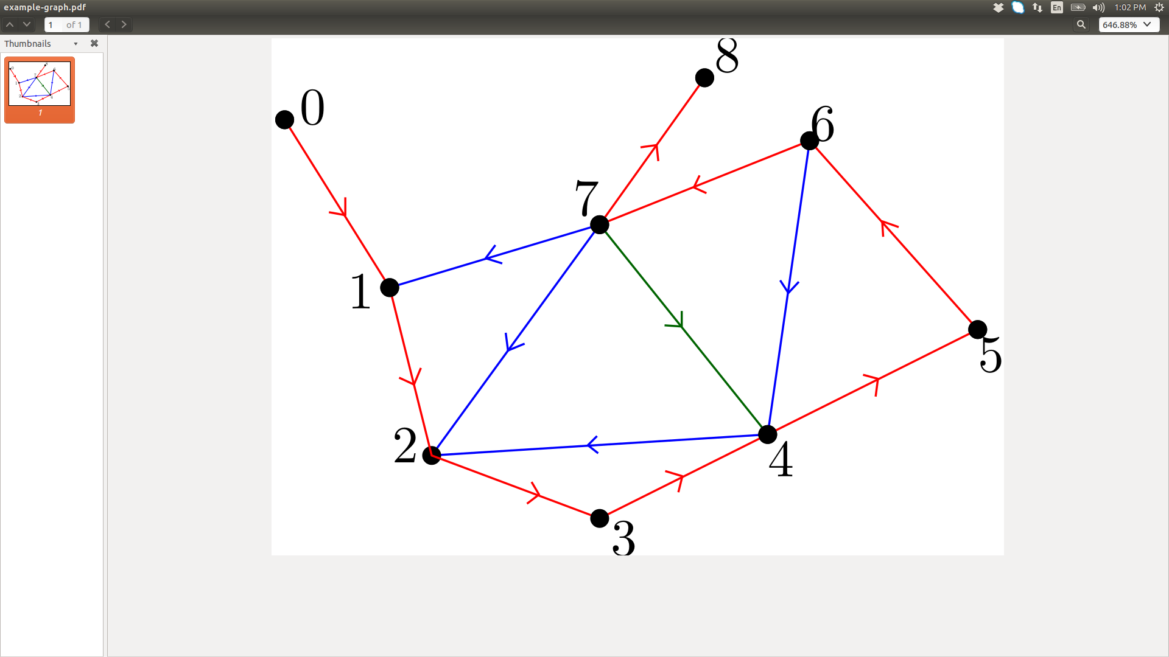
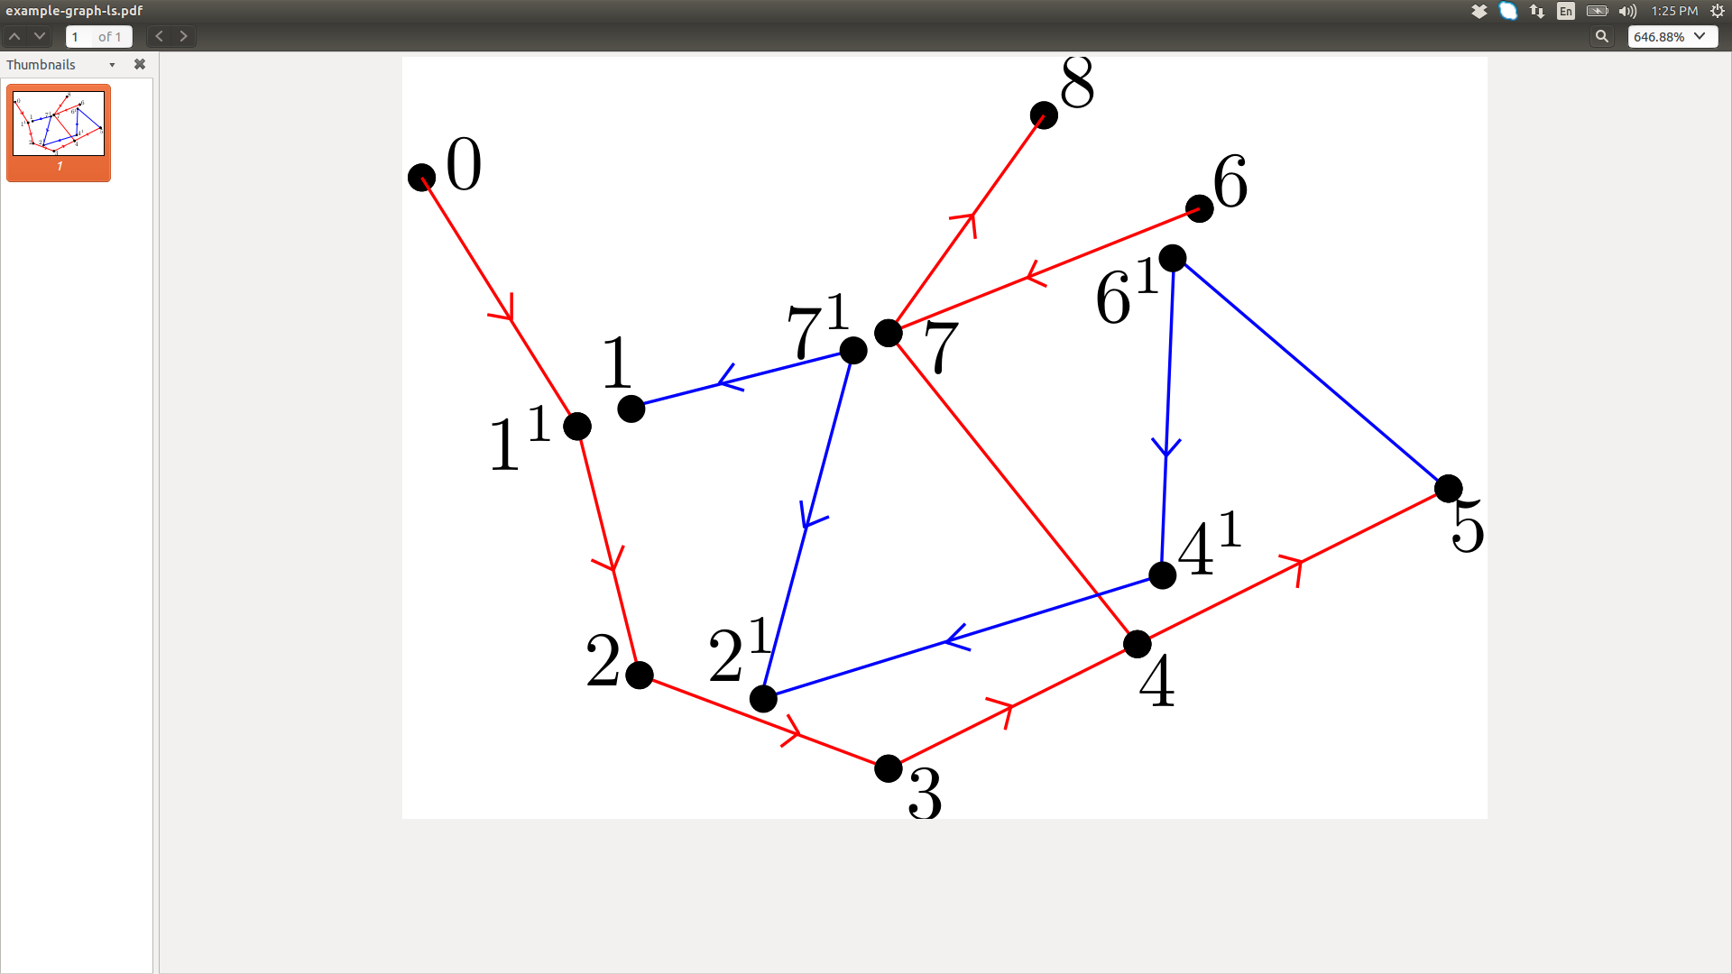
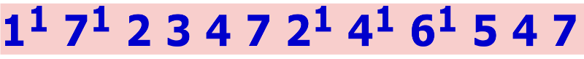
Prüfer Encoding for graphs
Approach: Split vertices to break underlying cycles
Final split-tree
Prüfer code:
COMAD/CODS 2019
Potential applications to machine learning

Slide 24
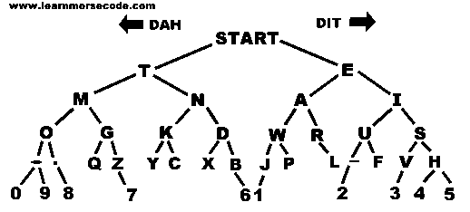
Binary Tree and Coding Theory
Morse-code (1837) message comprises dots (small gaps in two consecutive sounds (relay keys), and dashes (long gaps), essentially 0’s and 1’s;
this encodes alphabets uniquely on the basis of a graph (binary tree)
dashes (1’s) on left branches
dots (0’s) on right branches
1
0
1
0
1
0
1
1
0
Received message: 0 0 0 1 1 1 (. . . - - -)
Decoded message: 0 0| 0 1 | 1 1| => I AM
Decoded message: 0 0 0 | 1 1 1 | => SO
Decoded message: 0 | 0 | 0 | 1 1 1 | => EEEO
Ambiguous! Needs explicit delimiters
variable-length code;
encoding compact

Slide 25
Binary Tree and Coding Theory
dashes (1’s) on left branches
dots (0’s) on right branches
1
0
1
0
1
0
1
1
0
I
S
O
A
M
Received message: 0 0 0 1 1 1
Decoded message: 0 0| 0 1 | 1 1| => I AM
Decoded message: 0 0 0 | 1 1 1 | => SO
0 0 0 1 0 0 1 1 => I AM
1 0 1 1 => SO
Huffman Code: Prefix-free code
Morse-Code
Prefix-free code: => encodes symbols using only leaf-nodes!

Slide 26
Binary Tree Leads to Huffman Coding

Slide 27
Problems
Suppose that we want to encode a message constructed from the symbols A, B, C, D, and E using a fixed-length code
How many bits are required to encode each symbol?
at least 3 bits are required
How many bits are required to encode the message DEAACAAAAABA?
there are twelve symbols, each requires 3 bits
12*3 = 36 bits are required

Slide 28
Drawbacks of fixed-length codes
Wasted space
Same number of bits used to represent all characters
‘a’ and ‘e’ occur more frequently than ‘q’ and ‘z’
Potential solution: use variable-length codes
short codes for characters that occur frequently

Slide 29
Advantages of variable-length codes
The advantage of variable-length codes over fixed-length is short codes can be given to characters that occur frequently
on average, the length of the encoded message is less than fixed-length encoding
Ambiguity Resolution: how do we know where one character ends and another begins?
not a problem if number of bits is fixed!
A = 00
B = 01
C = 10
D = 11
0010110111001111111111
A C D B A D D D D D

Slide 30
Code without prefix property
The following code does not have prefix property
The pattern 1110 can be decoded as QQQP, QTP, QQS, or TS (e.g., Morse Code)
Symbol | Code
P | 0
Q | 1
R | 01
S | 10
T | 11

Slide 31
Example: Prefix-Free Code
DEAACAAAAABA
Symbol | Code
A | 0
B | 100
C | 101
D | 110
E | 111
11011100101000001000
20 bits

Slide 32
What code to use?
Question: Is there a variable-length, prefix-free code that makes the most efficient use of space?
Answer: Yes! Huffman Tree

Slide 33
Huffman coding tree
Binary tree
each leaf contains symbol (character)
label edge from node to left child with 0
label edge from node to right child with 1
Code for any symbol obtained by following path from root to the leaf containing symbol
Code has prefix-free property
leaf node cannot appear on path to another leaf
note: fixed-length codes are special cases of complete Huffman tree and clearly have the prefix-free property

Slide 34
Algorithm: Construction of Huffman Tree (DW: Textbook, 2.3.1)
Find frequencies (or probabilities of each symbol occurring in message
Begin with a forest of single node trees
each contain symbol and its frequency
Do recursively
select two trees with smallest frequency at the root
produce a new binary tree with the selected trees as children and store the sum of their frequencies in the root
Recursion ends when there is one tree
this is the Huffman coding tree (prefix-free coding)

Slide 35
Building a Huffman tree
Prefix-free Code
Frequencies of alphabets in Charles Dicken’s A Tale of Two Cities; shorter codes for more frequent characters

Slide 36
Example
Build the Huffman coding tree for the message
This is his message
Character frequencies
Begin with forest of single trees
A | G | M | T | E | H | b_ | I | S
1 | 1 | 1 | 1 | 2 | 2 | 3 | 3 | 5
1
1
1
1
2
2
3
3
5
A
G
M
T
E
H
_
I
S

Slide 37
Step 1
2
1
1
1
1
2
2
3
3
5
A
G
M
T
E
H
_
I
S

Slide 38
Step 2
2
2
1
1
1
1
2
2
3
3
5
A
G
M
T
E
H
_
I
S

Slide 39
Step 3
2
2
4
1
1
1
1
2
2
3
3
5
A
G
M
T
E
H
_
I
S

Slide 40
Step 4
4
2
2
4
1
1
1
1
2
2
3
3
5
A
G
M
T
E
H
_
I
S

Slide 41
Step 5
4
2
2
4
6
1
1
1
1
2
2
3
3
5
A
G
M
T
E
H
_
I
S

Slide 42
Step 6
8
4
4
2
2
2
2
6
E
H
1
1
1
1
3
3
5
A
G
M
T
_
I
S

Slide 43
Step 7
8
11
4
4
6
5
S
2
2
2
2
3
3
E
H
_
I
1
1
1
1
A
G
M
T

Slide 44
Step 8
19
8
11
4
4
6
5
S
2
2
2
2
3
3
E
H
_
I
1
1
1
1
A
G
M
T

Slide 45
Label edges
19
0
1
8
11
0
1
0
1
4
4
6
5
0
1
0
1
0
1
S
2
2
2
2
3
3
0
1
0
1
E
H
_
I
1
1
1
1
A
G
M
T

Slide 46
Huffman code & encoded message
This is his message
S 11
E 010
H 011
_ 100
I 101
A 0000
G 0001
M 0010
T 0011
00110111011110010111100011101111000010010111100000001010

Slide 47
Theorem (DW: Textbook, 2.3.15)
Given a probability distribution {p_{i}} on n symbols, Huffman
Tree provides prefix-free encoding with minimum
expected length.
Proof: Reading assignment
Also, the expected length (L) of a code word achieves the
Shannon’s lower bound
when {p_{i}} is a power of (1/2); L then becomes exactly equal
to the entropy of the probability distribution!

