Slide 1
Chapter 3
Arithmetic for Computers
Notes:
Morgan Kaufmann Publishers
Chapter 3 — Arithmetic for Computers

Slide 2
Arithmetic for Computers
§3.1 Introduction
Operations on integers
  Addition and subtraction
  Multiplication and division
  Dealing with overflow
Floating-point real numbers
  Representation and operations
Chapter 3 — Arithmetic for Computers — <number>
Notes:
Morgan Kaufmann Publishers
Chapter 3 — Arithmetic for Computers

Slide 3
Floating Point
§3.5 Floating Point
Representation for non-integral numbers
  Including very small and very large numbers
Like scientific notation
  –2.34 × 10⁵⁶
  +0.002 × 10^{–4}
  +987.02 × 10⁹
In binary
  ±1.xxxxxxx₂ × 2^{yyyy}
Types float and double in C
normalized
not normalized
Chapter 3 — Arithmetic for Computers — <number>
Notes:
Morgan Kaufmann Publishers
Chapter 3 — Arithmetic for Computers

Slide 4
Floating Point Standard
Defined by IEEE Std 754, Kahan (1985)
Developed in response to divergence of representations
  Portability issues for scientific code
Now almost universally adopted
Two representations
  Single precision (32-bit)
  Double precision (64-bit)
New standards in the offing? UNUM and POSITs
John L. Gustavson, Posit Arithmetic (2017)
Notes:
Morgan Kaufmann Publishers
Chapter 3 — Arithmetic for Computers

Slide 5
IEEE Floating-Point Format
single: 8 bits
double: 11 bits
single: 23 bits
double: 52 bits
S
Exponent
Fraction
S: sign bit (0 ⇒ non-negative, 1 ⇒ negative)
Normalize significand: 1.0 ≤ |significand| < 2.0
  Always has a leading pre-binary-point 1 bit, so no need to represent it explicitly (hidden bit)
  Significand is Fraction with the “1.” restored
Exponent: excess representation: actual exponent + Bias
  Ensures exponent is unsigned
  Single: Bias = 127; Double: Bias = 1203
Chapter 3 — Arithmetic for Computers — <number>
Notes:
Morgan Kaufmann Publishers
Chapter 3 — Arithmetic for Computers

Slide 6
IEEE Single Precision Floating-Point
Representation of floating point numbers in IEEE 754 standard:
single precision
1
8
23
sign
S
E
M
FP exponent E:
excess 127 binary coding
mantissa:
sign + magnitude, normalized
binary significand w/ hidden
integer bit: 1.M
Actual exponent is
e = E – 127
Floating point exponent E = e + 127
FP exponent (E) Actual exponent e
00000000 (0) Special use
00000001 (1) - 126
00000010 (2) - 125
…………. …….
01111111 (127) 0
…………. …….
11111110 (254) + 127
11111111 (255) Special use

Slide 7
Floating Point (a brief look)
We need a way to represent
  numbers with fractions, e.g., 3.1416
  very small numbers, e.g., .000000001
  very large numbers, e.g., 3.15576 × 10⁹
Representation:
  sign, exponent, significand: (–1)^{sign} × significand × 2^{exponent}
  more bits for significand gives more accuracy
  more bits for exponent increases range
IEEE 754 floating point standard:
  single precision: 8 bit exponent, 23 bit significand
  double precision: 11 bit exponent, 52 bit significand

Slide 8
IEEE 754 floating-point standard
Leading “1” bit of significand is implicit
Exponent is “biased” to make sorting easier
  all 0s is smallest exponent; all 1s is largest
  bias of 127 for single precision and 1023 for double precision
  summary: (–1)^{sign} × (1+significand) × 2^{exponent – bias}
Example:
  decimal: -0.75 = -3/4 = - 3/2²
  binary: -0.11 = -1.1 x 2⁻¹
  floating point: exponent = 126 = 01111110
  IEEE single precision:
  1 01111110 10000000000000000000000

Slide 9
Floating Point Complexities
Operations are somewhat more complicated
In addition to overflow, we may have “underflow”
Accuracy can be a big problem
  IEEE 754 keeps three extra bits, guard , round, and sticky
  Non-zero number divided by zero yields “infinity” → overflow
  Non-zero number divided by infinity yields → underflow
  zero divide by zero yields “not a number (NaN)”
  other complexities
Implementing the standard can be tricky
Not using the standard can be even worse
Remember the 1994 Pentium FDIV bug; write-off cost US$ 300 M

Slide 10
Single-Precision Range
Exponents 00000000 and 11111111 reserved
Smallest value
  Exponent: 00000001
  ⇒ actual exponent = 1 – 127 = –126
  Fraction: 000…00 ⇒ significand = 1.0
  ±1.0 × 2^{–126} ≈ ±1.2 × 10^{–38}
Largest value
  exponent: 11111110
  ⇒ actual exponent = 254 – 127 = +127
  Fraction: 111…11 ⇒ significand ≈ 2.0
  ±2.0 × 2⁺¹²⁷ ≈ ±3.4 × 10⁺³⁸
Chapter 3 — Arithmetic for Computers — <number>
Notes:
Morgan Kaufmann Publishers
Chapter 3 — Arithmetic for Computers

Slide 11
Double-Precision Range
Exponents 0000…00 and 1111…11 reserved
Smallest value
  Exponent: 00000000001
  ⇒ actual exponent = 1 – 1023 = –1022
  Fraction: 000…00 ⇒ significand = 1.0
  ±1.0 × 2^{–1022} ≈ ±2.2 × 10^{–308}
Largest value
  Exponent: 11111111110
  ⇒ actual exponent = 2046 – 1023 = +1023
  Fraction: 111…11 ⇒ significand ≈ 2.0
  ±2.0 × 2⁺¹⁰²³ ≈ ±1.8 × 10⁺³⁰⁸
Chapter 3 — Arithmetic for Computers — <number>
Notes:
Morgan Kaufmann Publishers
Chapter 3 — Arithmetic for Computers

Slide 12
Floating-Point Precision
Relative precision
  all fraction bits are significant
  Single: approx 2^{–23}
    Equivalent to 23 × log₁₀2 ≈ 23 × 0.3 ≈ 6 decimal digits of precision
  Double: approx 2^{–52}
    Equivalent to 52 × log₁₀2 ≈ 52 × 0.3 ≈ 16 decimal digits of precision
Chapter 3 — Arithmetic for Computers — <number>
Notes:
Morgan Kaufmann Publishers
Chapter 3 — Arithmetic for Computers

Slide 13
Floating-Point Example
Represent –0.75
  –0.75 = (–1)¹ × 1.1₂ × 2^{–1}
  S = 1
  Fraction = 1000…00₂
  Exponent = –1 + Bias
    Single: –1 + 127 = 126 = 01111110₂
    Double: –1 + 1023 = 1022 = 01111111110₂
Single: 1 01111110 1000…00
Double: 1 01111111110 1000…00
Chapter 3 — Arithmetic for Computers — <number>
Notes:
Morgan Kaufmann Publishers
Chapter 3 — Arithmetic for Computers

Slide 14
Floating-Point Example
What number is represented by the single-precision float
1 10000001 01000…00
  S = 1
  Fraction = 01000…00₂
  Fxponent = 10000001₂ = 129
x = (–1)¹ × (1 + 01₂) × 2^{(129 – 127)}
  = (–1) × 1.25 × 2²
  = –5.0
Chapter 3 — Arithmetic for Computers — <number>
Notes:
Morgan Kaufmann Publishers
Chapter 3 — Arithmetic for Computers

Slide 15
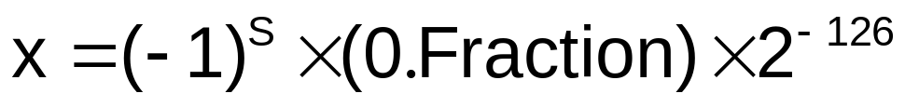
Denormal Numbers
Exponent = 000...0 ⇒ hidden bit is 0,
Smaller than normal numbers
  allow for gradual underflow
Denormal with fraction = 000...0
→ +0, -0
Chapter 3 — Arithmetic for Computers — <number>
Notes:
Morgan Kaufmann Publishers
Chapter 3 — Arithmetic for Computers

Slide 16
Infinities and NaNs
Exponent = 111...1, Fraction = 000...0
  ± Infinity
  Can be used in subsequent calculations, avoiding need for overflow check
Exponent = 111...1, Fraction ≠ 000...0
  Not-a-Number (NaN)
  Indicates illegal or undefined result
    e.g., 0.0 / 0.0
  Can be used in subsequent calculations
Chapter 3 — Arithmetic for Computers — <number>
Notes:
Morgan Kaufmann Publishers
Chapter 3 — Arithmetic for Computers

Slide 17
Floating-Point Addition
Consider a 4-digit decimal example
  9.999 × 10¹ + 1.610 × 10^{–1}
1. Align decimal points
  Shift number with smaller exponent
  9.999 × 10¹ + 0.016 × 10¹
2. Add significands
  9.999 × 10¹ + 0.016 × 10¹ = 10.015 × 10¹
3. Normalize result & check for over/underflow
  1.0015 × 10²
4. Round and renormalize if necessary
  1.002 × 10²
Chapter 3 — Arithmetic for Computers — <number>
Notes:
Morgan Kaufmann Publishers
Chapter 3 — Arithmetic for Computers

Slide 18
Floating-Point Addition
Now consider a 4-digit binary example
  1.000₂ × 2^{–1} + –1.110₂ × 2^{–2} (0.5 + –0.4375)
1. Align binary points
  Shift number with smaller exponent
  1.000₂ × 2^{–1} + –0.111₂ × 2^{–1}
2. Add significands
  1.000₂ × 2^{–1} + –0.111₂ × 2–1 = 0.001₂ × 2^{–1}
3. Normalize result & check for over/underflow
  1.000₂ × 2^{–4}, with no over/underflow
4. Round and renormalize if necessary
  1.000₂ × 2^{–4} (no change) = 0.0625
Chapter 3 — Arithmetic for Computers — <number>
Notes:
Morgan Kaufmann Publishers
Chapter 3 — Arithmetic for Computers

Slide 19
Floating Point Addition
Alignment
The proper digits have to be added
Addition of significands
Normalisation of the result
Rounding
Example in decimal system
precision 4 digits
What is 9.999 • 10¹ + 1.610 • 10⁻¹ ?
Result: 1.002 • 10²

Slide 20
FP Adder Hardware
Much more complex than integer adder
Doing it in one clock cycle would take too long
  Much longer than integer operations
  Slower clock would penalize all instructions
FP adder usually takes several cycles
  Can be pipelined
Chapter 3 — Arithmetic for Computers — <number>
Notes:
Morgan Kaufmann Publishers
Chapter 3 — Arithmetic for Computers

Slide 21
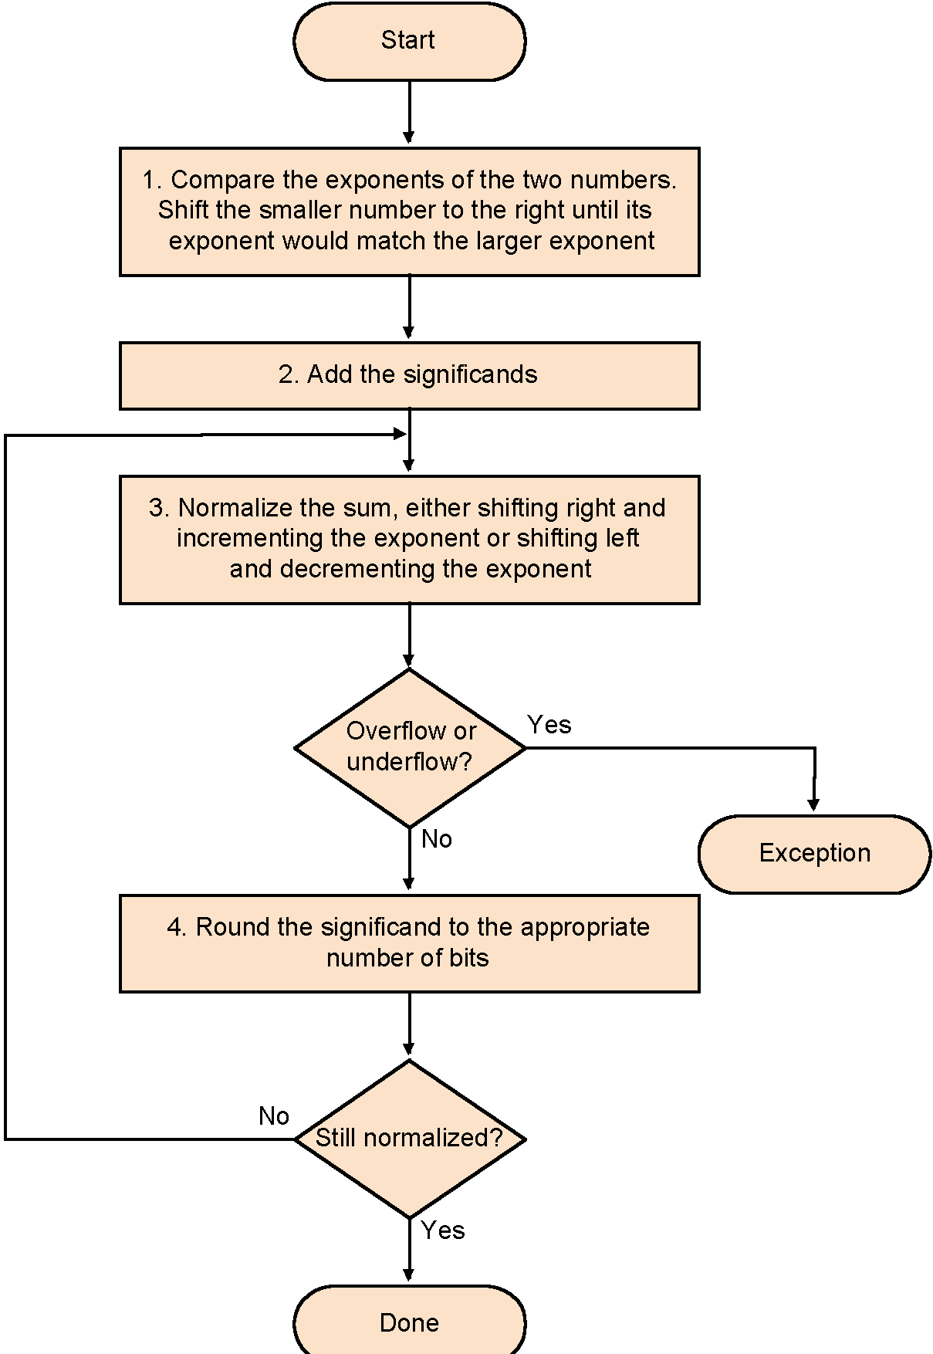
Floating Point Addition

Slide 22

FP Adder Hardware
Step 1
compare exponents
Step 2
equalizing exponents
Integer addition
Step 3
normalize
Step 4
round
Step 5
Result
Chapter 3 — Arithmetic for Computers — <number>
Notes:
Morgan Kaufmann Publishers
Chapter 3 — Arithmetic for Computers

Slide 23
Floating-Point Multiplication
Consider a 4-digit decimal example
  (1.110 × 10¹⁰ ) × (9.200 × 10^{–5} )
1. Add exponents
  For biased exponents, subtract bias from sum
  New exponent = 10 + –5 = 5
2. Multiply significands
  1.110 × 9.200 = 10.212 ⇒ 10.212 × 10⁵
3. Normalize result & check for over/underflow
  1.0212 × 10⁶
4. Round and renormalize if necessary
  1.021 × 10⁶
5. Determine sign of result from signs of operands
  +1.021 × 10⁶
Chapter 3 — Arithmetic for Computers — <number>
Notes:
Morgan Kaufmann Publishers
Chapter 3 — Arithmetic for Computers

Slide 24
Floating-Point Multiplication
Now consider a 4-digit binary example
  1.000₂ × 2^{–1} × –1.110₂ × 2^{–2} (0.5 × –0.4375)
1. Add exponents
  Unbiased: –1 + –2 = –3
  Biased: (–1 + 127) + (–2 + 127) = –3 + 254 – 127 = –3 + 127
2. Multiply significands
  1.000₂ × 1.110₂ = 1.1102 ⇒ 1.110₂ × 2^{–3}
3. Normalize result & check for over/underflow
  1.110₂ × 2^{–3} (no change) with no over/underflow
4. Round and renormalize if necessary
  1.110₂ × 2^{–3} (no change)
5. Determine sign: +ve × –ve ⇒ –ve
  –1.110₂ × 2^{–3} = –0.21875
Chapter 3 — Arithmetic for Computers — <number>
Notes:
Morgan Kaufmann Publishers
Chapter 3 — Arithmetic for Computers

Slide 25
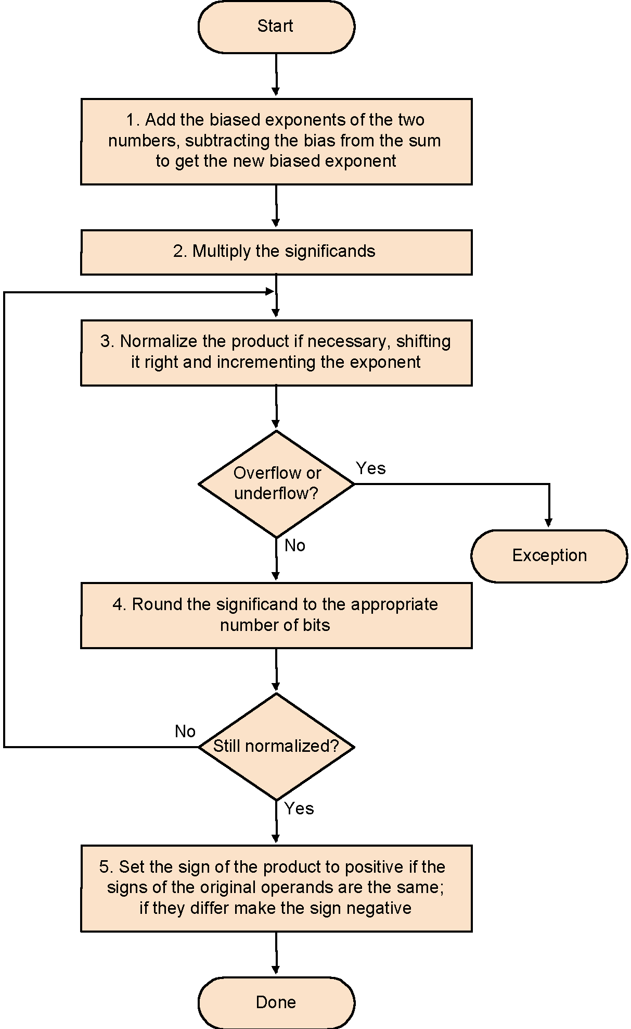
Floating Point Multiplication

Slide 26

Multiplication
§3.3 Multiplication
Start with long-multiplication approach
multiplicand
1000
× 1001
1000
0000
0000
1000
1001000
multiplier
product
Length of product is the sum of operand lengths
Chapter 3 — Arithmetic for Computers — <number>
Notes:
Morgan Kaufmann Publishers
Chapter 3 — Arithmetic for Computers

Slide 27

Integer Multiplication Hardware
Initially 0
Chapter 3 — Arithmetic for Computers — <number>
Notes:
Morgan Kaufmann Publishers
Chapter 3 — Arithmetic for Computers

Slide 28

Optimized Integer Multiplier
Perform steps in parallel: add/shift
One cycle per partial-product addition
  That’s ok, if frequency of multiplications is low
Chapter 3 — Arithmetic for Computers — <number>
Notes:
Morgan Kaufmann Publishers
Chapter 3 — Arithmetic for Computers

Slide 29
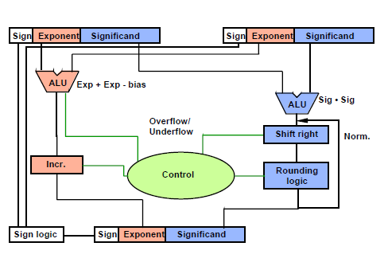
FP Multiplier – Hardware Realization
integer multiplier

Slide 30
FP Arithmetic Hardware
FP multiplier is of similar complexity to FP adder
  But uses a multiplier for significands instead of an adder
FP arithmetic hardware usually does
  Addition, subtraction, multiplication, division, reciprocal, square-root
  FP ↔ integer conversion
Operations usually takes several cycles
  Can be pipelined
Chapter 3 — Arithmetic for Computers — <number>
Notes:
Morgan Kaufmann Publishers
Chapter 3 — Arithmetic for Computers

Slide 31
FP Instructions in MIPS
FP hardware is Co-processor 1
  Adjunct processor that extends the ISA
Separate FP registers
  32 single-precision: $f0, $f1, … $f31
  Paired for double-precision: $f0/$f1, $f2/$f3, …
    Release 2 of MIPs ISA supports 32 × 64-bit FP reg’s
FP instructions operate only on FP registers
  Programs generally don’t do integer ops on FP data, or vice versa
  More registers with minimal code-size impact
FP load and store instructions
  lwc1, swc1,
    e.g., lwc1 $f8, 32($sp)
Chapter 3 — Arithmetic for Computers — <number>
Notes:
Morgan Kaufmann Publishers
Chapter 3 — Arithmetic for Computers

Slide 32
FP Instructions in MIPS
Single-precision arithmetic
  add.s, sub.s, mul.s, div.s
    e.g., add.s $f0, $f1, $f6
Double-precision arithmetic
  add.d, sub.d, mul.d, div.d
    e.g., mul.d $f4, $f4, $f6
Single- and double-precision comparison
Branch on FP condition code true or false
Chapter 3 — Arithmetic for Computers — <number>
Notes:
Morgan Kaufmann Publishers
Chapter 3 — Arithmetic for Computers

Slide 33
FP Example: °F to °C
C code:
float f2c (float fahr) {
return ((5.0/9.0)*(fahr - 32.0));
}
  fahr in $f12, result in $f0, literals in global memory space
Compiled MIPS code:
f2c: lwc1 $f16, const5($gp)
lwc2 $f18, const9($gp)
div.s $f16, $f16, $f18
lwc1 $f18, const32($gp)
sub.s $f18, $f12, $f18
mul.s $f0, $f16, $f18
jr $ra
Chapter 3 — Arithmetic for Computers — <number>
Notes:
Morgan Kaufmann Publishers
Chapter 3 — Arithmetic for Computers

Slide 34
Summary
Computer arithmetic is constrained by limited precision
Bit patterns have no inherent meaning but standards do exist
  two’s complement
  IEEE 754 floating point
Computer instructions determine “meaning” of the bit patterns
Performance and accuracy are important so there are many complexities and implementation challenges in real machines

