Slide 1
DIMENSIONALITY REDUCTION

Slide 2
Dimensionality of input
Number of Observables (e.g. age and income)
If number of observables is increased
  More time to compute
  More memory to store inputs and intermediate results
  More complicated explanations (knowledge from learning)
    Regression from 100 vs. 2 parameters
  No simple visualization
    2D vs. 10D graph
  Need much more data (curse of dimensionality)
    1M of 1-d inputs is not equal to 1 input of dimension 1M
Based on E Alpaydın 2004 Introduction to Machine Learning © The MIT Press (V1.1)

Slide 3
Dimensionality reduction
Some features (dimensions) bear little or nor useful information (e.g. color of hair for a car selection)
  Can drop some features
  Have to estimate which features can be dropped from data
Several features can be combined together without loss or even with gain of information (e.g. income of all family members for loan application)
  Some features can be combined together
  Have to estimate which features to combine from data
Based on E Alpaydın 2004 Introduction to Machine Learning © The MIT Press (V1.1)

Slide 4
Feature Selection vs Extraction
Feature selection: Choosing k<d important features, ignoring the remaining d – k
  Subset selection algorithms
Feature extraction: Project the original x_{i} , i =1,...,d dimensions to new k<d dimensions, z_{j} , j =1,...,k
  Principal Components Analysis (PCA)
  Linear Discriminant Analysis (LDA)
  Factor Analysis (FA)
Lecture Notes for E Alpaydın 2004 Introduction to Machine Learning © The MIT Press (V1.1)

Slide 5
Usage
Have data of dimension d
Reduce dimensionality to k<d
  Discard unimportant features
  Combine several features in one
Use resulting k-dimensional data set for
  Learning for classification problem (e.g. parameters of probabilities P(x|C)
  Learning for regression problem (e.g. parameters for model y=g(x|Thetha)
Based on E Alpaydın 2004 Introduction to Machine Learning © The MIT Press (V1.1)

Slide 6
Subset selection
Have initial set of features of size d
There are 2^d possible subsets
Need a criteria to decide which subset is the best
A way to search over the possible subsets
Can’t go over all 2^d possibilities
Need some heuristics
Based on E Alpaydın 2004 Introduction to Machine Learning © The MIT Press (V1.1)

Slide 7
“Goodness” of feature set
Supervised
  Train using selected subset
  Estimate error on validation data set
Unsupervised
  Look at input only(e.g. age, income and savings)
  Select subset of 2 that bear most of the information about the person
Based on E Alpaydın 2004 Introduction to Machine Learning © The MIT Press (V1.1)

Slide 8
Mutual Information
Have a 3 random variables(features) X,Y,Z and have to select 2 which gives most information
If X and Y are “correlated” then much of the information about of Y is already in X
Make sense to select features which are “uncorrelated”
Mutual Information (Kullback–Leibler Divergence ) is more general measure of “mutual information”
Can be extended to n variables (information variables x₁,.. x_{n} have about variable x_{n+1})
Based on E Alpaydın 2004 Introduction to Machine Learning © The MIT Press (V1.1)

Slide 9
Subset-selection
Forward search
  Start from empty set of features
  Try each of remaining features
  Estimate classification/regression error for adding specific feature
  Select feature that gives maximum improvement in validation error
  Stop when no significant improvement
Backward search
  Start with original set of size d
  Drop features with smallest impact on error
Based on E Alpaydın 2004 Introduction to Machine Learning © The MIT Press (V1.1)

Slide 10
Floating Search
Forward and backward search are “greedy” algorithms
  Select best options at single step
  Do not always achieve optimum value
Floating search
  Two types of steps: Add k, remove l
  More computations
Based on E Alpaydın 2004 Introduction to Machine Learning © The MIT Press (V1.1)

Slide 11
Feature Extraction
Face recognition problem
  Training data input: pairs of Image + Label(name)
  Classifier input: Image
  Classifier output: Label(Name)
Image: Matrix of 256X256=65536 values in range 0..256
Each pixels bear little information so can’t select 100 best ones
Average of pixels around specific positions may give an indication about an eye color.
Based on E Alpaydın 2004 Introduction to Machine Learning © The MIT Press (V1.1)

Slide 12

Projection
Find a projection matrix w from d-dimensional to k-dimensional vectors that keeps error low
Based on E Alpaydın 2004 Introduction to Machine Learning © The MIT Press (V1.1)

Slide 13
PCA: Motivation
Assume that d observables are linear combination of k<d vectors
z_{i}=w_{i1}x_{i1}+…+w_{ik}x_{id}
We would like to work with basis as it has lesser dimension and have all(almost) required information
What we expect from such basis
  Uncorrelated or otherwise can be reduced further
  Have large variance (e.g. w_{i1} have large variation) or otherwise bear no information
Based on E Alpaydın 2004 Introduction to Machine Learning © The MIT Press (V1.1)

Slide 14
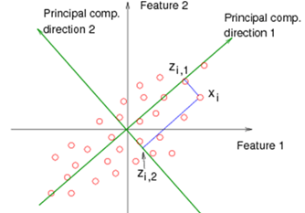
PCA: Motivation
Based on E Alpaydın 2004 Introduction to Machine Learning © The MIT Press (V1.1)

Slide 15
PCA: Motivation
Choose directions such that a total variance of data will be maximum
  Maximize Total Variance
Choose directions that are orthogonal
  Minimize correlation
Choose k<d orthogonal directions which maximize total variance
Based on E Alpaydın 2004 Introduction to Machine Learning © The MIT Press (V1.1)

Slide 16








PCA
Choosing only directions:
Maximize variance subject to a constrain using Lagrange Multipliers
Taking Derivatives
Eigenvector. Since want to maximize we should choose an eigenvector with largest eigenvalue
Based on E Alpaydın 2004 Introduction to Machine Learning © The MIT Press (V1.1)

Slide 17

PCA
d-dimensional feature space
d by d symmetric covariance matrix estimated from samples
Select k largest eigenvalue of the covariance matrix and associated k eigenvectors
The first eigenvector will be a direction with largest variance
Based on E Alpaydın 2004 Introduction to Machine Learning © The MIT Press (V1.1)

Slide 18
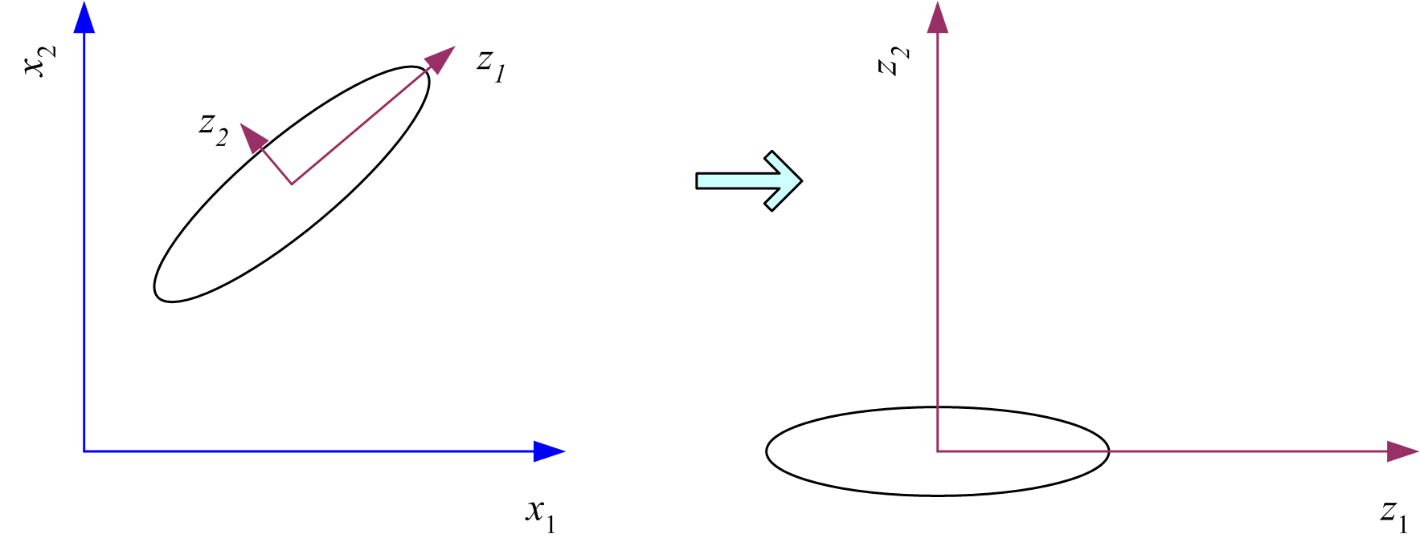
What PCA does
z = W^{T}(x – m)
where the columns of W are the eigenvectors of ∑, and m is sample mean
Centers the data at the origin and rotates the axes
Based on E Alpaydın 2004 Introduction to Machine Learning © The MIT Press (V1.1)

Slide 19
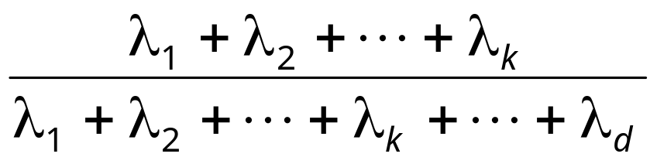
How to choose k ?
Proportion of Variance (PoV) explained
when λ_{i} are sorted in descending order
Typically, stop at PoV>0.9
Scree graph plots of PoV vs k, stop at “elbow”
Lecture Notes for E Alpaydın 2004 Introduction to Machine Learning © The MIT Press (V1.1)

Slide 20
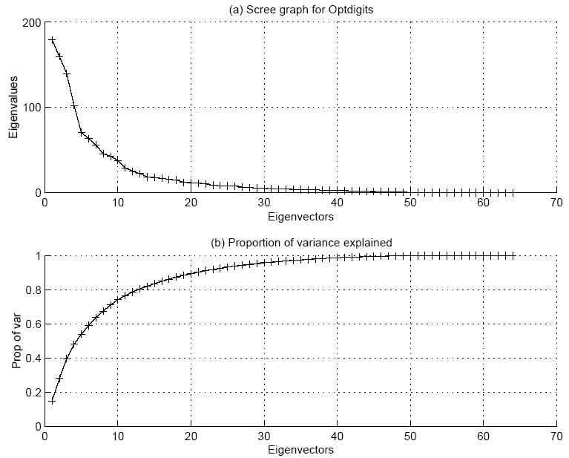
Lecture Notes for E Alpaydın 2004 Introduction to Machine Learning © The MIT Press (V1.1)

Slide 21
PCA
PCA is unsupervised (does not take into account class information)
Can take into account classes : Karhuned-Loeve Expansion
  Estimate Covariance Per Class
  Take average weighted by prior
Common Principle Components
  Assume all classes have same eigenvectors (directions) but different variances
Lecture Notes for E Alpaydın 2004 Introduction to Machine Learning © The MIT Press (V1.1)

Slide 22
PCA
Does not try to explain noise
  Large noise can become new dimension/largest PC
Interested in resulting uncorrelated variables which explain large portion of total sample variance
Sometimes interested in explained shared variance (common factors) that affect data
Based on E Alpaydın 2004 Introduction to Machine Learning © The MIT Press (V1.1)

Slide 23
Factor Analysis
Assume set of unobservable (“latent”) variables
Goal: Characterize dependency among observables using latent variables
Suppose group of variables having large correlation among themselves and small correlation with other variables
Single factor?
Based on E Alpaydın 2004 Introduction to Machine Learning © The MIT Press (V1.1)

Slide 24
Factor Analysis
Assume k input factors (latent unobservable) variables generating d observables
Assume all variations in observable variables are due to latent or noise (with unknown variance)
Find transformation from unobservable to observables which explain the data
Based on E Alpaydın 2004 Introduction to Machine Learning © The MIT Press (V1.1)

Slide 25

Factor Analysis
Find a small number of factors z, which when combined generate x :
x_{i} – µ_{i} = v_{i1}z₁ + v_{i2}z₂ + ... + v_{ik}z_{k} + ε_{i}
where z_{j}, j =1,...,k are the latent factors with
E[ z_{j} ]=0, Var(z_{j})=1, Cov(z_{i ,}, z_{j})=0, i ≠ j ,
ε_{i} are the noise sources
E[ ε_{i} ]= ψ_{i}, Cov(ε_{i} , ε_{j}) =0, i ≠ j, Cov(ε_{i} , z_{j}) =0 ,
and v_{ij} are the factor loadings
Lecture Notes for E Alpaydın 2004 Introduction to Machine Learning © The MIT Press (V1.1)

Slide 26


Factor Analysis
Find V such that where S is estimation of covariance matrix and V loading (explanation by latent variables)
V is d x k matrix (k<d)
Solution using eigenvalue and eigenvectors
Based on E Alpaydın 2004 Introduction to Machine Learning © The MIT Press (V1.1)

Slide 27
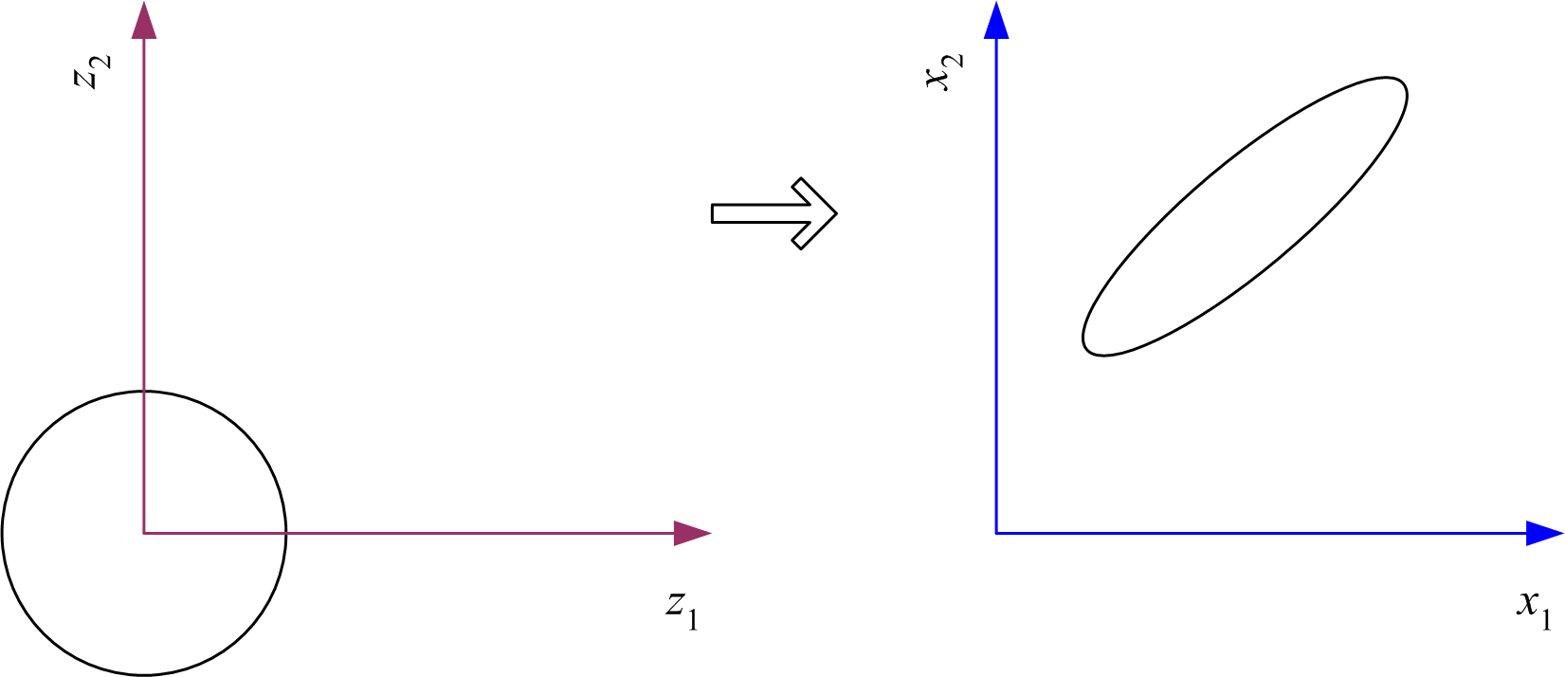
Factor Analysis
In FA, factors z_{j} are stretched, rotated and translated to generate x
Lecture Notes for E Alpaydın 2004 Introduction to Machine Learning © The MIT Press (V1.1)

Slide 28
FA Usage
Speech is a function of position of small number of articulators (lungs, lips, tongue)
Factor analysis: go from signal space (4000 points for 500ms ) to articulation space (20 points)
Classify speech (assign text label) by 20 points
Speech Compression: send 20 values
Based on E Alpaydın 2004 Introduction to Machine Learning © The MIT Press (V1.1)

Slide 29
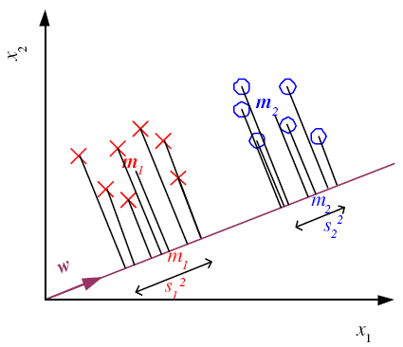
Linear Discriminant Analysis
Find a low-dimensional space such that when x is projected, classes are well-separated
Based on E Alpaydın 2004 Introduction to Machine Learning © The MIT Press (V1.1)

Slide 30
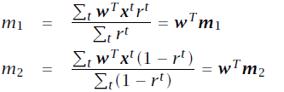
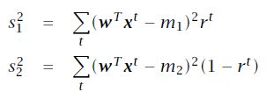
Means and Scatter after projection
Based on E Alpaydın 2004 Introduction to Machine Learning © The MIT Press (V1.1)

Slide 31
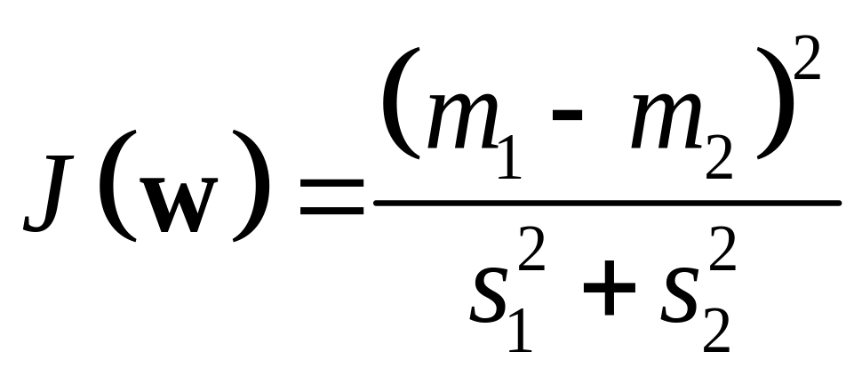
Good Projection
Means are far away as possible
Scatter is small as possible
Fisher Linear Discriminant
Based on E Alpaydın 2004 Introduction to Machine Learning © The MIT Press (V1.1)

Slide 32
Summary
Feature selection
  Supervised: drop features which don’t introduce large errors (validation set)
  Unsupervised: keep only uncorrelated features (drop features that don’t add much information)
Feature extraction
  Linearly combine feature into smaller set of features
  Supervised
    PCA: explain most of the total variability
    FA: explain most of the common variability
  Unsupervised
    LDA: best separate class instances
Based on E Alpaydın 2004 Introduction to Machine Learning © The MIT Press (V1.1)

