Slide 1
Support Vector Machines

Slide 2
Linear Separators
Binary classification can be viewed as the task of separating classes in feature space:
w^{T}x + b = 0
w^{T}x + b > 0
w^{T}x + b < 0
f(x) = sign(w^{T}x + b)

Slide 3
Linear Separators
Which of the linear separators is optimal?

Slide 4
What is a good Decision Boundary?
Many decision boundaries!
The Perceptron algorithm can be used to find such a boundary
Are all decision boundaries equally good?
Class 2
Class 1
Notes:
Perceptron learning rule can be used to find any decision boundary between class 1 and class 2

Slide 5
Examples of Bad Decision Boundaries
Class 2
Class 2
Class 1
Class 1

Slide 6




Finding the Decision Boundary
Let {x₁, ..., x_{n}} be our data set and let y_{i} ∈ {1,-1} be the class label of x_{i}
For y_{i}=1
For y_{i}=-1
y=1
y=1
So:
y=1
y=-1
y=1
y=-1
y=1
Class 2
y=-1
y=-1
y=-1
m
Class 1
y=-1

Slide 7
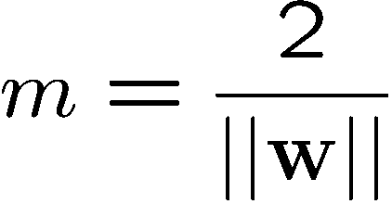
Large-margin Decision Boundary
The decision boundary should be as far away from the data of both classes as possible
We should maximize the margin, m
Class 2
m
Class 1

Slide 8
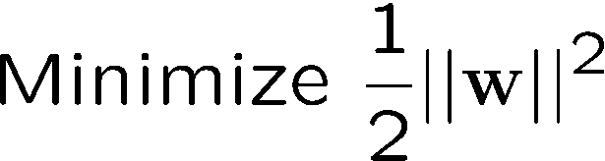
Finding the Decision Boundary
The decision boundary should classify all points correctly ⇒
The decision boundary can be found by solving the following constrained optimization problem
This is a constrained optimization problem. Solving it requires to use Lagrange multipliers

Slide 9
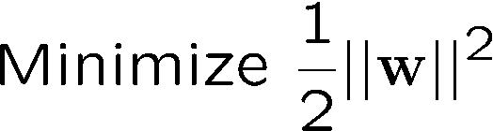
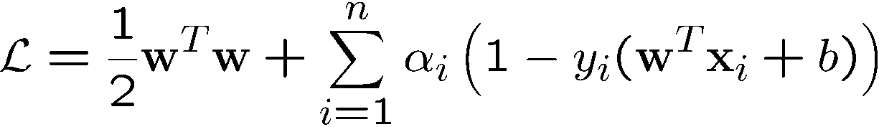
Finding the Decision Boundary
The Lagrangian is
α_{i}≥0
Note that ||w||² = w^{T}w

Slide 10
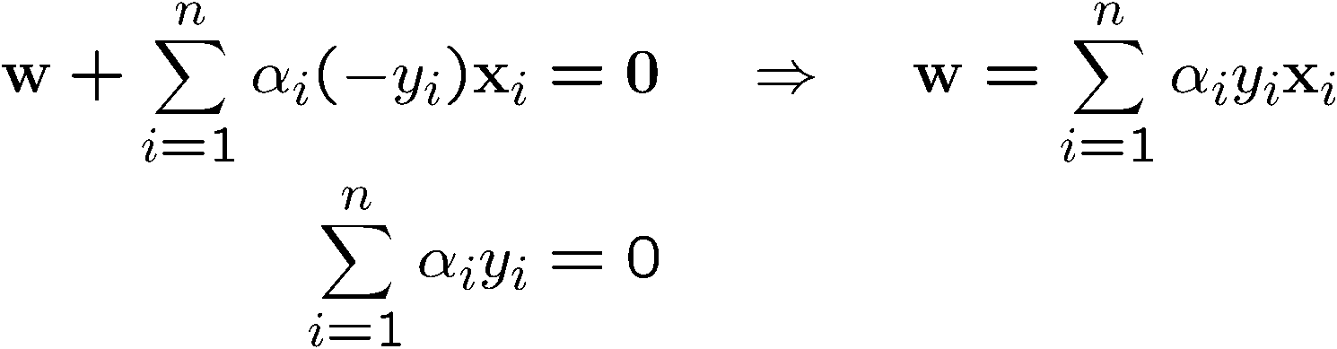
Gradient with respect to w and b
Setting the gradient of w.r.t. w and b to zero, we have
n: no of examples, m: dimension of the space

Slide 11
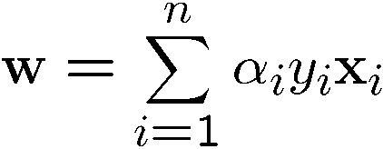

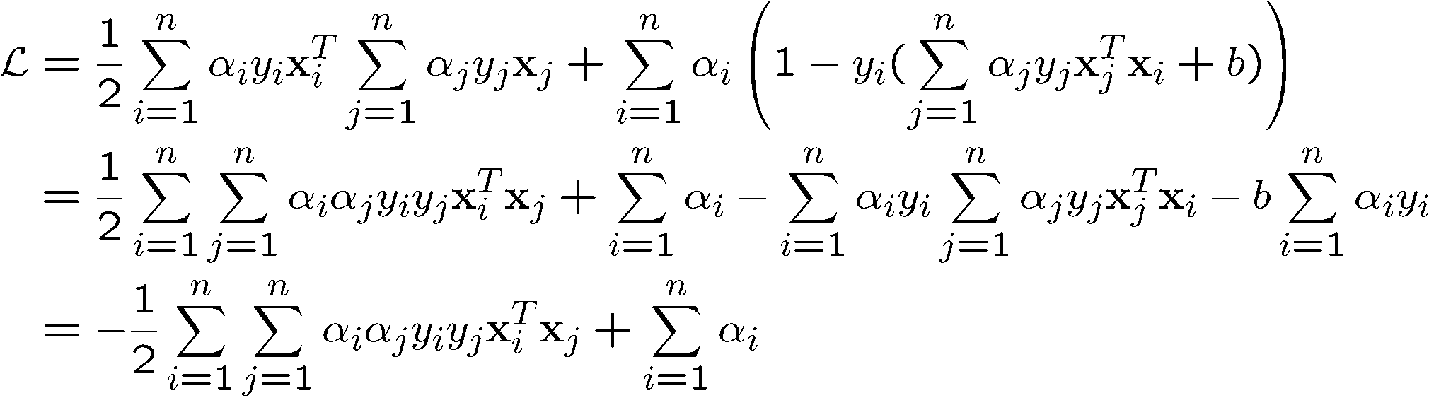
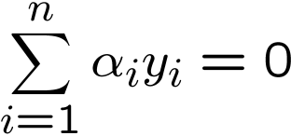
The Dual Problem
If we substitute to , we have
Since
This is a function of α_{i} only

Slide 12
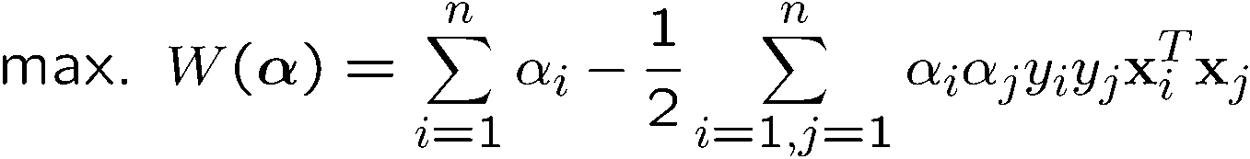
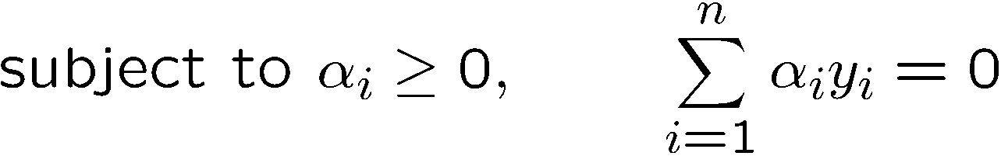
The Dual Problem
The new objective function is in terms of α_{i} only
It is known as the dual problem: if we know w, we know all α_{i}; if we know all α_{i}, we know w
The original problem is known as the primal problem
The objective function of the dual problem needs to be maximized (comes out from the KKT theory)
The dual problem is therefore:
Properties of α_{i} when we introduce the Lagrange multipliers
The result when we differentiate the original Lagrangian w.r.t. b

Slide 13
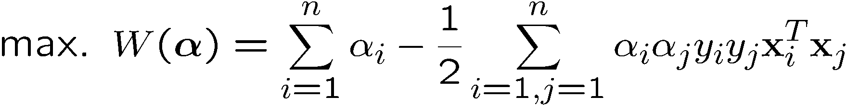
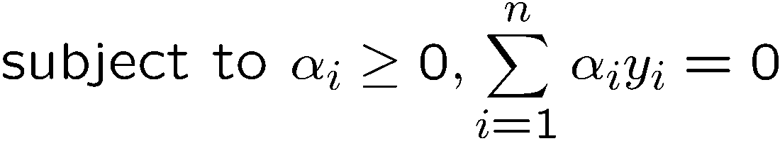
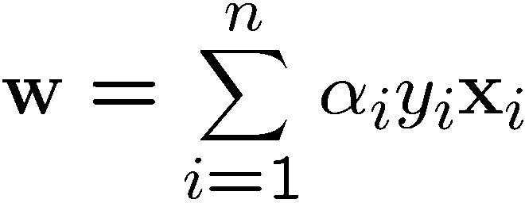
The Dual Problem
This is a quadratic programming (QP) problem
A global maximum of α_{i} can always be found
w can be recovered by
Notes:
Let x(1) and x(-1) be two S.V.
Then b = -1/2( w^T x(1) + w^T x(-1) )

Slide 14
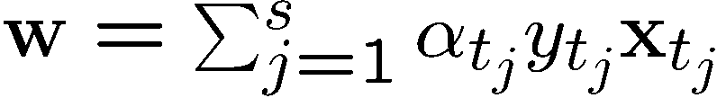
Characteristics of the Solution
Many of the α_{i} are zero
w is a linear combination of a small number of data points
This “sparse” representation can be viewed as data compression as in the construction of knn classifier
x_{i} with non-zero α_{i} are called support vectors (SV)
The decision boundary is determined only by the SV
Let t_{j} (j=1, ..., s) be the indices of the s support vectors. We can write
Note: w need not be formed explicitly

Slide 15




A Geometrical Interpretation
Class 2
α₁₀=0
α₈=0.6
α₇=0
α₂=0
α₅=0
α₁=0.8
α₄=0
α₆=1.4
α₉=0
α₃=0
Class 1
Notes:
So, if change internal points, no effect on the decision boundary

Slide 16
Characteristics of the Solution
For testing with a new data z
Compute and classify z as class 1 if the sum is positive, and class 2 otherwise
Note: w need not be formed explicitly

Slide 17
The Quadratic Programming Problem
Many approaches have been proposed
Loqo, cplex, etc. (see http://www.numerical.rl.ac.uk/qp/qp.html)
Most are “interior-point” methods
Start with an initial solution that can violate the constraints
Improve this solution by optimizing the objective function and/or reducing the amount of constraint violation
For SVM, sequential minimal optimization (SMO) seems to be the most popular
A QP with two variables is trivial to solve
Each iteration of SMO picks a pair of (α_{i},α_{j}) and solve the QP with these two variables; repeat until convergence
In practice, we can just regard the QP solver as a “black-box” without bothering how it works

Slide 18








Non-linearly Separable Problems
We allow “error” ξ_{i} in classification; it is based on the output of the discriminant function w^{T}x+b
ξ_{i} approximates the number of misclassified samples
Class 2
Class 1

Slide 19
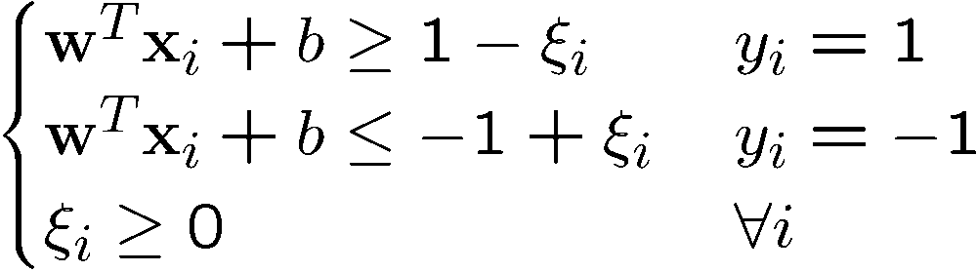
Soft Margin Hyperplane
The new conditions become
ξ_{i} are “slack variables” in optimization
Note that ξ_{i}=0 if there is no error for x_{i}
ξ_{i} is an upper bound of the number of errors
We want to minimize
C : tradeoff parameter between error and margin

Slide 20
The Optimization Problem
With α and μ Lagrange multipliers, POSITIVE
Notes:
Note also, everything is done by inner-products

Slide 21
The Dual Problem
With
Notes:
Note also, everything is done by inner-products

Slide 22
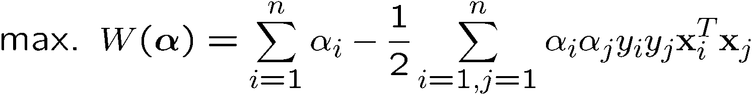
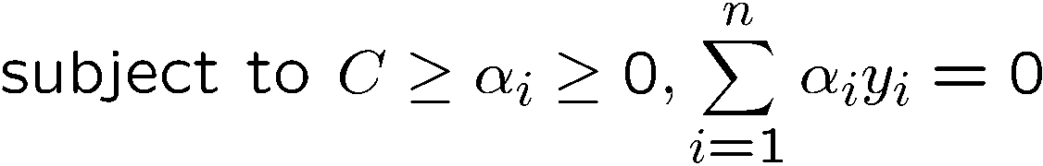
The Optimization Problem
The dual of this new constrained optimization problem is
New constrainsderive from since μ and α are positive.
w is recovered as
This is very similar to the optimization problem in the linear separable case, except that there is an upper bound C on α_{i} now
Once again, a QP solver can be used to find α_{i}
Notes:
Note also, everything is done by inner-products

Slide 23
The algorithm try to keep ξ null, maximising the margin
The algorithm does not minimise the number of error. Instead, it minimises the sum of distances fron the hyperplane
When C increases the number of errors tend to lower. At the limit of C tending to infinite, the solution tend to that given by the hard margin formulation, with 0 errors

Slide 24
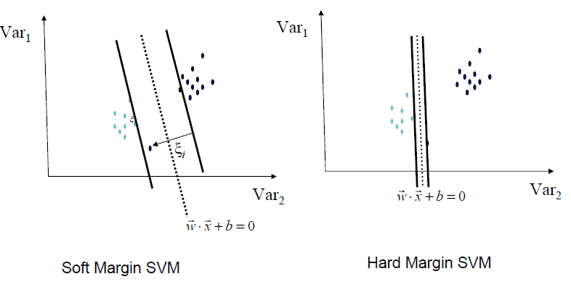
Soft margin is more robust

Slide 25
Extension to Non-linear Decision Boundary
So far, we have only considered large-margin classifier with a linear decision boundary
How to generalize it to become nonlinear?
Key idea: transform x_{i} to a higher dimensional space to “make life easier”
Input space: the space the point x_{i} are located
Feature space: the space of φ(x_{i}) after transformation
Why transform?
Linear operation in the feature space is equivalent to non-linear operation in input space
Classification can become easier with a proper transformation. In the XOR problem, for example, adding a new feature of x₁x₂ make the problem linearly separable
Notes:
XOR: x_1, x_2, and we want to transform to x_1^2, x_2^2, x_1 x_2
It can also be viewed as feature extraction from the feature vector x, but now we extract more feature than the number of features in x.

Slide 26
XOR
Is not linearly separable
X | Y
0 | 0 | 0
0 | 1 | 1
1 | 0 | 1
1 | 1 | 0
Is linearly separable
X | Y | XY
0 | 0 | 0 | 0
0 | 1 | 0 | 1
1 | 0 | 0 | 1
1 | 1 | 1 | 0

Slide 27
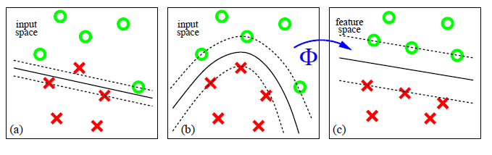
Find a feature space

Slide 28
Transforming the Data
φ( )
φ( )
φ( )
φ( )
φ( )
φ(.)
φ( )
φ( )
φ( )
φ( )
φ( )
φ( )
φ( )
φ( )
φ( )
φ( )
φ( )
φ( )
φ( )
Input space
Feature space
Note: feature space is of higher dimension than the input space in practice
Computation in the feature space can be costly because it is high dimensional
The feature space is typically infinite-dimensional!
The kernel trick comes to rescue

Slide 29
Transforming the Data
φ( )
φ( )
φ( )
φ( )
φ( )
φ(.)
φ( )
φ( )
φ( )
φ( )
φ( )
φ( )
φ( )
φ( )
φ( )
φ( )
φ( )
φ( )
φ( )
Input space
Feature space
Note: feature space is of higher dimension than the input space in practice
Computation in the feature space can be costly because it is high dimensional
The feature space is typically infinite-dimensional!
The kernel trick comes to rescue

Slide 30


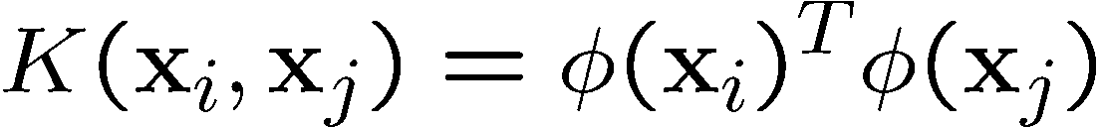
The Kernel Trick
Recall the SVM optimization problem
The data points only appear as inner product
As long as we can calculate the inner product in the feature space, we do not need the mapping explicitly
Many common geometric operations (angles, distances) can be expressed by inner products
Define the kernel function K by

Slide 31
An Example for φ(.) and K(.,.)
Suppose φ(.) is given as follows
An inner product in the feature space is
So, if we define the kernel function as follows, there is no need to carry out φ(.) explicitly
This use of kernel function to avoid carrying out φ(.) explicitly is known as the kernel trick

Slide 32
Kernels
Given a mapping:
a kernel is represented as the inner product
A kernel must satisfy the Mercer’s condition:

Slide 33
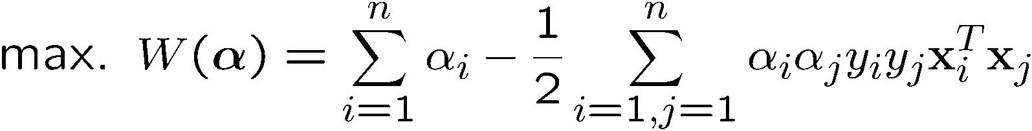

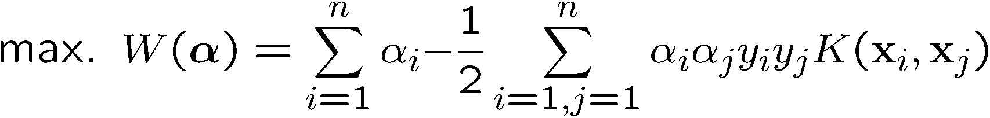
Modification Due to Kernel Function
Change all inner products to kernel functions
For training,
Original
With kernel function

Slide 34
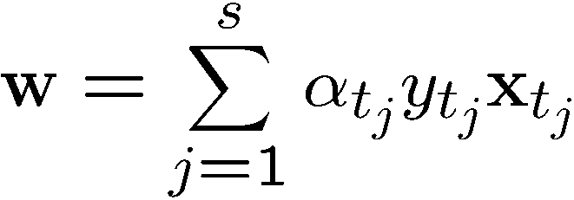
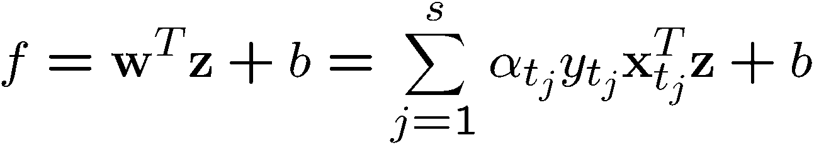
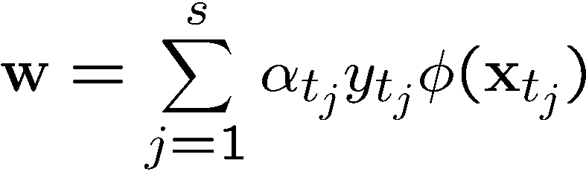
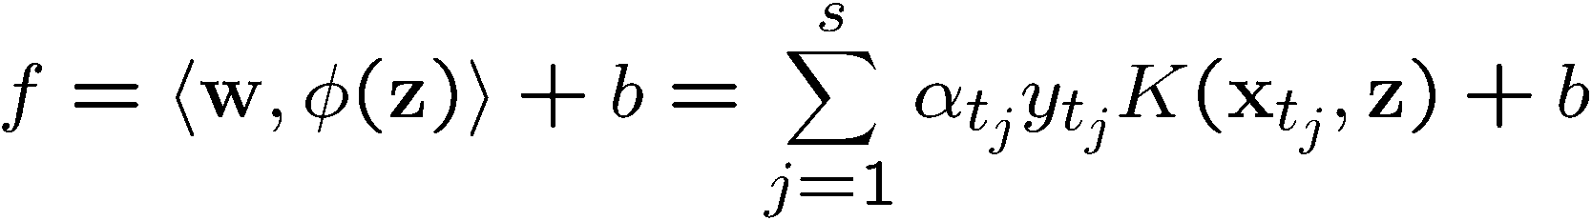
Modification Due to Kernel Function
For testing, the new data z is classified as class 1 if f ≥0, and as class 2 if f <0
Original
With kernel function

Slide 35
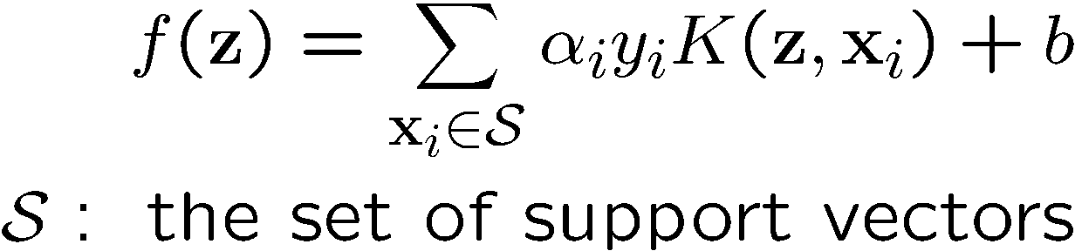
More on Kernel Functions
Since the training of SVM only requires the value of K(x_{i}, x_{j}), there is no restriction of the form of x_{i} and x_{j}
x_{i} can be a sequence or a tree, instead of a feature vector
K(x_{i}, x_{j}) is just a similarity measure comparing x_{i} and x_{j}
For a test object z, the discriminant function essentially is a weighted sum of the similarity between z and a pre-selected set of objects (the support vectors)

Slide 36
Example
Suppose we have 5 1D data points
x₁=1, x₂=2, x₃=4, x₄=5, x₅=6, with 1, 2, 6 as class 1 and 4, 5 as class 2 ⇒ y₁=1, y₂=1, y₃=-1, y₄=-1, y₅=1
Notes:
H =
4 9 -25 -36 49
9 25 -81 -121 169
-25 -81 289 441 -625
-36 -121 441 676 -961
49 169 -625 -961 1369

Slide 37
Example
class 1
class 2
class 1
1
2
4
5
6

Slide 38
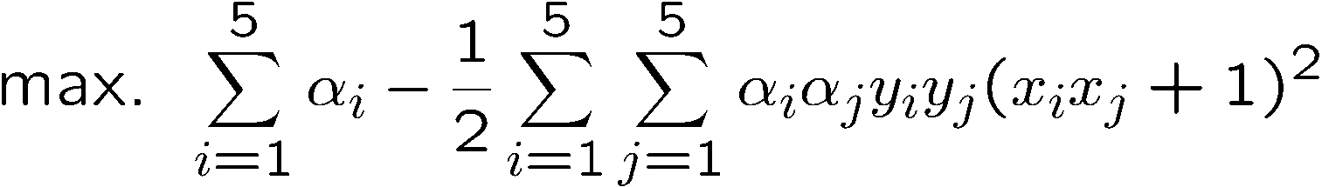
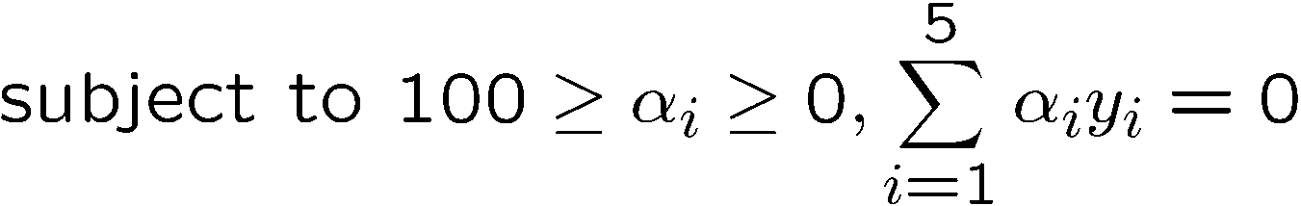
Example
We use the polynomial kernel of degree 2
K(x,y) = (xy+1)²
C is set to 100
We first find α_{i} (i=1, …, 5) by
Notes:
H =
4 9 -25 -36 49
9 25 -81 -121 169
-25 -81 289 441 -625
-36 -121 441 676 -961
49 169 -625 -961 1369

Slide 39



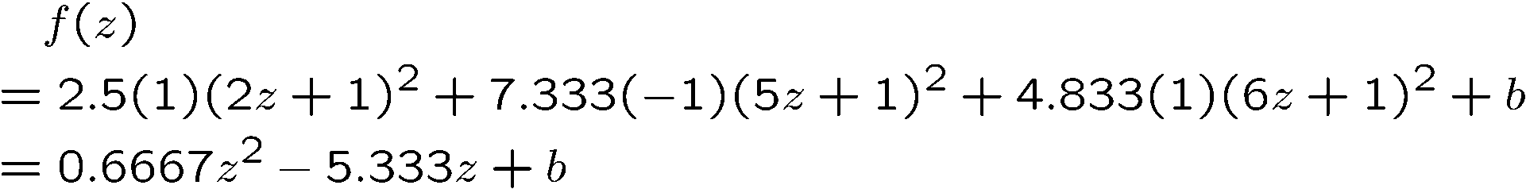
Example
By using a QP solver, we get
α₁=0, α₂=2.5, α₃=0, α₄=7.333, α₅=4.833
Note that the constraints are indeed satisfied
The support vectors are {x₂=2, x₄=5, x₅=6}
The discriminant function is
b is recovered by solving f(2)=1 or by f(5)=-1 or by f(6)=1,
All three give b=9
Notes:
The optimization toolbox of matlab contains a quadratic programming solver

Slide 40
Example
Value of discriminant function
class 1
class 2
class 1
1
2
4
5
6

Slide 41
Kernel Functions
In practical use of SVM, the user specifies the kernel function; the transformation φ(.) is not explicitly stated
Given a kernel function K(x_{i}, x_{j}), the transformation φ(.) is given by its eigenfunctions (a concept in functional analysis)
Eigenfunctions can be difficult to construct explicitly
This is why people only specify the kernel function without worrying about the exact transformation
Another view: kernel function, being an inner product, is really a similarity measure between the objects

Slide 42
A kernel is associated to a transformation
Given a kernel, in principle it should be recovered the transformation in the feature space that originates it.
K(x,y) = (xy+1)²= x²y²+2xy+1
It corresponds the transformation

Slide 43
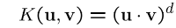

Examples of Kernel Functions
Polynomial kernel up to degree d
Polynomial kernel up to degree d
Radial basis function kernel with width σ
The feature space is infinite-dimensional
Sigmoid with parameter κ and θ
It does not satisfy the Mercer condition on all κ and θ
Notes:
Despite violating Mercer condition, the sigmoid kernel function can still work

Slide 44
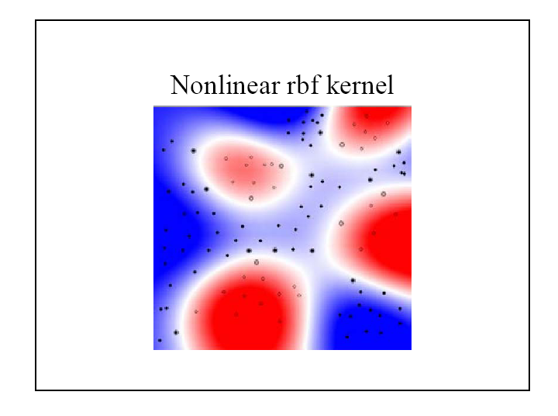
Example
44

Slide 45
Building new kernels
If k₁(x,y) and k₂(x,y) are two valid kernels then the following kernels are valid
Linear Combination
Exponential
Product
Polymomial tranfsormation (Q: polymonial with non negative coeffients)
Function product (f: any function)
Notes:
Despite violating Mercer condition, the sigmoid kernel function can still work

Slide 46
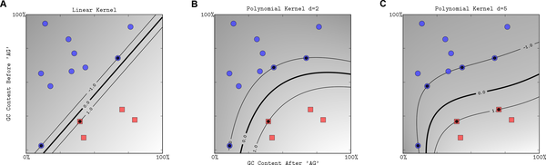
Ploynomial kernel

Slide 47
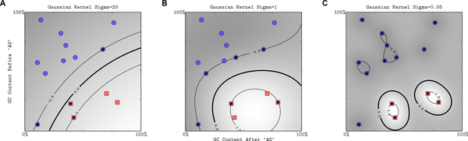
Gaussian RBF kernel

Slide 48
Spectral kernel for sequences
Given a DNA sequence x we can count the number of bases (4-D feature space)
Or the number of dimers (16-D space)
Or l-mers (4^{l} –D space)
The spectral kernel is

Slide 49
Choosing the Kernel Function
Probably the most tricky part of using SVM.
The kernel function is important because it creates the kernel matrix, which summarizes all the data
Many principles have been proposed (diffusion kernel, Fisher kernel, string kernel, …)
There is even research to estimate the kernel matrix from available information
In practice, a low degree polynomial kernel or RBF kernel with a reasonable width is a good initial try
Note that SVM with RBF kernel is closely related to RBF neural networks, with the centers of the radial basis functions automatically chosen for SVM

Slide 50
Other Aspects of SVM
How to use SVM for multi-class classification?
One can change the QP formulation to become multi-class
More often, multiple binary classifiers are combined
See DHS 5.2.2 for some discussion
One can train multiple one-versus-all classifiers, or combine multiple pairwise classifiers “intelligently”
How to interpret the SVM discriminant function value as probability?
By performing logistic regression on the SVM output of a set of data (validation set) that is not used for training
Some SVM software (like libsvm) have these features built-in

Slide 51
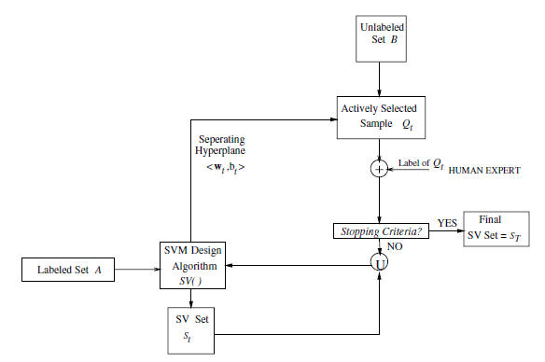
Active Support Vector Learning
P. Mitra, B. Uma Shankar and S. K. Pal, Segmentation of multispectral remote sensing
Images using active support vector machines, Pattern Recognition Letters, 2004.

Slide 52
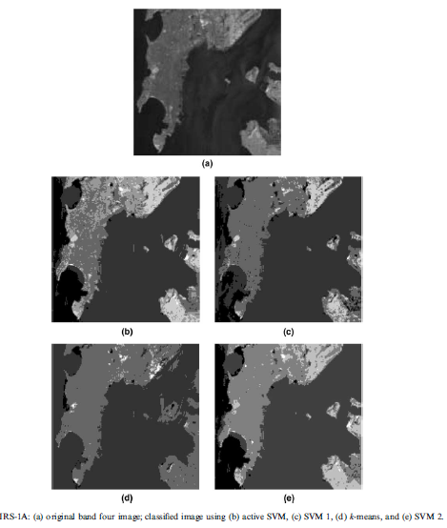
Supervised Classification

Slide 53
Software
A list of SVM implementation can be found at http://www.kernel-machines.org/software.html
Some implementation (such as LIBSVM) can handle multi-class classification
SVMLight is among one of the earliest implementation of SVM
Several Matlab toolboxes for SVM are also available

Slide 54
Summary: Steps for Classification
Prepare the pattern matrix
Select the kernel function to use
Select the parameter of the kernel function and the value of C
You can use the values suggested by the SVM software, or you can set apart a validation set to determine the values of the parameter
Execute the training algorithm and obtain the α_{i}
Unseen data can be classified using the α_{i} and the support vectors

Slide 55
Strengths and Weaknesses of SVM
Strengths
Training is relatively easy
No local optimal, unlike in neural networks
It scales relatively well to high dimensional data
Tradeoff between classifier complexity and error can be controlled explicitly
Non-traditional data like strings and trees can be used as input to SVM, instead of feature vectors
Weaknesses
Need to choose a “good” kernel function.

Slide 56
Conclusion
SVM is a useful alternative to neural networks
Two key concepts of SVM: maximize the margin and the kernel trick
Many SVM implementations are available on the web for you to try on your data set!

Slide 57
Resources
http://www.kernel-machines.org/
http://www.support-vector.net/
http://www.support-vector.net/icml-tutorial.pdf
http://www.kernel-machines.org/papers/tutorial-nips.ps.gz
http://www.clopinet.com/isabelle/Projects/SVM/applist.html

