Slide 1


Decision Trees

Slide 2
Representation of Concepts
Concept learning: conjunction of attributes
  (Sunny AND Hot AND Humid AND Windy) +
Decision trees: disjunction of conjunction of attributes
  (Sunny AND Normal) OR (Overcast) OR (Rain AND Weak) +
  More powerful representation
  Larger hypothesis space H
  Can be represented as a tree
  Common form of decision
  making in humans
OutdoorSport
sunny
overcast
rain
Humidity
Yes
Wind
high
normal
strong
weak
No
Yes
No
Yes

Slide 3
Rectangle learning….
- - - - - - - - - - -
- -
- -
- -
- -
+ + + + + + +
+ + + + + +
- -
- -
- -
- -
Conjunctions
(single rectangle)
- - - - - - - - - - -
- - - - - - - - - - -
- -
- -
- -
- -
- - - - - - - - - - -
+ + + + + + +
+ + + + + +
- - - - - - - - - - -
- -
- -
- -
- -
Disjunctions of Conjunctions
(union of rectangles)
- -
- -
- -
- -
+ + + + + + +
+ + + + + +
- -
- -
- -
- -
- -
- -
- -
- -
- - - - - - - - - - -

Slide 4
Training Examples
Day | Outlook | Temp | Humidity | Wind | Tennis?
D1 | Sunny | Hot | High | Weak | No
D2 | Sunny | Hot | High | Strong | No
D3 | Overcast | Hot | High | Weak | Yes
D4 | Rain | Mild | High | Weak | Yes
D5 | Rain | Cool | Normal | Weak | Yes
D6 | Rain | Cool | Normal | Strong | No
D7 | Overcast | Cool | Normal | Strong | Yes
D8 | Sunny | Mild | High | Weak | No
D9 | Sunny | Cool | Normal | Weak | Yes
D10 | Rain | Mild | Normal | Weak | Yes
D11 | Sunny | Mild | Normal | Strong | Yes
D12 | Overcast | Mild | High | Strong | Yes
D13 | Overcast | Hot | Normal | Weak | Yes
D14 | Rain | Mild | High | Strong | No

Slide 5
Decision Trees
Decision tree to represent learned target functions
  Each internal node tests an attribute
  Each branch corresponds to attribute value
  Each leaf node assigns a classification
Can be represented
by logical formulas
Outlook
sunny
overcast
rain
Humidity
Yes
Wind
high
normal
strong
weak
No
Yes
No
Yes

Slide 6
Representation in decision trees
Example of representing rule in DT’s:
if outlook = sunny AND humidity = normal
OR
if outlook = overcast
OR
if outlook = rain AND wind = weak
then playtennis

Slide 7
Applications of Decision Trees
Instances describable by a fixed set of attributes and their values
Target function is discrete valued
  2-valued
  N-valued
  But can approximate continuous functions
Disjunctive hypothesis space
Possibly noisy training data
  Errors, missing values, …
Examples:
  Equipment or medical diagnosis
  Credit risk analysis
  Calendar scheduling preferences

Slide 8
Decision Trees
Given distribution
Of training instances
Draw axis parallel
Lines to separate the
Instances of each class
+ + + +
+ + + +
+ + + +
- - -
- - -
- - -
- - -
- - -
- - -
- - -
- - -
- - -
- - -
- - -
- - -
+ + + +
+ + + +
+ + + +
+ + + +
+ + + +
+ + + +
Attribute 2
Attribute 1

Slide 9
Decision Tree Structure
Draw axis parallel
Lines to separate the
Instances of each class
+ + + +
+ + + +
+ + + +
- - -
- - -
- - -
- - -
- - -
- - -
- - -
- - -
- - -
- - -
- - -
- - -
+ + + +
+ + + +
+ + + +
+ + + +
+ + + +
+ + + +
Attribute 2
Attribute 1

Slide 10
Decision Tree Structure
Decision leaf
* Alternate splits possible
Attribute 2
+ + + +
+ + + +
+ + + +
- - -
- - -
- - -
- - -
- - -
- - -
- - -
- - -
- - -
- - -
- - -
- - -
+ + + +
+ + + +
+ + + +
+ + + +
+ + + +
+ + + +
  Decision node
  = condition
  = box
  = collection of satisfying examples
30
Decision nodes (splits)
20
40
Attribute 1

Slide 11
Decision Tree Construction
Find the best structure
Given a training data set

Slide 12
Top-Down Construction
Start with empty tree
Main loop:
1. Split the “best” decision attribute (A) for next node
2. Assign A as decision attribute for node
3. For each value of A, create new descendant of node
4. Sort training examples to leaf nodes
5. If training examples perfectly classified, STOP,
Else iterate over new leaf nodes
Grow tree just deep enough for perfect classification
  If possible (or can approximate at chosen depth)
Which attribute is best?

Slide 13
Best attribute to split?
+ + + +
+ + + +
+ + + +
- - -
- - -
- - -
- - -
- - -
- - -
- - -
- - -
- - -
- - -
- - -
- - -
+ + + +
+ + + +
+ + + +
+ + + +
+ + + +
+ + + +
Attribute 2
Attribute 1

Slide 14
Best attribute to split?
+ + + +
+ + + +
+ + + +
- - -
- - -
- - -
- - -
- - -
- - -
- - -
- - -
- - -
- - -
- - -
- - -
+ + + +
+ + + +
+ + + +
+ + + +
+ + + +
+ + + +
Attribute 2
Attribute 1 > 40?
Attribute 1

Slide 15
Best attribute to split?
+ + + +
+ + + +
+ + + +
- - -
- - -
- - -
- - -
- - -
- - -
- - -
- - -
- - -
- - -
- - -
- - -
+ + + +
+ + + +
+ + + +
+ + + +
+ + + +
+ + + +
Attribute 2
Attribute 1 > 40?
Attribute 1

Slide 16
Which split to make next?
Pure box/node
Mixed box/node
+ + + +
+ + + +
+ + + +
- - -
- - -
- - -
- - -
- - -
- - -
- - -
- - -
- - -
- - -
- - -
- - -
+ + + +
+ + + +
+ + + +
+ + + +
+ + + +
+ + + +
Attribute 2
Already pure leaf
No further need to split
Attribute 1 > 20?
Attribute 1

Slide 17
Which split to make next?
Already pure leaf
No further need to split
Attribute 2
+ + + +
+ + + +
+ + + +
- - -
- - -
- - -
- - -
- - -
- - -
- - -
- - -
- - -
- - -
- - -
- - -
+ + + +
+ + + +
+ + + +
+ + + +
+ + + +
+ + + +
A2 > 30?
Attribute 1

Slide 18
Principle of Decision Tree Construction
Finally we want to form pure leaves
  Correct classification
Greedy approach to reach correct classification
  Initially treat the entire data set as a single box
  For each box choose the spilt that reduces its impurity (in terms of class labels) by the maximum amount
  Split the box having highest reduction in impurity
  Continue to Step 2
  Stop when all boxes are pure

Slide 19
Choosing Best Attribute?
Consider 64 examples, 29⁺ and 35⁻
Which one is better?
Which is better?
29⁺, 35⁻
A₁
A₂
29⁺, 35⁻
t
f
t
f
25⁺, 5⁻
4⁺, 30⁻
15⁺, 19⁻
14⁺, 16⁻
29⁺, 35⁻
A₁
29⁺, 35⁻
A₂
t
f
t
f
21⁺, 5⁻
8⁺, 30⁻
18⁺, 33⁻
11⁺, 2⁻

Slide 20
Entropy
A measure for
  uncertainty
  purity
  information content
Information theory: optimal length code assigns (− log₂p) bits to message having probability p
S is a sample of training examples
  p₊ is the proportion of positive examples in S
  p₋ is the proportion of negative examples in S
Entropy of S: average optimal number of bits to encode information about certainty/uncertainty about S
Entropy(S) = p₊(−log₂p₊) + p₋(−log₂p₋) = −p₊log₂p₊− p₋log₂p₋
Can be generalized to more than two values

Slide 21
Entropy
Entropy can also be viewed as measuring
  purity of S,
  uncertainty in S,
  information in S, …
E.g.: values of entropy for p+=1, p+=0, p+=.5
Easy generalization to more than binary values
  Sum over pi *(-log₂ pi) , i=1,n
    i is + or – for binary
    i varies from 1 to n in the general case

Slide 22
Choosing Best Attribute?
Consider 64 examples (29⁺,35⁻⁾ and compute entropies:
Which one is better?
Which is better?
A₁
E(S)=0.993
A₂
E(S)=0.993
29⁺, 35⁻
29⁺, 35⁻
t
f
t
f
0.650
0.522
0.989
0.997
25⁺, 5⁻
4⁺, 30⁻
15⁺, 19⁻
14⁺, 16⁻
A₁
E(S)=0.993
E(S)=0.993
29⁺, 35⁻
29⁺, 35⁻
A₂
t
f
t
f
0.708
0.742
0.937
0.619
21⁺, 5⁻
8⁺, 30⁻
18⁺, 33⁻
11⁺, 2⁻

Slide 23
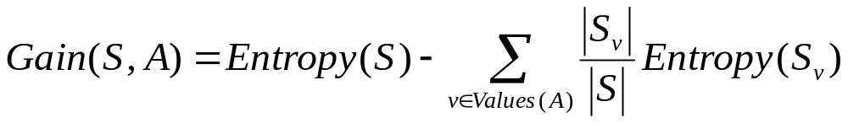
Information Gain
Gain(S,A): reduction in entropy after choosing attr. A
A₁
E(S)=0.993
A₂
E(S)=0.993
29⁺, 35⁻
29⁺, 35⁻
t
f
t
f
0.650
0.522
0.989
0.997
25⁺, 5⁻
4⁺, 30⁻
15⁺, 19⁻
14⁺, 16⁻
Gain: 0.395
Gain: 0.000
29⁺, 35⁻
A₁
E(S)=0.993
E(S)=0.993
29⁺, 35⁻
A₂
t
f
t
f
0.708
0.742
0.937
0.619
21⁺, 5⁻
8⁺, 30⁻
18⁺, 33⁻
11⁺, 2⁻
Gain: 0.265
Gain: 0.121

Slide 24
Gain function
Gain is measure of how much can
  Reduce uncertainty
    Value lies between 0,1
    What is significance of
      gain of 0?
        example where have 50/50 split of +/- both before and after discriminating on attributes values
      gain of 1?
        Example of going from “perfect uncertainty” to perfect certainty after splitting example with predictive attribute
  Find “patterns” in TE’s relating to attribute values
    Move to locally minimal representation of TE’s

Slide 25
Training Examples
Day | Outlook | Temp | Humidity | Wind | Tennis?
D1 | Sunny | Hot | High | Weak | No
D2 | Sunny | Hot | High | Strong | No
D3 | Overcast | Hot | High | Weak | Yes
D4 | Rain | Mild | High | Weak | Yes
D5 | Rain | Cool | Normal | Weak | Yes
D6 | Rain | Cool | Normal | Strong | No
D7 | Overcast | Cool | Normal | Strong | Yes
D8 | Sunny | Mild | High | Weak | No
D9 | Sunny | Cool | Normal | Weak | Yes
D10 | Rain | Mild | Normal | Weak | Yes
D11 | Sunny | Mild | Normal | Strong | Yes
D12 | Overcast | Mild | High | Strong | Yes
D13 | Overcast | Hot | Normal | Weak | Yes
D14 | Rain | Mild | High | Strong | No

Slide 26
Determine the Root Attribute
9+, 5− Ε=0.940
9+, 5− Ε=0.940
9+, 5− Ε=0.940
9+, 5− Ε=0.940
Humidity
Wind
High
Low
Weak
Strong
3+, 4−
Ε=0.985
6+, 1−
Ε=0.592
6+, 2−
Ε=0.811
3+, 3−
Ε=1.000
Gain (S, Humidity) = 0.151
Gain (S, Wind) = 0.048
Gain (S, Outlook) = 0.246
Gain (S, Temp) = 0.029

Slide 27
Sort the Training Examples
9+, 5− {D1,…,D14}
Outlook
Sunny
Overcast
Rain
{D1,D2,D8,D9,D11}
2+, 3−
{D3,D7,D12,D13}
4+, 0−
{D4,D5,D6,D10,D15}
3+, 2−
?
Yes
?
S_{sunny}= {D1,D2,D8,D9,D11}
Gain (S_{sunny}, Humidity) = .970
Gain (S_{sunny}, Temp) = .570
Gain (S_{sunny}, Wind) = .019

Slide 28
Final Decision Tree for Example
Outlook
Sunny
Rain
Overcast
Humidity
Yes
Wind
High
Normal
Strong
Weak
No
Yes
No
Yes

Slide 29
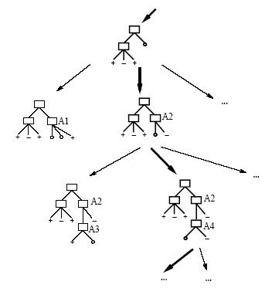
Hypothesis Space Search (ID3)
Hypothesis space (all possible trees) is complete!
  Target function is included in there

Slide 30
Hypothesis Space Search in Decision Trees
Conduct a search of the space of decision trees which
can represent all possible discrete functions.
Goal: to find the best decision tree
Finding a minimal decision tree consistent with a set of data
is NP-hard.
Perform a greedy heuristic search: hill climbing without
backtracking
Statistics-based decisions using all data

Slide 31
Hypothesis Space Search by ID3
Hypothesis space is complete!
  H is space of all finite DT’s (all discrete functions)
  Target function is included in there
Simple to complex hill-climbing search of H
  Use of gain as hill-climbing function
Outputs a single hypothesis (which one?)
  Cannot assess all hypotheses consistent with D (usually many)
  Analogy to breadth first search
    Examines all trees of given depth and chooses best…
No backtracking
  Locally optimal ...
Statistics-based search choices
  Use all TE’s at each step
  Robust to noisy data

Slide 32
Restriction bias vs. Preference bias
Restriction bias (or Language bias)
  Incomplete hypothesis space
Preference (or search) bias
  Incomplete search strategy
Candidate Elimination has restriction bias
ID3 has preference bias
In most cases, we have both a restriction and a preference bias.

Slide 33
Inductive Bias in ID3
Preference for short trees, and for those with high information gain attributes near the root
Principle of Occam's razor
  prefer the shortest hypothesis that fits the data
Justification
  Smaller likelihood of a short hypothesis fitting the data at random
Problems
  Other ways to reduce random fits to data
  Size of hypothesis based on the data representation
    Minimum description length principle

Slide 34
Overfitting the Data
Learning a tree that classifies the training data perfectly may
not lead to the tree with the best generalization performance.
- There may be noise in the training data the tree is fitting
- The algorithm might be making decisions based on
very little data
A hypothesis h is said to overfit the training data if the is
another hypothesis, h’, such that h has smaller error than h’
on the training data but h has larger error on the test data than h’.
On training
accuracy
On testing
Complexity of tree

Slide 35
Overfitting
Attribute 2
A very deep tree required
To fit just one odd training
example
+ + + +
+ + - +
+ + + +
- - -
- - -
- - -
- - -
- - -
- - -
- - -
- - -
- - -
- - -
- - -
- - -
+ + + +
+ + + +
+ + + +
+ + + +
+ + + +
+ + + +
Attribute 1

Slide 36
When to stop splitting further?
Attribute 2
A very deep tree required
To fit just one odd training
example
+ + + +
+ + - +
+ + + +
- - -
- - -
- - -
- - -
- - -
- - -
- - -
- - -
- - -
- - -
- - -
- - -
+ + + +
+ + + +
+ + + +
+ + + +
+ + + +
+ + + +
Attribute 1

Slide 37
Overfitting in Decision Trees
Consider adding noisy training example (should be +):
What effect on earlier tree?
Day | Outlook | Temp | Humidity | Wind | Tennis?
D15 | Sunny | Hot | Normal | Strong | No
Outlook
Sunny
Overcast
Rain
Humidity
Yes
Wind
High
Normal
Strong
Weak

Slide 38
Overfitting - Example
Noise or other
coincidental regularities
Outlook
Sunny
Overcast
Rain
1,2,8,9,11
3,7,12,13
4,5,6,10,14
2+,3-
4+,0-
3+,2-
Humidity
Yes
Wind
High
Normal
Strong
Weak
No
Wind
No
Yes
Strong
Weak
No
Yes

Slide 39
Avoiding Overfitting
Two basic approaches
- Prepruning: Stop growing the tree at some point during
construction when it is determined that there is not enough
data to make reliable choices.
- Postpruning: Grow the full tree and then remove nodes
that seem not to have sufficient evidence. (more popular)
Methods for evaluating subtrees to prune:
- Cross-validation: Reserve hold-out set to evaluate utility (more popular)
- Statistical testing: Test if the observed regularity can be
dismissed as likely to be occur by chance
- Minimum Description Length: Is the additional complexity of
the hypothesis smaller than remembering the exceptions ?
This is related to the notion of regularization that we will see
in other contexts– keep the hypothesis simple.

Slide 40
Reduced-Error Pruning
A post-pruning, cross validation approach
- Partition training data into “grow” set and “validation” set.
- Build a complete tree for the “grow” data
- Until accuracy on validation set decreases, do:
For each non-leaf node in the tree
Temporarily prune the tree below; replace it by majority vote.
Test the accuracy of the hypothesis on the validation set
Permanently prune the node with the greatest increase
in accuracy on the validation test.
Problem: Uses less data to construct the tree
Sometimes done at the rules level
General Strategy: Overfit and Simplify

Slide 41
Rule post-pruning
Allow tree to grow until best fit (allow overfitting)
Convert tree to equivalent set of rules
  One rule per leaf node
  Prune each rule independently of others
    Remove various preconditions to improve performance
  Sort final rules into desired sequence for use

Slide 42
Example of rule post pruning
IF (Outlook = Sunny) ^ (Humidity = High)
  THEN PlayTennis = No
IF (Outlook = Sunny) ^ (Humidity = Normal)
  THEN PlayTennis = Yes
Outlook
Sunny
Overcast
Rain
Humidity
Yes
Wind
High
Normal
Strong
Weak

Slide 43
Extensions of basic algorithm
Continuous valued attributes
Attributes with many values
TE’s with missing data
Attributes with associated costs
Other impurity measures
Regression tree

Slide 44
Continuous Valued Attributes
Create a discrete attribute from continuous variables
  E.g., define critical Temperature = 82.5
Candidate thresholds
  chosen by gain function
  can have more than one threshold
  typically where values change quickly
(48+60)/2
(80+90)/2
Temp | 40 | 48 | 60 | 72 | 80 | 90
Tennis? | N | N | Y | Y | Y | N

Slide 45
Attributes with Many Values
Problem:
  If attribute has many values, Gain will select it (why?)
  E.g. of birthdates attribute
    365 possible values
    Likely to discriminate well on small sample
  For sample of fixed size n, and attribute with N values, as N -> infinity
    ni/N -> 0
    - pi*log pi -> 0 for all i and entropy -> 0
    Hence gain approaches max value

Slide 46
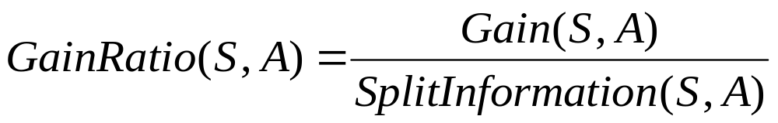
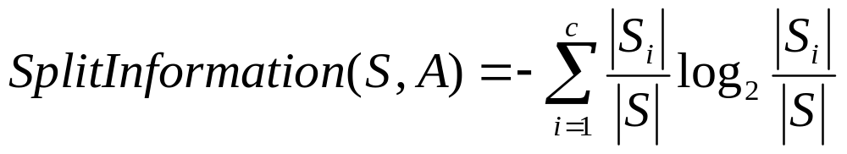
Attributes with many values
Problem: Gain will select attribute with many values
One approach: use GainRatio instead
Entropy of the partitioning
Penalizes higher number of partitions
where S_{i} is the subset of S for which A has value v_{i}
(example of Si/S = 1/N: SplitInformation = log N)

Slide 47
Unknown Attribute Values
What if some examples are missing values of attribute A?
Use training example anyway, sort through tree
  if node n tests A, assign most common value of A among other examples sorted to node n
  assign most common value of A among other examples with same target value
  assign probability p_{i} to each possible value v_{i} of A
    assign fraction p_{i} of example to each descendant in tree
Classify test instances with missing values in same fashion
Used in C4.5

Slide 48
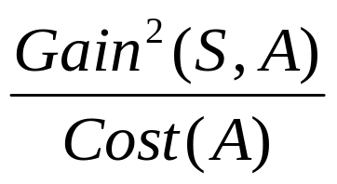
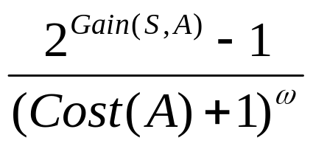
Attributes with Costs
Consider
  medical diagnosis: BloodTest has cost $150, Pulse has a cost of $5.
  robotics, Width-From-1ft has cost 23 sec., from 2 ft 10s.
How to learn a consistent tree with low expected cost?
Replace gain by
  Tan and Schlimmer (1990)
  Nunez (1988)
  where ω ∈ [0, 1] determines importance of cost

Slide 49


Gini Index
Another sensible measure of impurity
(i and j are classes)
After applying attribute A, the resulting Gini index is
Gini can be interpreted as expected error rate

Slide 50
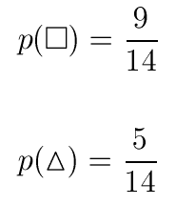


Gini Index
.
.
.
.
.
.
Attributes: color, border, dot
Classification: triangle, square

Slide 51





Gini Index for Color
.
.
.
.
.
.
.
.
red
Color?
green
.
yellow
.
.
.

Slide 52
Gain of Gini Index

Slide 53
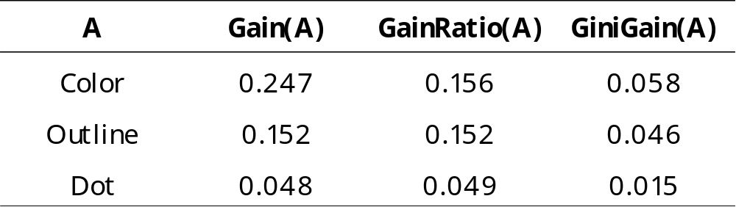
Three Impurity Measures

Slide 54
Regression Tree
Similar to classification
Use a set of attributes to predict the value (instead of a class label)
Instead of computing information gain, compute the sum of squared errors
Partition the attribute space into a set of rectangular subspaces, each with its own predictor
  The simplest predictor is a constant value

Slide 55
Rectilinear Division
A regression tree is a piecewise constant function of the input attributes
X₂
X1≤ t₁
r₅
r₂
X2 ≤ t₂
X1 ≤ t₃
r₃
t₂
r₄
r₁
r₁
r₂
r₃
X2 ≤ t₄
t₁
t₃
X₁
r₄
r₅

Slide 56
Growing Regression Trees
To minimize the square error on the learning sample, the prediction at a leaf is the average output of the learning cases reaching that leaf
Impurity of a sample is defined by the variance of the output in that sample:
  I(LS)=var_{y|LS}{y}=E_{y|LS}{(y-E_{y|LS}{y})²}
The best split is the one that reduces the most variance:
∑
|
LS
|
Δ
I
(
LS
,
A
)
=
var
{
y
}
−
a
var
{
y
}
y
|
LS
|
LS
|
y
|
LS
a
a

Slide 57
Regression Tree Pruning
Exactly the same algorithms apply: pre-pruning and post-pruning.
In post-pruning, the tree that minimizes the squared error on VS is selected.
In practice, pruning is more important in regression because full trees are much more complex (often all objects have a different output values and hence the full tree has as many leaves as there are objects in the learning sample)

Slide 58
When Are Decision Trees Useful ?
Advantages
  Very fast: can handle very large datasets with many attributes
  Flexible: several attribute types, classification and regression problems, missing values…
  Interpretability: provide rules and attribute importance
Disadvantages
  Instability of the trees (high variance)
  Not always competitive with other algorithms in terms of accuracy

Slide 59
History of Decision Tree Research
Hunt and colleagues in Psychology used full search decision
trees methods to model human concept learning in the 60’s
Quinlan developed ID3, with the information gain heuristics
in the late 70’s to learn expert systems from examples
Breiman, Friedmans and colleagues in statistics developed
CART (classification and regression trees simultaneously
A variety of improvements in the 80’s: coping with noise,
continuous attributes, missing data, non-axis parallel etc.
Quinlan’s updated algorithm, C4.5 (1993) is commonly used (New:C5)
Boosting (or Bagging) over DTs is a good general purpose algorithm

Slide 60
Summary
Decision trees are practical for concept learning
Basic information measure and gain function for best first search of space of DTs
ID3 procedure
  search space is complete
  Preference for shorter trees
Overfitting is an important issue with various solutions
Many variations and extensions possible

Slide 61
Software
In R:
  Packages tree and rpart
C4.5:
  http://www.cse.unwe.edu.au/~quinlan
Weka
  http://www.cs.waikato.ac.nz/ml/weka

