Slide 1
Chapter 2
Database Environment

Slide 2
Objectives
Purpose of three-level database architecture.
Contents of external, conceptual, and internal levels. Meaning of logical and physical data independence.
A classification of data models.
Purpose/importance of conceptual modeling.
Notes:
You skip this slide in the lecture, but I included it in case you still want it in the slides.

Slide 3
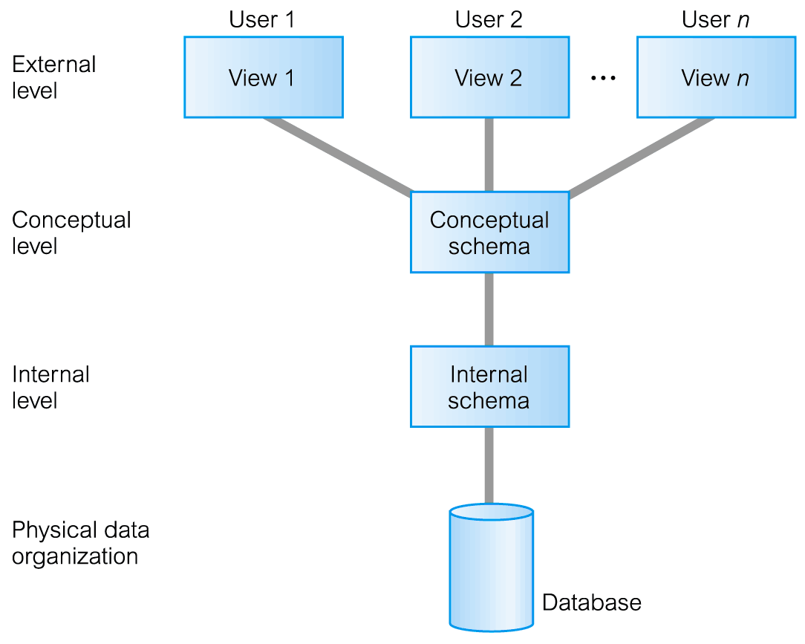
ANSI-SPARC Three-Level Architecture

Slide 4
ANSI-SPARC Three-Level Architecture
External Level
Users’ view of the database.
Describes that part of database that is relevant to a particular user.
Conceptual Level
Community view of the database.
Describes what data is stored in database and relationships among the data.

Slide 5
ANSI-SPARC Three-Level Architecture
Internal Level
Physical representation of the database on the computer.
Describes how the data is stored in the database.

Slide 6
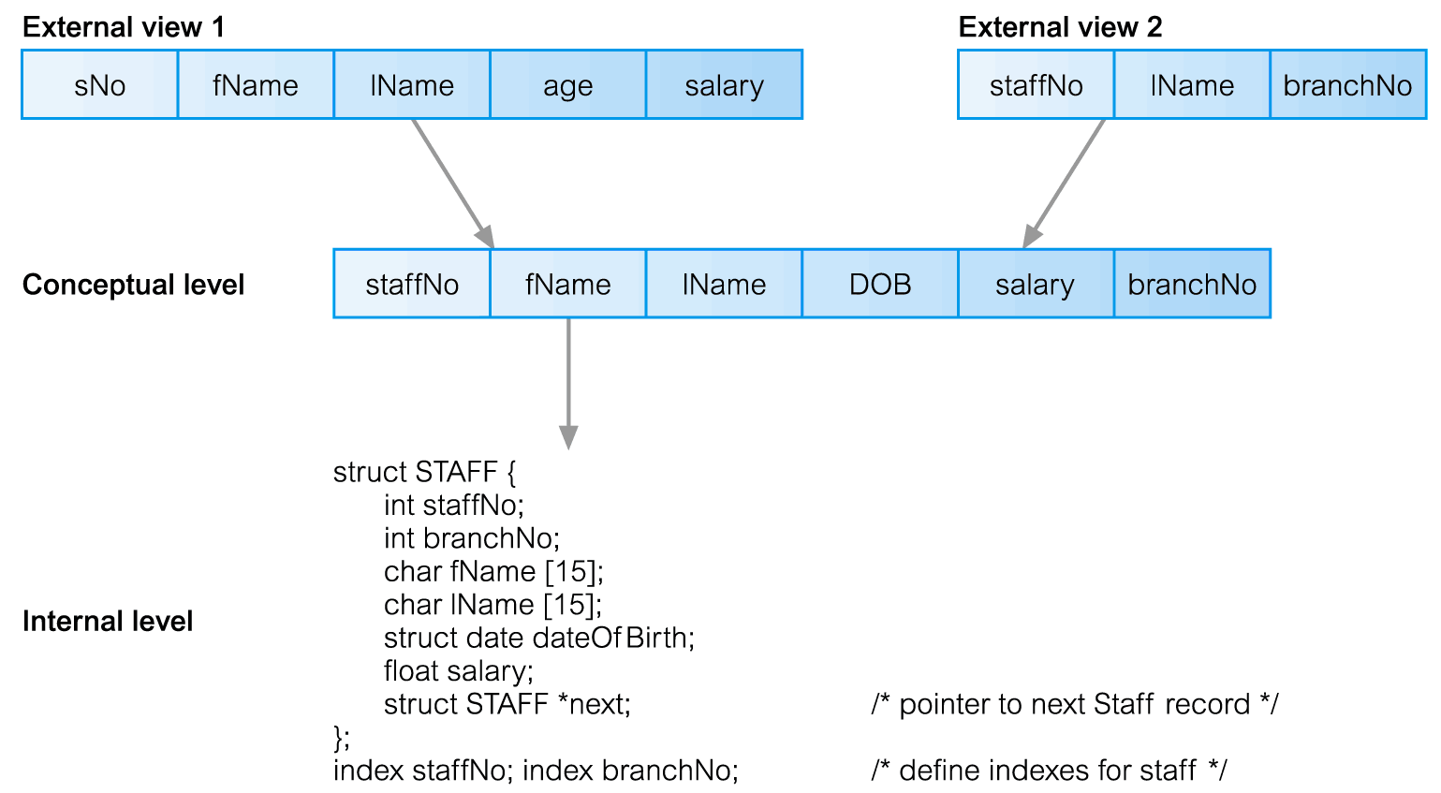
Differences between Three Levels of ANSI-SPARC Architecture

Slide 7
Data Independence
Logical Data Independence
Refers to immunity of external schemas to changes in conceptual schema.
Conceptual schema changes (e.g. addition/removal of entities).
Should not require changes to external schema or rewrites of application programs.

Slide 8
Data Independence
Physical Data Independence
Refers to immunity of conceptual schema to changes in the internal schema.
Internal schema changes (e.g. using different file organizations, storage structures/devices).
Should not require change to conceptual or external schemas.

Slide 9
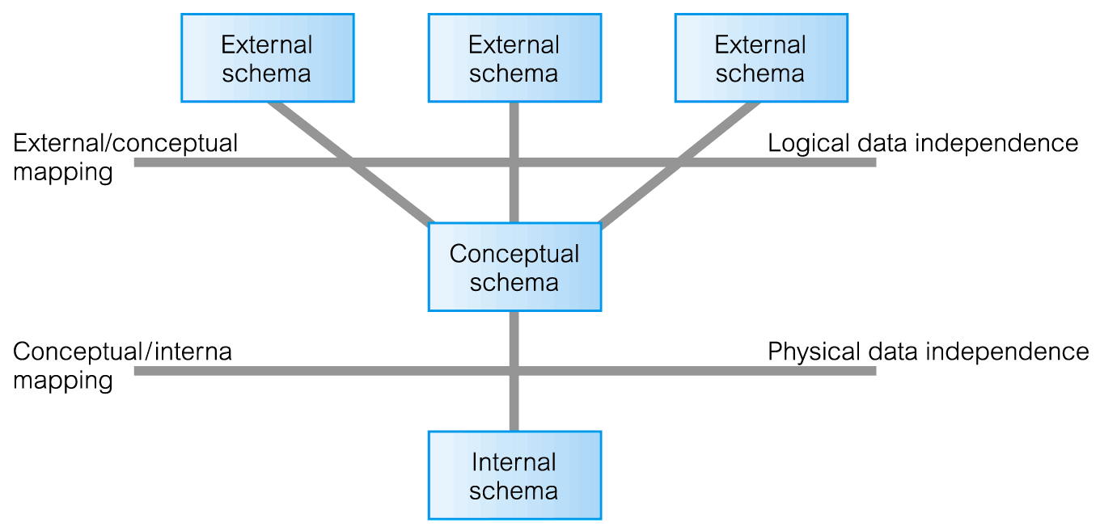
Data Independence and the ANSI-SPARC Three-Level Architecture

Slide 10
Data Model
Integrated collection of concepts for describing data, relationships between data, and constraints on the data in an organization.
Data Model comprises:
a structural part;
a manipulative part;
possibly a set of integrity rules.

Slide 11
Data Model
Purpose
To represent data in an understandable way.
Categories of data models include:
Object-based
Record-based
Physical

Slide 12
Data Models
Object-Based Data Models
Entity-Relationship
Semantic
Functional
Object-Oriented
Record-Based Data Models
Relational Data Model (SQL is a Relational DBMS)
Network Data Model
Hierarchical Data Model.
Physical Data Models

Slide 13
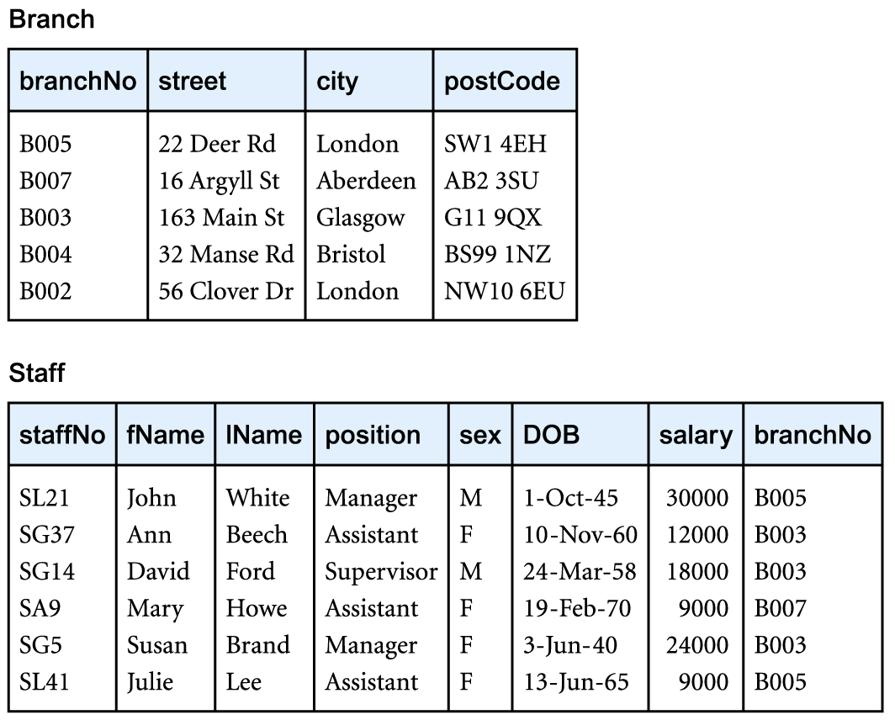
Relational Data Model

Slide 14
Conceptual Modeling
Conceptual schema is the core of a system supporting all user views.
Should be complete and accurate representation of an organization’s data requirements.
Conceptual modeling is process of developing a model of information use that is independent of implementation details.
Result is a conceptual data model.

Slide 15
System Catalog
Repository of information (metadata) describing the data in the database.
One of the fundamental components of DBMS.
Typically stores:
Names, types, and sizes of data items;
Constraints on the data;
Names of authorized users;
Data items accessible by a user and the type of access;
Usage statistics.

Slide 16
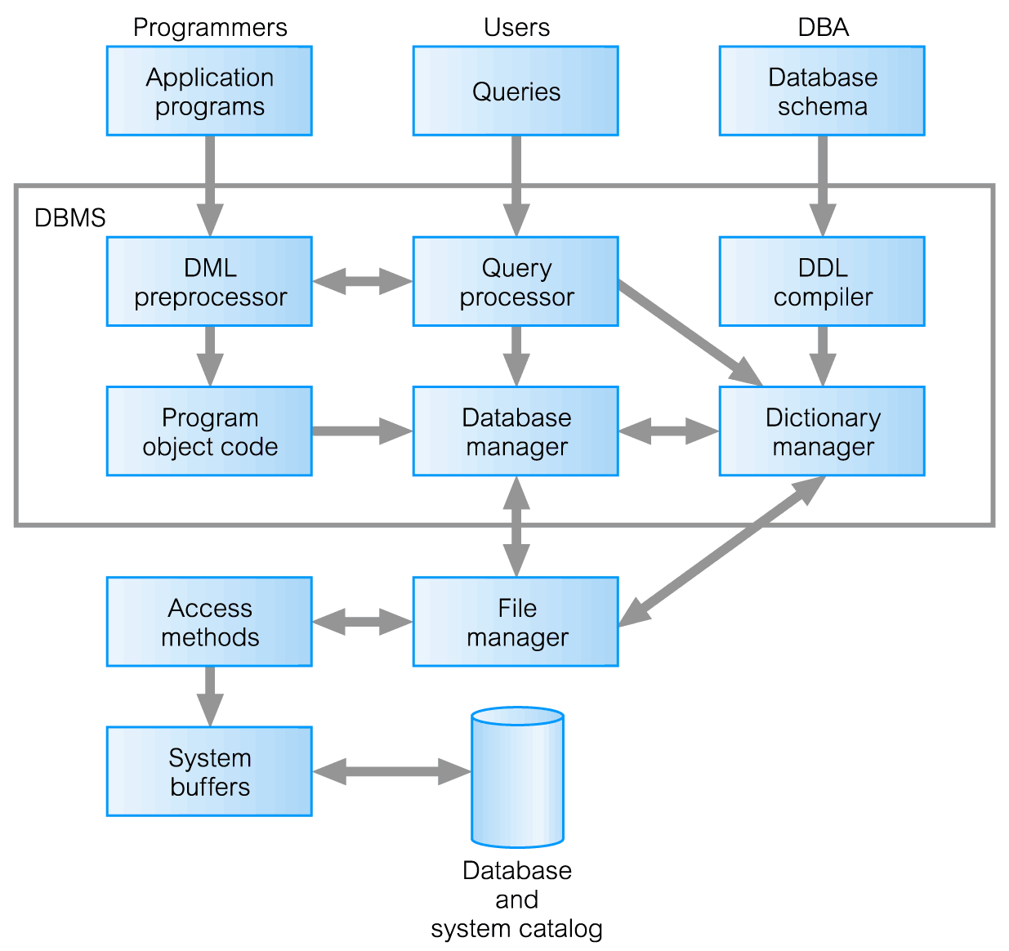
Components of a DBMS

Slide 17
Components of a DBMS
Query processor is a major DBMS component that transforms queries into a series of low-level instructions directed to the database manager.
Database manager (DM) interfaces with user-submitted application programs and queries. The DM examines the external and conceptual schemas to determine what conceptual records are required to satisfy the request. The DM then places a call to the file manager to perform the request.

Slide 18
Components of a DBMS
File manager manipulates the underlying storage files and manages the allocation of storage space on disk. It establishes and maintains the list of structures and indexes defined in the internal schema.
DML preprocessor converts DML statements embedded in an application program into standard function calls in the host language. The DML preprocessor must interact with the query processor to generate the appropriate code.

Slide 19
Components of a DBMS
DDL compiler converts DDL statements into a set of tables containing metadata. These tables are then stored in the system catalog while control information is stored in data file headers.
Catalog manager manages access to and maintains the system catalog. The system catalog is accessed by most DBMS components.

Slide 20
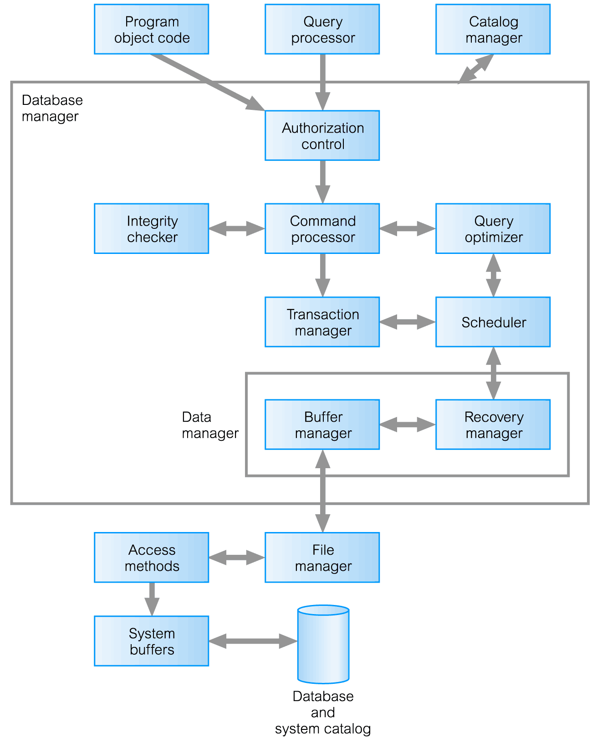
Components of Database Manager

Slide 21
Components of the Database Manager
Authorization control to confirm whether the user has the necessary permission to carry out the required operation.
Command processor on confirmation of user authority, control is passed to the command processor.
Integrity checker ensures that requested operation satisfies all necessary integrity constraints (e.g. key constraints) for an operation that changes the database.
Notes:
Lecture didn’t go over these last three slides, but it might have been just from running out of time, so I included them just in case!

Slide 22
Components of the Database Manager
Query optimizer determines an optimal strategy for the query execution.
Transaction manager performs the required processing of operations that it receives from transactions.
Scheduler ensures that concurrent operations on the database proceed without conflicting with one another. It controls the relative order in which transaction operations are executed.
Notes:
Lecture didn’t go over these last three slides, but it might have been just from running out of time, so I included them just in case!

Slide 23
Components of the Database Manager
Recovery manager ensures that the database remains in a consistent state in the presence of failures. It is responsible for transaction commit and abort.
Buffer manager is responsible for the transfer of data between the main memory and secondary storage, such as disk and tape.
The recovery manager is also known as (aka) the data manager. The buffer manager aka the cache manager.
Notes:
Lecture didn’t go over these last three slides, but it might have been just from running out of time, so I included them just in case!

