Slide 1
Chapter 4
The Relational Model

Slide 2
Chapter 4 - Objectives
Terminology of the relational model.
How tables are used to represent data.
Connection between mathematical relations and relations in the relational model.
Properties of database relations.
Meaning of entity integrity and referential integrity.
Purpose and advantages of views.

Slide 3
Relational Model Terminology
A relation is a table with columns and rows.
Only applies to the logical structure of the database, not the physical structure.
Attribute is a named column of a relation.
Domain is the set of allowable values for one or more attributes.

Slide 4
Relational Model Terminology
Tuple is a row of a relation.
Degree is the number of attributes in a relation.
Cardinality is the number of tuples in a relation.
Relational Database is a collection of normalized relations with distinct relation names.

Slide 5
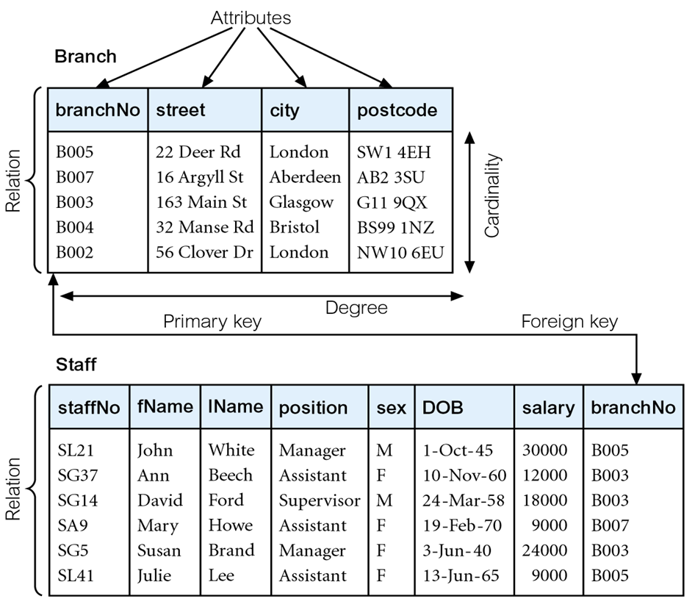
Instances of Branch and Staff Relations

Slide 6
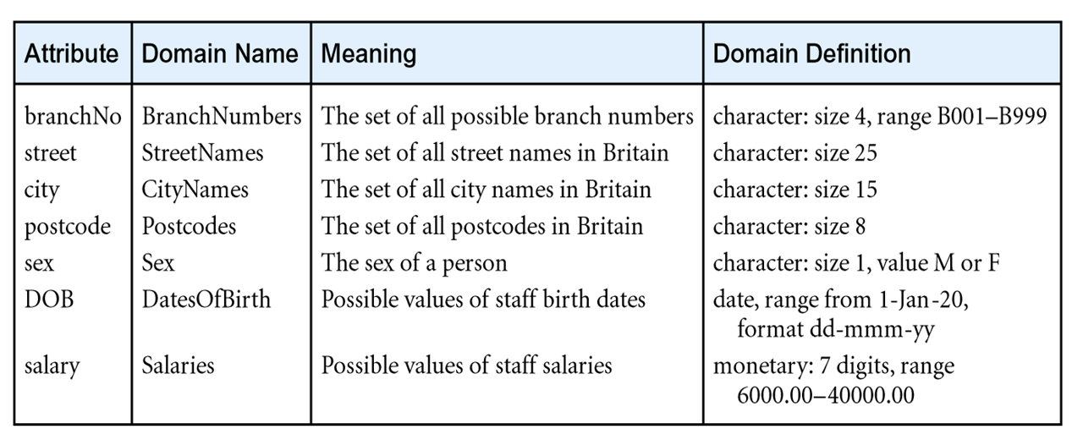
Examples of Attribute Domains

Slide 7
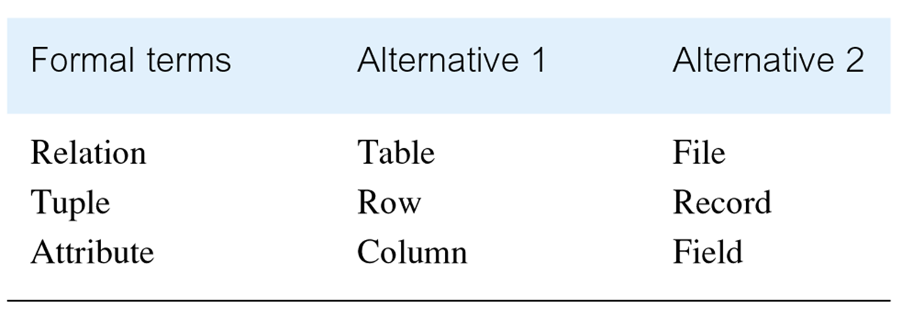
Alternative Terminology for Relational Model

Slide 8
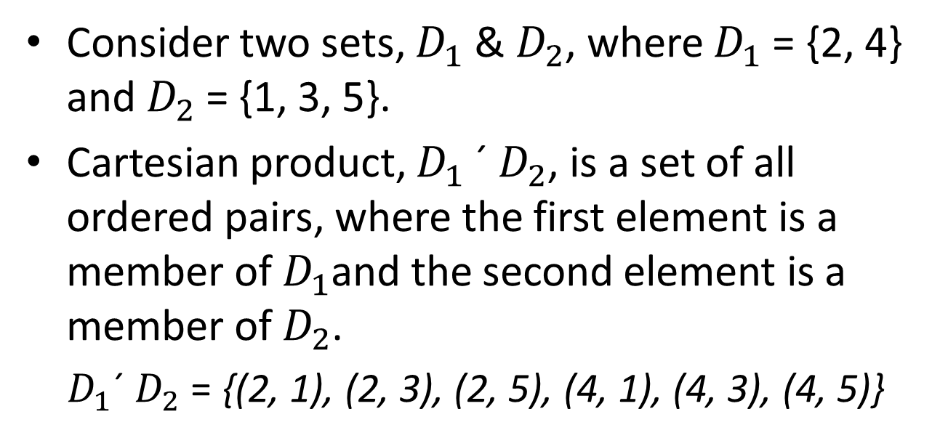
Mathematical Definition of Relation
Consider two sets, $D_{1}$ & $D_{2}$, where $D_{1}$ = {2, 4} and $D_{2}$ = {1, 3, 5}.
Cartesian product, $D_{1}$ ´ $D_{2}$, is a set of all ordered pairs, where the first element is a member of $D_{1}$and the second element is a member of $D_{2}$.
$D_{1}$´ $D_{2}$ = {(2, 1), (2, 3), (2, 5), (4, 1), (4, 3), (4, 5)}

Slide 9
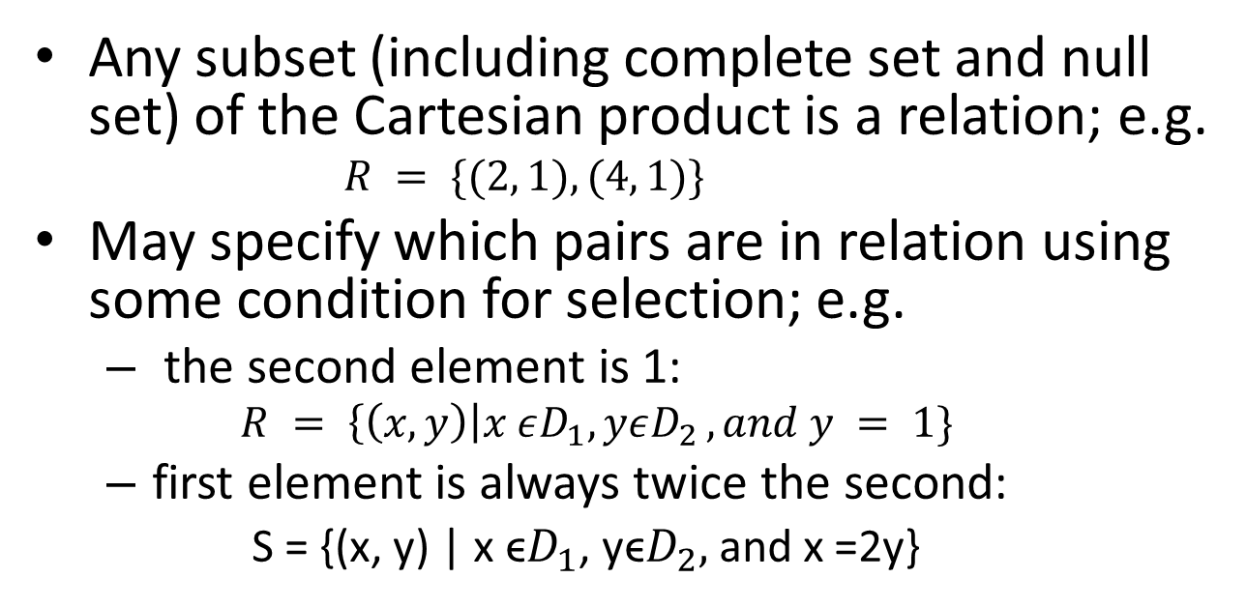
Mathematical Definition of Relation
Any subset (including complete set and null set) of the Cartesian product is a relation; e.g.
$$R = \{(2, 1), (4, 1)\}$$
May specify which pairs are in relation using some condition for selection; e.g.
the second element is 1:
$$R = \left\{\left(x, y\right)\right|x εD_{1}, yεD_{2 },and y = 1\}$$
first element is always twice the second:
S = {(x, y) | x ϵ$D_{1}$, yϵ$D_{2},$and x =2y}

Slide 10
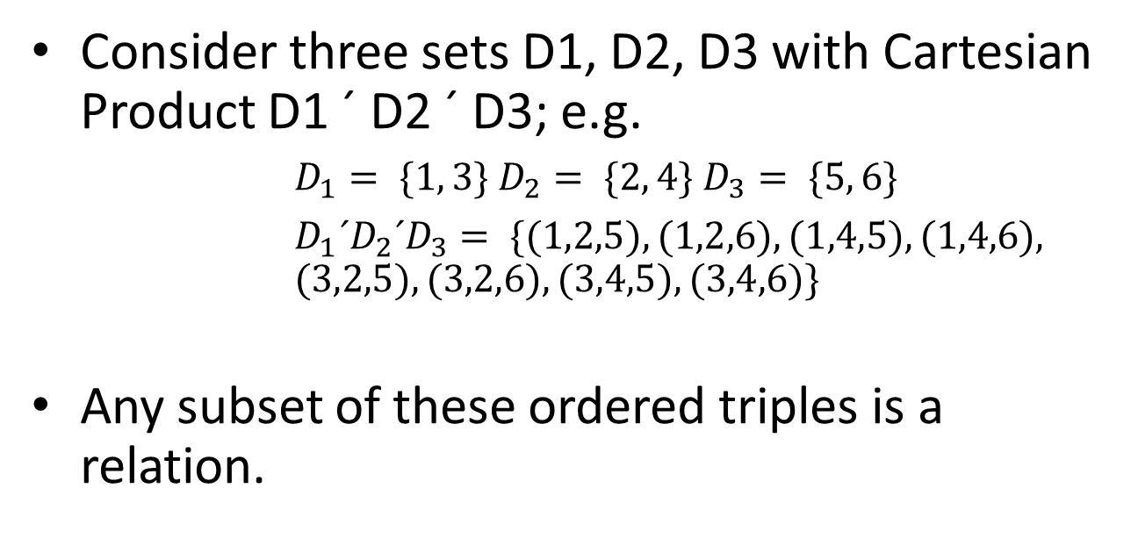
Mathematical Definition of Relation
Consider three sets D1, D2, D3 with Cartesian Product D1 ´ D2 ´ D3; e.g. $D_{1}= \{1, 3\} D_{2}= \{2, 4\} D_{3}= \{5, 6\}$
$D_{1}´D_{2}´D_{3}= \{(1,2,5), (1,2,6), (1,4,5), (1,4,6),$ $(3,2,5), (3,2,6), (3,4,5), (3,4,6)\}$
Any subset of these ordered triples is a relation.

Slide 11
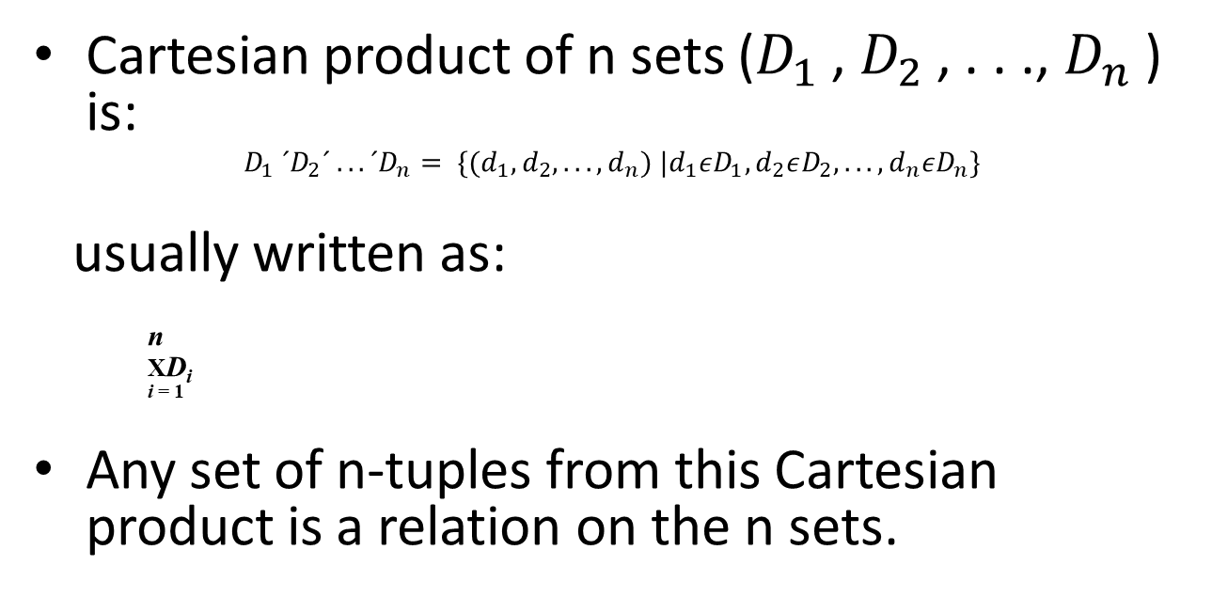
Mathematical Definition of Relation
Cartesian product of n sets ($D_{1}$, $D_{2}$, . . ., $D_{n}$) is:
$$D_{1} ´D_{2}´ . . . ´D_{n}= \{(d_{1},d_{2}, . . . ,d_{n}) |d_{1}εD_{1},d_{2}εD_{2}, . . . ,d_{n}εD_{n}\}$$
usually written as:
n
XD_{i}
^{i = 1}
Any set of n-tuples from this Cartesian product is a relation on the n sets.

Slide 12
Database Relations
Relation schema
Named relation defined by a set of attribute and domain name pairs.
Relational database schema
Set of relation schemas, each with a distinct name.

Slide 13
Properties of Relations
Relation name is distinct from all other related names in the relational schema.
Each cell of relation contains exactly one atomic (single) value.
Each attribute has a distinct name.
Values of an attribute are all from the same domain.

Slide 14
Properties of Relations
Each tuple is distinct; there are no duplicate tuples.
Order of attributes has no significance.
Order of tuples has no significance, theoretically.

Slide 15
Relational Keys
Superkey
An attribute, or set of attributes, that uniquely identifies a tuple within a relation.
Candidate Key
Superkey (K) such that no proper subset is a superkey within the relation.
In each tuple of R, values of K uniquely identify that tuple (uniqueness).
No proper subset of K has the uniqueness property (irreducibility).

Slide 16
Relational Keys
Primary Key
Candidate key selected to identify tuples uniquely within the relation.
Alternate Keys
Candidate keys that are not selected to be a primary key.
Foreign Key
Attribute, or set of attributes, within one relation that matches the candidate key of some (possibly same) relation.

Slide 17
Integrity Constraints
Null
Represents value for an attribute that is currently unknown or not applicable for the tuple.
Deals with incomplete or exceptional data.
Represents the absence of a value and is not the same as zero or spaces, which are values.

Slide 18
Integrity Constraints
Entity Integrity
In a base relation, no primary key attribute can be null.
Referential Integrity
If a foreign key exists in a relation, either the foreign key value must match a candidate key value of some tuple in its home relation or the foreign key value must be wholly null.
General Constraints
Additional rules specified by users or database administrators that define or constrain some aspect of the enterprise

Slide 19
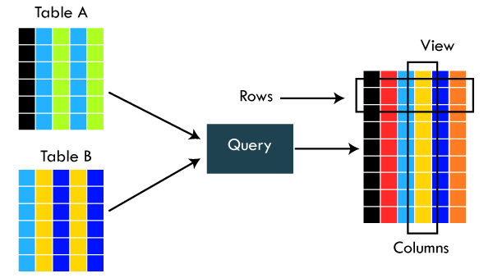
Views
Base Relation
Named relation corresponding to an entity in the conceptual schema, whose tuples are physically stored in a database.
View
Dynamic result of one or more relational operations operating on base relations to produce another relation.

Slide 20
Views
A virtual relation that does not necessarily actually exist in the database but is produced upon request, at the time of the request.
Contents of a view are defined as a query on one or more base relations.
Views are dynamic, meaning that changes made to base relations that affect view attributes are immediately reflected in the view.

Slide 21
Purpose of Views
Provides a powerful and flexible security mechanism by hiding parts of the database from certain users.
Permits users to access data in a customized way, so that the same data can be seen by different users in different ways, at the same time.
Can simplify complex operations on base relations.

Slide 22
Updating Views
All updates to a base relation should be immediately reflected in all views that reference that base relation.
If a view is updated, the underlying base relation should reflect the change.

Slide 23
Updating Views
There are restrictions on types of modifications that can be made through views:
Updates are allowed if the query involves a single base relation and contains a candidate key of a base relation.
Updates are not allowed involving multiple base relations.
Updates are not allowed involving aggregation or grouping operations.

Slide 24
Updating Views
Classes of views are defined as:
theoretically not updateable;
theoretically updateable;
partially updateable.
Syntax:
$$UPDATE < view_{name}> SET<column1>=<value1>,<column2>=<value2>,.....WHERE <condition>;$$

Slide 25
Takeaways
Relational model Terminologies with examples
Mathematical definition of Relations
Properties of relations and relational keys
Integrity Constraints
Views and updating views

Slide 26
Next Class
Relational Algebra:
A procedural query language that takes relation instances as input and returns relation instances as output.
It performs queries using operators.
A binary or unary operator can be used. They take in relations as input and produce relations as output.

