Slide 1
Chapter 1
Introduction to Databases

Slide 2
Chapter 1 - Objectives
Some common uses of database systems.
Characteristics of file-based systems.
Problems with file-based systems.
Meaning of the term database.
Meaning of the term Database Management System(DBMS)
Notes:
During the lecture, both of the “objectives” slides were skipped, but I included them in case you want the to stay in the slides.

Slide 3
Objectives
Typical functions of a DBMS.
Major components of the DBMS environment.
Personnel involved in the DBMS environment.
History of the development of DBMSs.
Advantages and disadvantages of DBMSs.
Notes:
During the lecture, both of the “objectives” slides were skipped, but I included them in case you want the to stay in the slides.

Slide 4
Examples of Database Applications
Purchases from the supermarket
Purchases using your credit card
Booking a holiday at the travel agents
Using the local library
Taking out insurance
Renting a video
Using the Internet
Studying at University

Slide 5
File-Based Systems
Collection of application programs that perform services for the end users (e.g. reports).
Each program defines and manages its own data.

Slide 6
Limitations of File-Based Approach
Separation and isolation of data
Each program maintains its own set of data.
Users of one program may be unaware of potentially useful data held by other programs.
Duplication of data
Same data is held by different programs.
Wasted space and potentially different values and/or different formats for the same item.

Slide 7
Database Approach
Arose because:
Definition of data was embedded in application programs, rather than being stored separately and independently.
No control over access and manipulation of data beyond that imposed by application programs.
Result:
The database and Database Management System (DBMS).

Slide 8
Database
Shared collection of logically related data (and a description of this data), designed to meet the information needs of an organization.
System catalog (metadata) provides description of data to enable program-data independence.
Logically related data comprises entities attributes, and relationships of an organization’s information

Slide 9
Database Management System (DBMS)
A software system that enables users to define, create, maintain, and control access to the database.
(Database) application program: a computer program that interacts with database by issuing an appropriate request (SQL statement) to the DBMS.

Slide 10
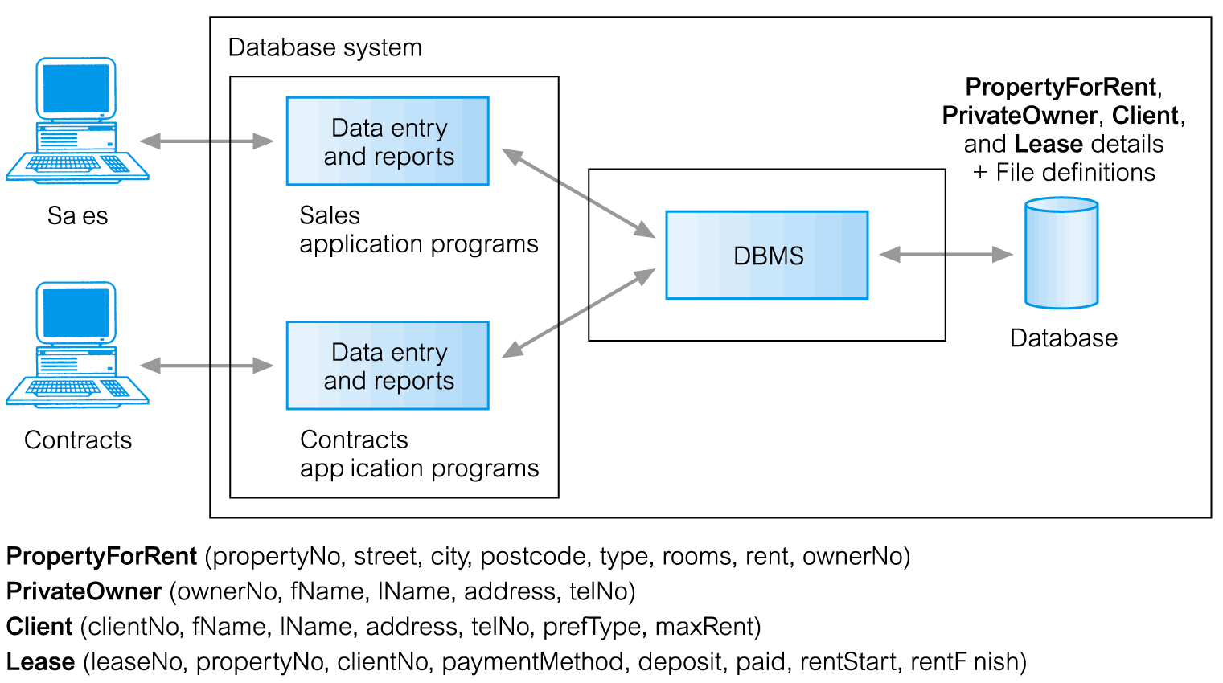
Database Management System (DBMS)
l

Slide 11
Database Approach
Data definition language (DDL).
Permits specification of data types, structures, and any data constraints.
All specifications are stored in the database.
Data manipulation language (DML).
General enquiry facility (query language) of the data.
Notes:
In lecture you talked about how these are meaningless distinctions, so I’m not sure if you still want it in the slides.

Slide 12
Database Approach
Controlled access to database may include:
A security system
An integrity system
A concurrency control system
A recovery control system
A user-accessible catalog

Slide 13
Components of DBMS Environment
Hardware
Can range from a PC to a network of computers.
Software
DBMS, operating system, network software (if necessary) and also the application programs.
Data
Used by the organization and a description of this data called the schema.

Slide 14
Components of DBMS Environment
Procedures
Instructions and rules that should be applied to the design and use of the database and DBMS.
People

Slide 15
Roles in the Database Environment
Data Administrator (DA)
Database Administrator (DBA)
Database Designers (Logical and Physical)
Application Programmers
End Users (naive and sophisticated)

Slide 16
History of Database Systems
First-generation
Hierarchical and Network
Second generation
Relational
Third generation
Object-Relational
Object-Oriented

Slide 17
Advantages of DBMSs
Control of data redundancy
Data consistency
More information from the same amount of data
Sharing of data
Improved data integrity
Improved security
Enforcement of standards
Economy of scale

Slide 18
Advantages of DBMSs
Balance conflicting requirements
Improved data accessibility and responsiveness
Increased productivity
Improved maintenance through data independence Increased concurrency
Improved backup and recovery services

Slide 19
Disadvantages of DBMSs
Complexity
Size
Cost of DBMS
Additional hardware costs
Cost of conversion
Performance
Higher impact of a failure

