Slide 1
Chapter 3
Database Architectures and the Web

Slide 2
Database Environment - Objectives
The meaning of the client–server architecture and the advantages of this type of architecture for a DBMS.
The difference between two-tier, three-tier and n-tier client–server architectures.
About cloud computing and data as a service (DaaS) and database as a service (DBaaS).

Slide 3
Database Environment - Objectives
The purpose of a Web service and the technological standards used to develop a Web service.
The meaning of service-oriented architecture (SOA).
The difference between distributed DBMSs, and distributed processing.
The architecture of a data warehouse.
About cloud computing and cloud databases.

Slide 4
Multi-user DBMS Architectures
The common architectures that are used to implement multi-user database management systems:
Teleprocessing
File-Server
Client-Server

Slide 5
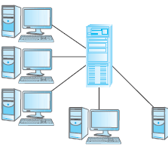
Teleprocessing
One computer with a single CPU and a number of terminals.
Processing performed within the same physical computer. User terminals are typically “dumb”, incapable of functioning on their own, and cabled to the central computer.

Slide 6
File-Server
File-server is connected to several workstations across a network.
Database resides on file-server.
DBMS and applications run on each workstation.
Disadvantages include:
Significant network traffic.
Copy of DBMS on each workstation.
Concurrency, recovery and integrity control more complex.

Slide 7
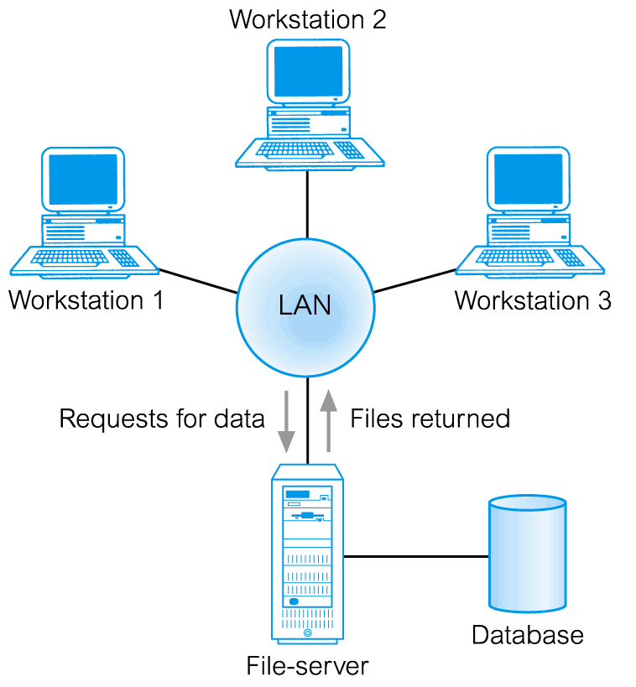
File-Server Architecture
In a file-server environment, the processing is distributed about the network, typically a local area network (LAN).

Slide 8
Traditional Two-Tier Client-Server
Client (tier 1) manages user interface and runs applications.
Server (tier 2) holds database and DBMS.
Advantages include:
wider access to existing databases;
increased performance;
possible reduction in hardware costs;
reduction in communication costs;
increased consistency

Slide 9
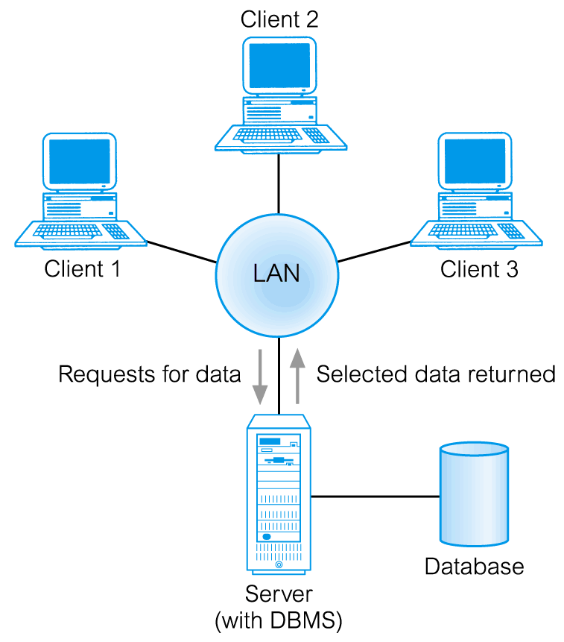
Traditional Two-Tier Client-Server

Slide 10
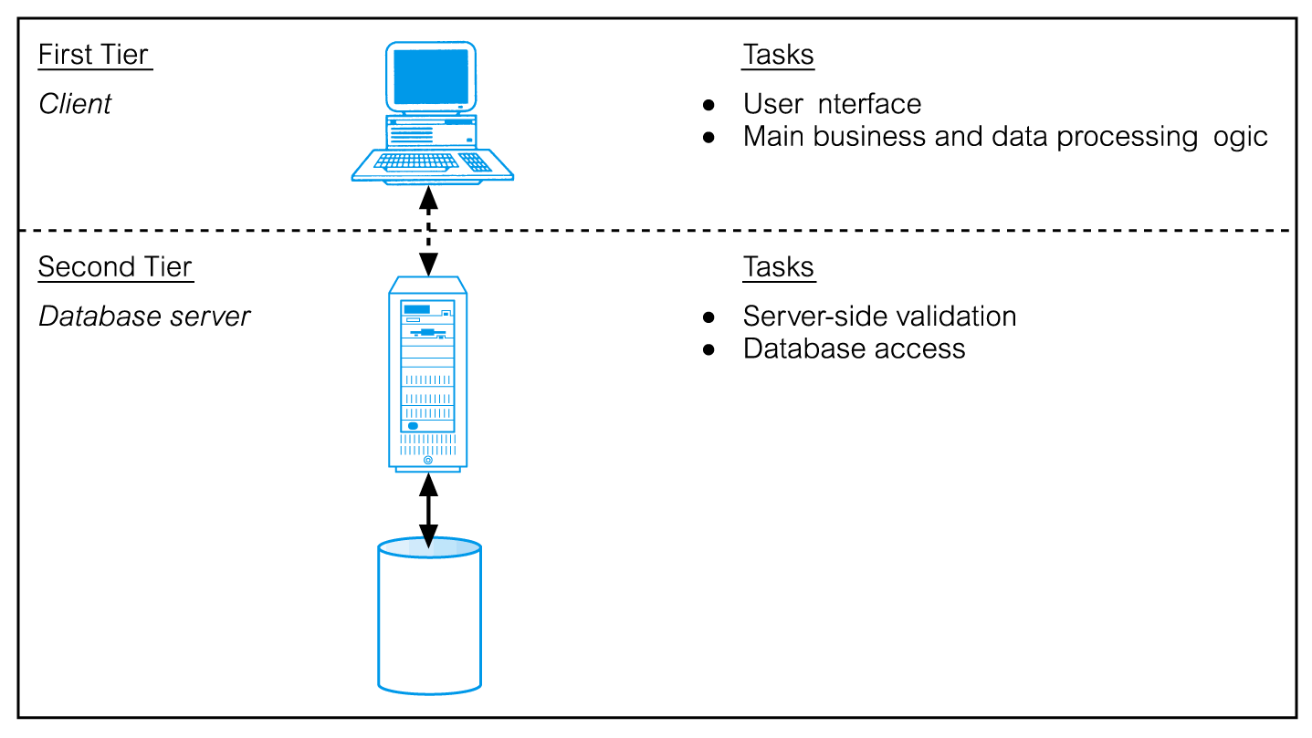
Traditional Two-Tier Client-Server

Slide 11
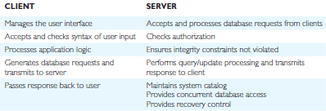
Summary of Client-Server Functions

Slide 12
Three-Tier Client-Server
The need for enterprise scalability challenged the traditional two-tier client–server model.
Client side presented two problems preventing true scalability:
‘Fat’ client, requiring considerable resources on client’s computer to run effectively.
Significant client side administration overhead.
By 1995, three layers proposed, each potentially running on a different platform.

Slide 13
Three-Tier Client-Server
Advantages:
‘Thin’ client, requiring less expensive hardware.
Application maintenance centralized.
Easier to modify or replace one tier without affecting others.
Separating business logic from database functions makes it easier to implement load balancing.
Maps quite naturally to Web environment.

Slide 14
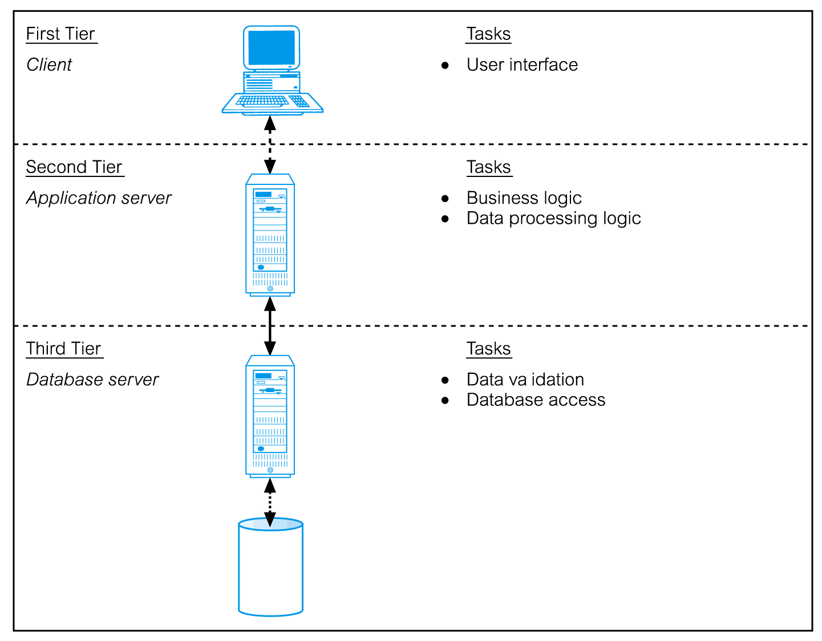
Three-Tier Client-Server

Slide 15
Distributed DBMSs
A distributed database is a logically interrelated collection of shared data (and a description of this data), physically distributed over a computer network.
A distributed DBMS is the software system that permits the management of the distributed database and makes the distribution transparent to users.

Slide 16
Distributed DBMSs
A DDBMS consists of a single logical database split into a number of fragments.
Each fragment is stored on one or more computers (replicas) under the control of a separate DBMS, with the computers connected by a network.
Each site is capable of independently processing user requests that require access to local data (that is, each site has some degree of local autonomy) and is also capable of processing data stored on other computers in the network.

Slide 17
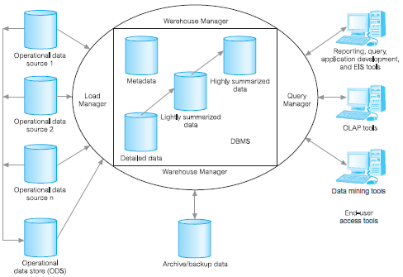
Data Warehousing
A data warehouse was deemed the solution to meet the requirements of a system capable of supporting decision making, receiving data from multiple operational data sources.

Slide 18
Cloud Computing
The National Institute of Standards and Technology (NIST) provided a definition.
Defined as “A model for enabling ubiquitous, convenient, on-demand network access to a shared pool of configurable computing resources (e.g. networks, servers, storage, applications, and services) that can be rapidly provisioned and released with minimal management effort or service provider interaction.”

Slide 19
Cloud Computing – Key Characteristics
On-demand self-service
Consumers can obtain, configure and deploy cloud services without help from provider.
Broad network access
Accessible from anywhere, from any standardized platform (e.g. desktop computers, laptops, mobile devices).

Slide 20
Cloud Computing – Key Characteristics
Resource pooling
Provider’s computing resources are pooled to serve multiple consumers, with different physical and virtual resources dynamically assigned and reassigned according to consumer demand. Examples of resources include storage, processing, memory, and network bandwidth.

Slide 21
Cloud Computing – Key Characteristics
Rapid elasticity
Provider’s capacity caters for customer’s spikes in demand and reduces risk of outages and service interruptions. Capacity can be automated to scale rapidly based on demand.
Measured service
Provider uses a metering capability to measure usage of service (e.g. storage, processing, bandwidth, and active user accounts).

Slide 22
Cloud Computing – Service Models
Software as a Service (SaaS):
Software and data hosted on cloud. Accessed through using thin client interface (e.g. web browser). Consumer may be offered limited user specific application configuration settings.
Examples include Salesforce.com sales management applications, NetSuite’s integrated business management software, Google’s Gmail and Cornerstone OnDemand.

Slide 23
Cloud-based database solutions
As a type of Software as a Service (SaaS), cloud-based database solutions fall into two basic categories:
Data as a Service (DaaS) and
Database as a Service (DBaaS).
Key difference between the two options is mainly how the data is managed.

Slide 24
Cloud-based database solutions
DBaaS
Offers full database functionality to application developers.
Provides a management layer that provides continuous monitoring and configuring of the database to optimized scaling, high availability, multi-tenancy (that is, serving multiple client organizations), and effective resource allocation in the cloud, thereby sparing the developer from ongoing database administration tasks.

Slide 25
Cloud-based database solutions
DaaS:
Services enables data definition in the cloud and subsequently querying.
Does not implement typical DBMS interfaces (e.g. SQL) but instead data is accessed via common APIs.
Enables organization with valuable data to offer access to others. Examples Urban Mapping (geography data service), Xignite (financial data service) and Hoovers (business data service.)

Slide 26
Cloud-based database solutions
DaaS:
Services enables data definition in the cloud and subsequently querying.
Does not implement typical DBMS interfaces (e.g. SQL) but instead data is accessed via common APIs.
Enables organization with valuable data to offer access to others. Examples Urban Mapping (geography data service), Xignite (financial data service) and Hoovers (business data service.)

Slide 27
Cloud Computing – Service Models
Platform as a Service (PaaS)
Allows creation of web applications without buying/maintaining the software and underlying infrastructure. Provider manages the infrastructure including network, servers, OS and storage, while customer controls deployment of applications and possibly configuration.
Examples include Salesforce.com’s Force.com, Google’s App Engine, and Microsoft’s Azure.

Slide 28
Cloud Computing – Service Models
Infrastructure as a Service (IaaS)
Provider’s offer servers, storage, network and operating systems – typically a platform virtualization environment – to consumers as an on-demand service, in a single bundle and billed according to usage.
A popular use of IaaS is in hosting websites. Examples Amazon’s Elastic Compute Cloud (EC2), Rackspace and GoGrid

Slide 29
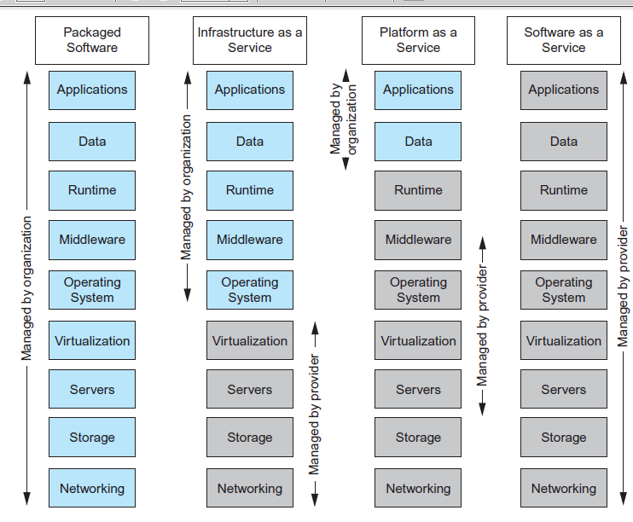
Cloud Computing – Comparison of Services Models

Slide 30
Benefits of Cloud Computing
Cost-Reduction: Avoid up-front capital expenditure.
Scalability/Agility: Organisations set up resources on an as-needs basis.
Improved Security: Providers can devote expertise & resources to security; not affordable by customer.
Improved Reliability: Providers can devote expertise & resources on reliability of systems; not affordable by customer.
Access to new technologies: Through use of provider’s systems, customers may access latest technology.

Slide 31
Benefits of Cloud Computing
Faster development: Provider’s platforms can provide many of the core services to accelerate development cycle.
Large scale prototyping/load testing: Providers have the resources to enable this.
More flexible working practices: Staff can access files using mobile devices.
Increased competitiveness: Allows organizations to focus on their core competencies rather than their IT infrastructures.

Slide 32
Risks of Cloud Computing
Network Dependency: Power outages, bandwidth issues and service interruptions.
System Dependency: Customer’s dependency on availability and reliability of provider’s systems.
Cloud Provider Dependency: Provider could became insolvent or acquired by competitor, resulting in the service suddenly terminating.
Lack of control: Customers unable to deploy technical or organisational measures to safeguard the data. May result in reduced availability, integrity, confidentiality, intervenability and isolation.
Lack of information on processing transparency

