Slide 1

access
Ada Emmett
Austin Texas
June 21, 2013
ACRL Scholarly Communications Roadshow:
From Understanding to Engagement

Slide 2
THEMES
BIG PICTURE
BIG OPPORTUNITIES
BIG PRESSURES
BIG RESPONSES

Slide 3
Scholarly communication system
Create
Share
Find and consume
Idea is born
Research

Slide 4
Scholarly communication system– a system of systems
systems
higher education
publishing industry
disciplinary practice
Internet culture
scholarly societies
research industry
IP/legal system
funders
faculty rewards system (p&t)

Slide 5
Scholarly Communication System, continued
individuals
groups
roles

Slide 6
Lifecycle of scholarly publishing
formulation
registration
certification
dissemination
preservation

Slide 7
Function | Old System | New System
Formulation | Alone or in laboratory with graduate students and colleagues | And… With colleagues all over the web
Registration | Journal submission Book publication Conference presentation Working paper / Technical Report | And… Blogs Disciplinary repositories Open notebooks
Certification | Publishers through peer review Universities indirectly through promotion and tenure | And… Accuracy/good science review (PloS One) Open peer review
Dissemination | Libraries Publishers – journals and monographs Scholarly societies thru publications & conferences Abstract and Indexing Services | And… Blogs Repositories Google and other web search engines Funding agency mandates
Archiving | Libraries | And… Collaborations like Portico & Hathi Trust Disciplinary and institutional repositories Publishers

Slide 8
pressures
political/policy
economic
social
technological

Slide 9

social

Slide 10




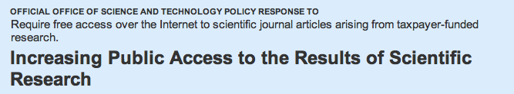
Social

Slide 11



Technology

Slide 12
technological
Rate of increase capacity to store, move, crunch data
Smaller technologies
Mobile technologies
Speed of moving
Data processing

Slide 13

Political/Policy

Slide 14

Political/Policy
Fair Access to Science & Technology Research Act
“Every year, the federal government funds over sixty billion dollars in basic and applied research. Most of this funding is concentrated within 11 departments/agencies (e.g., National Institutes of Health (NIH), National Science Foundation (NSF), and Department of Energy). This research results in a significant number of articles being published each year – approximately 90,000 papers are published annually as result of NIH funding alone.”
FASTR will make these articles freely available for all potential users to read and ensure that articles can be fully used in the digital environment, enabling the use of new computational analysis tools that promise to revolutionize the research process.
2012
2013

Slide 15

economic

Slide 16
Economic
decreasing budgets
rising costs

Slide 17

university
press-owned
journals
society
journals
commercial publisher-owned journals

Slide 18
STM sector
$20.3 B
Scholarly Publishing Market
revenue in 2009
Data from Simba Information 2010 publishing industry reports
SSH sector
$2.4 B

Slide 19
$5.8 billion
merged with Wiley 2007
John Wiley
Kluwer Health
Amer Chem Soc
Springer
Blackwell
Elsevier
STM sector, 2006
$10.3 billion
other 1,195 publishers
Data from Outsell’s 2006 STM market report

Slide 20
Intersections
political/policy
economic
social
technological

Slide 21

Open Access
Open access literature is digital, online, free of charge, and free of most copyright and licensing restrictions.
- Peter Suber

Slide 22
Open access publishing
Has taken time for impact factors and reputation to build
Business models still emerging
Author-pays model has better traction in the STM community
Emerging challenges with ‘predatory’ practices
Rising of an OA publishing trade organization for legitimate OA publishers (OASPA) and Directory of Open Access Journals (DOAJ) that lists journals with acceptable publishing practices.

Slide 23
Open access policies
Leverage/Mechanism to facilitate efficient and open sharing of faculty’s scholarly articles.
Whose policy:
Federal/funding agency policies
Faculty- or administration-initiated (overseas) policies
Policy mechanisms
Permissions-based
Deposit requirement based
Issues:
Author rights
Getting the right version for deposit
Repository enhancement
Compliance

Slide 24


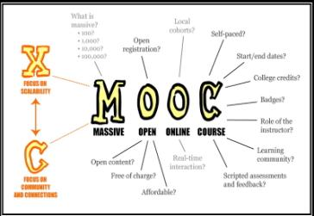

Open education
Open educational resources
MOOCs (Massive Open Online Courses)
CC licenses and discovery
This file is licensed under the Creative Commons Attribution 3.0 Unported license.
This image was originally posted to Flickr by mathplourde at http://flickr.com/photos/23311795@N04/8620174342. It was reviewed on 14 May 2013 by the FlickreviewR robot and is licensed under the terms of the cc-by-2.0.

Slide 25
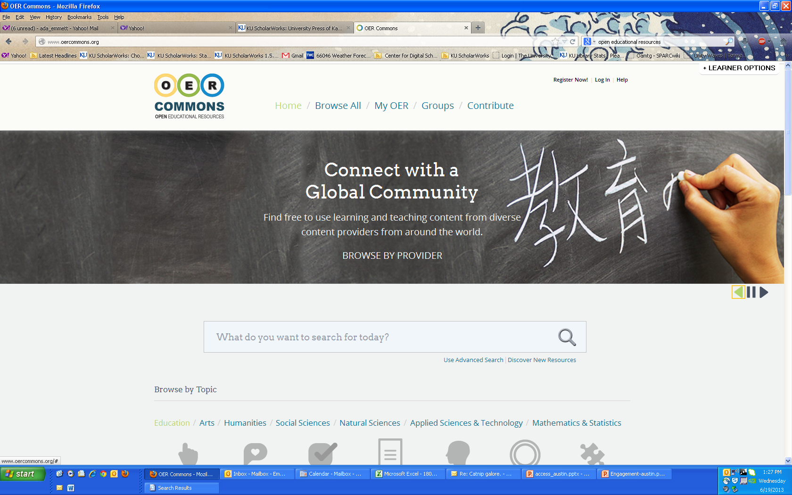

Slide 26
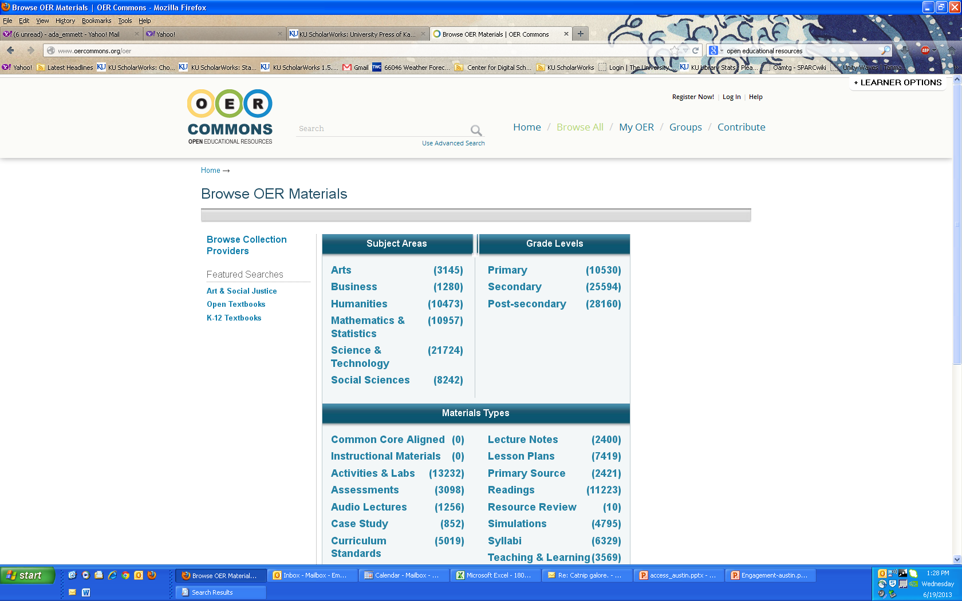

Slide 27

Library publishing
University of Michigan’s MPublishing
Amherst College
Library Publishing Toolkit – SUNY Geneseo
Library Publishing Coalition
Partnerships with University Presses

Slide 28
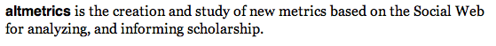
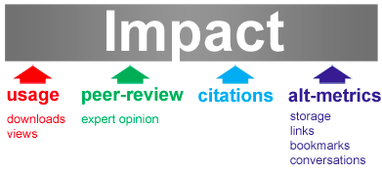
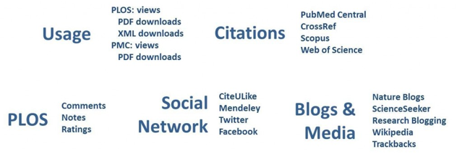
ALTMETRICS:
telling a different side of the story
Public Library of Science: Article-Level Metrics

Slide 29
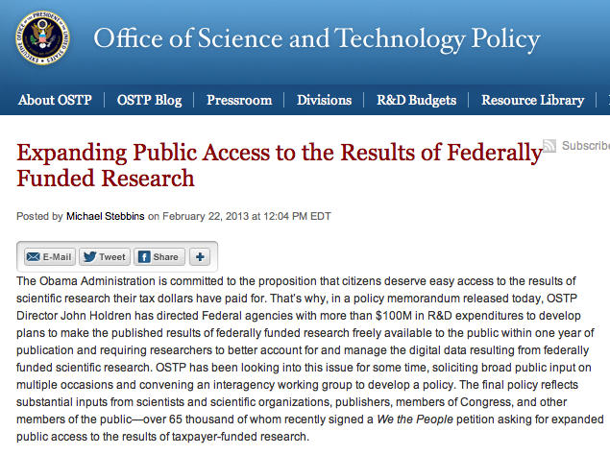
OSTP POLICY

Slide 30

It is a team sport

Slide 31
Big opportunities–Big responses
Understand the potential that new collaborations and partnerships offer for access, advocacy, and sustainability.
Cross-silo
Cross-discipline
collaborations
Trans-generational
peer review

Slide 32

Questions/Discussion
Start
This work was created by Stephanie Dahl-Davis and Ada Emmett for the ACRL Scholarly Communication 101 workshop, May 2013.
This work is licensed under a Creative Commons Attribution Non-Commercial Share Alike 3.0 United States license: http://creativecommons.org/licenses/by-nc-sa/3.0

