Slide 1
Engagement: to action Ada Emmett Austin, Texas June 21, 2013
ACRL Scholarly Communications Roadshow

Slide 2
Engaging Out: Campus Constituents
Engage the information
Engage by understanding the environment
Engage our campus constituents

Slide 3
Why engage with faculty?
Key stakeholders (therefore partners)
Producers & consumers of scholarly communication products
Editors, editorial board members, peer reviewers, scholarly society officers
Movers behind many new models – often born of their own frustrations
They can make change in ways that libraries cannot.

Slide 4

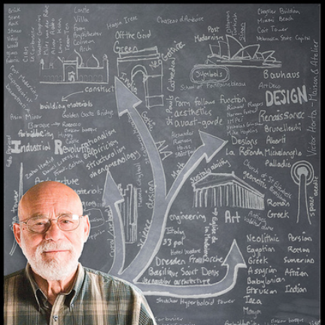

Slide 5
How might you start a conversation?

Slide 6
Potential Questions
Does this publisher allow you to post on a website, share with a colleague elsewhere, use graphs/pictures/sections of that work in future publications?
What grants support your research?
Does your funder require a data management plan or to provide public access to your work?
Has open access or scholarly communications been a topic of conversation in your society or discipline?
What are the areas of the publishing process you find troublesome or problematic?
I see others in your field are supporting open education in their teaching practices. What do you think about that?
Scenarios: faculty has signed Cost of Knowledge Boycott, publishes her own journal, starting an open textbook project, posts her data on her website…regularly attends Digital Humanities workshops, deposits his work in your IR, complains bitterly about the cost of scholarly journals…

Slide 7





Other groups to engage…
Bring faculty advocates from other campuses to speak.
Discuss scholarly communication issues (especially author rights) with graduate students and work with your Graduate College.
Engage with the research offices on campus about funder open access policies.
Alert administrators to litigation, legislation, and other current events that may have direct, campus-wide impact.
Address issues of information access in info lit sessions with undergraduate students.

Slide 8
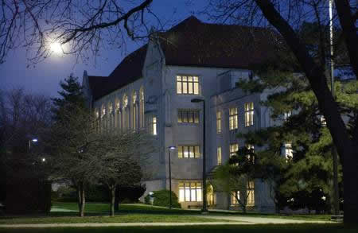
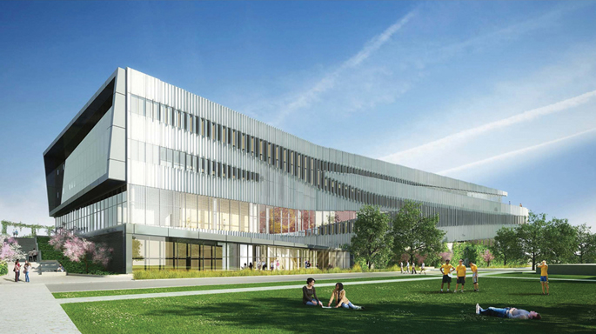
Our Pluses and Deltas…
Ada Emmett, University of Kansas
Will Cross, North Carolina State University

Slide 9
Engaging In: Library Programs

Slide 10
What do we mean by a program anyway?

Slide 11
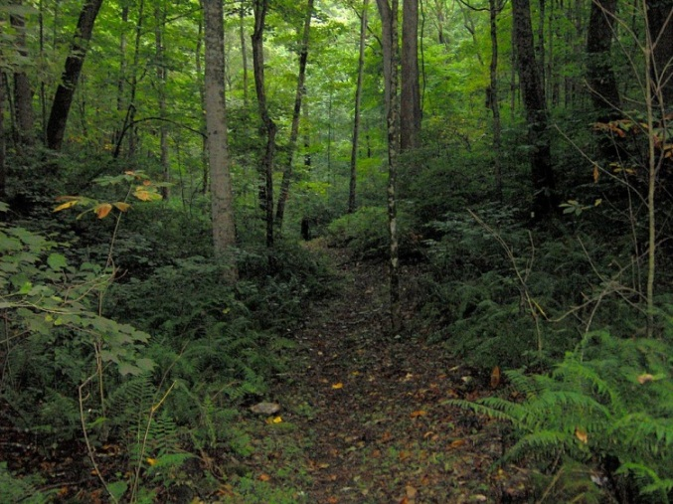
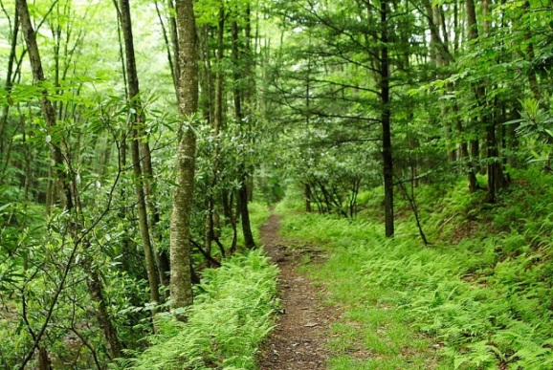
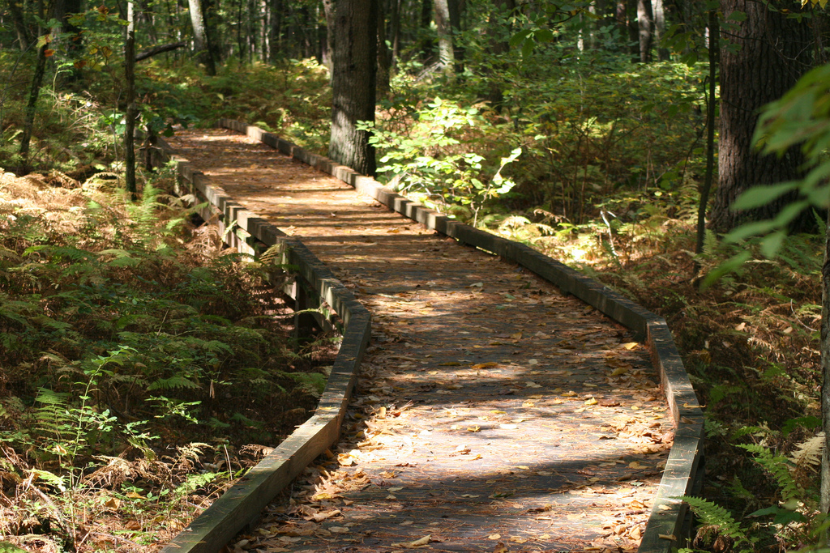

Slide 12
What it may look like within the library…
Have an institutional repository? Get more people involved – catalogers, subject librarians, etc.
Set an internal OA policy
Include scholarly communication in subject librarians’ jobs & service models
Provide technical & organizational infrastructure for publishing journals and other content
Educate librarians on copyright and author rights negotiation
Negotiate for OA archiving with publishers in license agreements

Slide 13
Pilots & Projects & New Programs, oh my!
Seminars, brown bags, talks to faculty & graduate students on publication agreements, open access advocacy, IR content recruitment, etc.
Support open access to backfiles of publications from departments and research centers
Faculty resolutions and OA policies
Explore publications projects with faculty
Foster digital humanities projects
Others?

Slide 14






Tools to support a program

Slide 15
What conditions on your campus do you need to consider to take a “next step”?
Dreaming big, what would be some steps you might take exactly where you and your institution are?
What are some obstacles facing you and what do you need to overcome them?
How do you know what you’re doing is working?

Slide 16
What is YOUR next step?

Slide 17
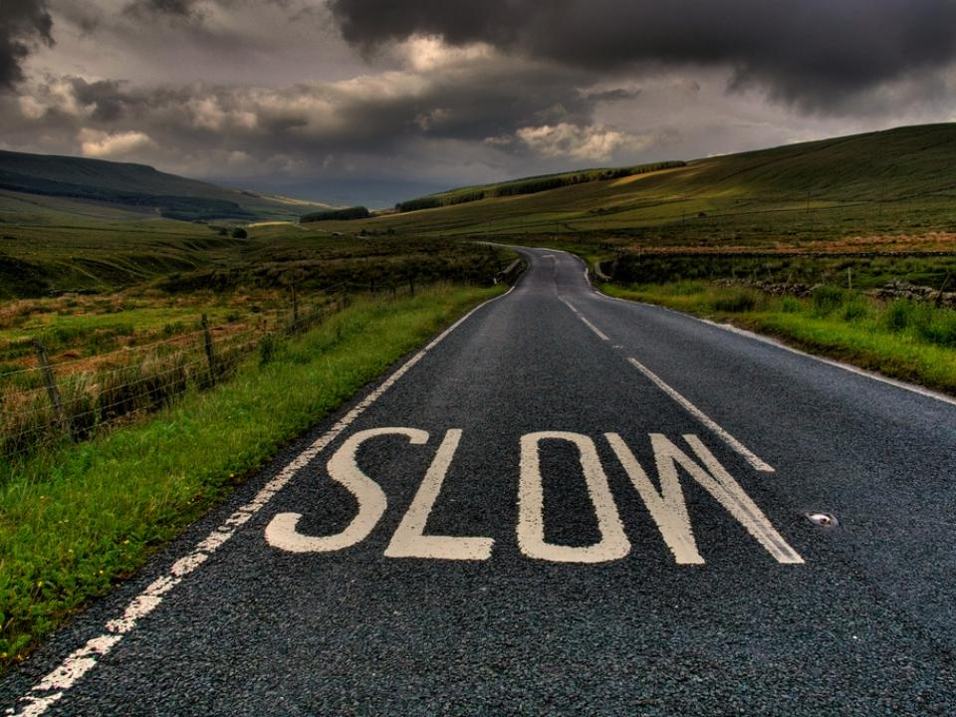

Slide 18
Attribution
Slide 4: Faculty Member - http://www.flickr.com/photos/mikeeperez/
Slide 8: Presenters’ own
Slide 11: Highland Rim Trail - http://commons.wikimedia.org/wiki/File:Highland-rim-trail-su-tn1.jpg; Forest Trail Seneca - http://www.forestwander.com/?p=1033; Peverly Pond Trail - http://www.flickr.com/photos/usfwsnortheast/4150315808/
Slide 16: Slow - http://www.flickr.com/photos/fatboyke/
All photos used under a Creative Commons 3.0 Attribution-Share Alike 3.0 license
This work was created by Sarah L. Shreeves, Joy Kirchner, and Ada Emmett, and last updated by Molly Keener in May 2013. It is licensed under the Creative Commons Attribution-Noncommercial Share Alike 3.0 Unported License. To view a copy of this license, visit http://creativecommons.org/licenses/by-nc-sa/3.0/ or send a letter to Creative Commons, 171 Second Street, Suite 300, San Francisco, California, 94105, USA.

