Slide 1
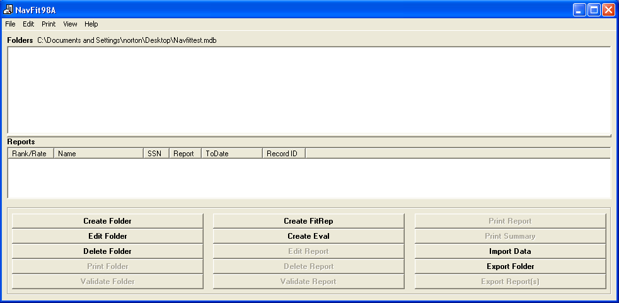
USNA Evaluation/Fitness Report Training

Slide 2
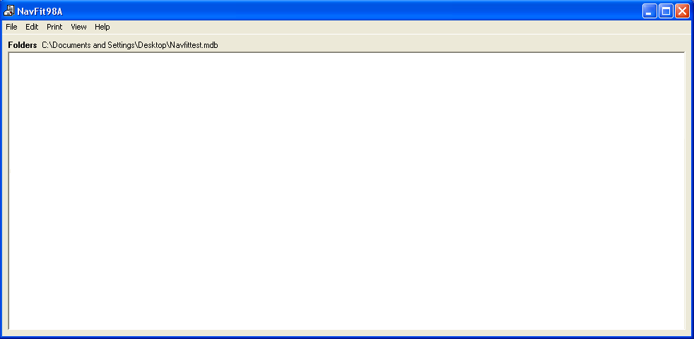
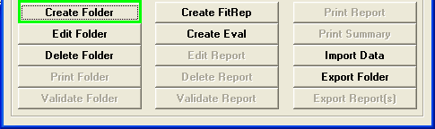
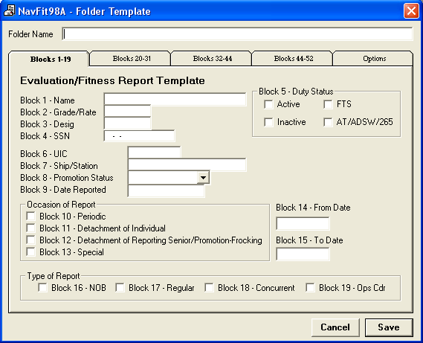
Creating folders
Click on “Root” followed by the “Create Folder” Button to open the “Folder Template”.
The Folder Template can be used to input information into multiple reports of the same summary group. For our purposes here, giving the folder a name will suffice. Folders will be listed alphabetically on the menu screen unless subdirectories are created. Subdirectories are created in the same way, by clicking the file you want to subdivide such as:
Enlisted
-E5
-Regular
-Frocked
-E6
-Regular
-Approved
-NOB
Once the name has been input, click “save” and your directory is complete.

Slide 3
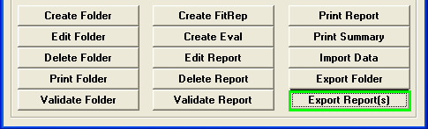
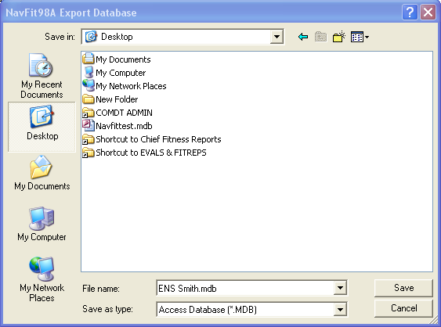
Transferring reports to another user
From the menu, clicking “Export Report(s)” will open the save as menu.
-Under the drop down menu “Save in:” select the location that you want to save the file to.
In “File name” type the name that you want to use and click “save”.

Slide 4
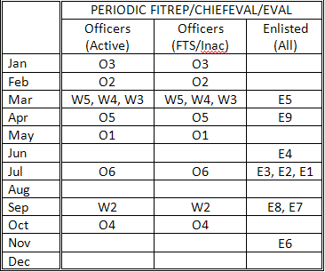
FITREP/CHIEFEVAL/EVAL COUNSELING Planning Calendar
(FITREP/EVAL ending dates are the last day of the month for officers and the 15th of the month for enlisted)
A Periodic report may be omitted if the member received an Observed Regular report within the past 3 months. The omitted period is then included in the next Regular report. Otherwise, the Periodic report must be submitted on the due date, but may then be extended by letter for up to 3 months in place of a Promotion/Frocking or Detachment report. Mid-term counseling should normally be performed in the month scheduled, and may not be omitted or unduly delayed, but may be performed in an earlier or later month if necessary or more appropriate to the needs of the member.

Slide 5
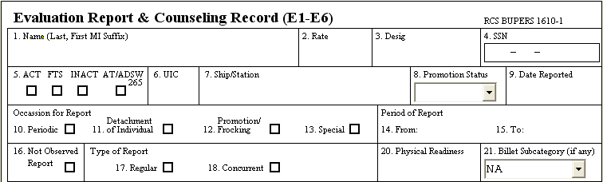
Instructions for specific blocks
Block #3 - DESIG
Enlisted: Warfare Specialty
  AW, SS, SW, etc. (limit of two)
  Officer: Designator
    1525, 1140, etc.
Block #1 – LAST NAME, FIRST NAME MI
No period after MI.
One space between each name.
Proofread for accuracy!
Block #2 – GRADE/RATE
MA1
LCDR
Block #4 – SSN
Automatically inserts hyphens.
Verify for accuracy!

Slide 6
Instructions for specific blocks
Block #5 - PUT AN “X” IN ONE BLOCK ONLY
Block determines who is ranked against whom for advancement.
ACT: USN ONLY.
FTS: Full Time Support of Reserves ONLY.
INACT: Inactive duty, drilling Reserves ONLY.
AT/ADSW/265/OYR
  USNR temporarily on active duty.
  Includes all mobilized Reserves.
  Competes as inactive Reserve, even while under orders.

Slide 7
Instructions for specific blocks
Block #6 – UIC
USNA – 00161
Band – 64377
Block #7 – SHIP/STATION
USNA ANNAPOLIS MD
ACADEMY BAND ANNAP

Slide 8
Instructions for specific blocks
Block #8 – PROMOTION STATUS
Block determines who is ranked against whom.
Regular: Regularly promoted to the grade or rate in block 2; not currently frocked; not currently selected to higher grade.
Frocked: Frocked to the rate in block 2; not actually advanced/paid for the rate in block 2.
Selected: Selected to a grade or rate higher than shown in block 2; not yet frocked or regularly promoted or advanced.
Spot: Spot-promoted to the grade entered in block 2; currently applies only to certain LTs spot promoted to LCDR.
Block #9 – DATE REPORTED
Format
  YYMMMDD (10NOV21)
  Date reported to command according to EDVR/ODCR.
  Do not confuse with date of report (block 14).

Slide 9
Instructions for specific blocks
Blocks #10-13 – OCCASION FOR REPORT
Blocks 10 and 11 are self explanatory.
Block 12, Promotion/Frocking, is used only on the occasion that a reporting period will go beyond 15 months, i.e., if a member is frocked from E4 to E5, a frocking eval is not necessary because the report cycle will be less than 15 months.
Block 13, Special, is for special occasions for Regular reports and must maintain regular report continuity. Provide justification statement. A report without this statement will be returned for correction.

Slide 10
Instructions for specific blocks
Blocks #14-15 – PERIOD OF REPORT
Block 14, From, YYMMMDD format, should indicate the day after the ending date of the last report – regardless of reporting date.
  It can be earlier than block 9 if en route leave, travel, or TEMDU are included.
  The From Date on enlisted member’s first eval is the date detached from Initial Entry Training (IET). IET is defined as recruit training; NAVET/OSVET indoc; and schools following in direct sequence prior to reporting to first permanent duty station.
Block 15, To, YYMMMDD format, should indicate the ending date of the reporting period.
  Typically the 15th of the month for periodic evals/last day of the month for periodic FITREPS.
  Occasionally an odd day, such as detachment, RIR, etc.

Slide 11
Instructions for specific blocks
Block #16 – NOT OBSERVED REPORT
Enter an “X” in block 16 if this is an entirely not observed report.
Trait grades left blank.
Used for short periods of duty or temporary duty of generally no more than three months (90 days).
No career recommendation permitted.
Promotion recommendation must be NOB.
Promotion recommendation summary must be left blank.
Cross reference to block 43: Comments are limited primarily to administrative and training information.
* Refer to Chapter 6 of BUPERINST 1610.10B for more information.

Slide 12
Instructions for specific blocks
Block #16 – NOT OBSERVED REPORT
Instructions for specific block entries on Not Observed Reports
 | Must have entries | May have entries | May not have entries
NOB EVAL | 1, 2, 4-16, 20-29, 45 (must be NOB), 48, 50 | 3, 17-19, 30-32, 40 (blank or 0.00), 42-44, 49, 51, 52 | 33-39, 41, 46, 47
NOB FITREP/ CHIEFEVAL | 1, 2, 4-16, 20-29, 42 (must be NOB), 44, 45 | 3, 17-19, 30-32, 41, 46, 47 | 33-40, 43

Slide 13
Instructions for specific blocks
Blocks #17-19 – TYPE OF REPORT
Place an “X” in the box that applies.
Concurrent reports: Use only if a member is assigned TAD for a significant amount of time, usually three months or more.
Place an “X” in blocks 17 and 18 if submitting as regular and concurrent (must maintain report continuity).
  The regular reporting senior puts an “X” in block 17.
  The Concurrent reporting senior is the person listed in block 22, the member’s regular (parent command) reporting senior is listed in block 47/52.

Slide 14
Instructions for specific blocks
Block #20 – PHYSICAL READINESS
P (or PP): Passed both Physical Readiness Test (PRT) and Body Composition Assessment (BCA).
F: Overall PFA failure (Failed BCA or PRT).
M: Medically waived from entire PFA (BCA and PRT).
W: Passed BCA but medically waived from one or more PRT event(s).
B: Passed the BCA but was authorized non-participation in the PRT for other than medical reasons (A comment will be made in block 41/43 with reason for non-participation).
See NAVADMIN 193/10 for more information.
Block #21 – BILLET SUBCATEGORY
NA: Should appear on most reports
BASIC: Used for members of the basic group if sub-categories are used, i.e., Approved.
APPROVED: Used for members that are approved for retirement/resignation.
See BUPERINST 1610.10B for more information.

Slide 15
Instructions for specific blocks
Blocks #22-27 – REPORTING SENIOR INFORMATION
The Superintendent is the reporting senior for all O5-O6 officers.
The Commandant of Midshipmen is the reporting senior for O4 and below personnel within his cost center.
The Director, Division of Professional Development is delegated reporting senior for O3 and below personnel within his division.
All Division Directors and Department Heads within the cost center (O4 and above) are delegated reporting senior authority for E5 and below reports.
The Commandant of Midshipmen is the reporting senior for any adverse reports within the cost center (the Chief of Staff will review all adverse reports).
The following are delegated reporting senior authority for TAD Ensigns under their cognizance:
  Deputy Commandant of Midshipmen
  Battalion Officers
  Director, Character Development and Training
  Director, Leadership Education and Development
  Director, Seamanship and Navigation
  Director, Naval Academy Sailing
  Director, Waterfront Readiness
  Midshipmen Supply Officer
See USNAINST 1610.5A and CMDTMIDNINST 1610.1 for additional information.

Slide 16
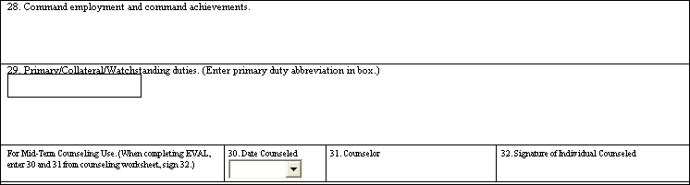
Instructions for specific blocks
Block #28 – COMMAND EMPLOYMENT AND COMMAND ACHIEVEMENTS
Should read:
EDUCATION AND TRAINING OF MIDSHIPMEN. To develop Midshipmen morally, mentally, and physically and to imbue them with the highest ideals of duty, honor, and loyalty in order to graduate leaders who are dedicated to a career of Naval service.

Slide 17
Instructions for specific blocks
Block #29 – PRIMARY DUTY
Most significant duty abbreviated.
  14 or fewer characters and spaces, all caps.
  Example: ASST PROFESSOR; COMPANY OFCR; COMPANY SEL

Slide 18
Instructions for specific blocks
Blocks #29 – PRIMARY/COLLATERAL /WATCHSTANDING DUTIES
Remainder of block 29 consists of the following elements:
  Duty titles: Enter duty titles and number of months each duty is assigned during this reporting period. e.g., XO Admin LPO-12.
    Order of duty titles: 1) Most significant primary duty (corresponds to the small box abbreviation); 2) other primary duties; 3) collateral duties; and 4) watchingstanding duties. e.g. COLL: CFC-10; UPC-12. WATCH: OOW-12.
  Periods Not Available for Duty: Such periods may include en route time prior to reporting, e.g., LV/TT/TEMDU: 10JAN03-09FEB15; TEMADD: 09APR18-09MAY30.
    LV/TT/TEMDU is leave/travel time/and Temporary Duty Under Instruction (only during PCS) abbreviated, used when member is transferring commands and also taking leave en route. This is the link between the ending date of the member’s detaching eval and the date prior to reporting onboard – it justifies the gap.
  Job Scope Statement: Briefly state the scope of primary duty responsibility.
    Example: Leads and counsels 146 Midshipmen in their professional, ethical, and physical development.
  Per NAVADMIN 093/10 PFA cycles will be documented. (Example: PFA: 10-1/10-2.) If “PP” was typed into block 20 previously this tells the reader that the member passed the first and second cycle PFAs for 2010.

Slide 19
Instructions for specific blocks
Block #30 – DATE COUNSELED
Input date mid-term counseling was received during the report period. Use YYYMMMDD format: 10MAY15.
If mid-term counseling was not required in this period input: NOT REQ.
If mid-term counseling was not performed input: NOT PERF. Make a brief explanation in block 31.
Block #31 – COUNSELOR
Input name of person who conducted the counseling. Use LAST, FIRST MI only. Do not use Rank/Rate or Job Title.
If block 30 was NOT PERF, input brief explanation, e.g., TEMADD or ILLNESS.
If longer explanation is needed, input SEE COMMENT and provide in block 41/43.
Block #32
Member signs here.

Slide 20
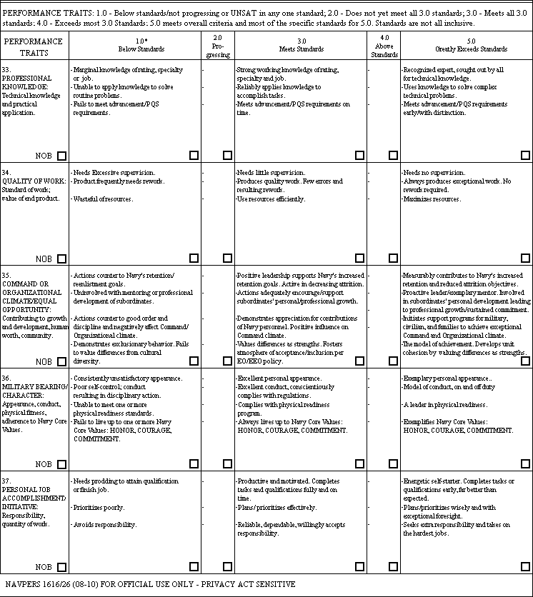
Instructions for specific blocks
Blocks #33-39
3.0 = an average Sailor that meets all required standards. This is the standardized average to base your grading on.
Do not over-inflate your marks!

Slide 21
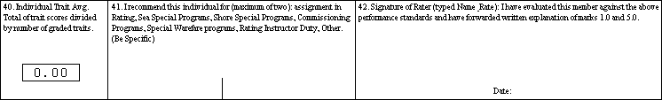
Instructions for specific blocks
Block #40
No action necessary; this average is automatically calculated.
Block 45 CHIEFEVAL, automatically calculated.
Block #41
(40 CHIEFEVAL/FITREP)
Use ALL CAPS.
Do not leave blank, if none enter NONE or NA.
Enter a maximum of two recommendations.
Use “Assignment in Rating” if you cannot recommend for anything else.
Block #40/41
Recommendation should be the next significant milestone.
Do not enter very long-range goal; e.g., do not recommend an ENS for command screening or CWO for E6 and below.
Block #42
TYPE: LAST, FIRST MI
RATE/RANK
Rater signs in black or blue ink.
If signature is unobtainable, see BUPERINST 1610.10B, Chapter 14.

Slide 22
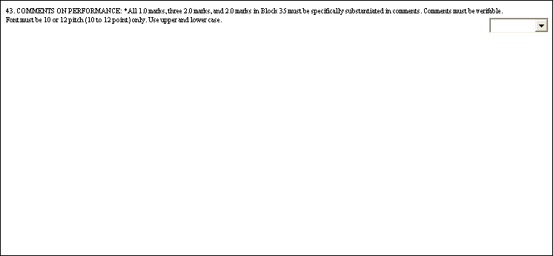
Instructions for specific blocks
Block #43 (41 – CHIEFEVAL/FITREP)
See BUPERSINST 1610.10B, Chapter 13 for specific guidance on preparation, organization, style, reporting on misconduct, prohibited comments, and special interest items that must be mentioned when applicable.

Slide 23
Evaluation/FITREP block 41/43 template
One-line Top Banner (reserved for EPs/top MPs) - centered/all caps – cite hard/soft breakouts and recommendations
**MY #1 OF 34 HAND-SELECTED LIEUTENANTS -- READY NOW FOR O4!**
Two-line introduction describing member (sentence-case/not centered).
Innovative thinker and inspirational leader. A community superstar who has my absolute trust and confidence. Already performs like a seasoned LCDR. Makes tough decisions every day and every one of them is perfect!
WHITE SPACE
Provide three bullets of three lines each that support the grades and overall promotion recommendations. Start bullets with strong, dynamic action verbs that are all capitalized. Provide tangible data to include retention, advancement, qualifications, and Sailorization stats.
MOTIVATIONAL LEADER. Superbly stepped into department head role following incumbent’s short-fused transfer…
REMARKABLE LOGISTICIAN. Saved over $1.5 million by…
SAILORIZATION EXPERT. Led his division to a 95% advancement rate, 97% retention rate…
WHITE SPACE
Two-line summary (sentence-case/not centered).
This superstar has CO Afloat in his future. Already thinks, acts, and communicates like a seasoned Commanding Officer. A leader among leaders!
WHITE SPACE
One-line Bottom Banner (EPs/top MPs) - centered/all caps – promotion and career recommendations
**HAS MY STRONGEST POSSIBLE RECOMMENDATION FOR PROMOTION TO LCDR. SCREEN FOR CO AFLOAT!**
NOTE: For lower MP and P evals/fitreps that do not receive the top and bottom banners, the extra space can be used to add another bullet.

Slide 24
Blocks 41/43 (cont’d)
Justification Remarks
  Establish the flow of the write-up based on the performance blocks.
  1-3 word catch phrase at the beginning of each justification.
  Justification of catch phrase to include numbers, descriptive details, results of performance.
  Cross-reference the performance mark blocks with the comment block. Do not repeat the performance block words to justify comments. Use the words in the performance mark blocks to help guide you through the write-up.
Proofread your draft:
  Look for run-on sentences.
  Verify usage of present tense and past tense word usage.
  Spell check (Tools menu).
  Don’t rely solely on Spell Check. Read the comments, looking for words that may be spelled correctly but are not the words you intended to use, e.g., “form” instead of “from”.

Slide 25
Block #41/43 (cont’d)
For E5s, ask “Do the comments show increasing leadership?”
For E6s, ask “Do the comments show leadership accomplishments?”
For E7s, ask “Do the comments show how the Sailor’s leadership impacted the command? How did his/her leadership benefit E6 and below working for him? How did his leadership affect command climate and retention? Did his leadership promote his Sailors and contribute to their advancement?”
Above average marks should equal above average comments, e.g., “He is my #1 Petty Officer First Class.”
Average marks should equal average comments, e.g., “He is relied on to perform [duties].”
3.0 = an average Sailor. A 3.0 grade should not be viewed as adverse.

Slide 26
Common Catch Phrases for block #41/43
EXEMPLARY LEADER
RESULTS DRIVEN
RESIDENT EXPERT
TEAM BUILDER
FOCUSED
CIVIC-MINDED
ENTHUSIASTIC
INSPIRING MENTOR
SEEKS ADDITIONAL RESPONSIBILITY
DECISIVE LEADER
HIGHLY MOTIVATED
ORGANIZED
EXCEPTIONAL VOLUNTEER
INNOVATIVE
STRIVES FOR EXCELLENCE
DEVELOPS JUNIOR PERSONNEL
EMULATES CORE VALUES
LEADS BY EXAMPLE
MAXIMIZES RESOURCES
NATURAL LEADER
SETS THE STANDARD
POSITIVE ROLE MODEL
DEDICATED
EXPERT TRAINER
MENTOR
UNSURPASSED PROFESSIONAL
VISIONARY LEADER
INFLUENTIAL MOTIVATOR

Slide 27
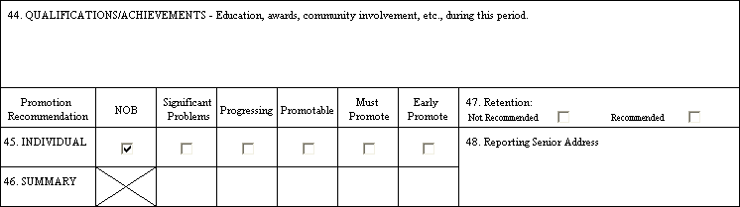
Instructions for specific blocks
Block #44 (not on CHIEFEVAL/FITREP)
Courses and/or credit hours completed.
Reserved for completed, not anticipated achievements, do not enter courses in progress, etc.
Degrees or certificates awarded.
Special Navy or other qualifications attained or renewed.
Personal awards or LOCs received, not recommended.
Other special honors or recognition received.

Slide 28
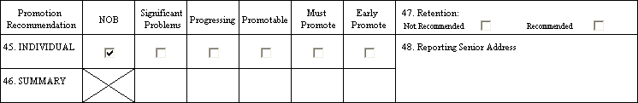
Instructions for specific blocks
Block #45 (42 – CHIEFEVAL/FITREP)
Promotable, Must Promote, and Early Promote are recommendations for promotion.
Progressing means that the member is making progress but is not ready to be recommended for promotion. Progressing may not be marked if an advancement recommendation is already in effect in the current grade.
Significant Problems is a recommendation against promotion and must be justified in the comments. This withdraws an advancement recommendation previously in effect. For E7 and above this is a recommendation against retention unless comments specifically recommend retention.
ENS/LTJG FITREPS for designators other than LDOs cannot receive a promotion recommendation higher than Promotable.
A Promotable recommendation allows up to two traits, excluding Character or Equal Opportunity to be assessed as Progressing (2.0), and still maintain an overall evaluation and promotion recommendation of Promotable.
A member who receives a 2.0 trait grade cannot receive a promotion recommendation higher than Promotable.
Command or Organizational Climate/Equal Opportunity (FITREP/EVAL) and Character (CHIEFEVAL) must be evaluated as 3.0 or higher to maintain eligibility for advancement and receive a recommendation of Promotable.
A Promotable or higher recommendation may not be assigned with any trait graded 1.0.
NOTE: An enlisted member who receives a 1.0 trait grade loses eligibility for their Good Conduct Medal and must reestablish a new 3-year period following the end date of the report.

Slide 29
Maximum limits on “Early Promote” and “Must Promote” recommendations
Summary Group Size | Early Promote | Must Promote (May be increased by one for each Early Promote recommendation not used) |  |  |  | Promotable
 | E1-E9 LDO O1/O2 O3-O6 | E1-E5 W2 LDO O1-O2 O3 | E6 | E7-E9 W3-W5 O4 | O5-O6 | O1-O2 (ALL EXCEPT LDO)
1 2 3 4 5 | 1 1 1 1 1 | No Limit | 1 1 2 2 | 1 1 1 2 | 1 1 1 1 | No Limit
6 7 8 9 10 | 2 2 2 2 2 |  | 2 3 3 4 4 | 1 2 2 3 3 | 1 1 2 2 2
11 12 13 14 15 | 3 3 3 3 3 |  | 4 5 5 6 6 | 3 3 4 4 5 | 2 2 3 3 3
16 17 18 19 20 | 4 4 4 4 4 |  | 6 7 7 8 8 | 4 5 5 6 6 | 3 3 4 4 4
21 22 23 24 25 | 5 5 5 5 5 |  | 8 9 9 10 10 | 6 6 7 7 8 | 4 4 5 5 5
26 27 28 29 30 | 6 6 6 6 6 |  | 10 11 11 12 12 | 7 8 8 9 9 | 5 5 6 6 6
Summary
Groups of 30 or less

Slide 30
Instructions for specific blocks
Block #47 (Not on FITREP)
Place an X in “Not Recommended” or “Recommended.”
For officers and chief petty officers, a retention recommendation will be assumed unless the report is adverse.
Block #46 (43 – CHIEFEVAL/FITREP)
Summarizes total number of promotion recommendations for each category of competing evaluations.
Place total number in the specific blocks for each evaluation.

Slide 31
Summary Groups - Enlisted
SUMMARY GROUP ENLISTED (E1 TO E9)
BLOCK | BLOCK LABEL | REMARKS (Group enlisted reports that share all the following characteristics)
2 | Rate | Group by current pay grade, regardless of rating.
5 | Duty/Competitive Status | For enlisted, group ACT and FTS together, group INACT, AT/ADSW separately.
6 | UIC | If the reporting senior has more than one UIC but desires to group all enlisted personnel together, they may do so. Block 6 should match the primary UIC of the reporting senior in block 26.
8 | Promotion Status | Group by promotion status.
15 | To | Group by ending date of the report.
17-18 | Type of Report | Group by type of report.
21 | Billet Subcategory | Group by entry in this block.
22 | Reporting Senior | Group by reporting senior.
45EV | Promotion Recommendation | Must have Observed promotion recommendation. Do not include NOB promotion recommendations in a summary group.
42CE

Slide 32
Summary Groups - Officers
SUMMARY GROUP OFFICERS (W2 TO O6)
BLOCK | BLOCK LABEL | REMARKS (Group officer reports that share all the following characteristics)
2 | Grade/Rate | Group by grade worn on report ending date.
3 | Designator | Group by competitive designator category.
5 | Duty/Competitive Status | Group by box marked in Block 5.
8 | Promotion Status | Group by promotion status.
15 | To | Group by ending date of the report.
17-18 | Type of Report | Group by type of report.
21 | Billet Subcategory | Group by entry in this block.
22 | Reporting Senior | Group by reporting senior. (“Dual-hatted” commanders may group by command, if Block 26 displays a separate UIC for each command.) (Dual-hatted is defined as a flag officer with two or more separate organizations as opposed to having only one command with multiple UICs).
42 | Promotion Recommendation | Must have Observed promotion recommendation. Do not include NOB promotion recommendations in a summary group.

Slide 33
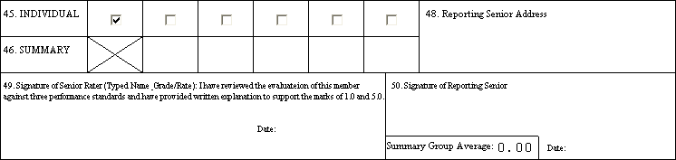
Instructions for specific blocks
Block #49 (Not on CHIEFEVAL/FITREP)
LAST NAME, FIRST INITIAL MI, GRADE OR RATE
Obtain signature. (If signature is unobtainable, see BUPERINST 1610.10B, Chapter 14.
If no senior rate, enter “NONE AVAILABLE.”
Block #48 (44 – CHIEFEVAL/FITREP)
Enter reporting senior’s address:
SUPERINTENDENT
UNITED STATES NAVAL ACADEMY
121 BLAKE ROAD
ANNAPOLIS, MD 21402-1300
-------------------------------------------------------------------------------------
COMMANDANT OF MIDSHIPMEN
UNITED STATES NAVAL ACADEMY
101 BUCHANAN ROAD
ANNAPOLIS, MD 21402-5101
For active duty reporting seniors with transfer or retirement orders enter address of next command or home address, as appropriate.

Slide 34
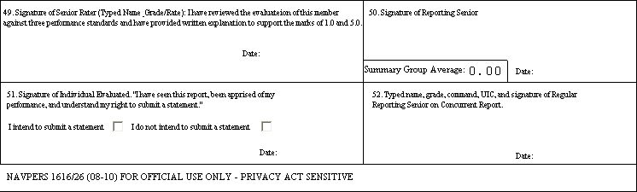
Instructions for specific blocks
Block #51 (46 – CHIEFEVAL/FITREP)
Obtain signature and date.
Ensure member marks whether he/she intends to make a statement.
If member cannot or does not sign, refer to BUPERINST 1610.10B, Chapter 14.
If member desires to submit a statement, refer to BUPERSINST 1610.10B, Chapter 18.
Also ensure member signs block 32.
Block #52 (47 – CHIEFEVAL/FITREP)
Must be forwarded to member’s regular reporting senior for signature.
To convert report to Concurrent/Regular place an X in block 17. Report must maintain continuity.
See BUPERINST 1610.10B, Chapter 14 for additional information.
Block #50 (45- CHIEFEVAL/FITREP)
Obtain signature.
Must be signed by reporting senior, no exceptions.
Write in summary group average from Summary Letter.

Slide 35
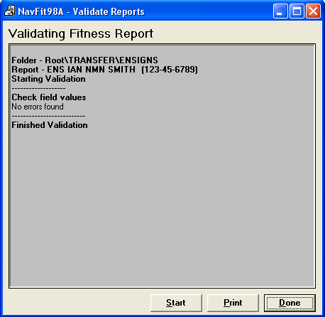
! VALIDATE THE REPORT!
Use the Validation Feature built into NAVFIT!
Validate both individual reports and Summary Groups.
The Validation Feature will catch most common errors and prevent most errors associated with reports rejected by Navy Personnel Command.

Slide 36
Performance Evaluation resources/references
Resources
Navy Personnel Command Performance Evaluation Assistance
  FITNESS/EVALUATION REPORT POLICY ASSISTANCE
  (901) 874-4881 DSN: 882-4881
  (901) 874-4882 DSN: 882-4882
  (901) 874-3313 DSN: 882-3313
  TECHNICAL SUPPORT NAVFIT98A PROGRAM
  (901) 874-3319 DSN: 882-3319
  email: jb.bland@navy.mil
References
Navy Personnel Command Reference Library
OPNAVINST 6110.1H (Physical Readiness Program)
MILPERSMAN (Military Personnel Manual)
BUPERINST 1610.10C (EVAL/FITREP Manual)
SECNAVINST 1650.1G (Awards Manual)
Recent NAVADMINS
215/10 (Performance Evaluation and Advancement Guidance for Individual Augmentee Sailors)
193/10 (Change to Physical Fitness Assessment Documentation on Fitness Reports)
083/10 (Revised Performance Evaluation and Advancement Policy)

