Slide 1
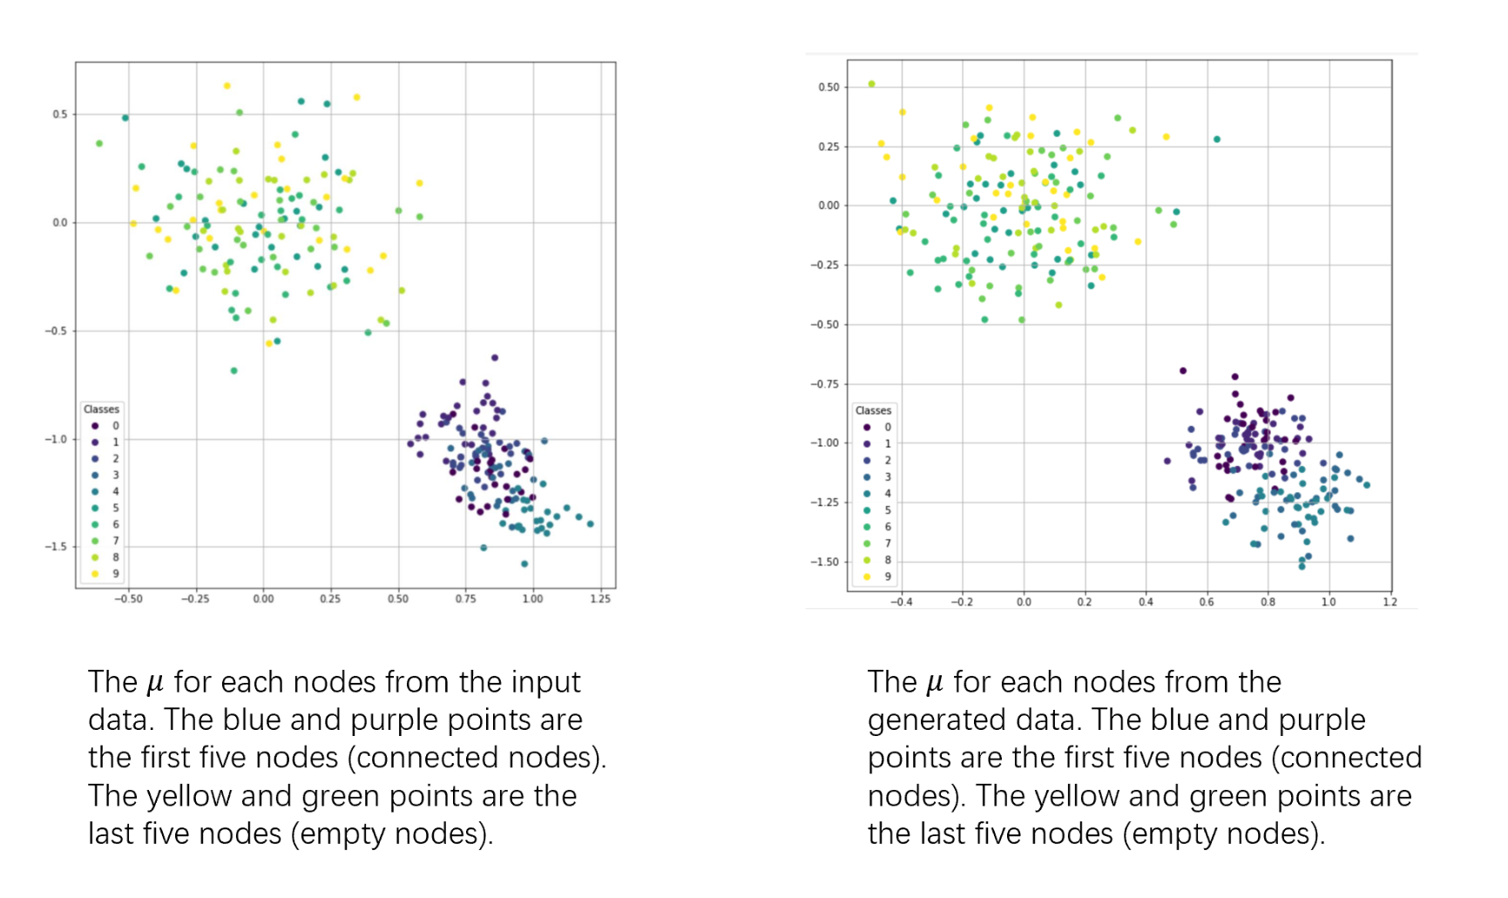

Slide 2
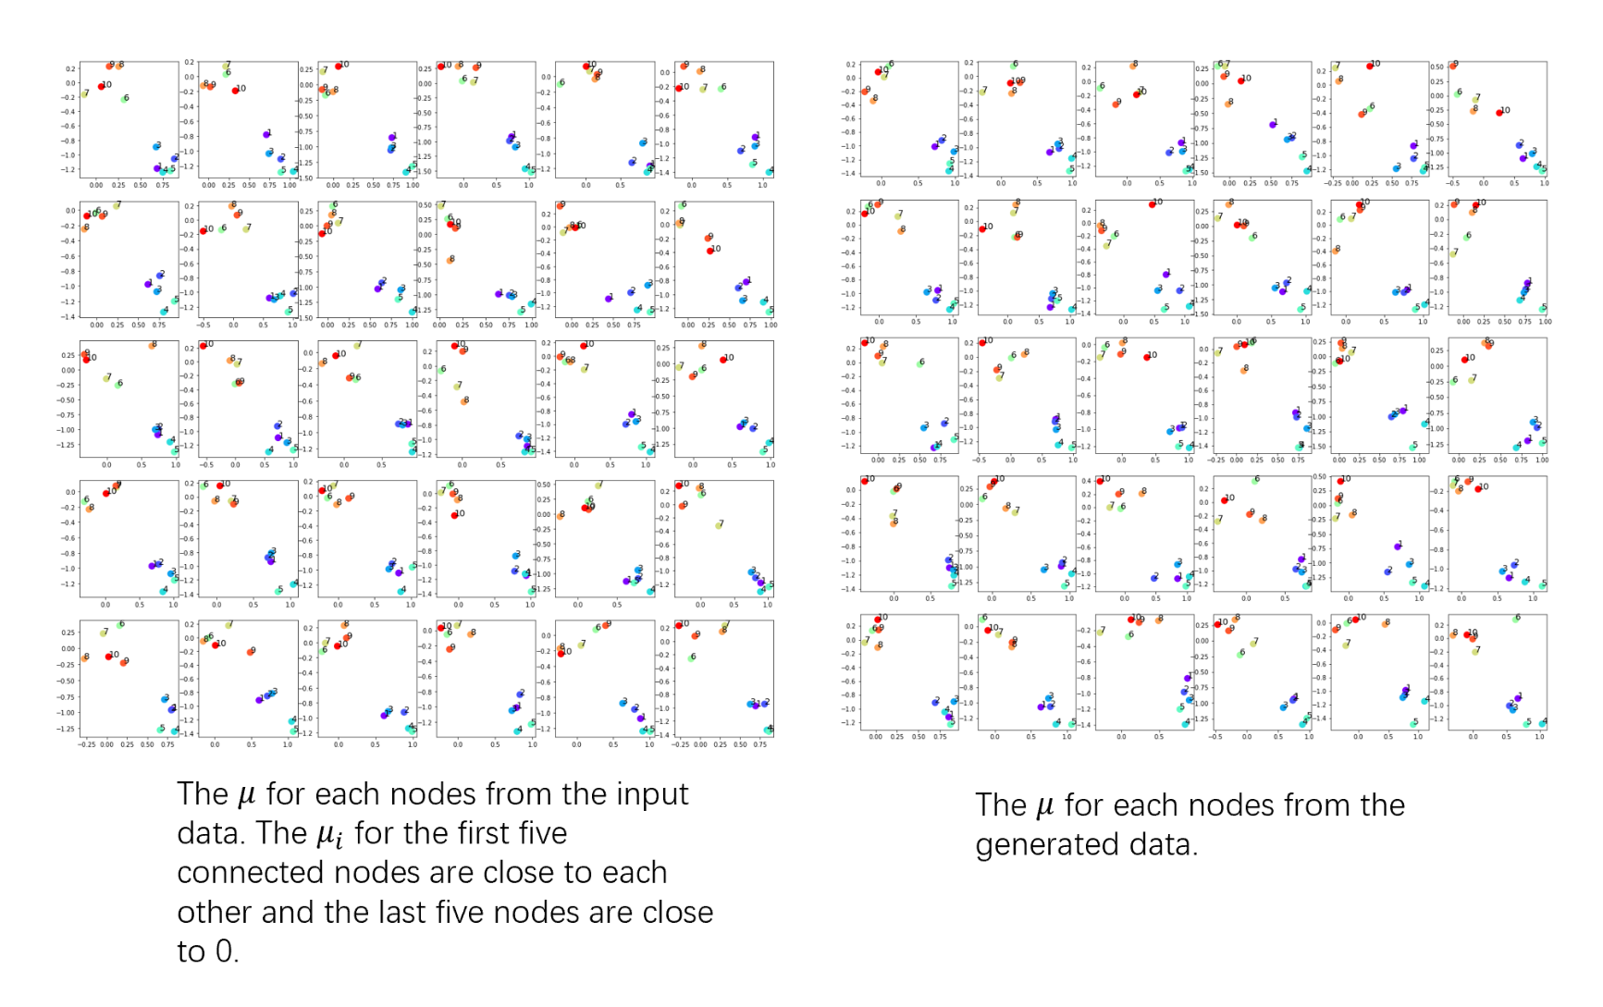

Slide 3
Comparison between model with 2 out channels and model with 10 out channels
Use the same simulation input data (p=0.5);
Set training epoch as 1,000,000;
use the same diag(N) matrix as the covariance matrix in the Gaussian distribution.

Slide 4
Mean centrality for different out_channels and filter_value
Node index | 0 | 1 | 2 | 3 | 4 | 5 | 6 | 7 | 8 | 9
Original input centrality | 0.227 | 0.210 | 0.237 | 0.240 | 0.240 | 0 | 0 | 0 | 0 | 0
Filtered by 0.5 (10 channels) | 0.365 | 0.357 | 0.365 | 0.365 | 0.358 | 0.016 | 0.016 | 0.016 | 0.019 | 0.014
Filtered by the mean centrality in input for each node (10 channels) | 0.365 | 0.357 | 0.365 | 0.365 | 0.358 | 0.016 | 0.016 | 0.016 | 0.019 | 0.014
Filtered by 0.5 (2 channels) | 0.339 | 0.341 | 0.340 | 0.356 | 0.358 | 0 | 0.005 | 0 | 0.005 | 0
Filtered by the mean centrality in input for each node (2 channels) | 0.480 | 0.480 | 0.482 | 0.495 | 0.471 | 0.263 | 0.267 | 0.258 | 0.196 | 0.227

Slide 5
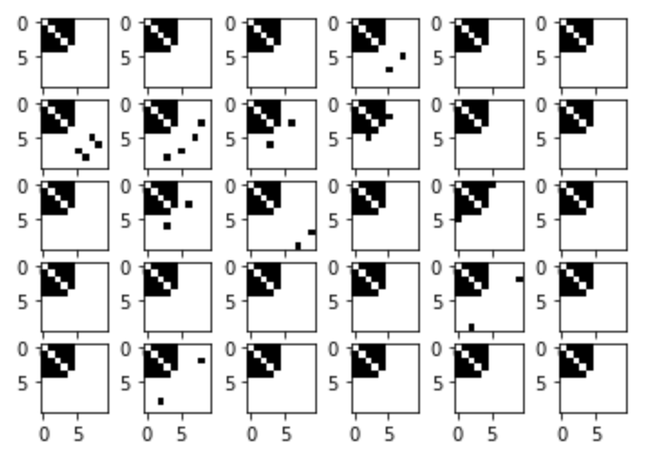
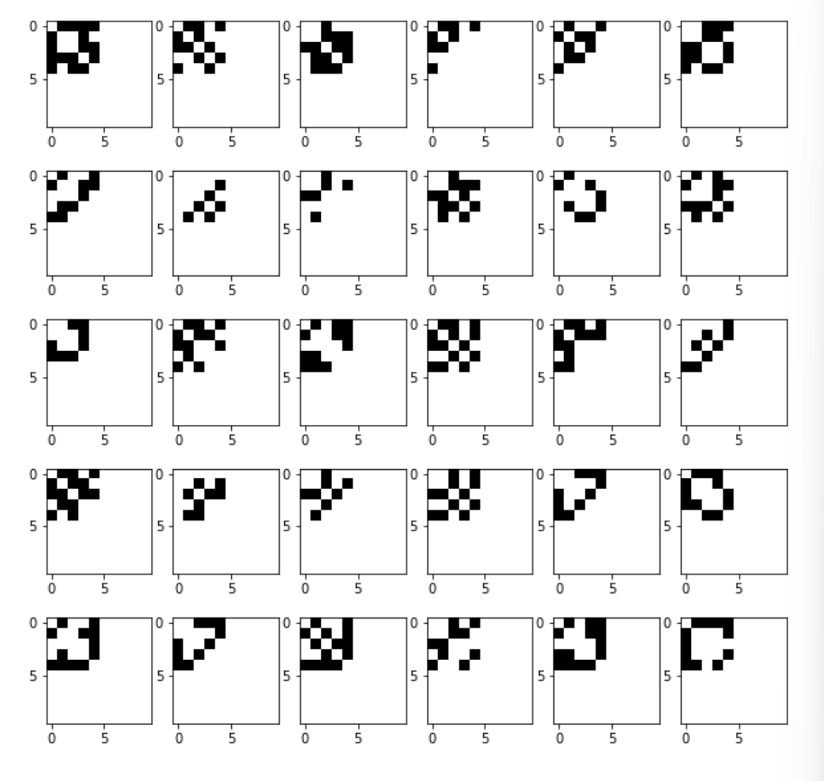
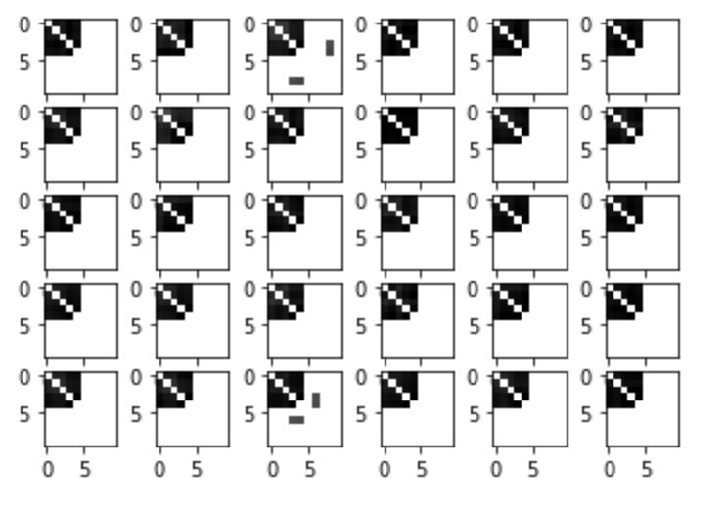
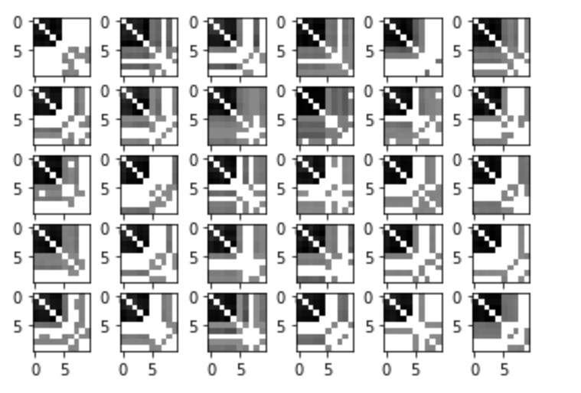
Filtered by 0.5 (10 channels)
Filtered by the mean centrality in input for each node (10 channels)
(A(i,j)=1, if A(i, j) > mean centrality (i),
A(i,j) = 0, else)
Input (p=0.5)
Filtered by 0.5 (2 channels)
Filtered by the mean centrality in input for each node (2 channels)

