Slide 1
New VGAE model
New VGAE model: Flawless1202/VGAE_pyG: An VGAE implementation using pytorch geometric. (github.com)
Input: 30 graphs with 10 nodes
Optimizers: Adams optimizer with learning rate 0.001
Epoches: 1000000 epoches
Latent space: 2 out-channels

Slide 2
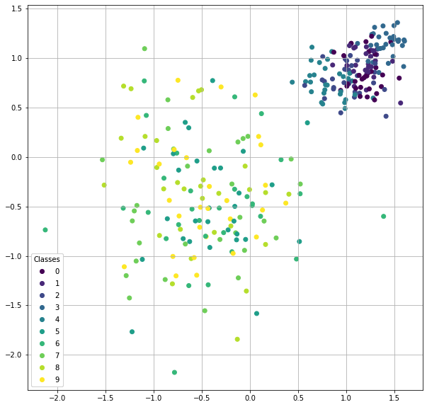
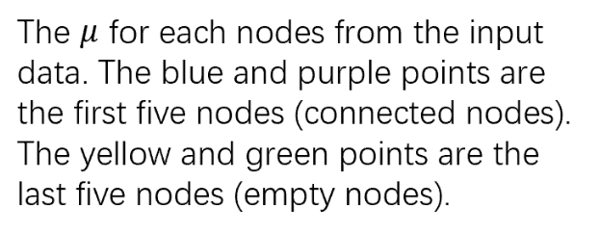

Slide 3
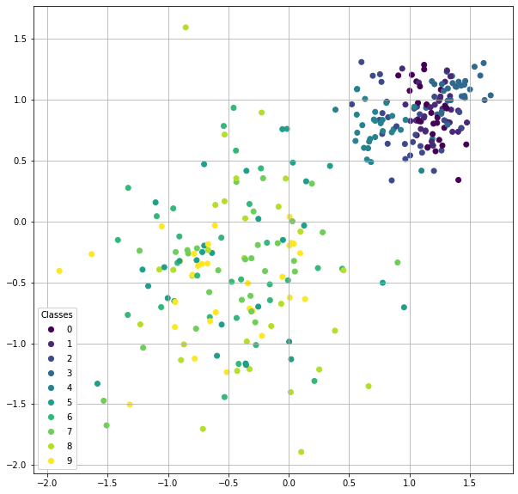
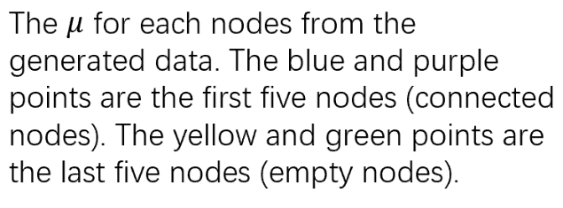

Slide 4
input
generated

Slide 5
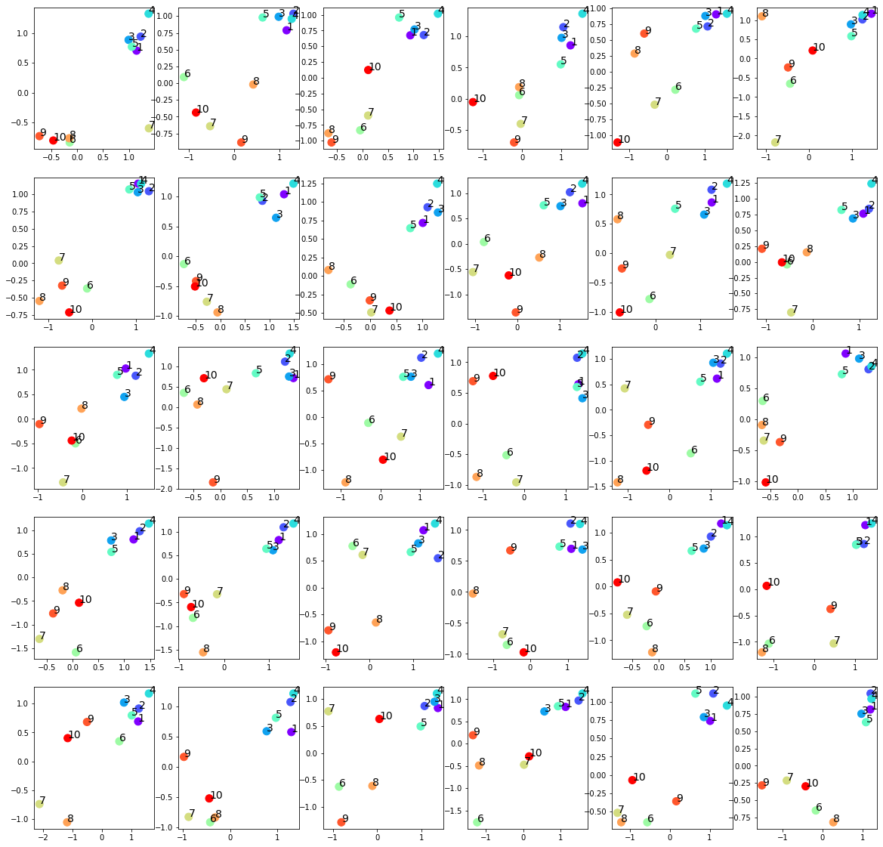
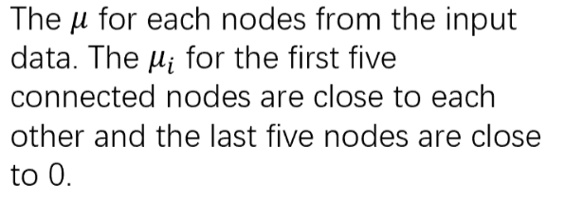

Slide 6
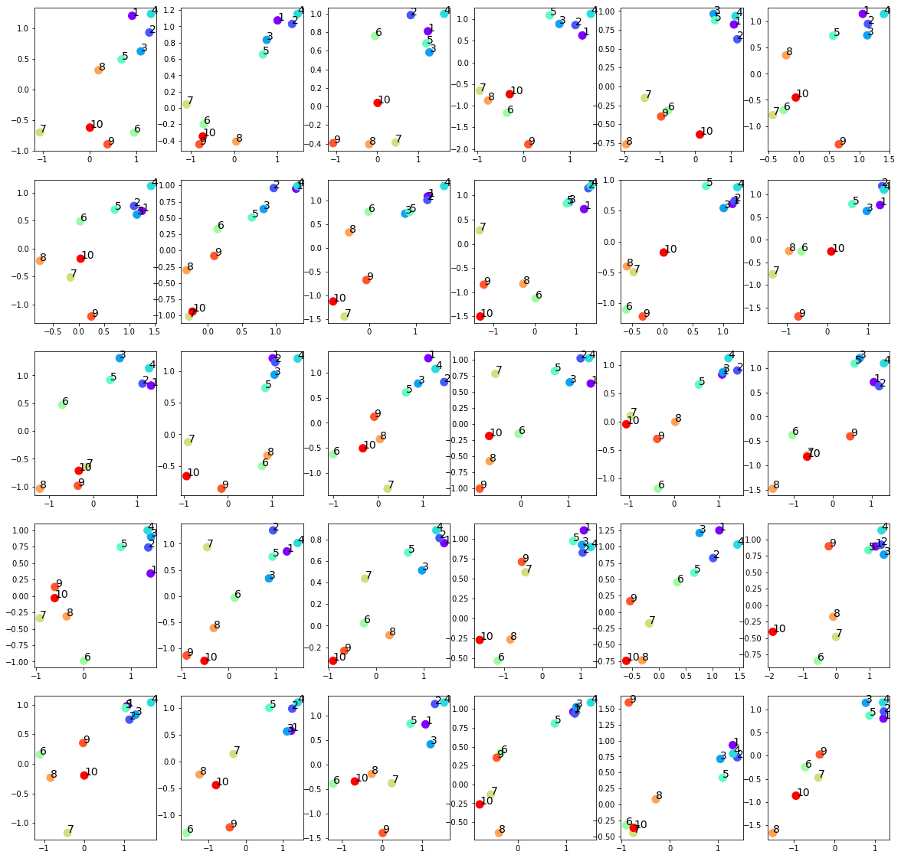
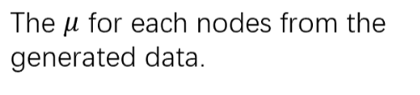

Slide 7
input
generated

Slide 8
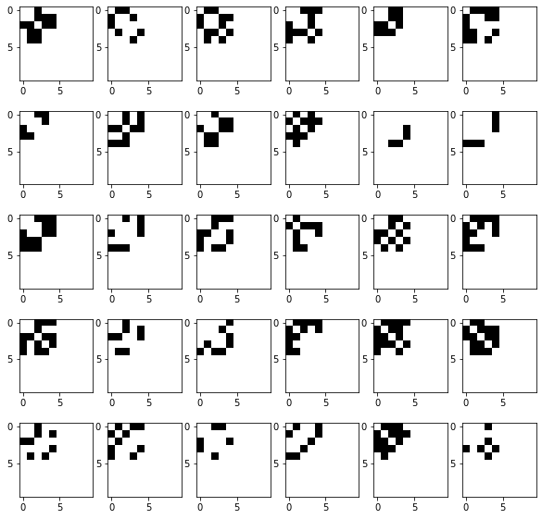
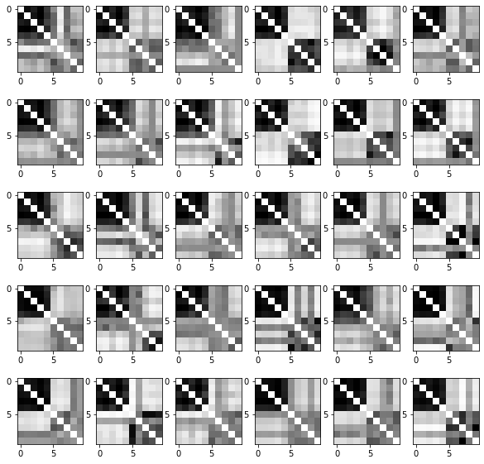
Input adjacency matrices (p=0.5)
Raw generated adjacency matrices (filter_value=0)

Slide 9
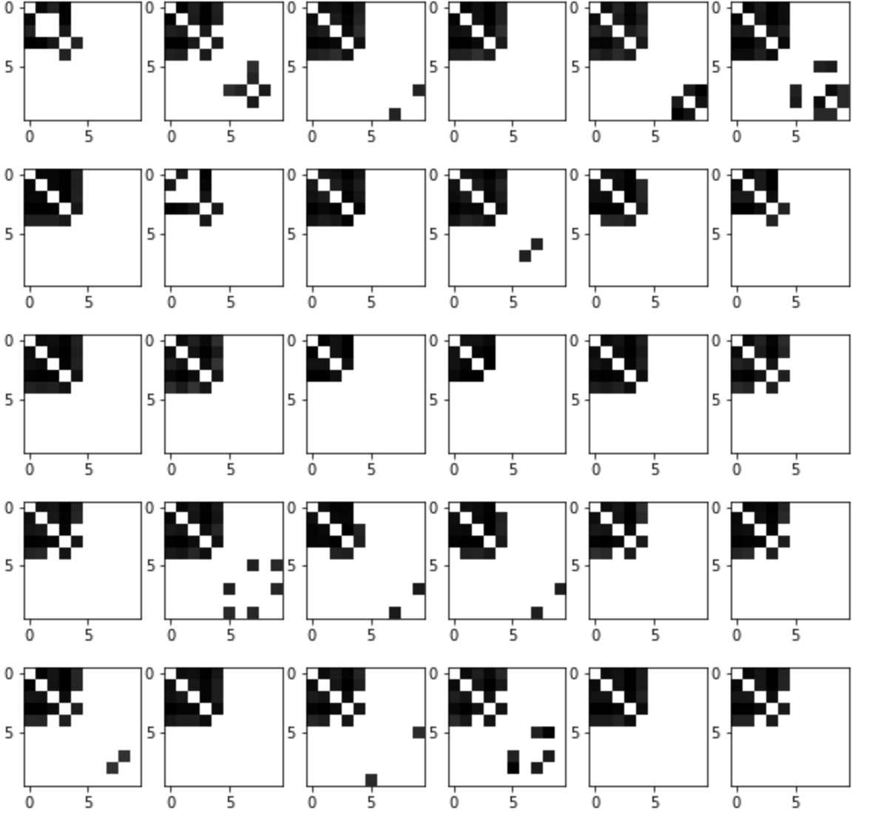
Input adjacency matrices (p=0.5)
generated adjacency matrices (filter_value=0.5)

Slide 10
Normalized Centrality
Node index | 1 | 2 | 3 | 4 | 5 | 6 | 7 | 8 | 9 | 10
Generated matrices centrality | 0.33 | 0.34 | 0.30 | 0.36 | 0.26 | 0.02 | 0.01 | 0.03 | 0.01 | 0.02
Original matrices centrality | 0.19 | 0.19 | 0.17 | 0.20 | 0.22 | 0. | 0. | 0. | 0. | 0.

Slide 11
New VGAE model
New VGAE model: Flawless1202/VGAE_pyG: An VGAE implementation using pytorch geometric. (github.com)
Input: 30 graphs with 10 nodes
Optimizers: Adams optimizer with learning rate 0.001
Epoches: 1000000 epoches
Latent space: 2 out-channels
p = 0.8 for the upper left submatrix

Slide 12
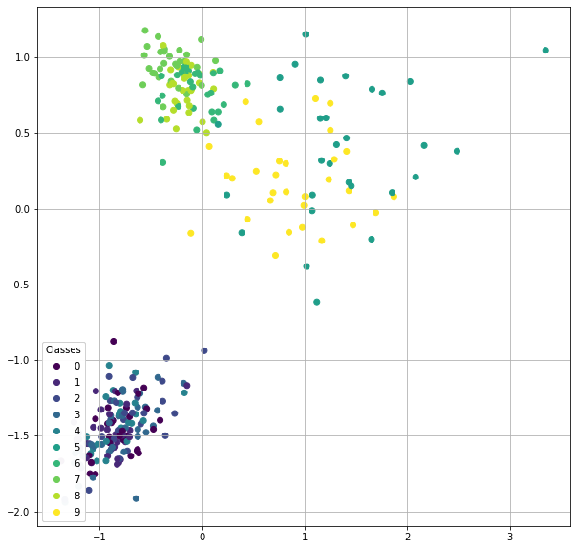

Slide 13
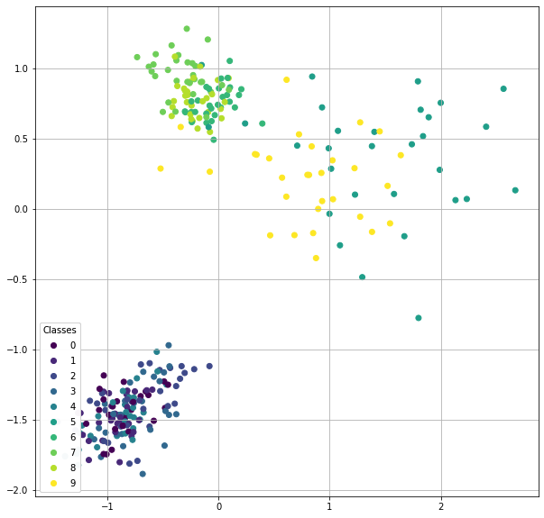

Slide 14
input
generated

Slide 15
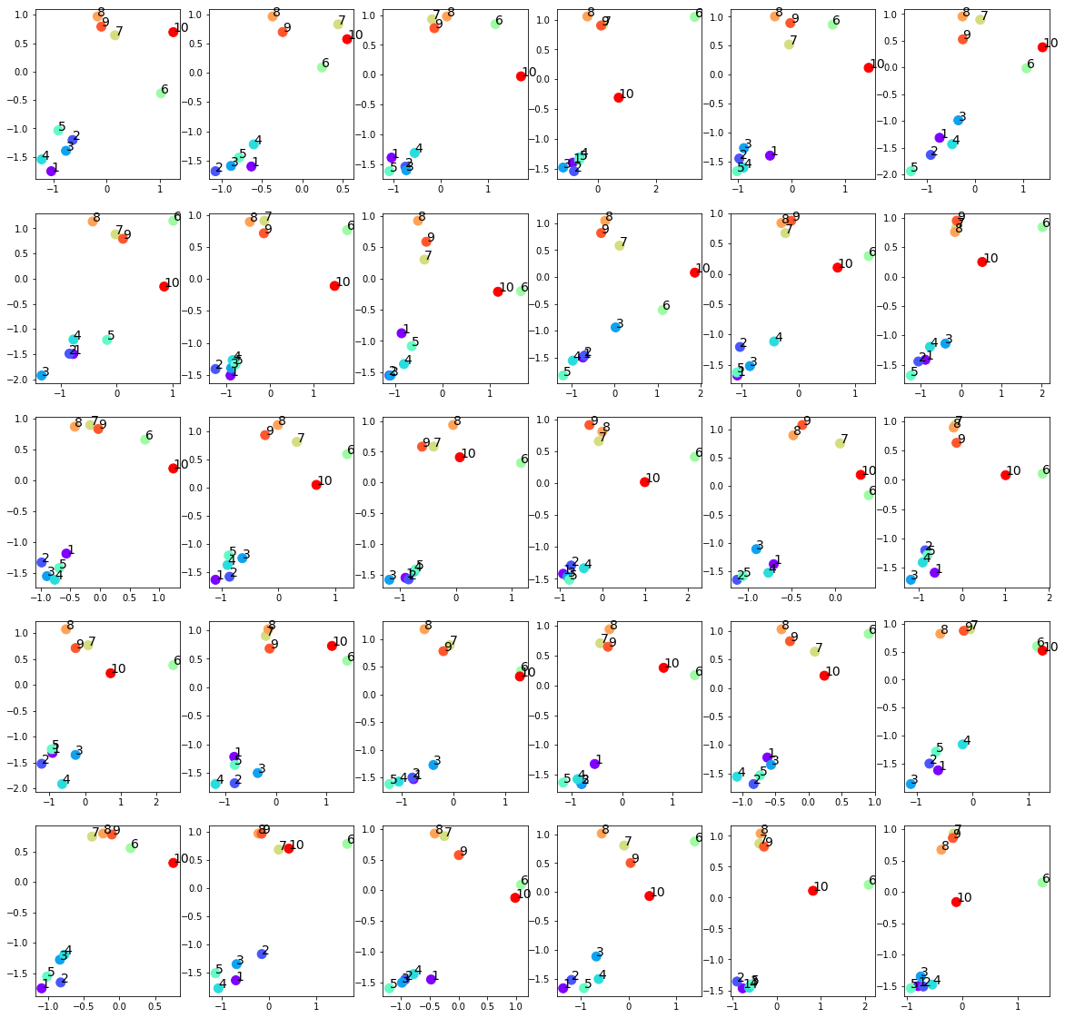

Slide 16
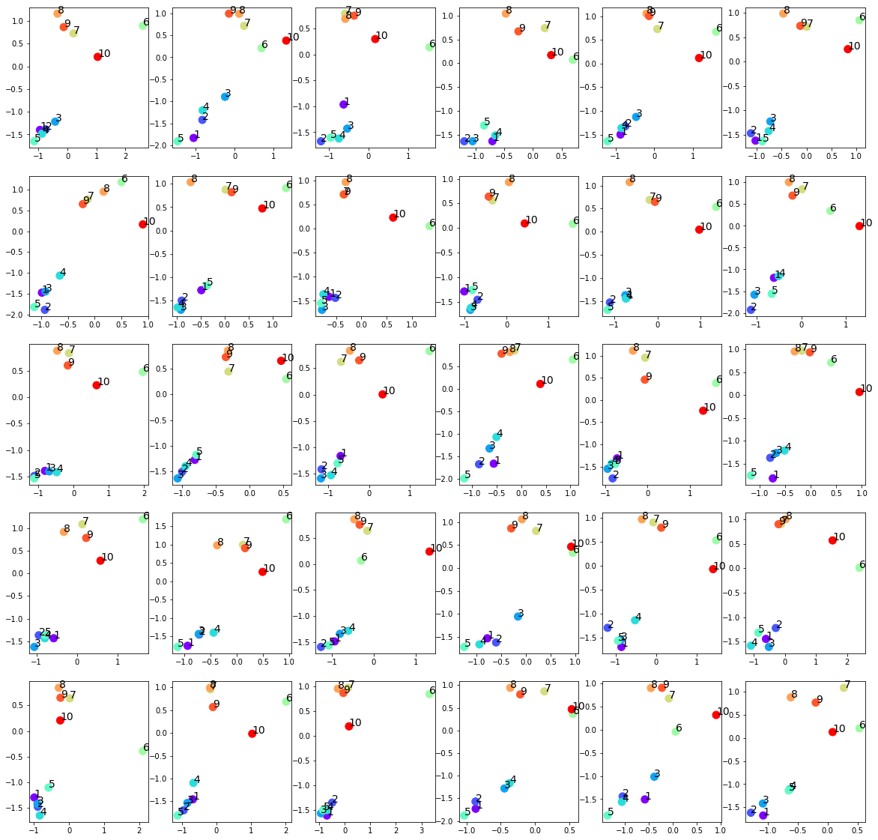

Slide 17
input
generated

Slide 18
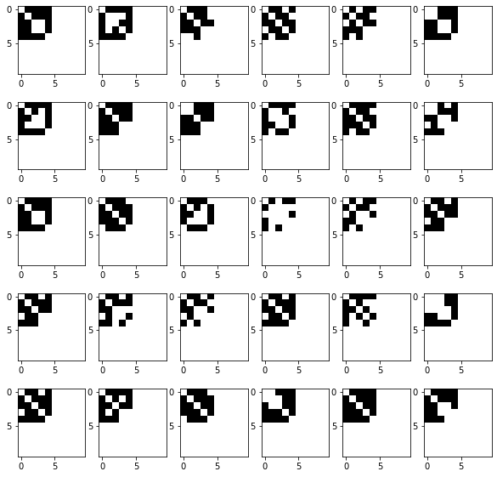
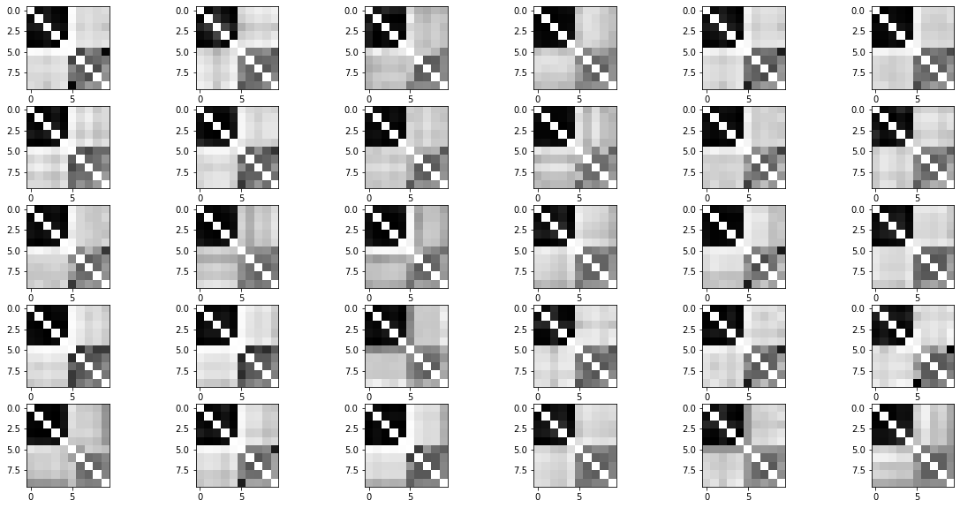
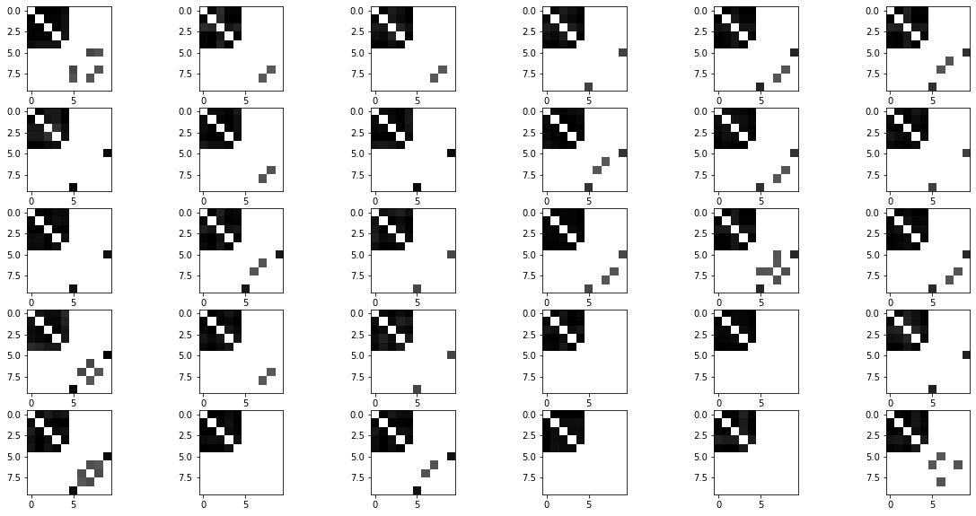
Raw generated adjacency matrices (filter_value=0)
Input adjacency matrices (p=0.8)
Generated adjacency matrices (filter_value=0.5)

Slide 19
Normalized Centrality
Node index | 1 | 2 | 3 | 4 | 5 | 6 | 7 | 8 | 9 | 10
Generated matrices centrality | 0.37 | 0.34 | 0.36 | 0.37 | 0.37 | 0.06 | 0.02 | 0.05 | 0.03 | 0.05
Original matrices centrality | 0.32 | 0.34 | 0.30 | 0.32 | 0.31 | 0. | 0. | 0. | 0. | 0.

Slide 20
p=0.25 simulation
Input: 30 graphs with 10 nodes
Optimizers: Adams optimizer with learning rate 0.001
Epoches: 1000000 epoches
Latent space: 2 out-channels
p = 0.25 for the upper left submatrix

Slide 21
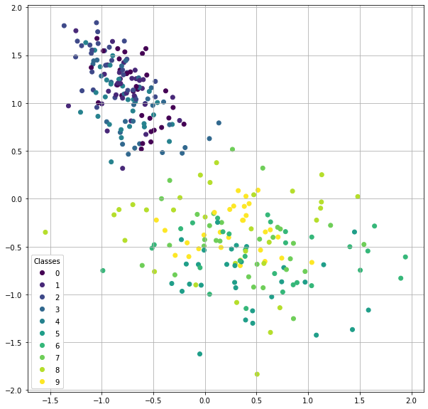

Slide 22
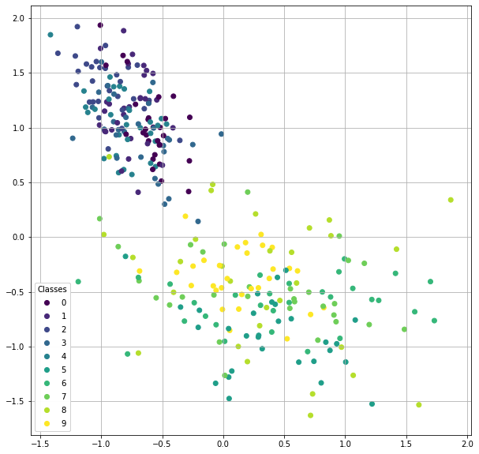

Slide 23
input
generated

Slide 24
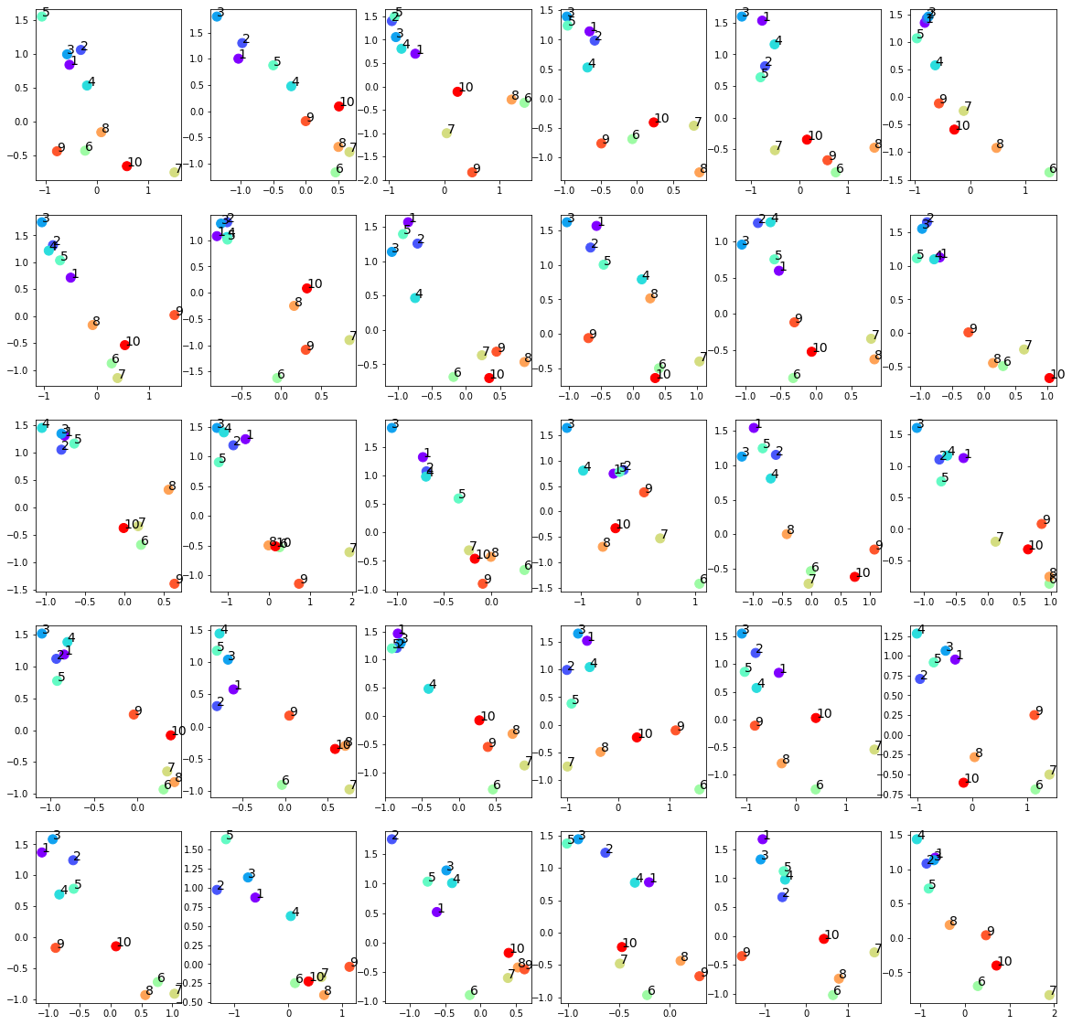

Slide 25
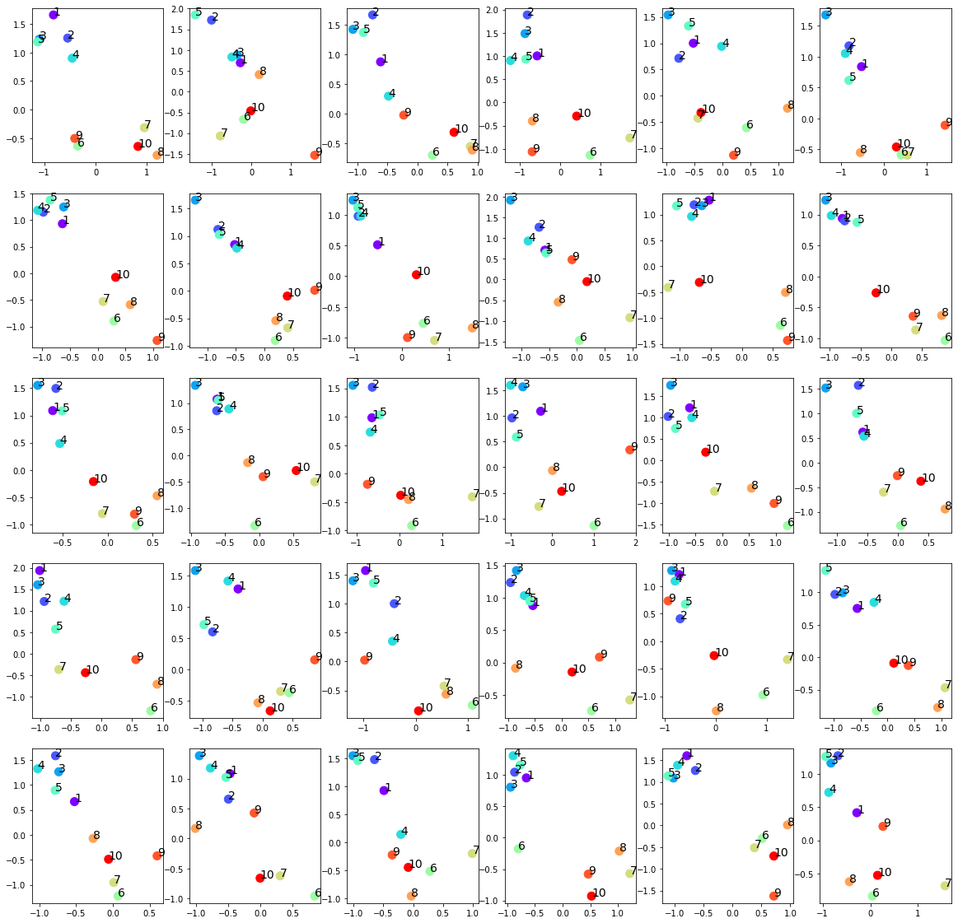

Slide 26
input
generated

Slide 27
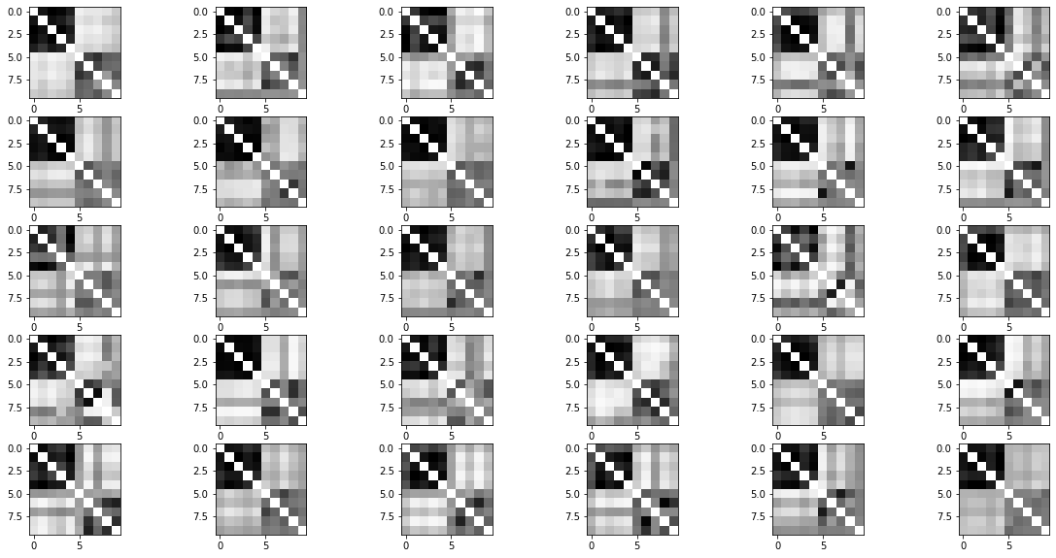
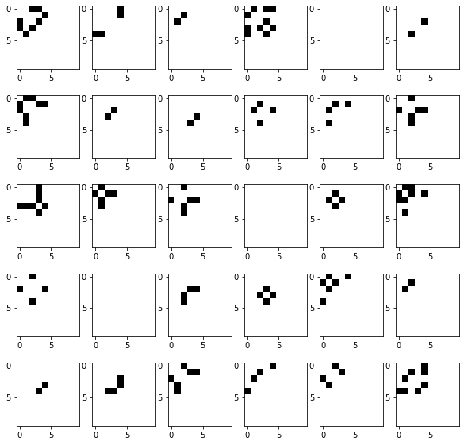
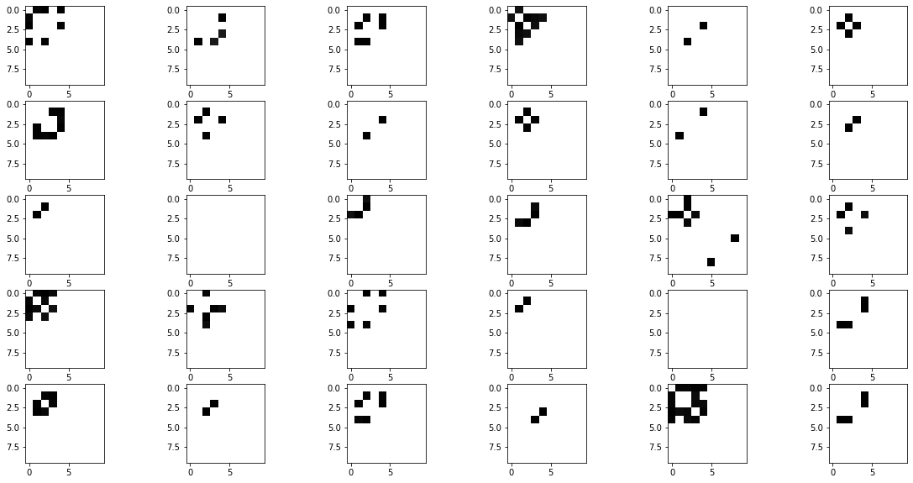
Raw generated adjacency matrices (filter_value=0)
Input adjacency matrices (p=0.25)
Generated adjacency matrices (filter_value=0.5)

Slide 28
Normalized Centrality
Node index | 1 | 2 | 3 | 4 | 5 | 6 | 7 | 8 | 9 | 10
Generated matrices centrality | 0.13 | 0.13 | 0.17 | 0.12 | 0.13 | 0.003 | 0.00 | 0.004 | 0.00 | 0.00
Original matrices centrality | 0.12 | 0.13 | 0.09 | 0.10 | 0.10 | 0.0 | 0.0 | 0.0 | 0.0 | 0.0

Slide 29
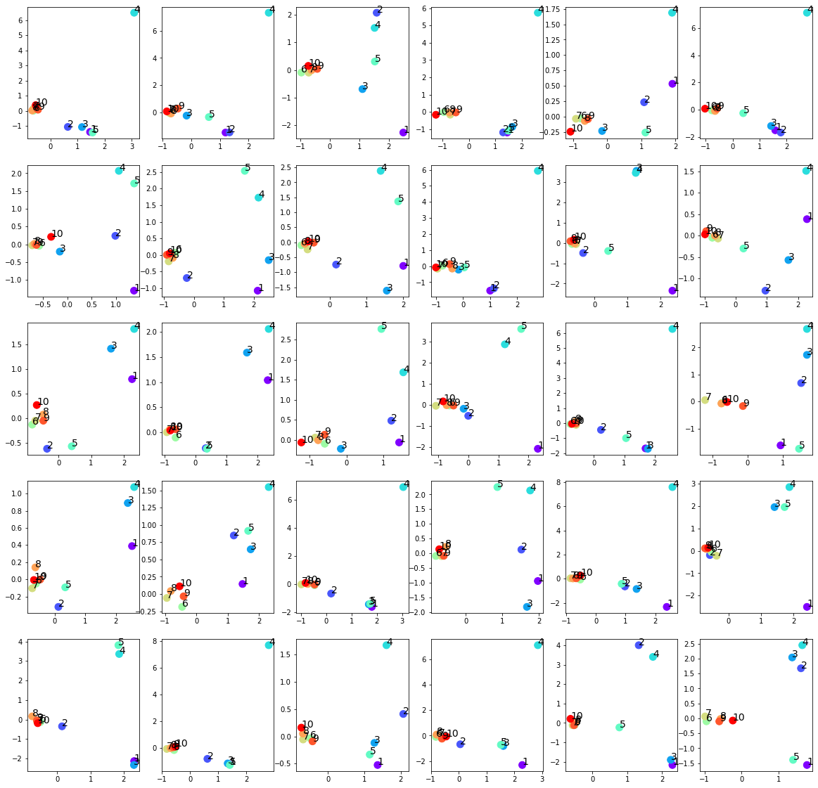
Failed trainings
Settings:
Input: 30 graphs with 10 nodes
Optimizers: Adams optimizer with learning rate 0.01
Epoches: 1000000 epoches
Latent space: 2 out-channels
p = 0.25 for the upper left submatrix
The last five nodes over-concentrate around 0
No effect on the first five nodes
Easier to happen when setting p<0.5

Slide 30
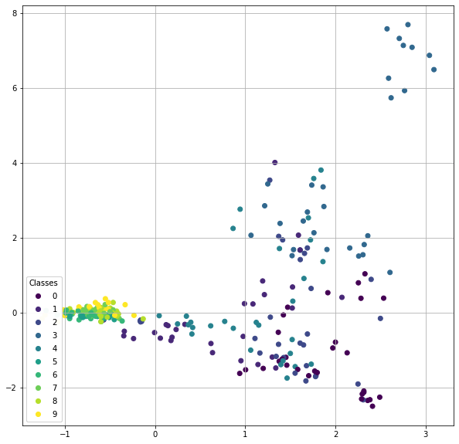
Failed trainings
Settings:
Input: 30 graphs with 10 nodes
Optimizers: Adams optimizer with learning rate 0.01
Epoches: 1000000 epoches
Latent space: 2 out-channels
p = 0.25 for the upper left submatrix
The last five nodes over-concentrate around 0
No effect on the first five nodes
Easier to happen when setting p<0.5

Slide 31
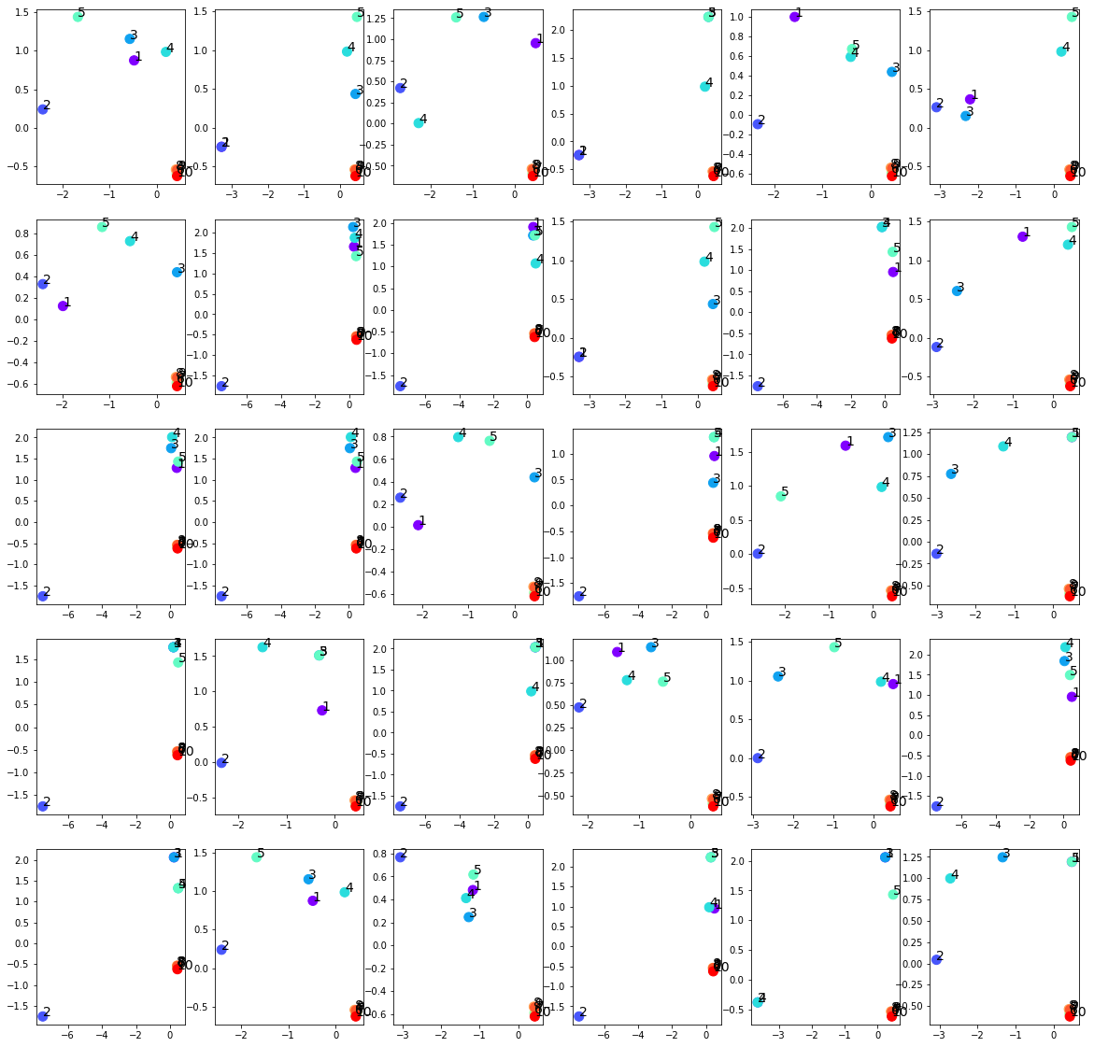

Slide 32
