Slide 1
New VGAE model
New VGAE model: Flawless1202/VGAE_pyG: An VGAE implementation using pytorch geometric. (github.com)
Input: 30 graphs with 10 nodes
Optimizers: Adams optimizer with learning rate 0.01
Epoches: 10000 epoches
Latent space: 2 out-channels

Slide 2
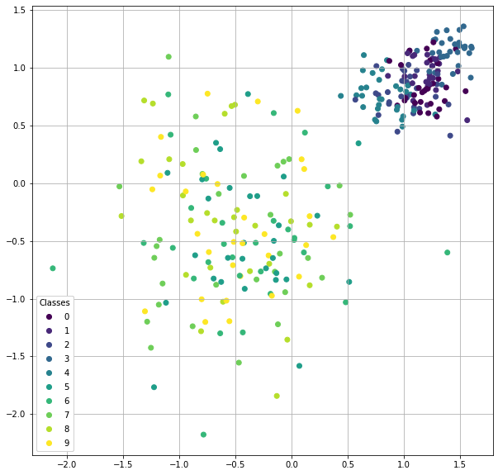
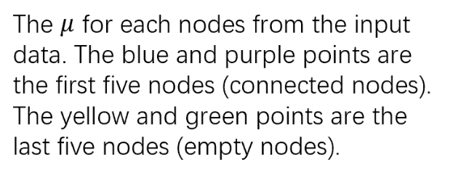

Slide 3
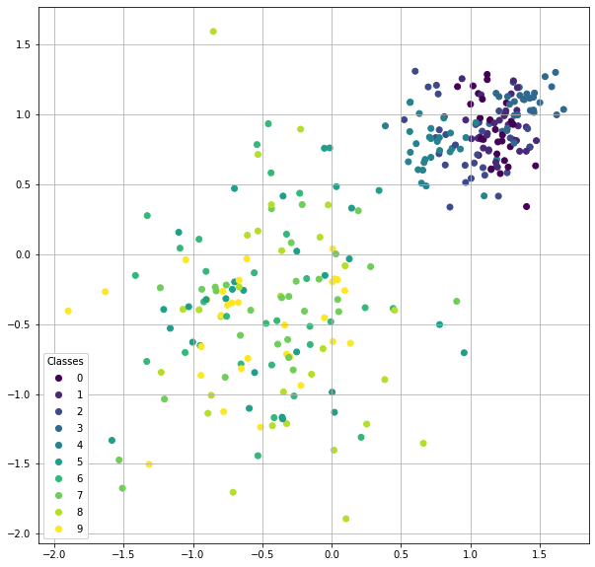
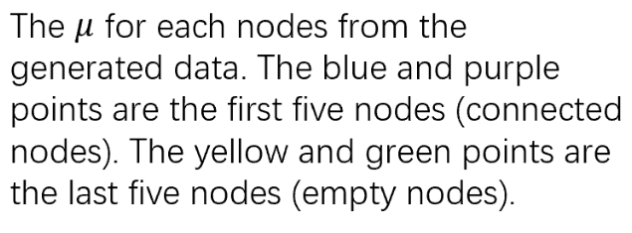

Slide 4
input
generated

Slide 5
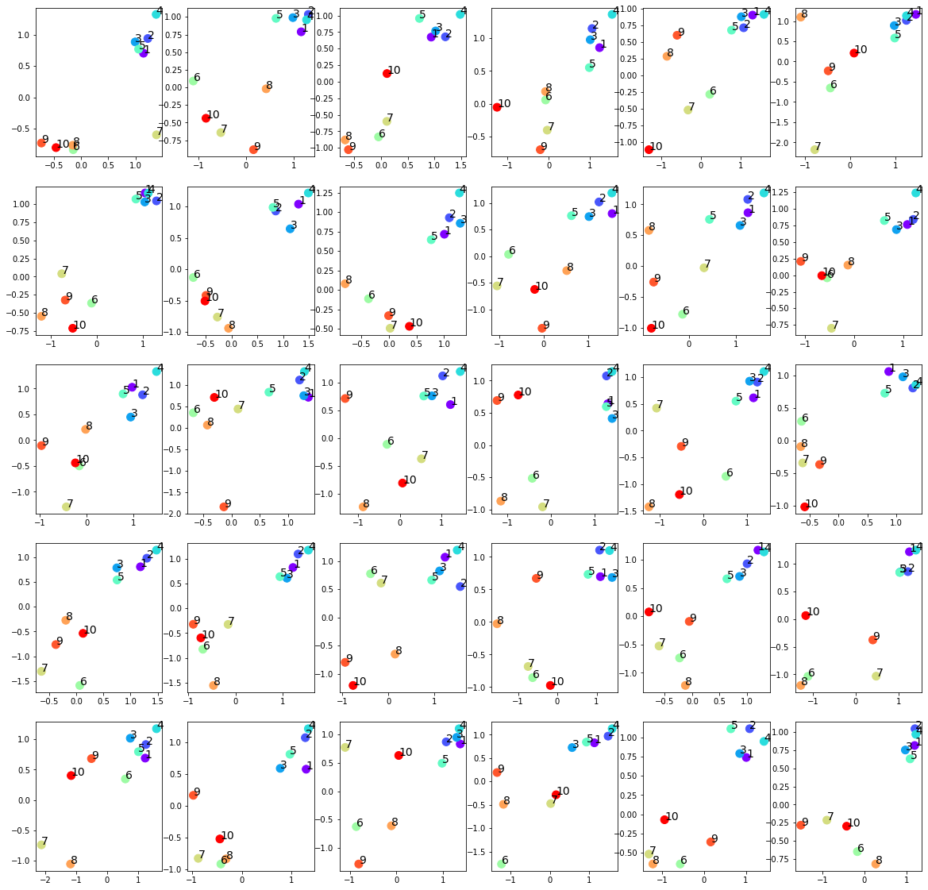
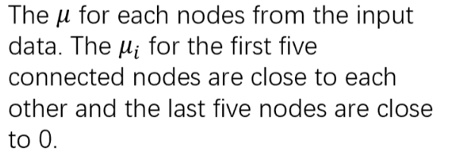

Slide 6
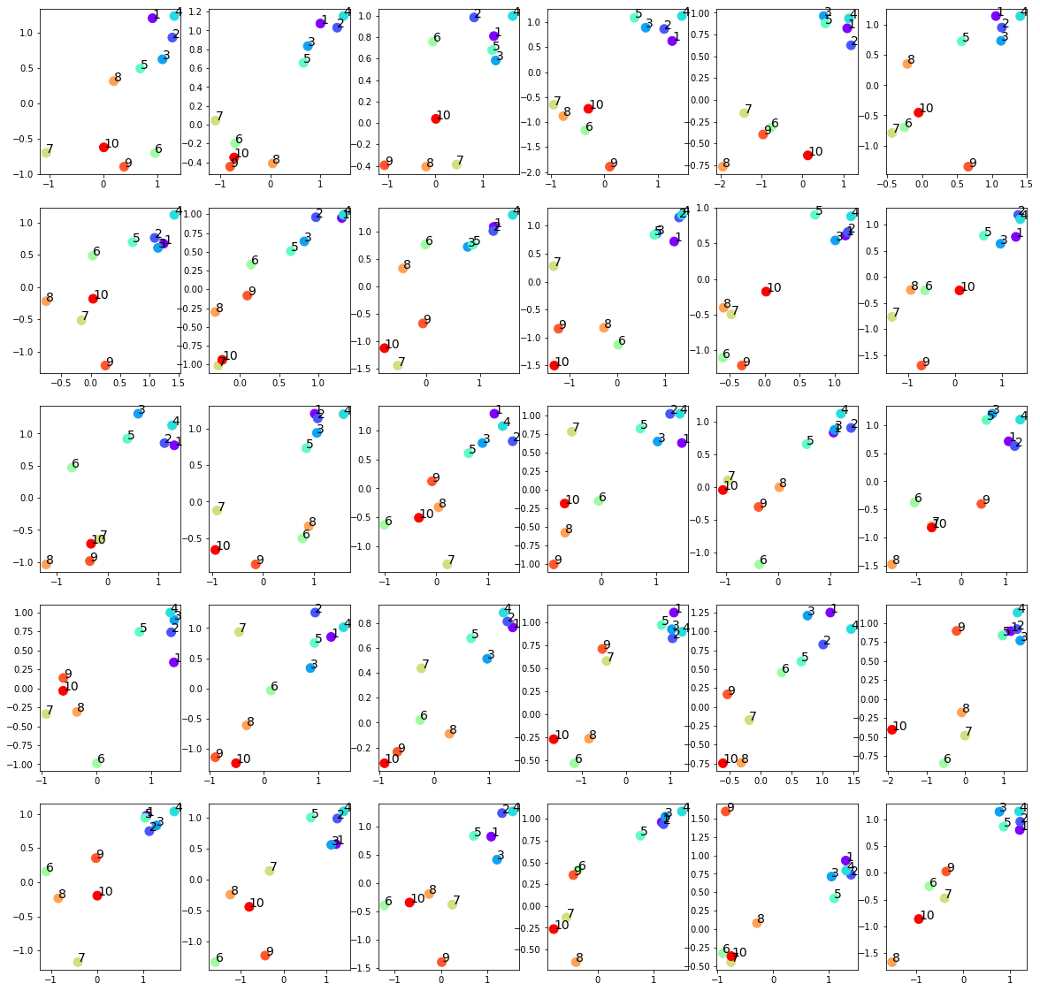
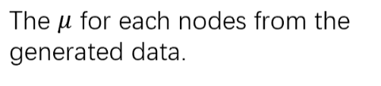

Slide 7
input
generated

Slide 8
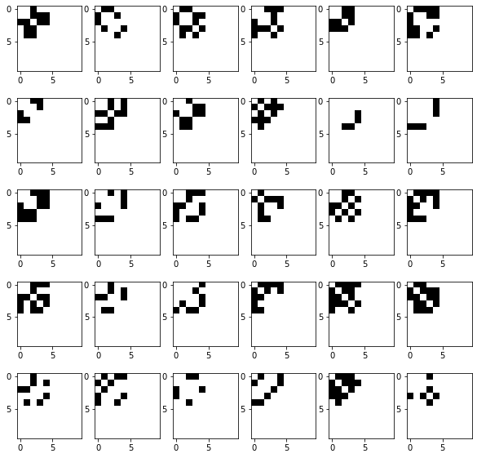
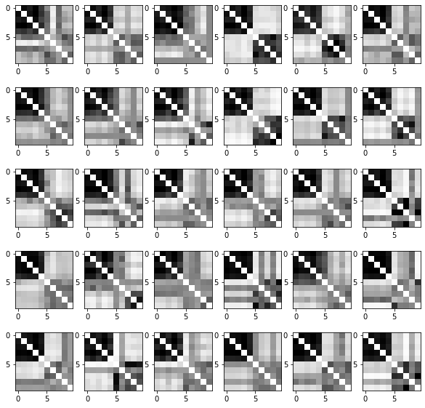
Input adjacency matrices (p=0.5)
Raw generated adjacency matrices (filter_value=0)

Slide 9
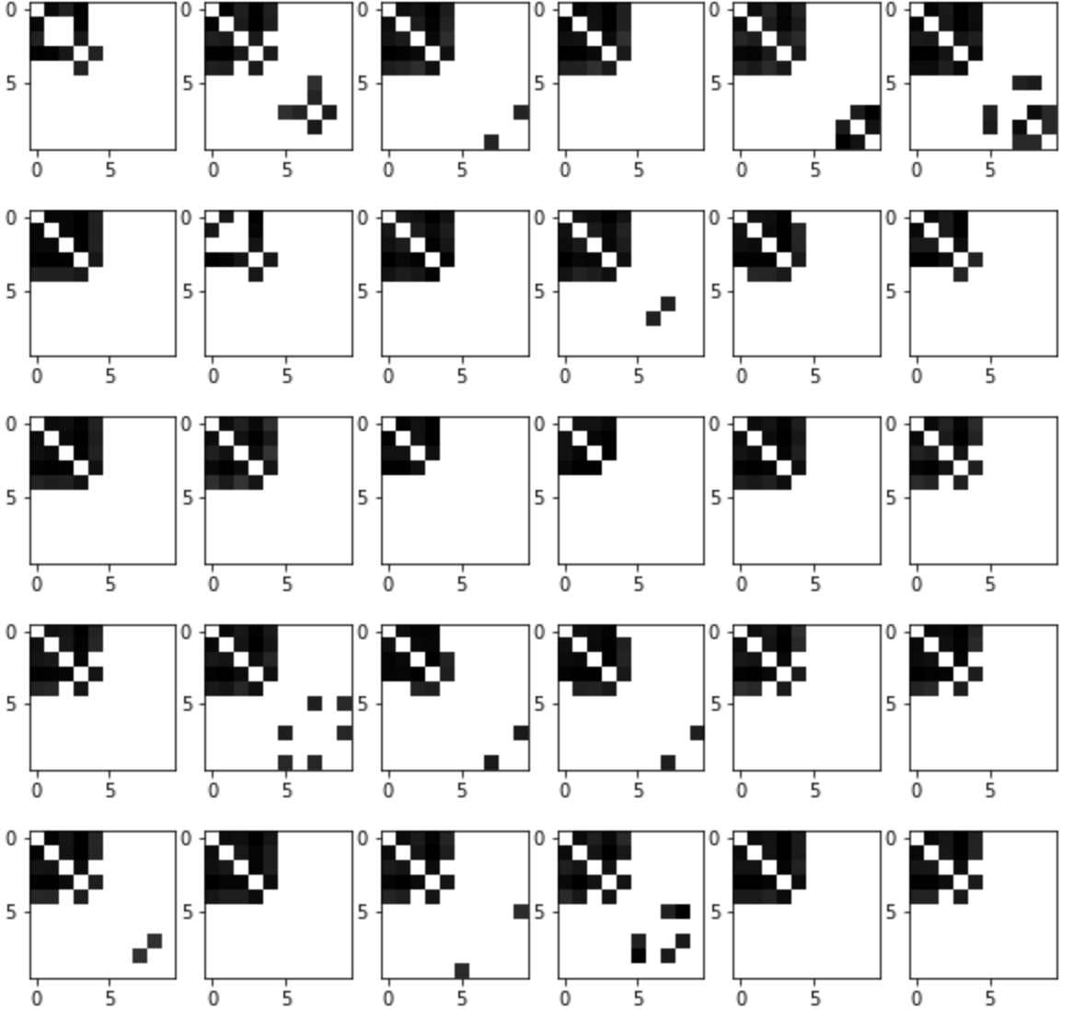
Input adjacency matrices (p=0.5)
generated adjacency matrices (filter_value=0.5)

Slide 10
Normalized Centrality
Node index | 1 | 2 | 3 | 4 | 5 | 6 | 7 | 8 | 9 | 10
Generated matrices centrality | 0.33 | 0.34 | 0.30 | 0.36 | 0.26 | 0.02 | 0.01 | 0.03 | 0.01 | 0.02
Original matrices centrality | 0.19 | 0.19 | 0.17 | 0.20 | 0.22 | 0. | 0. | 0. | 0. | 0.

