Slide 1
CIS 2368.01 Website Development I • Midterm Project (40%)
Cardinal Market
UIW Campus Student Ecommerce Sandbox Website
A 5-page responsive student marketplace featuring peer-to-peer campus trading, verified UIW safe meetup zones, live item preview, interactive catalog filtering, and student account dashboard.
Team Members & Page Ownership:
• Isabella Gomez: index.html (Home) & account.html (Account) | css/isabella.css & js/isabella.js
• Nathan Ortiz: listings.html (Browse Marketplace) | css/nathan.css & js/nathan.js
• Maria Frausto: item.html (Item Details & Messaging) | css/maria.css & js/maria.js
• Sophia Gomez: sell.html (Sell Form & Live Preview) | css/sophia.css & js/sophia.js
• Shared Architecture: css/main.css, js/main.js | Course: CIS 2368 • Professor: Prof. Idar
Notes:
Good afternoon, Professor Idar and classmates. Welcome to our Midterm Project presentation for CIS 2368. Today, our team presents Cardinal Market, an interactive 5-page sandbox e-commerce website designed specifically for University of the Incarnate Word students.

Slide 2
CIS 2368 MIDTERM PROJECT - SANDBOX WEBSITE
Project Overview & Mission: Facebook Marketplace for UIW
The Student Challenge
• High Textbook Costs: College bookstore prices and online retail markups strain student budgets.
• Dorm Move-in Waste: Students frequently need dorm fridges, lamps, and chairs, but lack an easy campus swap channel.
• Off-Campus Safety Concerns: Selling on general platforms involves meeting strangers in non-secure locations.
The Cardinal Solution
• UIW-Exclusive Community: Created specifically for Incarnate Word students, faculty, and campus organizations.
• Verified Safe Exchange Zones: Recommends public, well-lit campus hubs (Mabee Library & Student Center).
• Zero Transaction Fees: 100% peer-to-peer student savings with zero intermediary platform cuts.
Design Criteria
• 100% Vanilla Web Standards: Built purely in semantic HTML5, modern CSS3 (Grid/Flexbox), and vanilla JavaScript ES6.
• Fully Responsive & Accessible: Adapts seamlessly across desktop, tablet, and mobile with ARIA landmarks.
• Inter-Page Data Sync: Client-side persistence using localStorage unites listings, saved items, and messages.
Notes:
Cardinal Market provides a localized, student-centric marketplace. Because trades happen on campus at designated safe spots like Mabee Library or the SEC, students enjoy immediate, secure exchanges with fellow Cardinals.

Slide 3
CIS 2368 MIDTERM PROJECT - SANDBOX WEBSITE
Site Architecture & 5-Page Navigation Structure
1. Home (index.html) — Owner: Isabella Gomez
Landing banner with dynamic greeting based on visitor time of day, quick category tiles, and array-driven featured cards.
2. Browse (listings.html) — Owner: Nathan Ortiz
Comprehensive marketplace catalog with live search query matching, category dropdown filters, price sorting, and dynamic card generation.
3. Item Detail (item.html) • Owner: Maria Frausto (Halloween Spooky Edition 🎃)
Deep product inspection with URL parameter loading (?id=...), October Halloween Mystery Boo Pack spotlight, interactive 3-image SVG gallery switcher, dynamic discount math, and messaging modal.
4. Sell Form (sell.html) — Owner: Sophia Gomez
Reactive seller posting form with instant live preview, HTML5 file upload reader, validation, and a 150-particle Cardinal confetti celebration.
5. Account (account.html) — Owner: Isabella Gomez
Personalized student dashboard allowing profile name editing, active listing management, saved favorites, and simulated message threads.
Notes:
This slide visualizes the full 5-page structure of Cardinal Market. The syllabus required a 3-5+ page working website with full navigation. We delivered 5 complete, interconnected pages with shared navigation and active page highlighting.

Slide 4
CIS 2368 MIDTERM PROJECT - SANDBOX WEBSITE
Modified Examples of Class Code (Rubric Criterion)
Class Lesson / Code Given
Original Concept in Class
Cardinal Market Enhanced Implementation
JS/script.js & hw8
Conditionals & Greeting
Static window.onload greeting:
welcomeMsg.style.color = "#800000";
Simple role check ("student"/"faculty").
Dynamic time-of-day greeting (morning/afternoon/evening) calculated via Date().getHours(). Responsive gold font over Cardinal red hero banner.
hw4 & inputOutput.html
Form Handling & Output
Basic form inputs (text, number, radio) with standard submit or button calculating total.
Real-time two-way data binding in sell.html: input/change events update listing preview live; validates price >= 0 and file MIME type.
hw7 & hw8
DOM & Arrays
Basic document.write() and simple loops over arrays printing lists.
Array of item objects dynamically rendered into CSS Grid cards using createElement and appendChild; query-driven filter() and sorting.
hw5 & hw6
CSS Layouts & Box Model
Fixed widths, floats, inline styles, basic padding/margin box model.
Modern CSS Grid (repeat(auto-fill, minmax(240px, 1fr))), Flexbox alignment, CSS Custom Variables (:root), and mobile media queries.
hw3 & hw7
Interactivity & Events
Single onclick alerts and static table layouts.
Interactive modal dialog with character counter, thumbnail photo switcher, and localStorage persistence across all pages.
Notes:
A key requirement of the midterm project rubric is: 'Show modified examples of code given in class.' This table directly details how our sandbox site honors that requirement across all 5 pages.

Slide 5
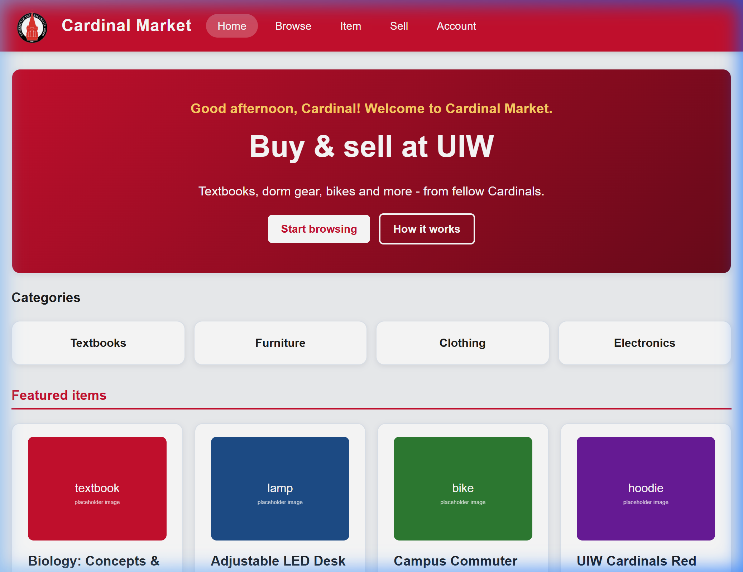
CIS 2368 MIDTERM PROJECT - SANDBOX WEBSITE
Home Page (index.html) — Isabella Gomez
Key Features & Code Architecture
• Dynamic Greeting (script.js): Inspects current hour with new Date().getHours() and renders custom morning, afternoon, or evening welcome message.
• Interactive Onboarding Alert: showMarketplaceInfo() gives first-time visitors a 4-step quick guide modal.
• Category Quick-Nav Grid: CSS Grid with repeat(auto-fit, minmax(160px, 1fr)) and smooth hover elevations.
• Array-Driven Featured Cards: Dynamic generation using forEach to create cards linked directly to item.html?id=...
Modified Class Code (isabella.js):
// Modified from class script.js greeting
window.onload = function() {
var msg = document.getElementById("welcome-msg");
if (msg) {
var h = new Date().getHours();
var g = (h < 12) ? "Good morning, Cardinal!"
: (h < 18) ? "Good afternoon, Cardinal!"
: "Good evening, Cardinal!";
msg.textContent = g + " Welcome to Cardinal Market.";
msg.style.color = "#ffd166"; // UIW Gold
}
};
Notes:
Here on the Home Page, owned by Isabella Gomez, you can see how we welcome visitors with our Cardinal red hero banner and a dynamic time-of-day greeting calculated from visitor clock.

Slide 6
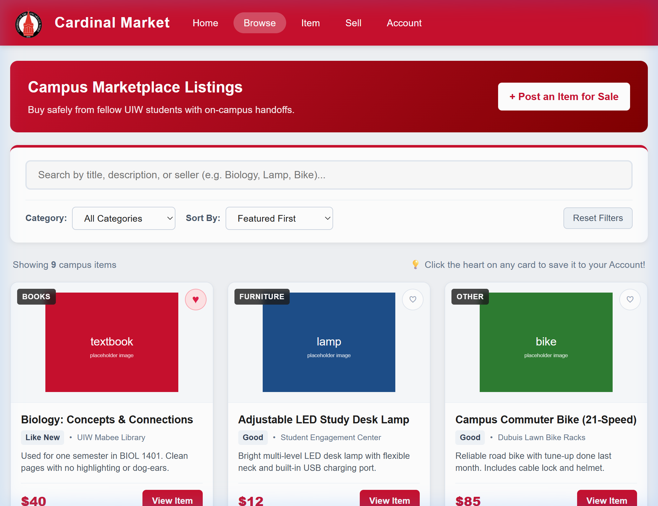
CIS 2368 MIDTERM PROJECT - SANDBOX WEBSITE
Browse Marketplace (listings.html) — Nathan Ortiz
Reactive Catalog & Filter Logic
• Real-time Search Bar: Listens to input events to instantly filter titles, descriptions, and sellers.
• Multi-criteria Filtering: Combines category dropdown (Textbooks, Dorm, Clothing, Other) with text matching.
• Sorting Engine: Supports price low-to-high, high-to-low, and alphabetical sorting via Array.sort().
• Interactive Favorite Heart: Toggles saved item status and synchronizes with localStorage for the Account page.
Modified Class Code (nathan.js):
// Real-time multi-criteria filtering
function applyFilters() {
var q = searchInput.value.toLowerCase().trim();
var cat = categorySelect.value;
var filtered = allListings.filter(function(item) {
var matchCat = (cat === "all") || (item.category === cat);
var matchSearch = (q === "") ||
item.title.toLowerCase().includes(q) ||
item.desc.toLowerCase().includes(q);
return matchCat && matchSearch;
});
renderListings(filtered);
}
Notes:
On the Browse page, owned by Nathan Ortiz, students can search and filter the entire campus inventory in real time using Array.filter() and save items with the heart button.

Slide 7
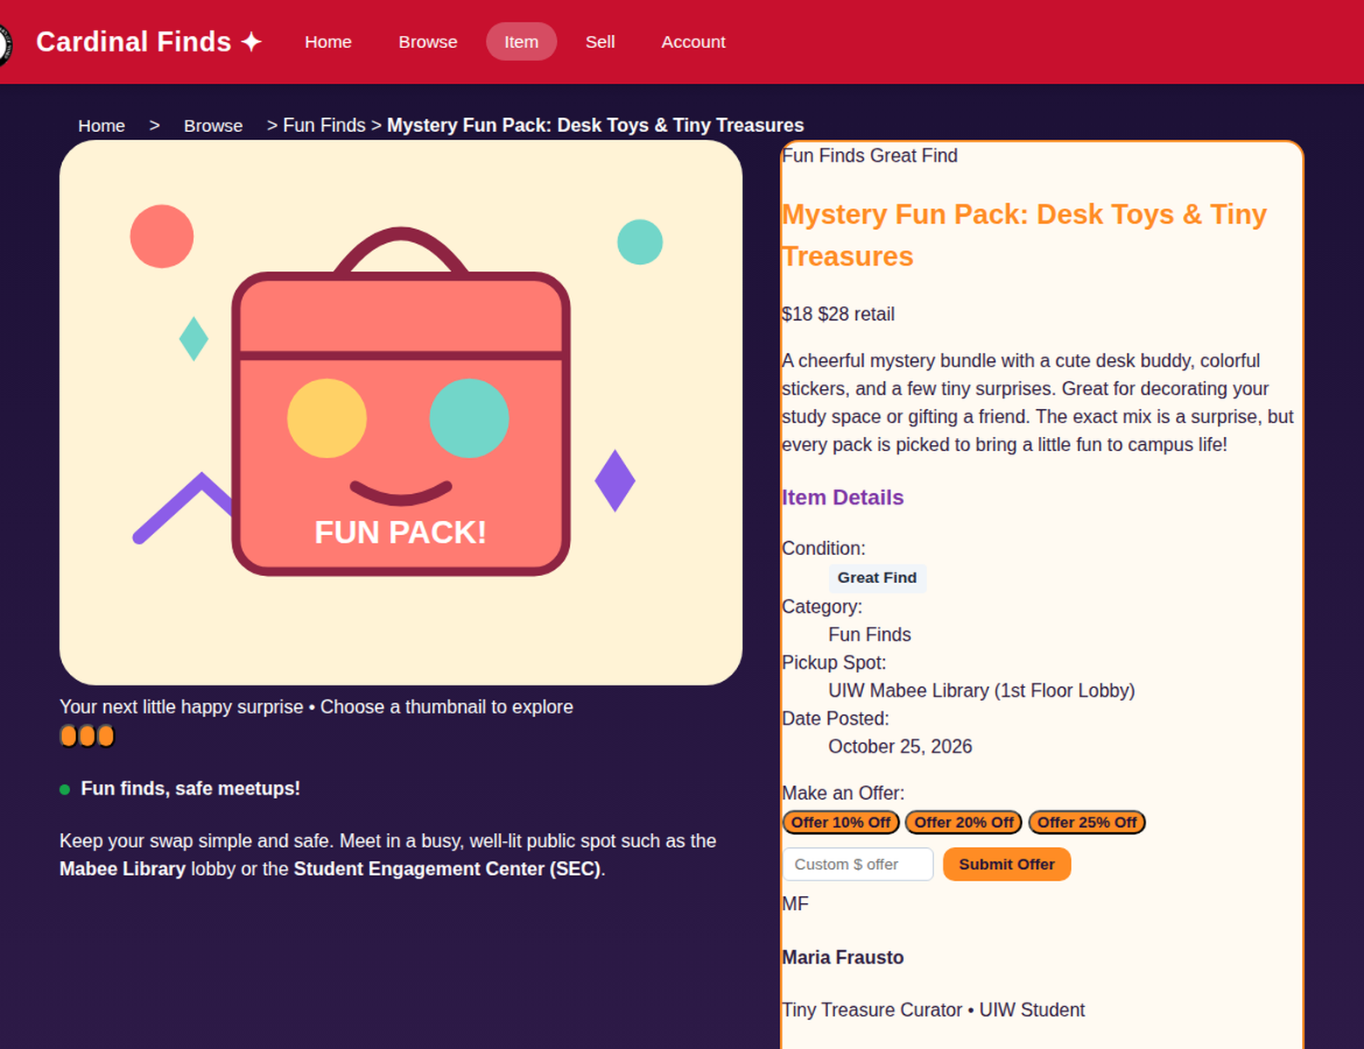
CIS 2368 MIDTERM PROJECT - SANDBOX WEBSITE
Item Detail & Messaging (item.html) — Maria Frausto (October Spooky Season 🎃)
October Spooky Season: Inspection, Offers & Messaging
• October Spooky Feature: "Halloween Mystery Boo Pack: Spooky Dorm Treats & Tiny Terrors" ($18, Spooktacular Find badge, curator Maria Frausto).
• Spooky SVG Gallery: Three clickable custom thumbnails (spooky-pack, ghost-buddy, pumpkin-stickers) swap the main image with fade & zoom modal.
• Spooky Offer Calculations: Dynamic Offer 10% 🎃, 20% 👻, and 25% 🦇 buttons compute Math.round(price * (1 - discount)) and confirm treat offer.
• Messaging & Saving: Modal with 300-char live counter saves messages to localStorage for account.html; heart toggles Save Item.
• UIW Safety & Halloween Styling: maria.css scoped theme in midnight purple (#1b1035) & pumpkin orange (#ff8c24); safe meetup at Mabee Library.
Modified Class Code (maria.js - sayHello input/feedback pattern):
// Modified from class sayHello.js: read input, calculate discount, give instant feedback
btn.addEventListener("click", function () {
var discount = parseFloat(btn.getAttribute("data-discount"));
var offerPrice = Math.round(item.price * (1 - discount));
offerResult.innerHTML = "🎃 Spooky treat offer: $" + offerPrice + " (Save " + (discount * 100) + "%)!";
customOfferInput.value = offerPrice;
});
Notes:
Good afternoon, Professor Idar. I'm Maria Frausto, and I designed and coded item.html, along with maria.css and maria.js.
Since it's October and midterm season, I wanted our marketplace to feature a special Halloween Spooky Season edition! On item.html, our featured item is the 'Halloween Mystery Boo Pack: Spooky Dorm Treats & Tiny Terrors' priced at $18, with a Spooktacular Find badge and myself listed as the verified curator.
Technically, this page meets and exceeds our rubric criteria:
1. Dynamic URL Loading: Using JavaScript URLSearchParams, the page reads '?id=' from the URL. If a specific item is passed from the Browse catalog or newly posted on the Sell page, it dynamically renders that item's data. Otherwise, it defaults to our Halloween Mystery Boo Pack.
2. Interactive Spooky Gallery: I created three custom SVG graphics—the Spooky Pack, Ghost Buddy, and Pumpkin Stickers. When a student clicks any thumbnail, an event listener swaps the main image with a smooth CSS fade transition, and clicking the main image opens an accessible image zoom modal.
3. Dynamic Offer Calculations: I added three Halloween quick-offer buttons—Offer 10% Off 🎃, Offer 20% Off 👻, and Offer 25% Off 🦇. When clicked, JavaScript reads the data-discount attribute, executes Math.round(price * (1 - discount)), populates the custom offer input box, and alerts the student with their spooky treat offer.
4. Messaging and LocalStorage: The 'Message Seller' button opens an accessible modal dialog with a live 300-character countdown. Sent messages are stored in localStorage so they appear immediately in Isabella's Account dashboard.
5. UIW Safe Meetup & Spooky Styling: In maria.css, I styled the page with a custom midnight purple (#1b1035) and pumpkin orange (#ff8c24) palette, and integrated a UIW Campus Safety box recommending daylight meetups at the Mabee Library or Student Engagement Center (SEC).
For our modified class code requirement, I expanded the sayHello.js pattern from class. Instead of a simple text greeting, my code reads dynamic attribute inputs, performs discount arithmetic, and provides immediate DOM feedback to the student buyer.

Slide 8
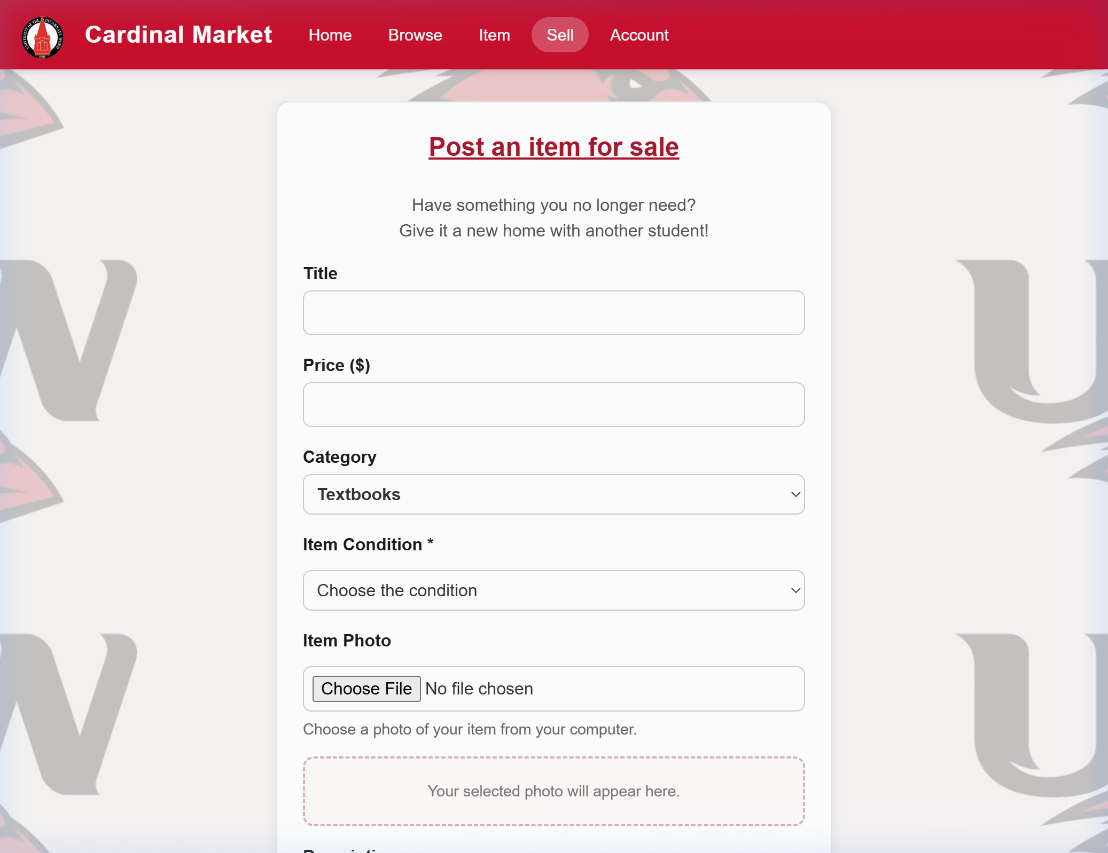
CIS 2368 MIDTERM PROJECT - SANDBOX WEBSITE
Sell Form & Live Preview (sell.html) — Sophia Gomez
Form Engineering & Celebration Physics
• Live Form Preview (hw4): Typing in the title, price, category, or condition updates the preview card instantly in real time.
• HTML5 File API Image Upload: URL.createObjectURL(file) displays local photos immediately before submission.
• Form Validation: Requires positive price values and non-empty titles with helpful error prompts.
• Sophia Confetti Engine: Generates 150 celebratory particles in UIW colors with randomized CSS variables.
Modified Class Code (sophia.js):
// Live reactive preview binding
titleInput.addEventListener("input", updateListingPreview);
priceInput.addEventListener("input", function() {
var p = Number(priceInput.value);
previewPrice.textContent = (p >= 0)
? p.toLocaleString("en-US", {style:"currency", currency:"USD"})
: "$0.00";
});
// 150-particle randomized Cardinal confetti on publish
launchConfetti();
Notes:
On the Sell page, designed by Sophia Gomez, students can post their own items for sale with real-time live preview, file photo upload, and an exciting 150-particle Cardinal confetti animation.

Slide 9
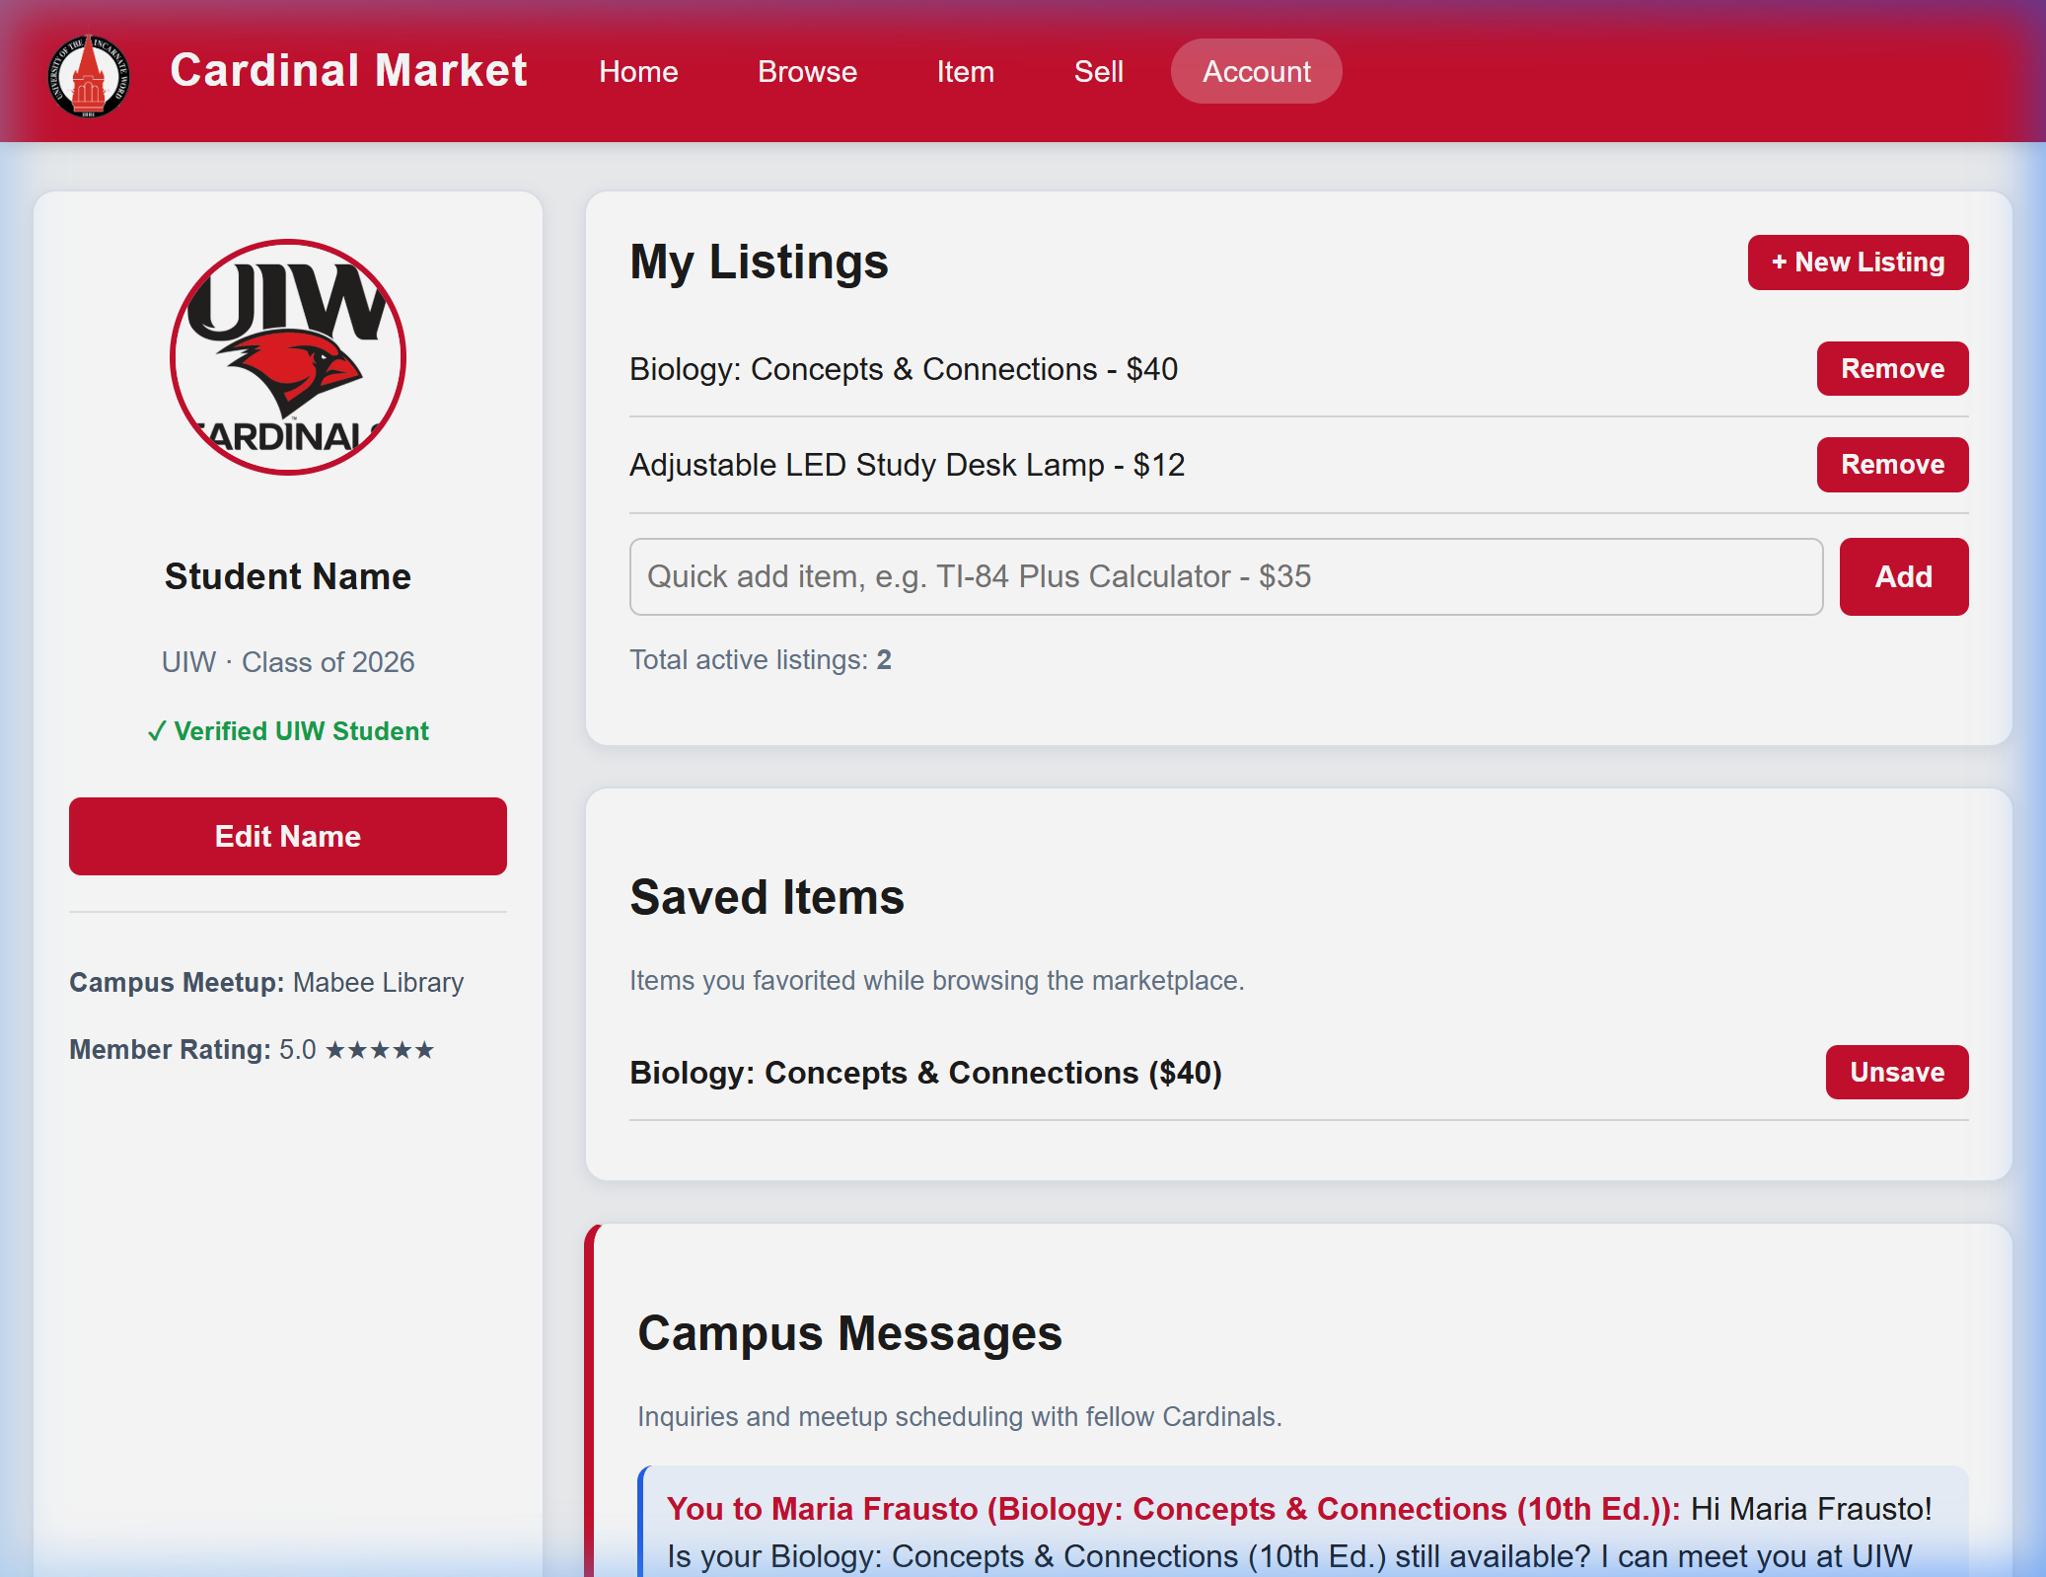
CIS 2368 MIDTERM PROJECT - SANDBOX WEBSITE
Account Dashboard (account.html) — Isabella Gomez
Dashboard Management & State Sync
• Profile Name Customization: Allows editing student name with prompt() and persists across page reloads via localStorage.
• Active Listings Management: Students can add listings inline or remove active ones with smooth fade-out CSS transitions.
• Event Delegation (hw7): A single listener on the parent <ul> handles remove clicks on both existing and newly added items.
• Cross-Page Synchronization: Automatically displays saved favorites from Browse and messages sent from the Item Detail page.
Modified Class Code (isabella.js):
// Event delegation for dynamic remove buttons
myListings.addEventListener("click", function(e) {
if (e.target.classList.contains("remove-btn")) {
var row = e.target.closest("li");
if (confirm("Remove this listing?")) {
row.classList.add("fading");
setTimeout(function() { row.remove(); updateListingCount(); }, 300);
}
}
});
Notes:
The Account Dashboard, also created by Isabella Gomez, ties the entire sandbox website experience together with student profile management, event delegation on listings, and message inbox.

Slide 10
CIS 2368 MIDTERM PROJECT - SANDBOX WEBSITE
Technical Implementation Breakdown (5% Oral Defense)
HTML5 Structure
• Semantic Tags: Replaced generic <div> wrappers with <header>, <nav>, <main>, <section>, <article>, <aside>, and <footer>.
• Accessible Forms: Clean <label for=...> associations, ARIA roles (role=dialog, aria-live=polite, aria-modal=true).
• SEO & Meta Tags: Viewport configuration, UTF-8 charset, descriptive page titles, and image alt text throughout.
CSS3 Architecture
• Three-Tier Hierarchy: External shared (main.css) + External student files (nathan.css, maria.css, etc.) + Internal <style>.
• CSS Custom Properties: Centralized :root variables (--cardinal, --cardinal-dark, --light, --dark) for consistent theming.
• Modern Responsive Layouts: CSS Grid with auto-fill/minmax and Flexbox. Responsive media queries at 768px and 820px breakpoints.
JavaScript Engine
• DOM Manipulation: Element selection via getElementById and querySelectorAll; creation via createElement and appendChild.
• Event Architecture: Reactive listeners for input, change, click, keydown, and window load events.
• State & Persistence: localStorage synchronization for custom listings, user favorites, and seller messages.
Notes:
For the 5% oral explanation portion, this slide summarizes the foundational web development principles powering our sandbox site across semantic HTML5, modern CSS3 with CSS variables, and event-driven JavaScript.

Slide 11
CIS 2368 MIDTERM PROJECT - SANDBOX WEBSITE
Live Sandbox Demo Walkthrough Guide (Step-by-Step)
Step 1: Landing on Home (index.html)
Open the home page. Observe the greeting change according to the current time of day. Click How it works to view onboarding alert modal, then explore the featured cards.
Step 2: Browsing & Filtering (listings.html)
Click Browse in the nav. Type lamp in the search box to watch instant real-time filtering. Change category dropdown to Textbooks, sort by price, and click the heart icon on a card to save it.
Step 3: Item Detail & Halloween Boo Pack (item.html)
Click View Item on the 'Halloween Mystery Boo Pack' (or direct nav). Click different spooky gallery thumbnails (ghost buddy, pumpkin stickers) to watch the smooth image swap and zoom modal. Click 'Offer 20% Off 👻' to watch dynamic discount math populate the offer field ($14), and send an offer alert. Open 'Message Seller' to see the live 300-char countdown and send a message saved to localStorage.
Step 4: Posting a New Listing (sell.html)
Click Sell in the nav. Fill out an item title and price. Notice the live listing preview updating keystroke-by-keystroke. Click Preview My Listing to launch Sophia 150-particle confetti animation.
Step 5: Account Dashboard Verification (account.html)
Click Account in the nav. Click Edit Name to change your student name. Verify that your newly published listing, favorited items, and sent seller message appear in the dashboard.
Notes:
Now, we will conduct the live demo of our Sandbox Website following this 5-step user journey from landing on Home to filtering, viewing details, posting an item, and verifying the Account dashboard.

Slide 12
CIS 2368 MIDTERM PROJECT - SANDBOX WEBSITE
Team Contributions, Learnings & Future Roadmap
Team Division of Labor
• Isabella Gomez: index.html & account.html | isabella.css & isabella.js. Built greeting, category navigation, dashboard management, and list delegation.
• Nathan Ortiz: listings.html | nathan.css & nathan.js. Built catalog search engine, category filter logic, sorting algorithms, and favorite persistence.
• Maria Frausto: item.html | maria.css & maria.js. Built URL parameter routing, photo thumbnail switcher, campus safety guide, and messaging modal.
• Sophia Gomez: sell.html | sophia.css & sophia.js. Built reactive listing form, live preview data binding, File API reader, and confetti celebration.
• Shared Architecture: main.css & main.js. Developed core design tokens, header/footer navigation, active link tracking, and GitHub repo coordination.
Key Learnings & Future Roadmap
• Version Control Collaboration: Coordinating Git branching (isabella-work, sophia-work, main) and resolving merge conflicts taught us professional team development.
• State Management Without Frameworks: Implementing localStorage allowed us to create a seamless multi-page experience purely with Vanilla JS.
• Future Enhancement 1 — Backend Database: Connecting the frontend to a Node.js/Express API and MongoDB database for persistent multi-user data across devices.
• Future Enhancement 2 — UIW SSO Authentication: Restricting accounts strictly to verified @student.uiwtx.edu email credentials.
• Future Enhancement 3 — Payment Gateway: Integrating Stripe or Venmo campus student payments.
Thank you! Questions & Discussion.
Notes:
Thank you very much, Professor Idar and classmates, for your time and feedback. We are now happy to answer any questions!

