Slide 1
FLOODLENS
LIVE SYSTEM
Transparent neighbourhood
flood awareness
1 / 2 / 5 km
resident-selected assessment circle
28,907
Final project report and demonstration
HydroBASINS polygons imported
Terrain, forecast rainfall, river-basin context, and historical-event ML evaluation
1,428,959
HydroRIVERS features imported
20-slide final result presentation
Local Docker demonstration • 19 October 2026

Slide 2
02
Project in one view
A usable resident interface backed by real spatial data, with research ML kept separate.
Resident experience
Operational pipeline
Research laboratory
Select a neighbourhood and a 1, 2, or 5 km circle. Read terrain, forecast rainfall, and river-basin context in plain language.
React and Leaflet call FastAPI. A PostGIS-backed worker samples FABDEM, reads HydroSHEDS, and fetches Open-Meteo rainfall.
Compare real labels with Extra Trees and U-Net masks on held-out events. Classification models add event-level context.
A complete local demonstrator with transparent coverage states, reproducible deployment, visible model failures, and measured held-out performance.
Neighbourhood awareness only: no official warning, evacuation advice, depth estimate, or property flood probability.
FloodLens final project report
2

Slide 3
03
Why local flood information is easy to misread
Terrain maps can mislead
River proximity is context
A score can look official
Raw surface elevation may treat buildings and trees as barriers. FloodLens uses bare-earth terrain and still reports its limits.
A mapped river near a point does not prove hydraulic connectivity to a street or property.
A simple number may be mistaken for a warning or probability. FloodLens labels its terrain score as a relative index.
Design objective
Help residents understand the water around them while showing what the data cannot establish.
FloodLens final project report
3

Slide 4
04
Aim, users, and scientific boundaries
What FloodLens provides
What the project does not claim
Relative terrain susceptibility inside a selected local circle
An official alert or evacuation service
48-hour forecast rainfall context from Open-Meteo
A flood depth or property-level probability
Containing basin, upstream basin, and nearby mapped-river context
Proof that a nearby river will affect a selected property
Explicit unavailable and outside-coverage results
Global coverage beyond imported regions and mounted terrain tiles
The assessment circle is a user-selected area. It is different from a watershed.
FloodLens final project report
4

Slide 5
05
Data sources and their roles
SOURCE
USE
IMPORTANT LIMIT
FABDEM v1.2
30 m bare-earth elevation
Misses drains, walls, culverts, and sewers
HydroBASINS L8
Containing and upstream basin context
Basin membership does not prove property connectivity
HydroRIVERS
Nearby mapped river and distance
Generalised geometry; proximity is contextual
Open-Meteo
48-hour hourly rainfall forecast
Forecast provider, not an official warning
OpenStreetMap
Location selection and basemap
Basemap only; no flood labels
Sen1Floods11 + CHIRPS
Historical labels, SAR, and rainfall research
Research only; labels may include permanent water
Current local demo coverage: Asia HydroSHEDS imports and Chennai-area FABDEM tiles.
FloodLens final project report
5

Slide 6
06
System architecture
The resident app and historical-event lab share one local web service while keeping calculations separate.
Browser
FastAPI
PostGIS
Worker
Data providers
React + Leaflet
Resident UI
›
Validation, UUID jobs, polling
›
Jobs, results, basin and river geometry
›
Claims jobs and calculates context
›
FABDEM
Open-Meteo
HydroSHEDS
Docker exposes the app on localhost. PostgreSQL stays private. The worker claims jobs transactionally.
Offline research never writes a flood probability into the resident assessment.
FloodLens final project report
6

Slide 7
07
From map click to neighbourhood assessment
1
Select location
2
Choose area
3
Create job
Click the map, choose a city, or enter coordinates.
Select a 1 km, 2 km, or 5 km circle.
FastAPI validates input and stores a UUID job.
4
Collect context
5
Persist result
6
Explain result
Worker samples terrain, rain, and river-basin data.
PostGIS stores factors, provenance, and status.
Frontend shows result cards or an unavailable state.
queued › running › complete or waiting_for_data / outside_coverage / failed
FloodLens final project report
7

Slide 8
08
Terrain score: deterministic, local, and explainable
Relative terrain susceptibility
What 65/100 means
55%
25%
Moderate relative terrain susceptibility within the sampled circle.
low relative elevation position
flatness
20%
It does not mean a 65% chance of flooding and it does not estimate water depth.
low local relief
0–33 lower • 34–66 moderate • 67–100 higher
Terrain quality also reports valid-cell coverage and missing-data flags.
FloodLens final project report
8

Slide 9

09
Resident demo: a guided three-step interface
The redesign clarifies the location, circle size, and result order before exposing technical details.
1. Location
City shortcut, map click, or exact coordinates.
2. Assessment area
Large 1 km, 2 km, and 5 km choices explain the local circle.
3. Result
Land, forecast-rain, and river-context cards appear first.
Technical evidence, source details, comparisons, and print output remain available in disclosures.
FloodLens final project report
9

Slide 10
10
Verified live Chennai assessment
A complete 2 km run used mounted terrain tiles, imported HydroSHEDS data, and live Open-Meteo rainfall.
65 / 100
0.97
18.6 mm
0.26 km
relative terrain susceptibility
valid terrain-cell ratio
48-hour rainfall total
nearest mapped river segment
Terrain, rainfall, containing basin, upstream context, and nearby river context all reached a complete result for the selected Chennai point.
28,907 basin polygons
1,428,959 river features
Docker app + DB + worker
Explicit partial coverage
FloodLens final project report
10

Slide 11
11
Research lab: two related ML tasks
The models study historical observed water. They do not produce the resident terrain score.
Whole-chip classification
Pixel water segmentation
Does this 512 × 512 chip contain at least 5% labelled observed water?
Models: spatial gradient baseline and rainfall LSTM.
Output: one probability and a thresholded class.
Which pixels match the verified observed-water label?
Models: Extra Trees and a three-scale two-band U-Net.
Output: a water mask plus error overlay.
Training and evaluation stay in research/. The resident API never treats these predictions as warnings or property risk.
FloodLens final project report
11

Slide 12
12
Evaluation prevents same-event leakage
Validation selects checkpoints and thresholds; the test events remain unseen.
TRAIN
VALIDATION
TEST
242 chips
87 chips
81 chips
Six complete-rainfall events fit model weights.
USA and Sri Lanka select checkpoint and threshold.
Bolivia and Paraguay form the held-out evaluation.
Spain is excluded because its historical rainfall sequence is incomplete. Missing values are not imputed.
Event-held-out evaluation is harder and more honest than a random chip split.
FloodLens final project report
12

Slide 13
13
How the models work together
1
Historical inputs
2
Classification
3
Segmentation
Sentinel-1 VV/VH radar and 60 days of CHIRPS rain.
Spatial summaries or an LSTM estimate chip-level water.
Extra Trees and U-Net label each valid pixel.
Spatial gradient baseline
Three-scale U-Net
VV/VH percentiles, distribution spread, cross-polarisation summaries, texture gradients, and transformed rainfall.
Two radar bands, augmented 128 × 128 crops, masked BCE plus Dice loss, and overlapping tiled inference.
The lab places both tasks beside the same held-out event so users can inspect agreement and failure.
FloodLens final project report
13

Slide 14
14
Held-out results on Bolivia and Paraguay
Scores come from 81 chips across two unseen events and remain exploratory.
0.725
0.569
U-Net segmentation F1
U-Net intersection-over-union
0.667
0.864
spatial baseline classification F1
spatial baseline precision
The LSTM reached PR-AUC 0.762, but threshold transfer reduced F1 to 0.293.
Classification and segmentation scores describe different tasks.
FloodLens final project report
14

Slide 15

15
Historical Event Lab: comparison in the browser
Select an event and chip, change model, adjust opacity, and inspect run details.
Held-out comparison
Extra Trees and U-Net IoU/F1 appear beside chip-level classification.
Visible threshold transfer
The original LSTM remains visible because weak transfer is useful evidence.
Reproducible selection
The export points to the accepted baseline artifact and frozen segmentation run.
FloodLens final project report
15

Slide 16
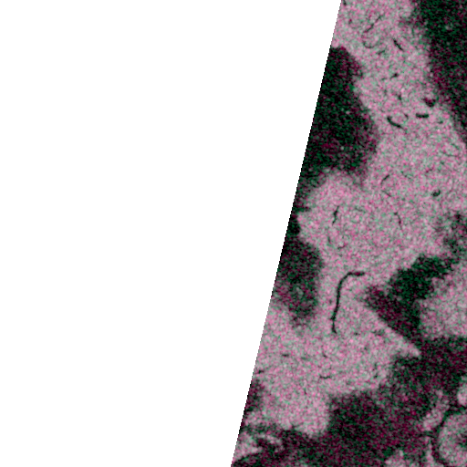
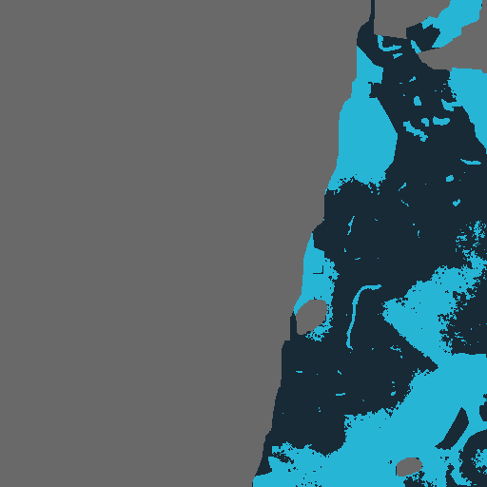
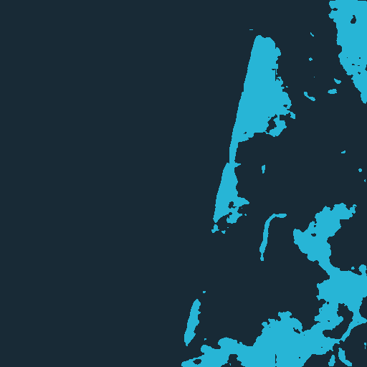
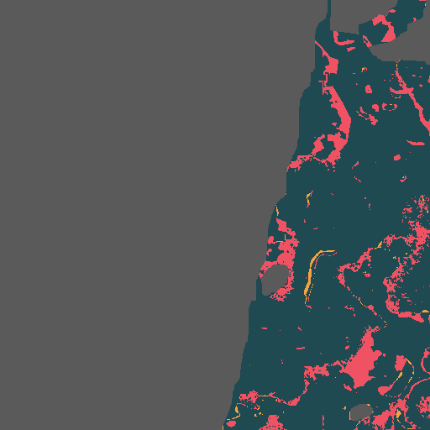
16
Failure analysis on a held-out satellite chip
Bolivia_103757 separates radar input, verified water, prediction, and error.
Radar input
Verified label
U-Net prediction
False and missed water
False water marks predictions outside the label. Missed water marks labelled pixels the model failed to recover. Spatial errors reveal what aggregate F1 hides.
FloodLens final project report
16

Slide 17
17
A higher F1 can still hide a bad model
The event-balanced LSTM v2 reached F1 0.603 by predicting every held-out chip as positive.
Rejected LSTM v2
Accepted spatial baseline
81 / 81
0
0.667
0.864
chips predicted positive
true negatives
held-out F1
precision
The apparent F1 improvement did not represent a useful decision rule.
It preserves positive and negative decisions, with PR-AUC 0.871 and ROC-AUC 0.909.
Model selection uses the confusion pattern and threshold-independent metrics, not F1 alone.
FloodLens final project report
17

Slide 18
18
Final deliverables produced
The project now includes a resident application, a research laboratory, verified local data, trained models, and reproducible documentation.
Resident web application
Historical Event Lab
Model and data artifacts
Guided map workflow, 1/2/5 km assessment circles, asynchronous job progress, factor cards, source disclosures, comparison snapshots, and print output.
Held-out event and chip selection, synchronized radar/label/prediction panels, model switching, zoom, opacity, failure sorting, run provenance, and experiment history.
Accepted classification and segmentation runs, frozen thresholds, predictions, metrics, event split, local dataset registry, and provenance-aware imports.
Deployment package
Project evidence
Safety boundary
Docker Compose runs the app, worker, and PostGIS database. The same app serves the resident site and /research/ viewer.
Technical README files, method notes, source inventory, reproducible run instructions, screenshots, and this final presentation.
Unavailable data stays unavailable. Research output remains outside the resident assessment and carries no warning or property-risk claim.
FloodLens final project report
18

Slide 19
19
Final result: what a user receives
A completed assessment turns multiple technical data sources into a short, understandable neighbourhood summary.
1
Location and area
Selected map point, exact coordinates when expanded, and the chosen 1 km, 2 km, or 5 km circle.
2
Land context
Relative terrain susceptibility, factor explanation, coverage ratio, and a clear statement that the score is not flood probability.
3
Rainfall context
Provider, forecast window, total rainfall, intensity context, and an unavailable state if the provider cannot return data.
4
River and basin context
Containing basin, upstream context, nearest mapped river distance, and wording that prevents property-level interpretation.
5
Evidence and provenance
Analysis ID, dataset status, import coverage, source versions, timing, technical JSON, and printable output.
The final screen starts with the information residents can act on, while detailed evidence stays available for review.
FloodLens final project report
19

Slide 20
20
End result and project status
Complete
Complete
Verified
Exploratory
local resident workflow
historical-event research viewer
Chennai data-backed demonstration
held-out ML performance
Final outcome
FloodLens successfully demonstrates how terrain, forecast rainfall, river-basin context, and historical-event ML analysis can be combined in one transparent project without presenting experimental predictions as public warnings.
Ready for
Academic submission
Portfolio demonstration
Research prototype
Future validation work
Next scientific step: add more independent events and India-focused geography-held-out validation before considering resident-facing ML.

