Slide 1
BANK LOAN OF CUSTOMERS

Slide 2
TEAM MEMBERS
Pooja Rani Nayak
Pravin Shende
Ankit Prakash
Prince Dadhich

Slide 3
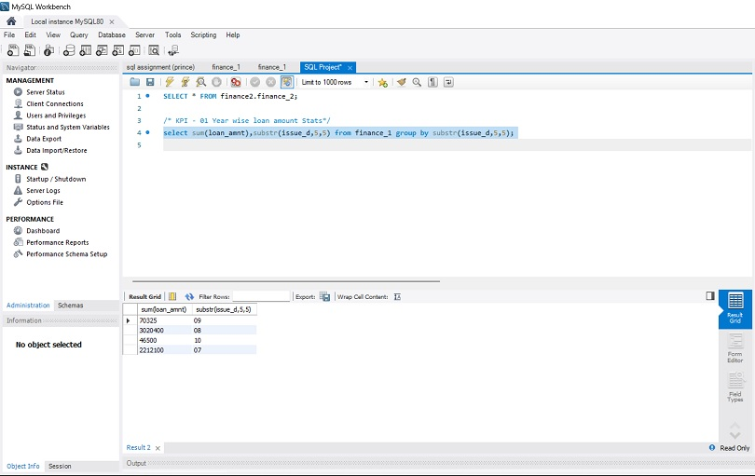
Year Wise Loan Amount Stats
The next image we see that in the 2011 has the highest loan amount and 2007 as the least loan amount.
The highest amount is seen to be as 260506575 and the lowest is seen to be 2219275
In the year 2010, 2009, 2008 the loan amount was seen to be 122050200, 46436325 & 14390275

Slide 4
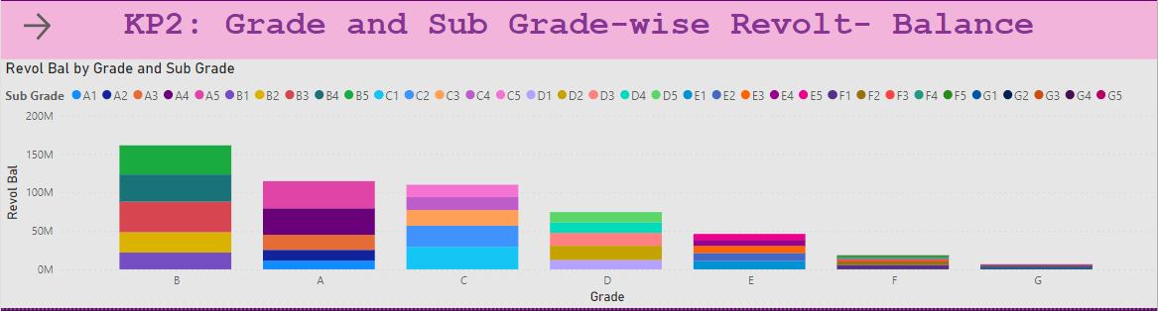
Grade and sub grade wise revol_bal
We have 5 Grades as seen figure those are A,B,C,D,E,F,G.
The Grade is further divided into 5 sub grades, such as A is divided to A1, A2, A3, A4 &A5 and so on..
In the image we can see that B is highest grade against the Revol Bal and G has the lowest grade against the Revol Bal.

Slide 5
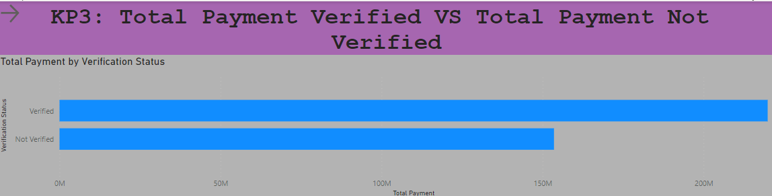
Total Payment for Verified Status Vs Non Verified Status
The image shows as total verified payment & total not verified payment in this we can see that verified payment is higher than the not verified payment
Total payment of the verified status is seen to be 219892307.51
Total payment of not verified is seen to be 15,3541418.21

Slide 6
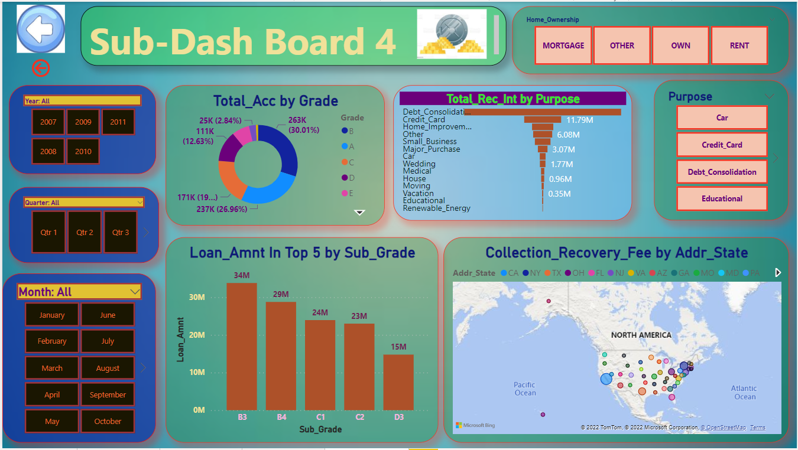
State wise and last_credit_pull_d wise loan status
In the image we have different year showing us the state was loan amount taken.
The first five state with the highest loan amount is B3, B4, C1, C2 & D3
As seen, we have different Rec_Int by purpose few of them are weeding, medical, house. The highest Rec_Int is for Debt Consolidate and the least is for Renewable Energy.

Slide 7
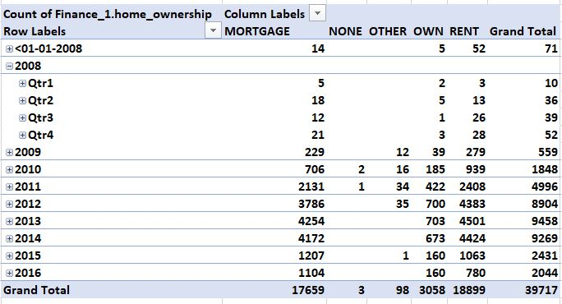
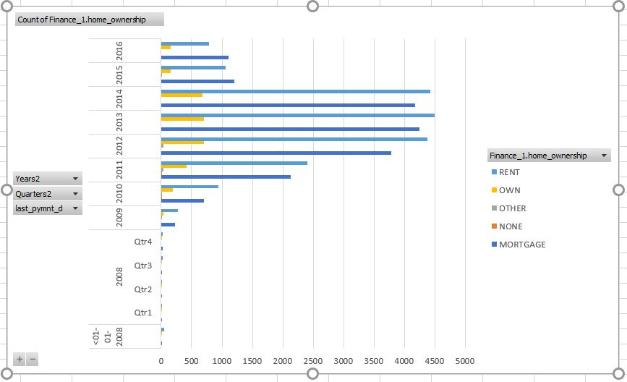
Home ownership Vs last payment date stats
In the home ownership section, we have 3 major things Mortgage, Rent & Own.
The last payment amount for Mortgage is 56305545, rent is 41686653 & Own is 8228967.
The highest last payment was seen in Mortgage & the lowest is seen in lowest.

Slide 8
Thank You!

