Slide 1
Howework 2
C Fundamentals and Basic Data Types

Slide 2
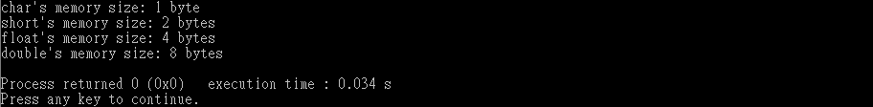
Question 1
Please print char, short, int, float, and double variable's memory size.
Notes:
變數的記憶體大小

Slide 3
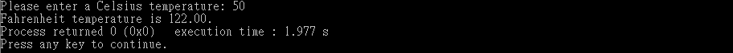
Question 2
Input a Celsius temperature and then output a Fahrenheit temperature.
Formula: F = (C *9/5)+32
Notes:
數值加減乘除應用

Slide 4
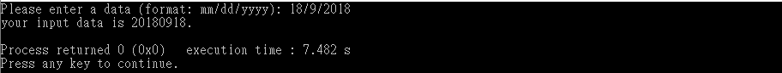
Question 3
Write a program that accepts a date from the user in the form mm/dd/yyyy and then displays it in the form yyyymmdd:
Notes:
字串處理

Slide 5
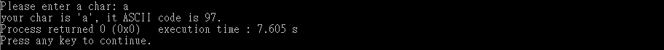
Question 4
Input a char and then print it and it's ASCII code.
Notes:
字元轉ASCII

Slide 6

Question 5
Please write a program, input a lower case char, output an uppercase char.
If the input is uppercase, output has to keep uppercase char.
Notes:
練習加減乘除

Slide 7
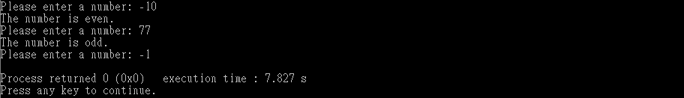
Question 6 (bonus)
Please write a program to determine whether the input number is odd or even. If the input number is -1, end the program.
If the number is odd, the output shows "The number is odd".
If the number is even, the output shows "The number is even".

