Slide 1
Howework 3

Slide 2
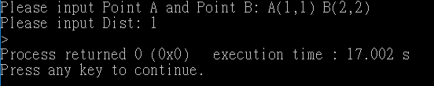
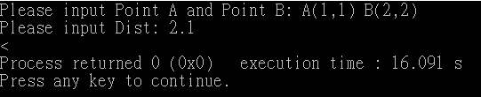
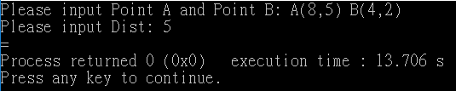
Question a
計算兩點A(a1,a2) , B(b1,b2)距離是否大於Dist
Input :
A(a1,a2) B(b1,b2) (註：a1 a2 b1 b2皆為int)
Dist(註：Dist為float)
Output : > 或 = 或 <

Slide 3
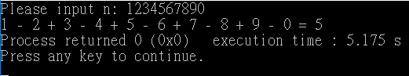
Question b
Given an integer 𝑛 = 𝑑9 ⋯𝑑2𝑑1𝑑0, where each 𝑑𝑖 is a decimal digit,
n 為10位數字, n >= 0
請計算Sum = 𝑑9 − 𝑑8 + 𝑑7 − 𝑑6 + 𝑑5 − 𝑑4 + 𝑑3 − 𝑑2 + 𝑑1 − 𝑑0
Input: n(n為int)
Output: 𝑑9 − 𝑑8 + 𝑑7 − 𝑑6 + 𝑑5 − 𝑑4 + 𝑑3 − 𝑑2 + 𝑑1 − 𝑑0 = sum

Slide 4
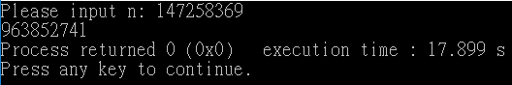
Question c
Given an integer 𝑛 = 𝑑8 ⋯𝑑2𝑑1𝑑0, where each 𝑑𝑖 is a decimal digit,
n 為9位數字, n >= 0
請計算Sum = (…((𝑑0 × 10 + 𝑑1) × 10 + 𝑑2)…) × 10 + 𝑑8
Input: n
Output: sum

Slide 5
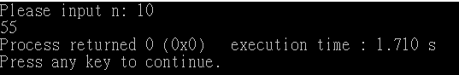
Question d
費氏數列定義為以下： F₀ = 0 F₁ = 1 F_{n} = F_{n-1} + F_{n-2}
請計算Fn (0<= n <= 10)
Input : n
Output : F_{n}

Slide 6
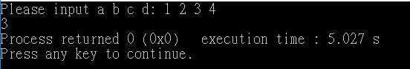
Question e
輸入 a, b, c, d (皆為int) 然後計算 Ans = a + b * c – d
(此題不用考慮overflow，直接計算即可)
Input : a , b, c, d
Output : Ans

Slide 7
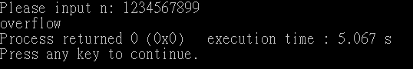
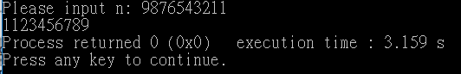
Question f(Bonus)
Given an integer 𝑛 = 𝑑9 ⋯𝑑2𝑑1𝑑0, where each 𝑑𝑖 is a decimal digit,
n 為10位數字, n >= 0
請計算Sum = (…((𝑑0 × 10 + 𝑑1) × 10 + 𝑑2)…) × 10 + 𝑑8 ，Sum是 int
若Sum無overflow印Sum
若Sum overflow 印出 overflow
Input: n
Output: sum 或 overflow

Slide 8
Upload Format
Please upload the compressed file of the current week’s work, the naming rules are: (your student number)_hw(the number of weeks).zip.
e.g: 0756600_hw3.zip
One homework per week, each homeweek has six questions, each of which is named as follows: (your student number)_hw(the number of weeks)(the alphabet of questions).c
e.g: 0756600_hw3a.c
The deadline is October 7, 2018.

