Slide 1
Homework 4

Slide 2

Question a
Print a n*n multiplication table
Input :
3
Output :
3*3 multiplication table
you may use \t

Slide 3
Question b
Print the same result as you input.
Input (There will be only char, you don’t have to consider int) :
I love computer science!
Output :
I love computer science!
Hint : Everything you need is in this powerpoint!

Slide 4
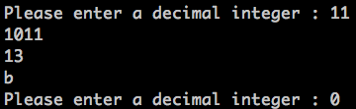
Question c
Transform a decimal into
Binary (ii) Octal (iii) Hexadecimal
and return when the input is 0
Input :
11
Output :
1011
13
b

Slide 5
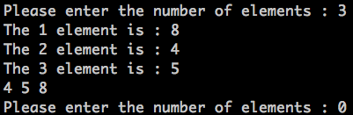
Question d
Sort the numbers you entered, and return when the input is 0
Input :
3
8
4
5
Output :
4 5 8
Hint : You can google any sort method, the best way to do is merge sort or quick sort. If you think the code is too difficult, you can try bubble sort or selection sort.

Slide 6

Question e
Find the prime number within 2~n, and print all of them. Return when the input is 0
Input n :
10
Output :
2 3 5 7
Hint : Find prime numbers by using CD (因數)

Slide 7
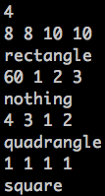
Question f (Bonus)
First, enter the number of test cases. And then enter the length of four lines in a quadrangle. Finally, determines if it is a
square (ii) rectangle (iii) quadrangle (iv) nothing
Input and output:
4
8 8 10 10 → output : rectangle
60 1 2 3 → output : nothing
4 3 1 2 → output : quadrangle
1 1 1 1 → output : square

Slide 8

Hint for Question f
It will be easier to use array
It is possible to set values for v[0] ~ v[3] by a single line while you are executing your program.
The program is shown here
v[0] v[1] v[2] v[3]

