Slide 1

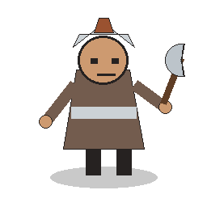
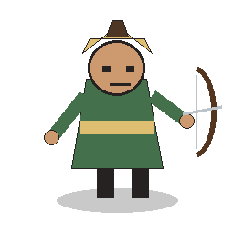

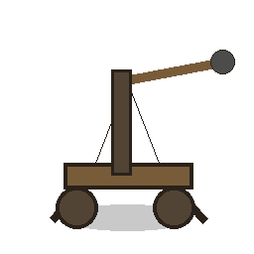
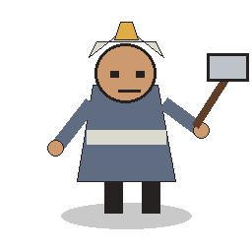
THE GRIDS PROJECT
Units with jobs, not just numbers
Commander
Warrior
Archer
A playable guide to stats, personalities, and the strategic habits that make the roster work together.
Healer
Trebuchet
Viking

Slide 2
ROSTER SNAPSHOT
Every unit has a sharp tactical job
Stats define the limits; personality tells you when to commit.
Commander
Warrior
Archer
Anchor
Frontline
Pressure
HP 150
ATK 20
HP 100
ATK 40
HP 80
ATK 20
Move 2
Range 1
Cost 1
Move 2
Range 1
Cost 2
Range 4
Cost 2
Move 2
Healer
Trebuchet
Viking
Support
Siege
Burst
HP 80
ATK 30
HP 70
ATK 20
HP 90
ATK 60
Move 3
Range 3
Cost 2
Move 1
Range 99
Cost 3
Move 1
Range 1
Cost 2

Slide 3
COMMAND ROLE
Commander
The Commander is the clock
Calm field general
A commander does not need to top the damage chart. It needs to make every trade expensive.
Wins by staying alive, holding tempo, and forcing the enemy to overextend.
HP
150
Personality: patient, stubborn, and politically impossible to ignore.
ATK
20
Move
2
Range
1

Slide 4
FRONTLINE PERSONALITIES
Warrior holds the door. Viking breaks it.
Both want melee contact, but they ask for different support.
Warrior
Viking
Reliable shield-breaker
All-in closer
Best when trading cleanly at the edge of a contested lane.
Short reach, enormous hit; needs lanes opened before committing.
HP
100
HP
90
ATK
40
ATK
60
Move
2
Move
1
Range
1
Range
1

Slide 5
RANGED PERSONALITIES
Archer draws lines. Trebuchet redraws the map.
Range is not only damage; it is a promise that some squares are unsafe.
Archer
Trebuchet
Patient lane controller
Slow, loud, inevitable
Controls space by threatening targets long before melee units arrive.
Punishes clustered enemies with board-wide reach and splash pressure.
HP
80
HP
70
ATK
20
ATK
20
Move
2
Move
1
Range
4
Range
6

Slide 6
SUPPORT ROLE
Healer
The Healer buys second chances
Mercy with a plan
Turns wounded allies into repeat threats; cannot damage enemies.
HP
80
Healing is a tempo weapon: it turns one surviving ally into two future attacks.
ATK
30
Move
3
Best use: keep the unit that controls the lane alive, not the unit that is easiest to reach.
Range
3

Slide 7
STRATEGY 01
Spend action points on position before damage
The game rewards threats that survive to act again.
1
2
3
Develop a threat
Draw only with intent
Attack when it changes the map
Move or deploy so next turn starts with a target already under pressure.
A card draw costs tempo. Draw when the board is stable or your hand lacks the next role.
Damage matters most when it removes a unit, opens a lane, or forces the commander backward.

Slide 8
STRATEGY 02
Make range bands do the work
A good formation lets one unit threaten while another unit protects the square it needs.
Simple formation rule: melee in front, healer one step behind, archer off-angle, trebuchet anywhere it can punish a cluster.

Slide 9
STRATEGY 03
Win by pairing jobs, not by picking favorites
The strongest turns combine a mover, a threat, and a closer.
Warrior + Healer
Archer + Viking
The lane sponge becomes a repeat attacker.
Chip from range, then finish with the huge melee hit.
Trebuchet + Commander
Any threat + knockback
Make the opponent choose between clustering and walking into command range.
An attack that moves a unit can open a deployment lane or break a formation.

