Slide 1


brokeCLAUDIA
Broken access control vulnerability in microCLAUDIA 3.2.0

Slide 2


Broken Access Control
Moving up from the fifth position, 94% of applications were tested for some form of broken access control with the average incidence rate of 3.81%, and has the most occurrences in the contributed dataset with over 318k.
https://cve.mitre.org/cgi-bin/cvekey.cgi?keyword=broken+access+control

Slide 3
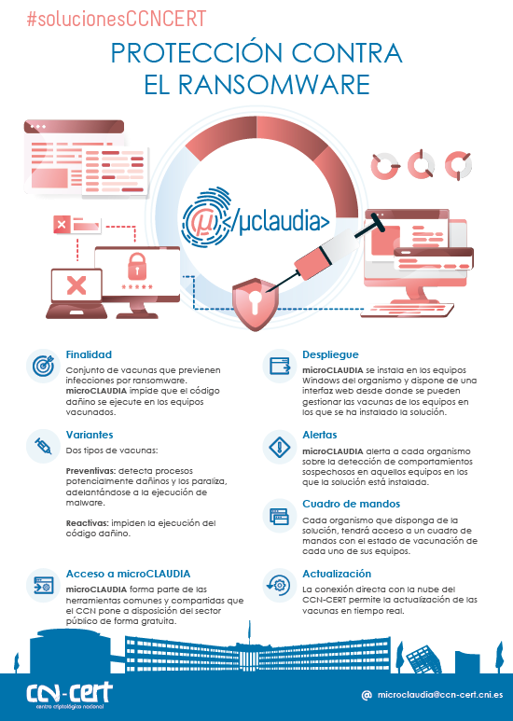
microCLAUDIA
It is a CLAUDIA engine based capability that provides protection against harmful ransomware code to an organization's equipment. It does this by using a lightweight agent for Windows systems that handles vaccine deployment and execution.

Slide 4


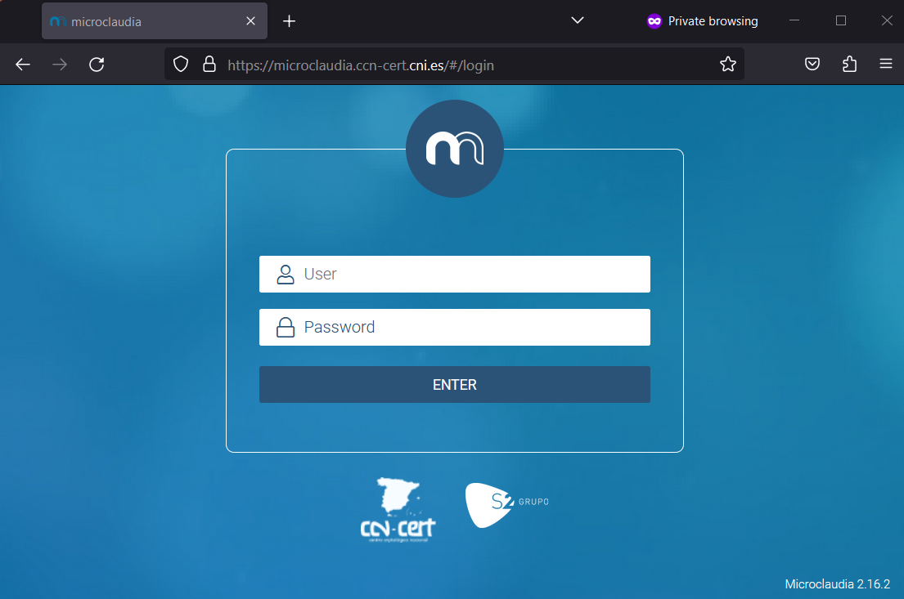
CCN-CERT cloud
microCLAUDIA central service

Slide 5

CCN-CERT cloud
microCLAUDIA central service

Slide 6




CCN-CERT cloud
…
microCLAUDIA central service

Slide 7


CCN-CERT cloud
…
microCLAUDIA central service

Slide 8
CCN-CERT cloud
…
microCLAUDIA central service

Slide 9
CCN-CERT cloud
…
microCLAUDIA central service

Slide 10
CCN-CERT cloud
…
microCLAUDIA central service

Slide 11
CCN-CERT cloud
…
microCLAUDIA central service

Slide 12
CCN-CERT cloud
…
microCLAUDIA central service

Slide 13



CCN-CERT cloud
…
Agency
Alerts
Vaccines
Agents
Data
…
microCLAUDIA central service

Slide 14
brokeCLAUDIA
Broken access control vulnerabilities exist when a user can access resources or perform actions that they are not supposed to be able to.
In version 3.2.0 and earlier versions of microCLAUDIA, there is a broken access control vulnerability (brokeCLAUDIA) that allows an attacker who has previously gained access to an account to access or modify data from other organizations not associated with the user.
In other words, the attacker could manipulate information from organizations that are not directly related to the compromised account.

Slide 15
CCN-CERT cloud
microCLAUDIA central service

Slide 16

CCN-CERT cloud
microCLAUDIA central service

Slide 17
CCN-CERT cloud
microCLAUDIA central service

Slide 18

CCN-CERT cloud
microCLAUDIA central service

Slide 19
CCN-CERT cloud
web
/
api
microCLAUDIA central service

Slide 20


CCN-CERT cloud
…
Agency
Alerts
Vaccines
Agents
Data
brokeAPI
…
microCLAUDIA central service

Slide 21
brokeCLAUDIA
To successfully exploit this vulnerability, it's crucial to grasp the following key aspects:
1. The attacker needs to obtain the identifiers associated with those organizations to perform the unauthorized actions.
2. The vulnerability exists only when making requests through the API, not through the web interface.
3. The identifiers used in web requests are transmitted in the URL, which poses a risk if an attacker gains access to the identifiers by dumping the history of a compromised machine.
4. The manager role grants the ability to modify (activate/deactivate vaccines, install/uninstall agents, etc.) data.

Slide 22


Slide 23
Remediation

Slide 24
Remediation
In order to remediate the broken access control vulnerability identified in microCLAUDIA, it is essential to implement several key measures.
First and foremost, it is imperative to enhance API controls to prevent unauthorized access to information. Implement checks to ensure that direct access to data is restricted, and enforce verification processes to confirm the association of the user with the organization before granting access.
Moreover, it is crucial to address the specific security concern related to the transmission of identifiers in GET requests. This entails ensuring that identifiers vital for the main functionality are not transmitted in a manner that exposes them. Adopting secure methods of transmission is highly recommended to fortify this aspect of microCLAUDIA's security architecture.
By diligently implementing these measures, the identified broken access control vulnerability in microCLAUDIA can be effectively mitigated. The combination of enhanced API controls and secure data transmission practices forms a robust defense, significantly reducing the risk of unauthorized access and manipulation of sensitive information.

Slide 25
Thank you
https://github.com/TheMalwareGuardian/brokeCLAUDIA

Slide 26
Questions?

