Slide 1
MyRecipe
A recipe saving and sharing app
By: Alex Franklin, Ehsan Motlagh, and Meredith White

Slide 2
Background:
A social media site where users can share recipes all on one platform
Social media sites allow users to browse each others’ content
Allows us to share our own content, add comments, and upvotes
Social media sites are image-driven and clickable
Toggling between private and public – privacy concerns with users

Slide 3
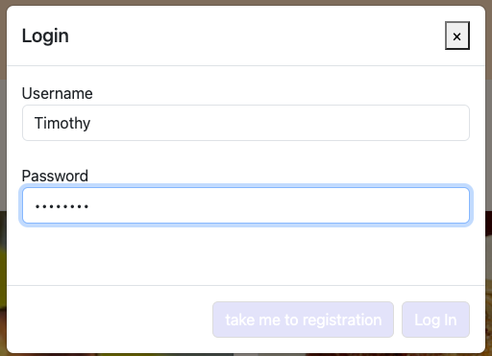
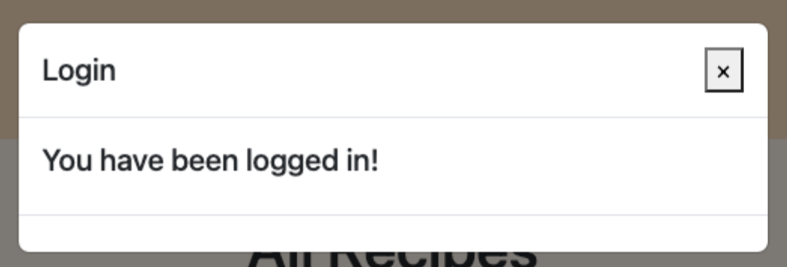
Our Solution
Login and registration

Slide 4
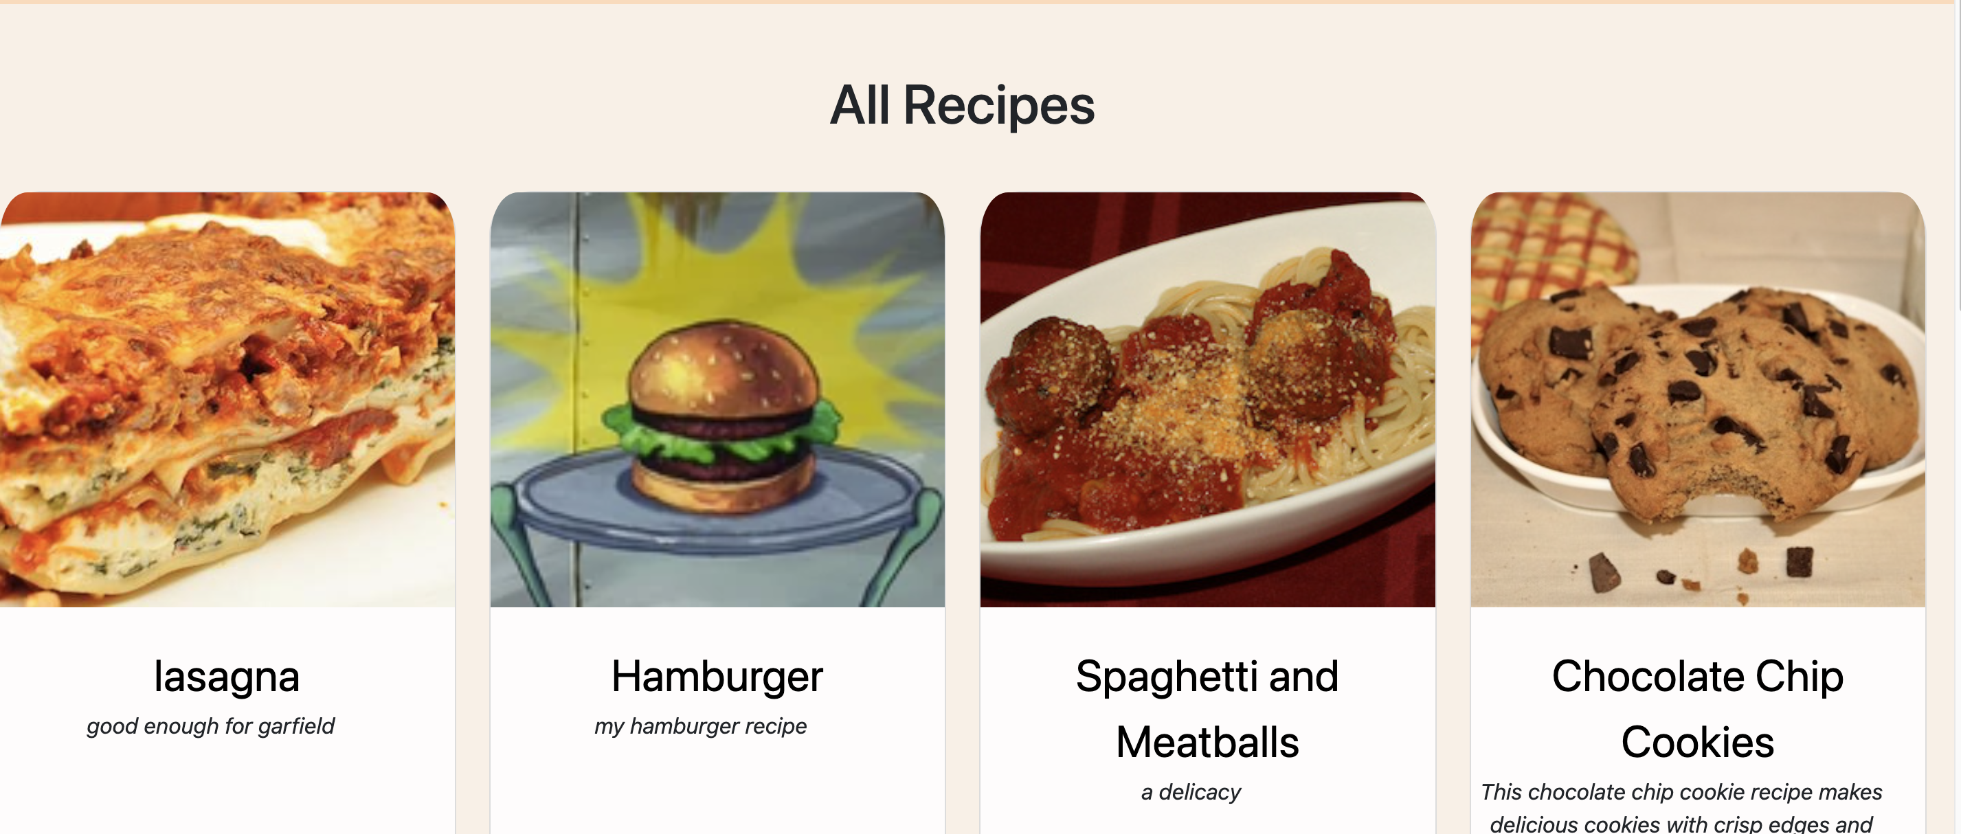
Our Solution
Home page with big images and short blurbs

Slide 5
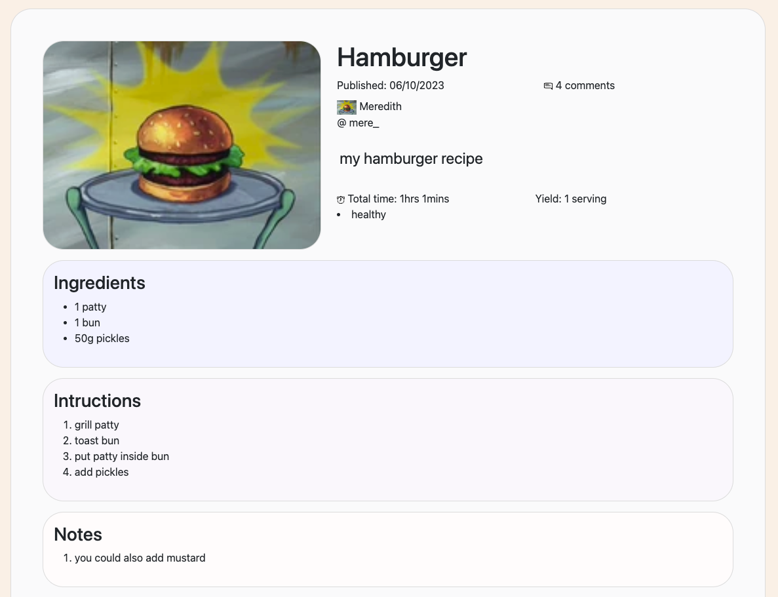
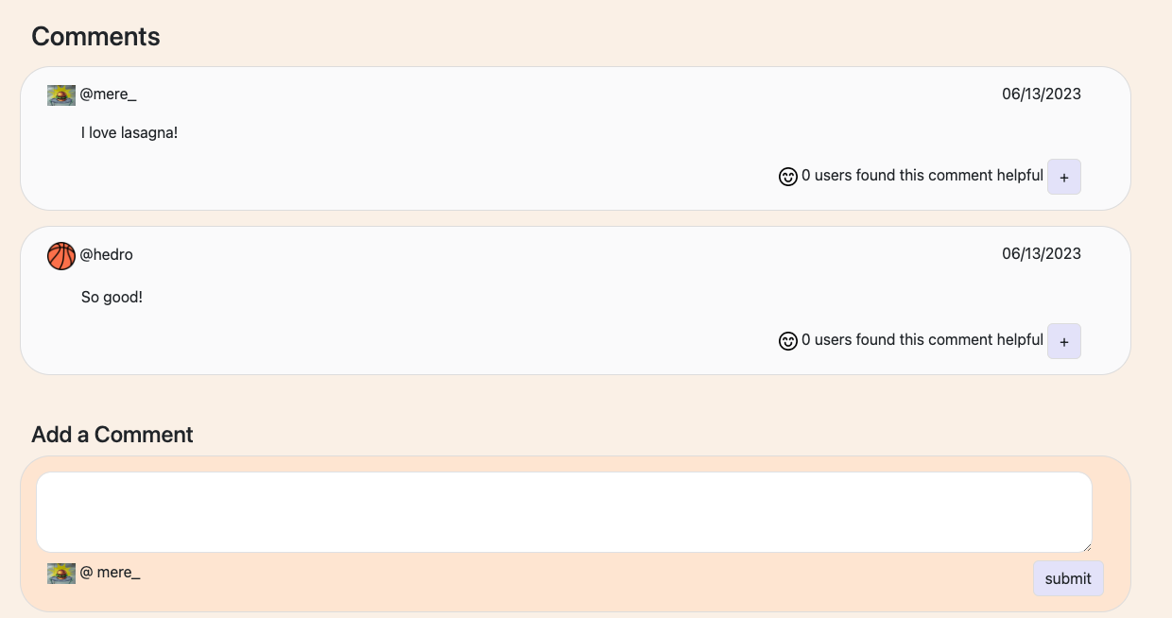
Our Solution
Anyone can view public recipes
Registered users can comment

Slide 6
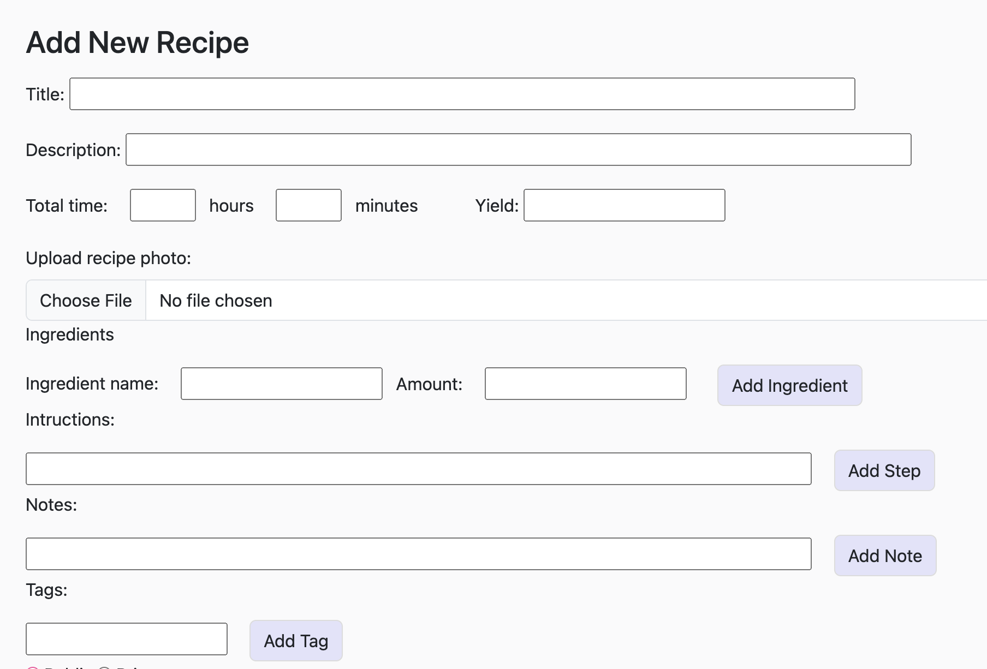
Our Solution
Easy to fill out, streamlined and simple process for adding recipes

Slide 7
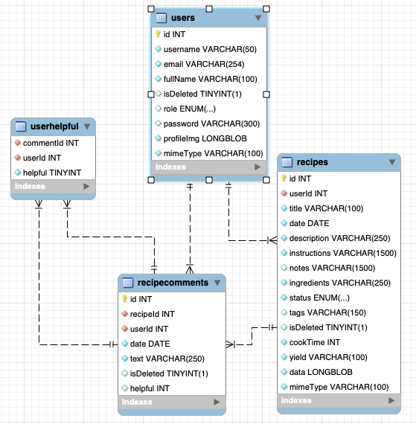
Challenges and Solutions
Our Database Structure

Slide 8
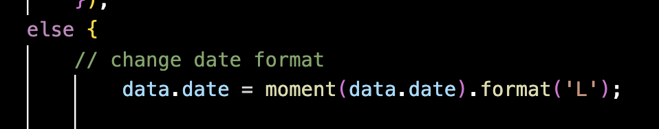
Challenges and Solutions
Using moment to format our dates

Slide 9
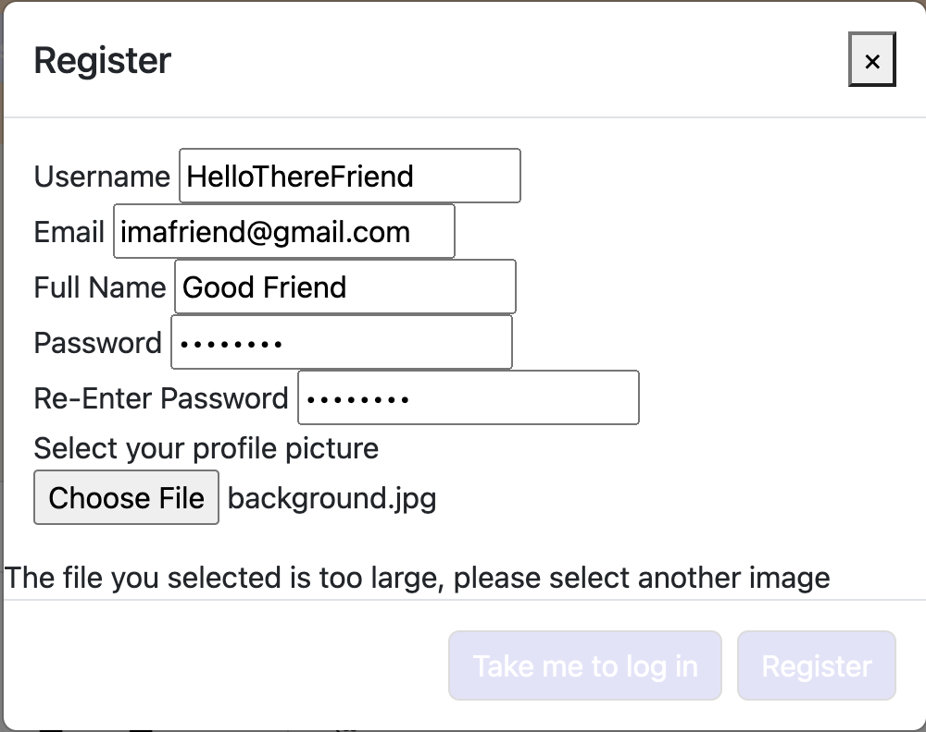
Challenges and Solutions
File size too big.
Possible solution:
NPM image-blob-reduce
Our solution:
- Warn the user

Slide 10
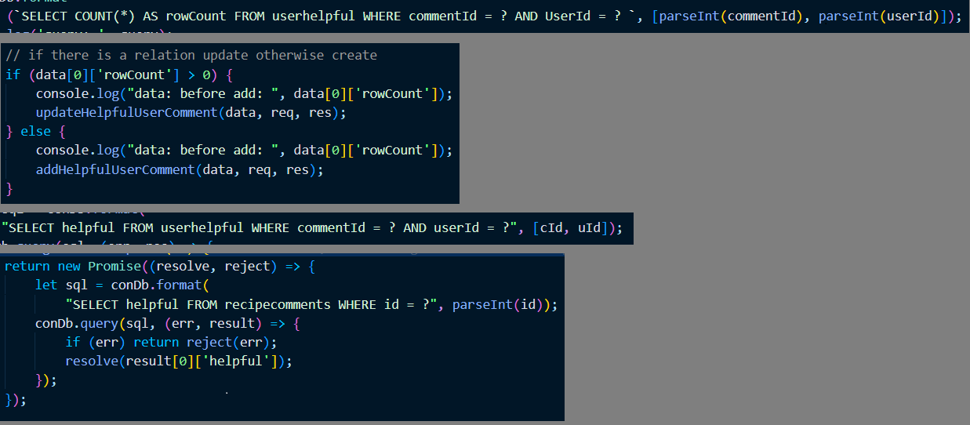
Challenges and Solutions
EHSAN : The biggest challenge is the syntax of Node.js and functional programming.
The helpful button, when user clicks on it(update), first we check if its already clicked
Or not(select query) if not we had to create the relation(create) if yes I had to update, to update the relation I had to check the value (select) then update first the relation value and at last the total value.

Slide 11
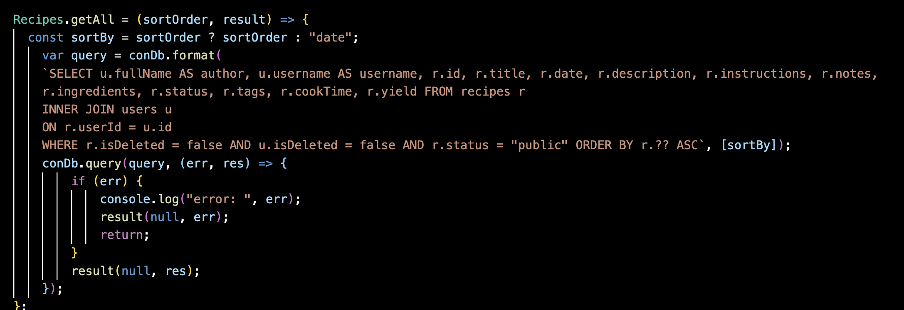
Challenges and Solutions
Using relational databases

Slide 12
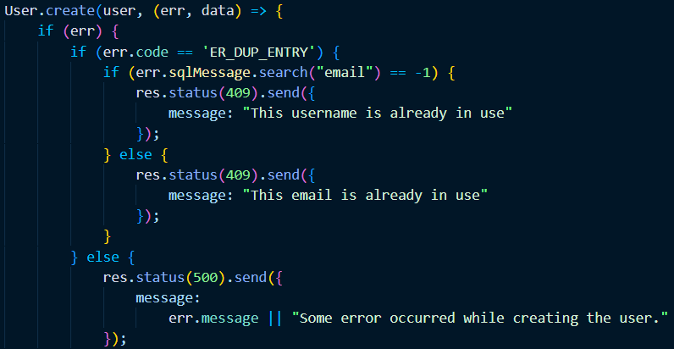
What we Learned

Slide 13
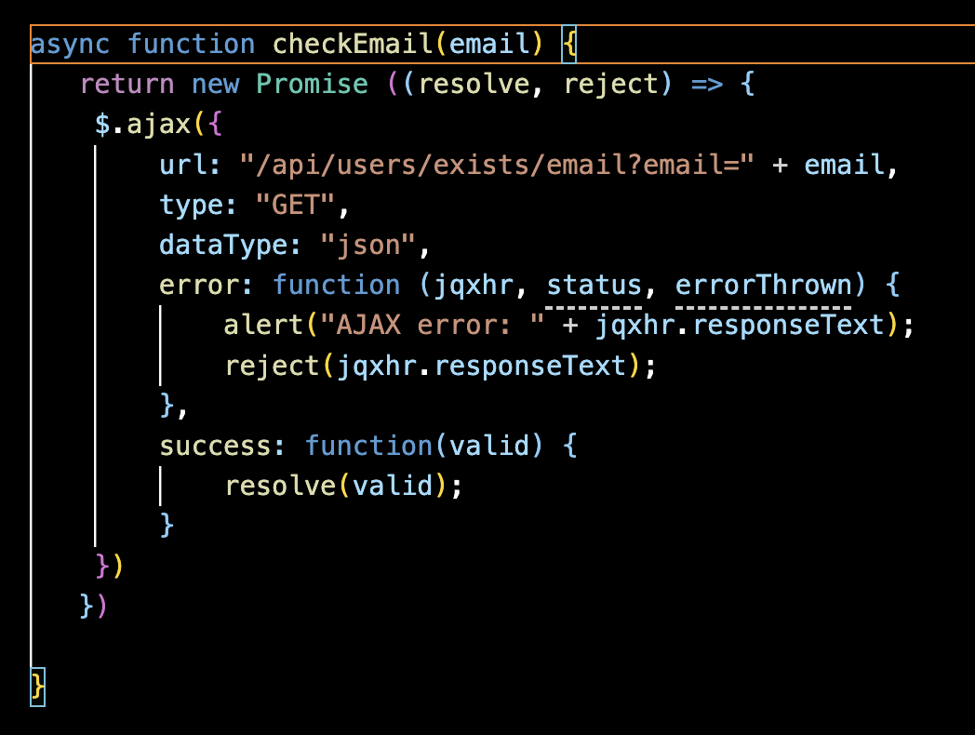
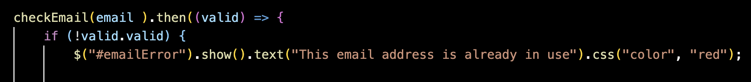
Using Promises

Slide 14
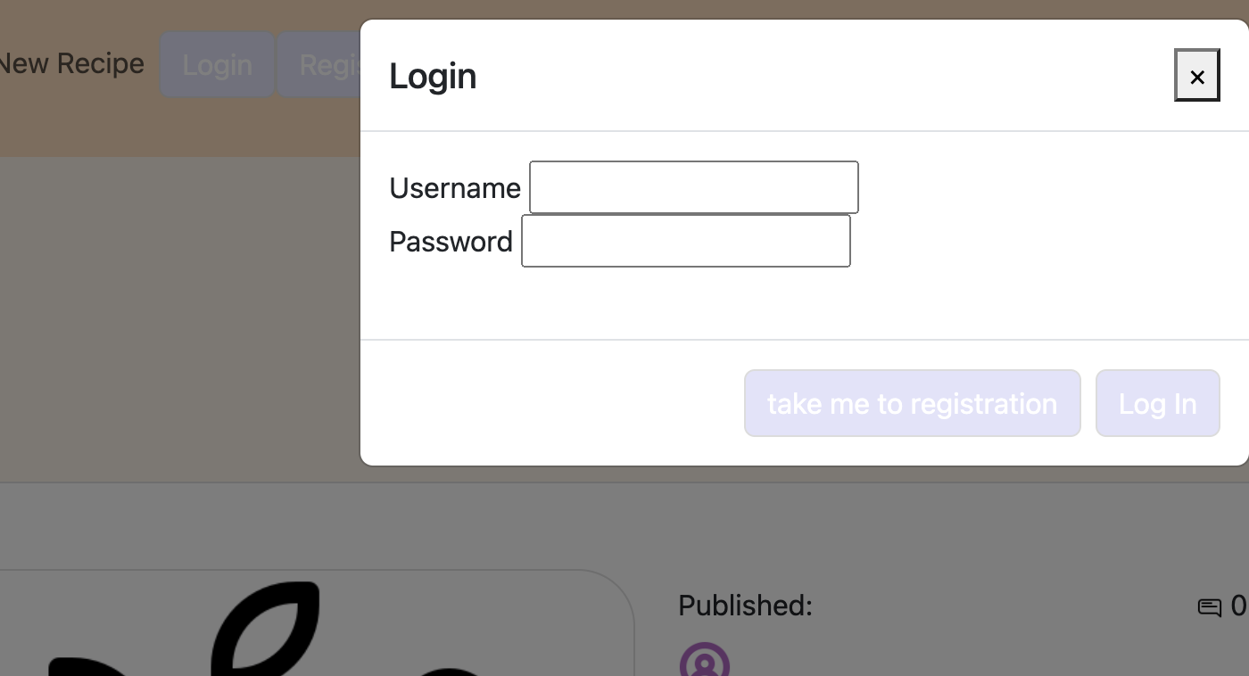
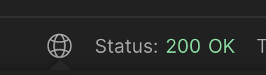
What we Learned
Not building it by user experience is not a plan for success
Dividing work into back/front
Fully functional and large back end without being able to anticipate how much work it would be in the front end – not much experience.
Don’t do this.

Slide 15
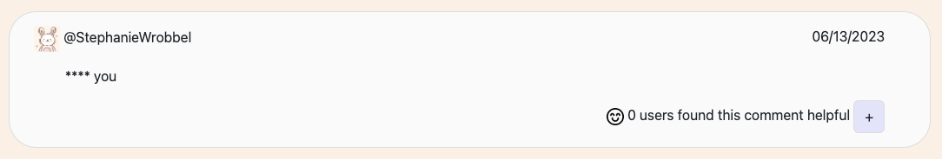
What we Learned: Packages and documentation
EHSAN: to prevent users from using and adding bad words finding a package that meets your need takes time and research. This makes us to read documentation and how to use it.

Slide 16
Future Work
Making our app fully functional
Making our app look nice
Adding ability to see other users’ profiles
Adding ability to save other recipes
Adding ability to add to a grocery list
Adding login page for admin

Slide 17
Summary
We created many functional API calls
We created a homepage that displayed short blurbs of recipes
We created a login and registration modal
We created the ability for users to submit their own recipes
We created admin panel who has access to functions that regular users don’t.

