Slide 1
Dimensionality Reduction and Semi-Supervised Classification
A fully crossed study of PCA and LDA across 3 datasets, 3 classifiers, and 3 label budgets
162
Phase 7–8 Final Research Report · 6 November 2026
Fixed splits · seed 42 · no test-set leakage
matched experiments
81 supervised + 81 self-training

Slide 2
The problem: scarce labels, abundant unlabelled data
Why a preprocessing choice may decide whether self-training helps or hurts
Labelled data
Unlabelled data
10% · 25% · 50%
of the non-test pool is labelled
90% · 75% · 50%
of the pool has hidden ground truth
Expert annotation is slow and expensive. Every classifier therefore faces the same constraint: a small, fixed labelled subset, one seed, and one split.
Self-training can exploit this pool by adding high-confidence pseudo-labels. But PCA or LDA may remove exactly the information pseudo-labelling relies on.
RESEARCH QUESTION
Does applying PCA or LDA before classification change how much self-training improves accuracy and macro-F1?
2 / 15

Slide 3
Research objectives: four questions
One fully crossed design answers all four without confounding
RQ1 · Representation
RQ2 · Classifier
RQ3 · Label budget
Does Baseline, PCA, or LDA change the downstream score under identical splits?
Do Logistic Regression, linear SVM, and KNN respond differently to pseudo-labels?
How does the benefit of self-training change at 10%, 25%, and 50% labelled data?
3 × 3
representations × datasets
81
conditions per training regime
3
labelled proportions
RQ4 · Cost and reliability
7.59×
training-time ratio
Measure training and prediction time, pseudo-label acceptance, stopping reasons, convergence warnings, and numerical failures.
3 / 15

Slide 4
Three datasets, three difficulty regimes
Same pipeline; very different dimensionality, class counts, and label structure
Breast Cancer Wisconsin
MNIST digits
569 rows · 30 features · 2 classes
42,000 rows · 784 features · 10 classes
455 train / 114 test · 80/20 stratified holdout
33,600 train / 8,400 test · 80/20 stratified holdout
Small and nearly linearly separable: a useful sanity check where 10% still leaves hundreds of rows.
High-dimensional and large: the expensive regime, and the source of every numerical failure in this study.
UCI HAR
Provenance and integrity
10,299 rows · 561 features · 6 classes
Staged once in Phase 2 from documented Kaggle mirrors of the UCI datasets and never re-downloaded. Splits, hashes, and scaler scope are recorded in preprocessing_splits.json.
7,352 train / 2,947 test · 21 / 9 subjects
Official subject-disjoint split: the test set contains people the training data never saw.
4 / 15

Slide 5
Methodology: one fixed pipeline per condition
From raw split to audited comparison in five reproducible stages
PHASE 3
PHASE 4
PHASE 5
PHASE 6
PHASE 7–8
1
2
3
4
5
Fixed split
Reduce
Supervised
Self-train
Audit
80/20 stratified for Breast Cancer and MNIST; official subject split for HAR. Seed 42.
PCA once per dataset; LDA per labelled condition. Fit on training rows only.
81 runs: 3 datasets × 3 proportions × 3 representations × 3 classifiers.
Same 81 conditions with 0.90 confidence and a maximum of 3 rounds.
Match pairs, recompute metrics, and check leakage and immutability.
INVARIANTS
Seed 42 · scaler fit on training rows only · test rows never used for fitting, pseudo-labelling, or threshold choice
5 / 15

Slide 6
Preprocessing: two worlds kept separate
Every transformation is fit only where it is allowed to look
Split and scale
Labelled / unlabelled split
80/20 stratified holdout for Breast Cancer and MNIST.
Official subject-disjoint split for HAR.
StandardScaler fit on the training partition only.
Test rows are transformed, never used for fitting.
10%, 25%, or 50% of non-test rows are labelled.
The remainder forms the unlabelled pool.
Hidden unlabelled truth never reaches a model.
The same rows are reused across every classifier and representation.
WHY IT MATTERS
Identical splits make Phase 5 vs Phase 6 differences attributable to the training regime, not to leakage or different data.
6 / 15

Slide 7
PCA: variance-driven compression, fit once
Unsupervised reduction to a 95% explained-variance target
PCA is fitted on the complete scaled training pool once per dataset, then applied unchanged to labelled, unlabelled, and test rows.
Because it is unsupervised, class labels never enter the projection. PCA cannot see the test set or the pseudo-label decisions.
Fewer dimensions cut cost, but may also remove signal that pseudo-labelling relies on.
Breast Cancer
30 → 10 95.21% variance
MNIST
784 → 318 95.03% variance
UCI HAR
561 → 102 95.08% variance
Full SVD solver · fitted once per dataset · never refit for a classifier or proportion
Result: PCA stays close to the baseline overall (macro-F1 change −0.0003), but the effect is not uniform across datasets.
7 / 15

Slide 8
LDA: supervised projection with a hard cap
Fitted per labelled proportion, using only the labelled rows
LDA is fitted separately for every labelled proportion and uses only the labelled rows of that condition.
Components are capped at min(n_features, n_classes − 1) and the SVD solver is used.
Because LDA uses labels, its projection changes when the label budget changes.
Breast Cancer · 2 classes
1 component
MNIST · 10 classes
9 components
UCI HAR · 6 classes
5 components
KNOWN FAILURE MODE
LDA can produce extreme out-of-sample values. Three MNIST LDA + Logistic Regression fits became numerically degenerate; their measured scores are reported, never replaced.
8 / 15

Slide 9
Supervised baselines: 81 runs, no pseudo-labels
Three classifiers held constant across every dataset, representation, and label budget
Logistic Regression
Linear SVM
K-Nearest Neighbours
lbfgs solver · C = 1 · max_iter = 2000 · multinomial for 10 and 6 classes
squared hinge · dual formulation · C = 1 · tol = 1e-3 · max_iter = 2000
k = 5 · distance weights · Euclidean metric · brute-force search
0.9230
mean macro-F1
0.8923
mean macro-F1
0.9035
mean macro-F1
BEST SUPERVISED MACRO-F1
Breast Cancer 0.9905 · MNIST 0.9337 · HAR 0.9618
WARNINGS
16 linear-SVM fits emitted ConvergenceWarning (8 MNIST, 8 HAR). All 81 runs completed and all metrics are valid test-set measurements.
9 / 15

Slide 10
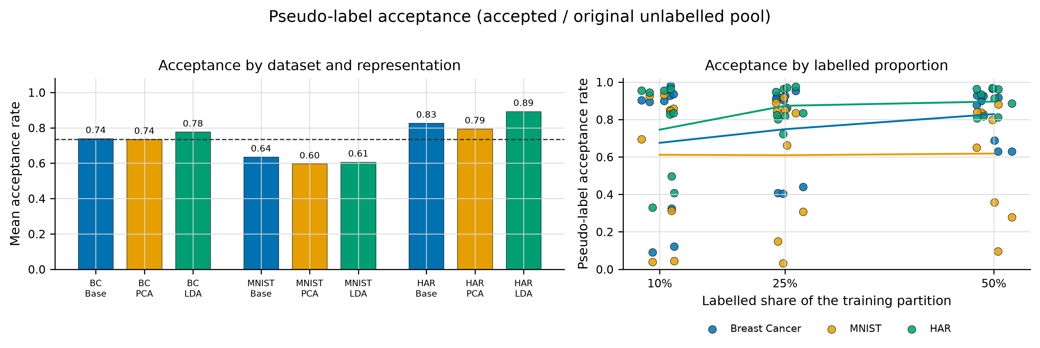
Self-training: confidence-gated pseudo-labels
Only labelled and unlabelled training rows participate; test rows and hidden truth never do
0.90 confidence
3 iterations max
1 new label minimum
Only predictions at or above 0.90 enter the labelled set.
Initial fit plus up to three augmented refits; 68 runs hit the cap.
A round that accepts nothing stops; 13 runs ended this way.
Pseudo-label acceptance by dataset; mean acceptance per condition 73.4% (65.1% of all pooled unlabelled rows).
10 / 15

Slide 11
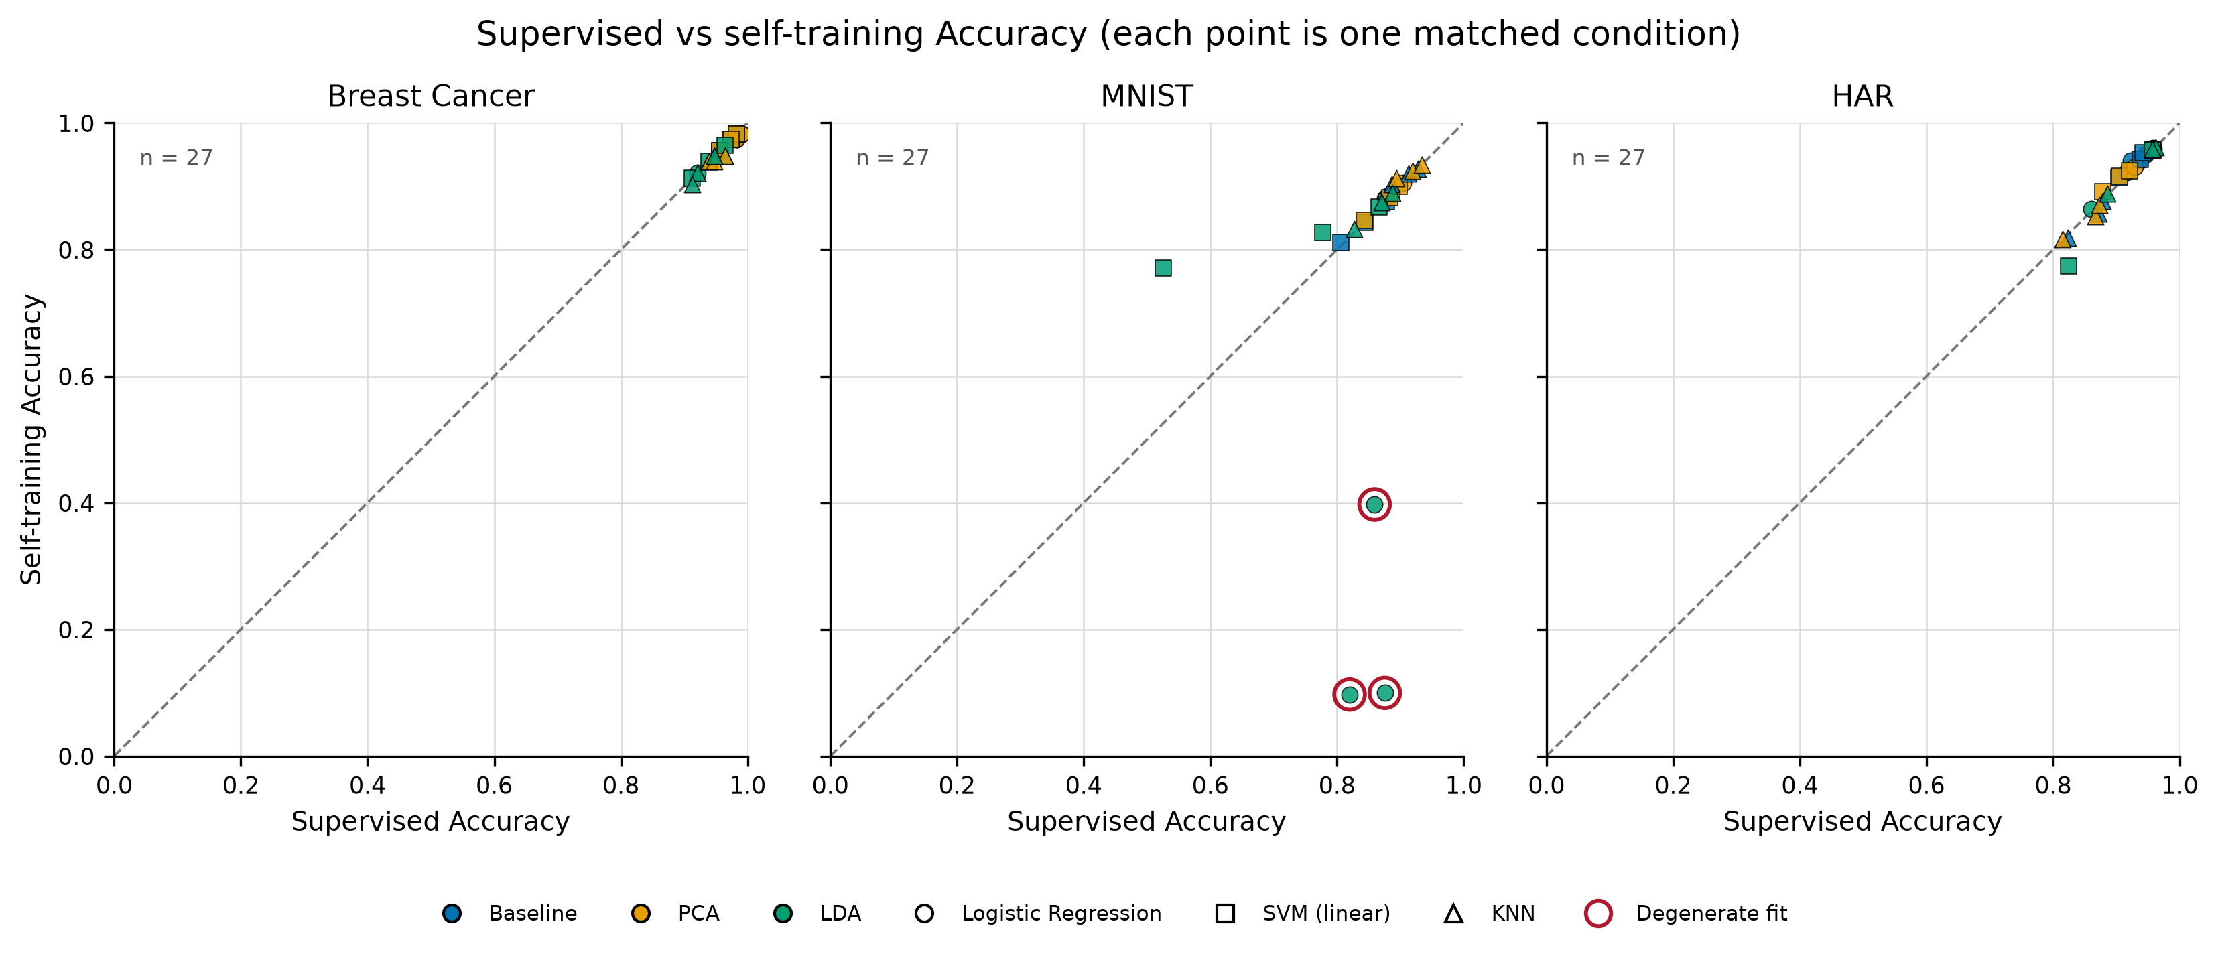
Results: self-training is close to neutral
81 matched pairs: same split, features, classifier, and label budget
−0.0206
mean accuracy change
−0.0237
mean macro-F1 change
38 / 27 / 16
improved / regressed / tied
Per-condition accuracy, supervised vs self-training; the largest drops are the three MNIST LDA + LR failures.
11 / 15

Slide 12
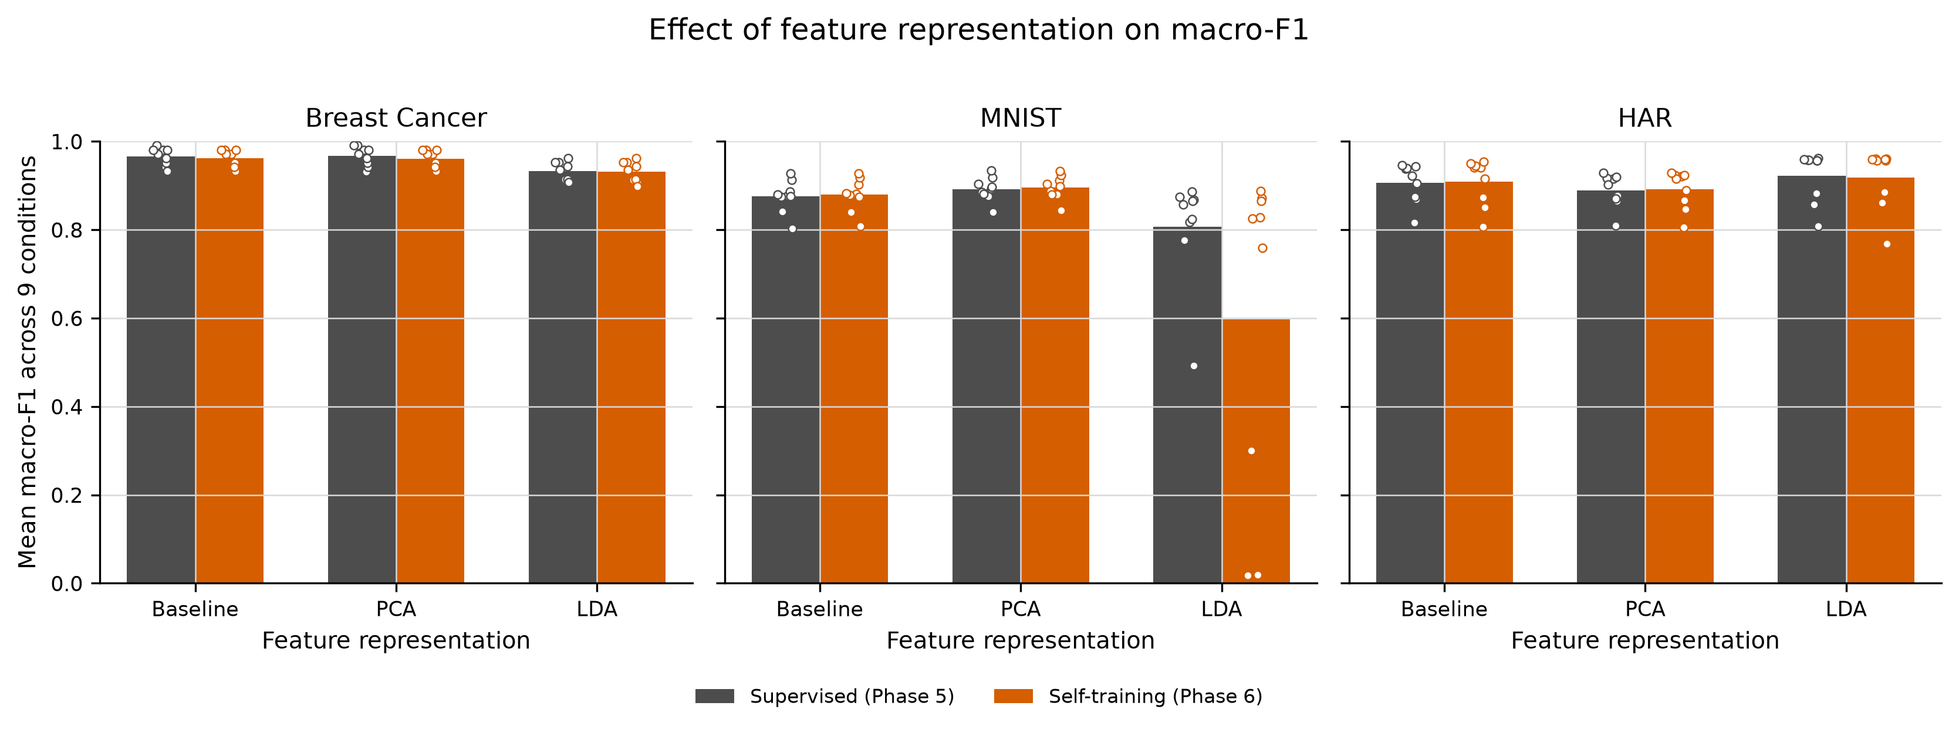
Where the effect comes from
Macro-F1 change by representation across all 81 matched pairs
Baseline +0.0007
PCA −0.0003
LDA −0.0714
Neutral: self-training neither helps nor hurts on average.
Also neutral; compression does not systematically break pseudo-labelling.
Driven by three degenerate MNIST LDA + LR fits; excluding them, the overall change is +0.0038.
12 / 15

Slide 13
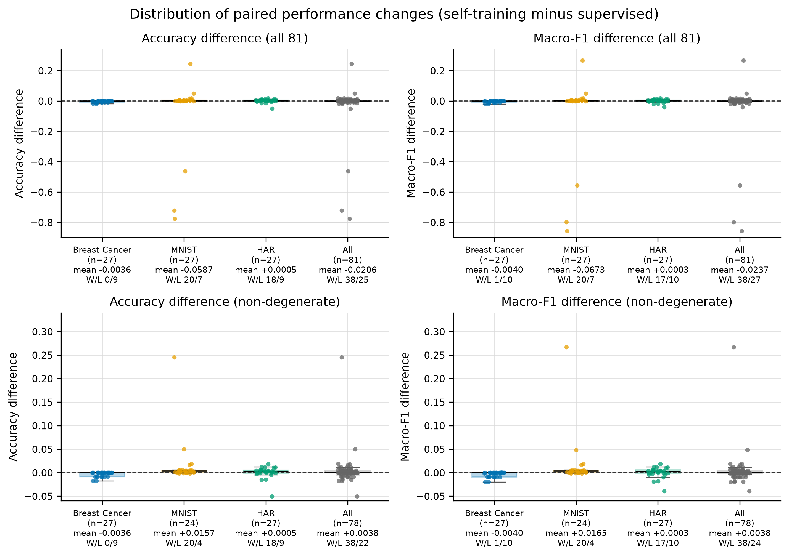
Limitations are reported, not hidden
Warnings, numerical failures, and design limits are kept distinct
3 degenerate MNIST LDA + LR fits: accuracy falls by 0.78, 0.72, and 0.46. They stay in the primary statistics.
16 Phase 5 and 17 Phase 6 LinearSVC convergence warnings; 3 NumericalStabilityWarnings in Phase 6.
3-iteration cap: 68 of 81 runs reached it, so iteration counts and acceptance are right-censored.
13 runs stopped because no remaining sample reached the 0.90 threshold.
MNIST SVM consumes 91.3% of self-training time (5,318.8 s of 5,826.3 s).
Phase 5 recorded no prediction time, so prediction-cost comparison is not possible.
One fixed split and seed: descriptive paired differences only, no p-values or confidence intervals.
Paired improvement distributions; the degenerate outliers sit far below the main mass.
Full audit: limitations_and_future_work.md and Section 16 of the final report.
13 / 15

Slide 14
Conclusion
A small, honest effect: the method is neutral once numerical failures are separated
Self-training is not a free win: mean scores were slightly lower overall.
The negative sign is driven by three numerical failures, not by the method itself.
Baseline and PCA are neutral; LDA is the risky combination.
Linear SVM is the only classifier with a positive mean change (+0.0125 macro-F1).
EXCLUDING 3 DEGENERATE FITS
+0.0038
mean macro-F1 change over the remaining 78 conditions
−0.0237 all-condition macro-F1 change
7.59× self-training training-time ratio
38 improved · 27 regressed · 16 tied on macro-F1 (α = 0.90, 3 rounds).
Best absolute scores: Breast Cancer 0.9905 (baseline LR, 25%) · MNIST 0.9337 (PCA KNN, 50%) · HAR 0.9618 (LDA KNN, 25%)
14 / 15

Slide 15
Future scope
Four directions that follow directly from the limitations
01
Multi-seed, repeated splits
02
Stronger semi-supervised methods
Repeat every condition under several seeds and analyse with a mixed-effects model that separates split variance from condition variance.
Co-training, label propagation, entropy minimisation, and consistency regularisation under identical splits.
03
LDA numerical stability
04
Broader representations
Shrinkage LDA, robust scaling, or an explicit rejection rule for degenerate projections before training.
Deep embeddings, calibrated per-dataset thresholds, and prediction timing in the supervised phase.
Thank you — questions welcome
Full results: final_research_report.md/.pdf · preparation: viva_questions_and_answers.md
15 / 15

