Slide 1
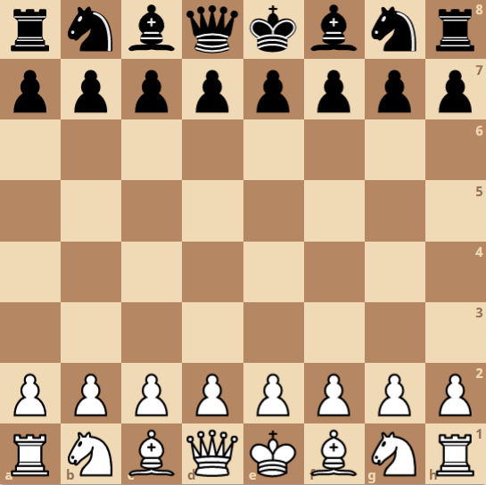
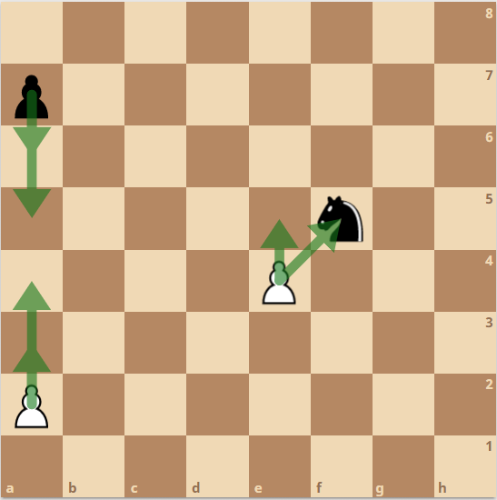
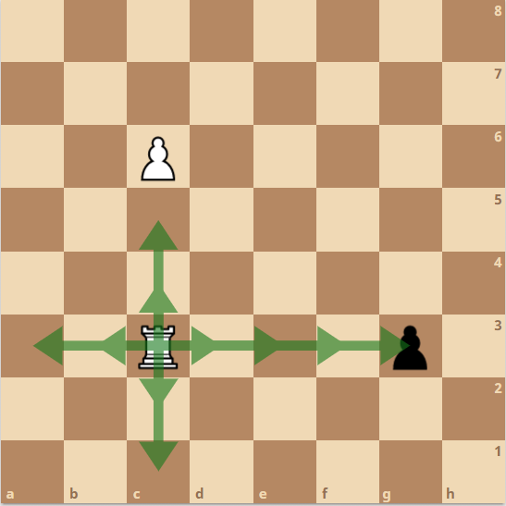
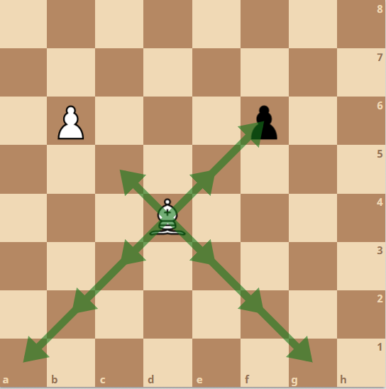
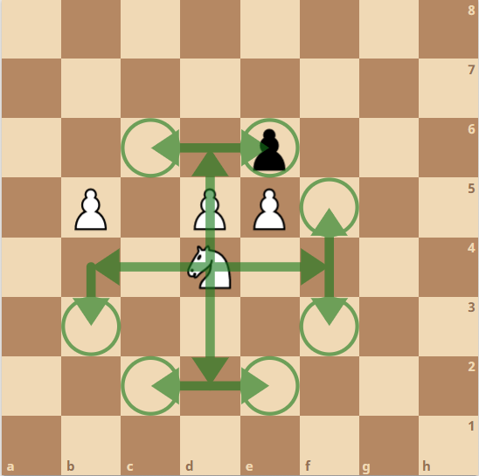
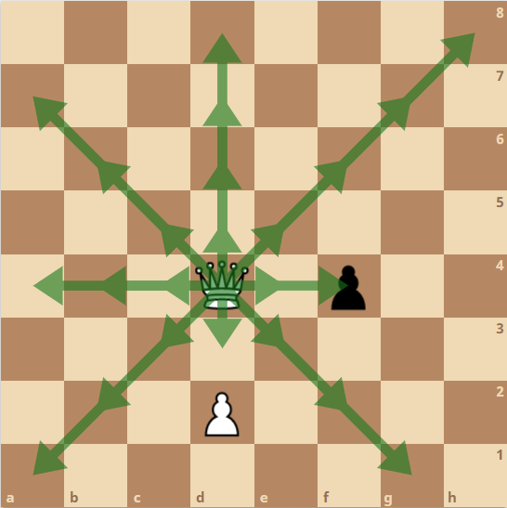
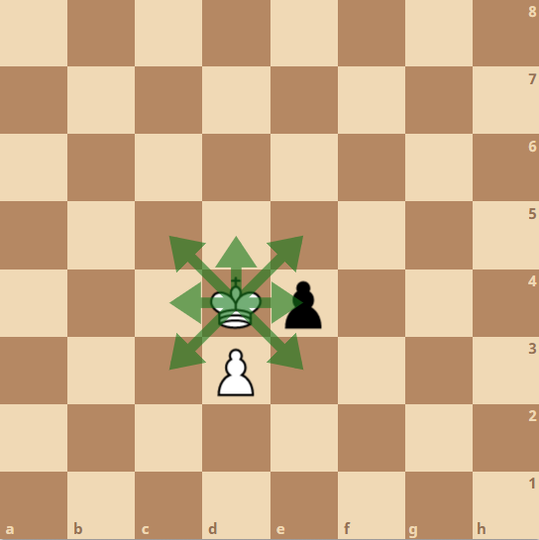

Slide 2
Fig 1.5 - knight moves
Fig 1.6 - queen moves
Fig 1.7 - king moves
Fig 1.1 – board layout
Fig 1.2 – pawn moves
Fig 1.3 – rook moves
Fig 1.2 – bishop moves

Slide 3
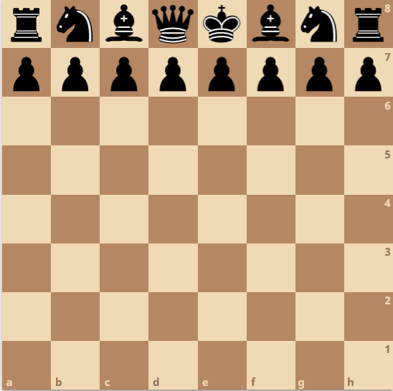
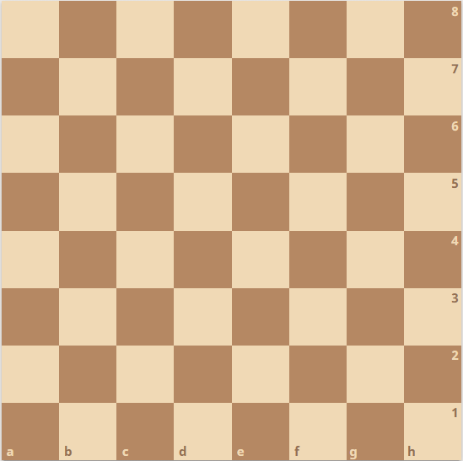
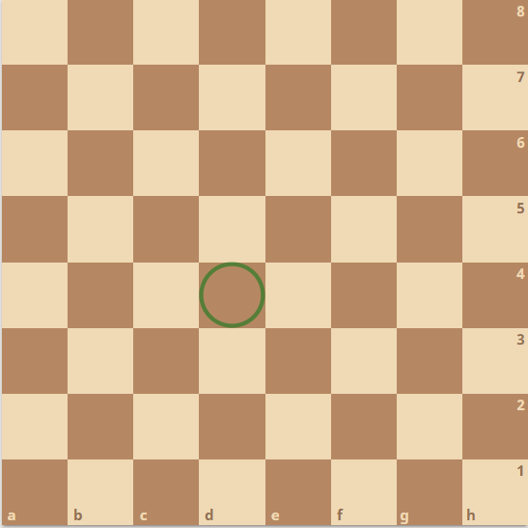
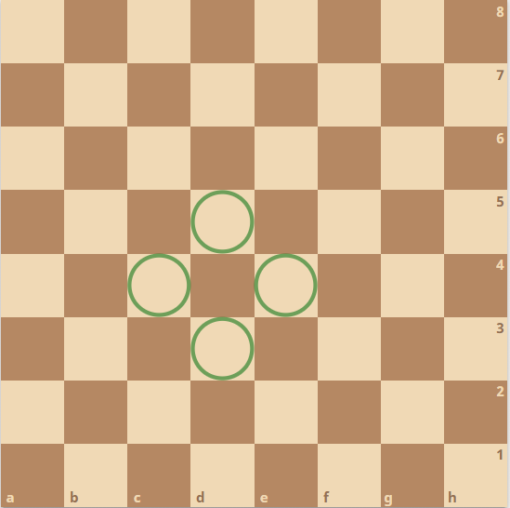
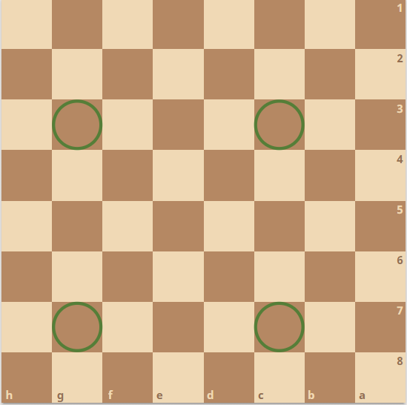
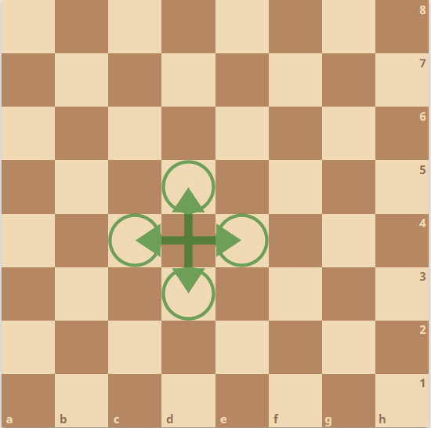
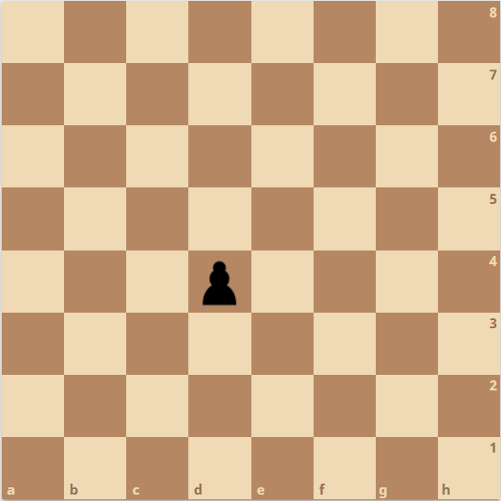
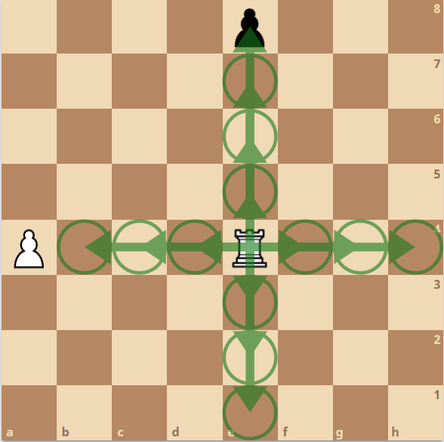
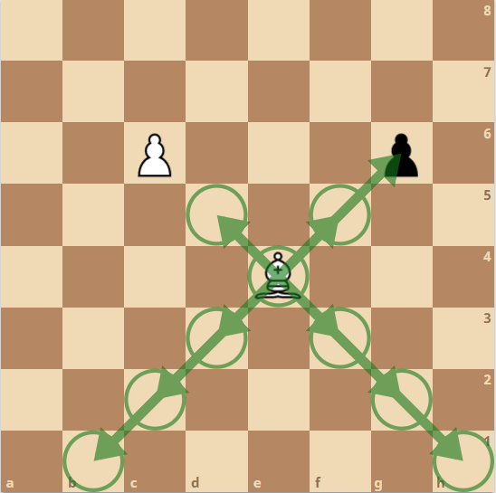
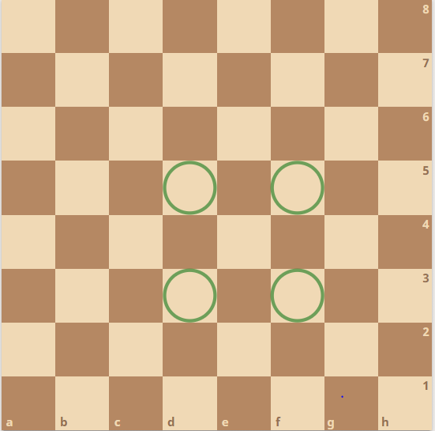
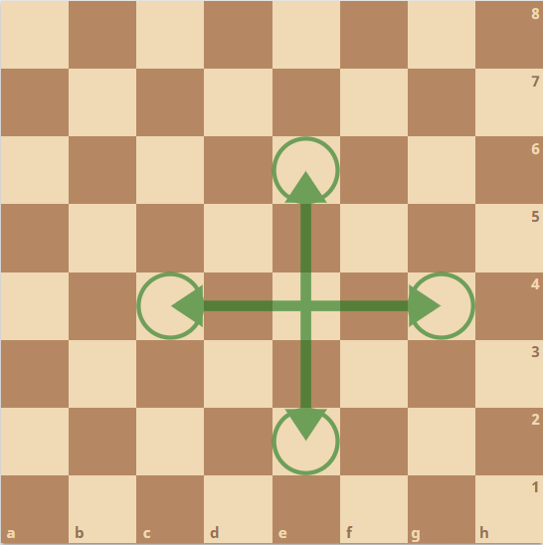
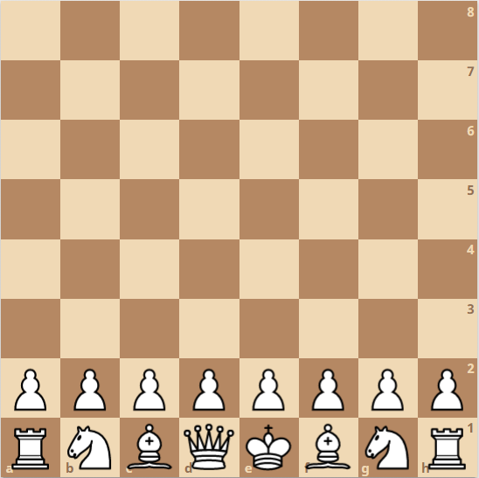
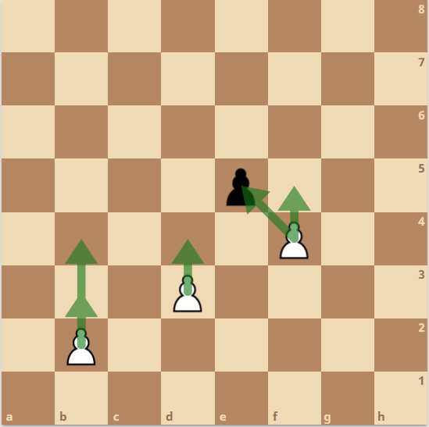
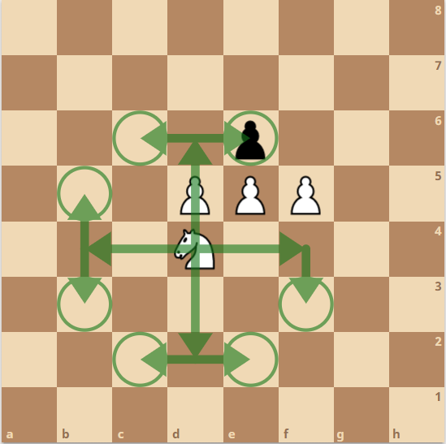

Fig 2.1 – board layout
Fig 2.2 – pawn moves
Fig 2.3 – rook moves
Fig 2.4 – bishop moves
Fig 2.5 – unicorn moves
Fig 2.6 – knight moves

Slide 4
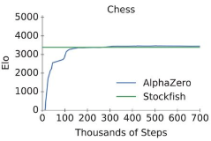
Fig 3.1 – AI skill level over time

Slide 5
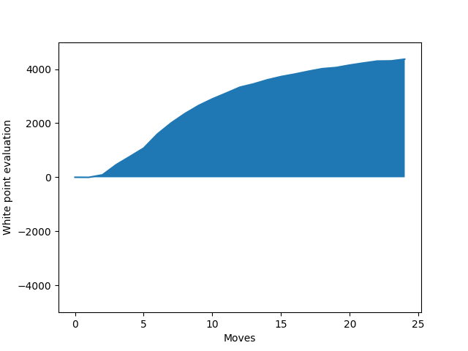
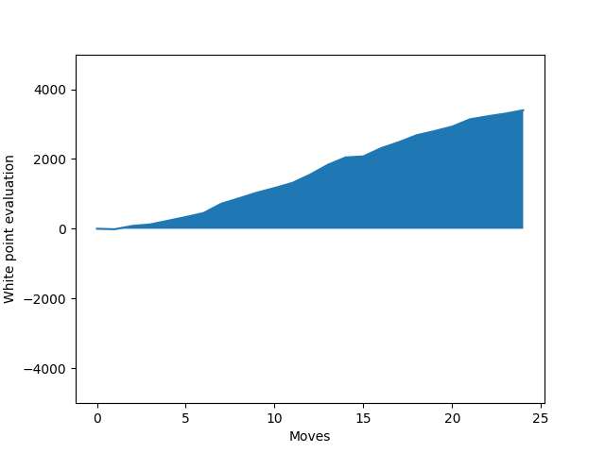
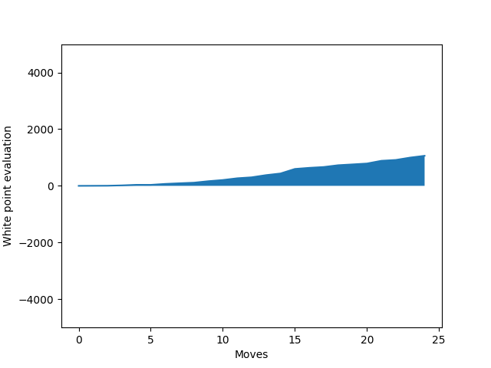
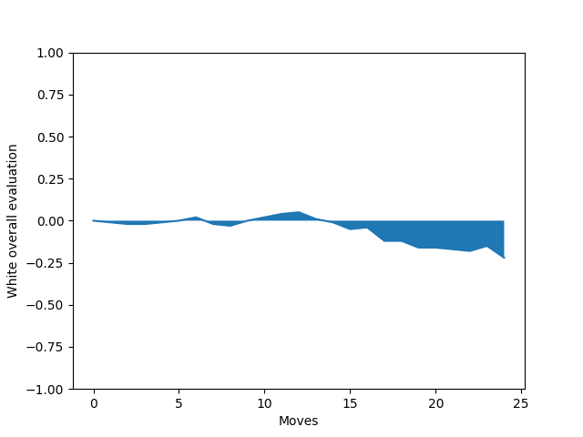
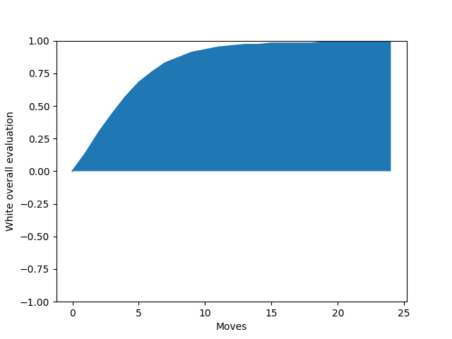
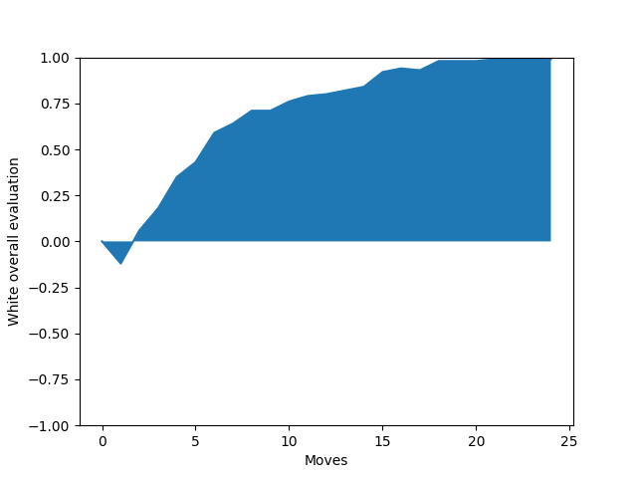
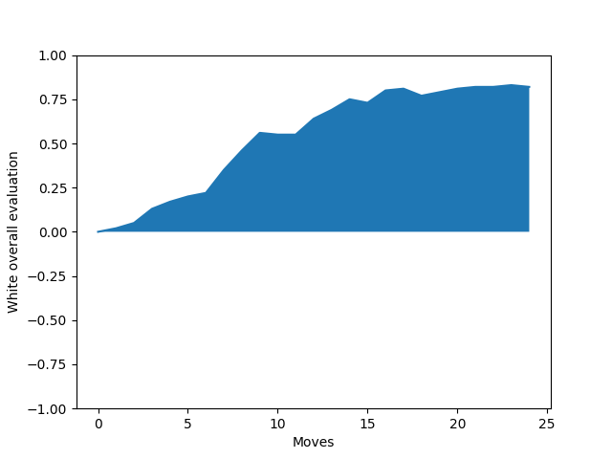
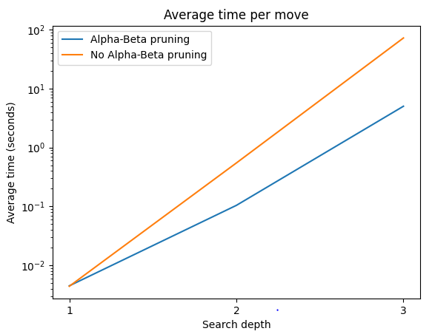
Fig 4.1 - 1 vs 0 depth - evaluation
Fig 4.3 - 2 vs 1 depth - evaluation
Fig 4.5 - 3 vs 2 depth - evaluation
Fig 4.7 – curious vs non-curious – net win %
Fig 4.2 - 1 vs 0 depth – net win %
Fig 4.4 - 2 vs 1 depth – net win %
Fig 4.6 - 3 vs 2 depth – net win %
Fig 4.8 - average time per move - logarithmic

Slide 6
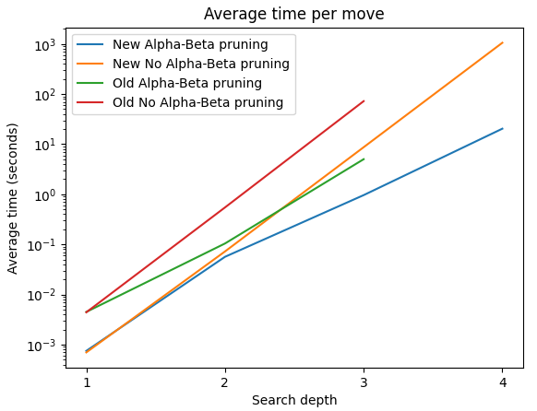
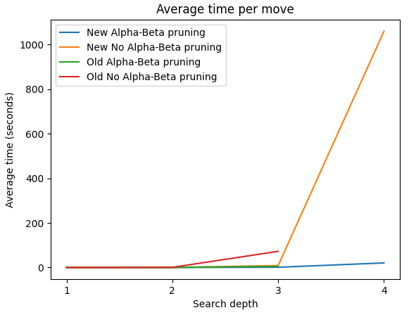
Fig 5.1 – average time per move – logarithmic scale
Fig 5.2 – average time per move – linear scale

Slide 7
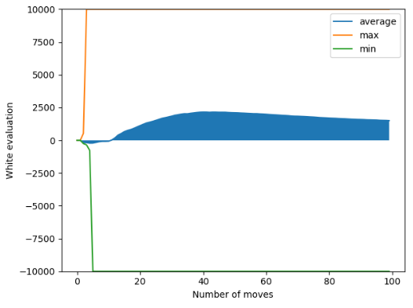
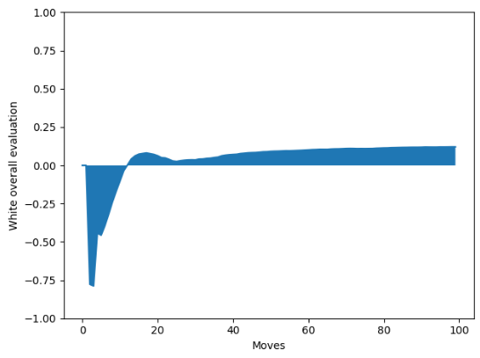
Fig 5.3 – with vs without tables - evaluation
Fig 5.4 – with vs without tables – net win %

Slide 8





- 100
- 350
- 350
- 525
- 1000
Fig 3.2 – piece values

