Slide 1

What does the Data Say about Getting the Flu Jab?
An analysis of CDC flu vaccine pediatric data.
Martin Crabtree| IS362 Final Project | May 17, 2026

Slide 2
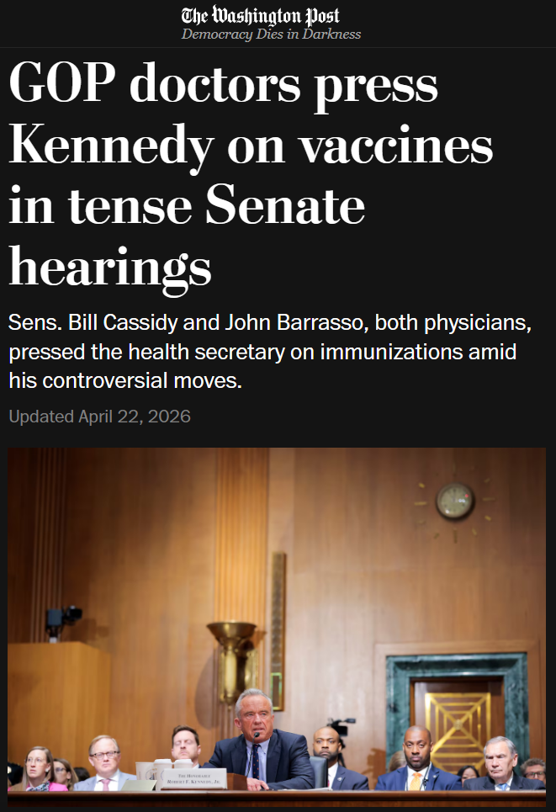
During the 2024-2025 flu season, 89% of children who died from the flu were unvaccinated.
THE DEBATE
During the April 2026 Finance Committee hearing with HHS Secretary Robert F. Kennedy Jr., Sen. Bennet noted that 89% of children who died from the flu during the 2025 flu season were unvaccinated, and the flu vaccine should be recommended for children.
HHS Secretary Robert F. Kennedy Jr., defended his decision to remove flu vaccine recommendations from the HHS website because the vaccine has an efficacy as low as 20%.
What does the CDC flu data say? Should flu vaccines be recommended for children?
Flu Vaccine Effectiveness | IS362 Final Project

Slide 3
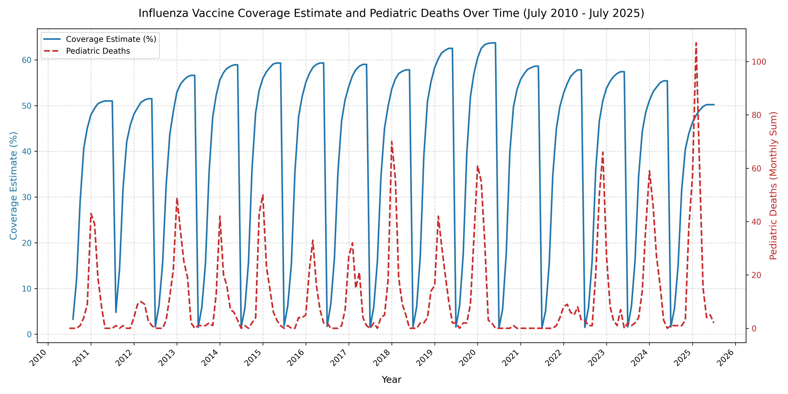
Comparing 2024-2025 to Past Flu Season Trends
50% Coverage
Pediatric deaths peak as vaccine coverage rises then drops off as reaches ~50% of the pediatric population.
15 year low
~50.2% Vaccine coverage in the 2024-2025 flu season is the lowest in 15 years.
297 deaths
Note 1: 2020-2022 saw abnormally low cases of flu due to Covid-19 pandemic precautions. Note 2: The pediatric age group is age < 18, however the flu vaccine is not given to < 6 months of age.
2024-2025 saw a total of 297 flu-associated pediatric deaths
Data retrieved from the CDC data API at https://data.cdc.gov/ & CDC FluView Interactive Dashboard https://gis.cdc.gov
Flu Vaccine Effectiveness | IS362 Final Project

Slide 4
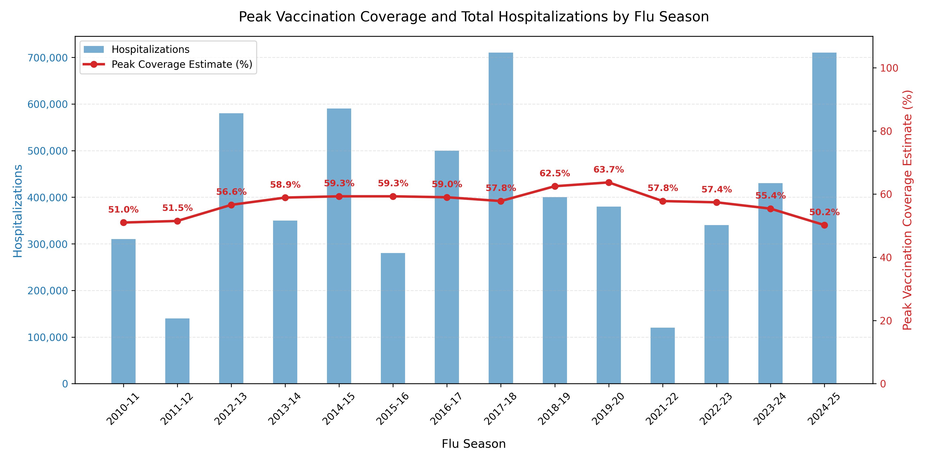
Does Flu Vaccine Coverage Impact Hospitalizations?
No…
The short answer is no. The flu vaccine does not determine flu related hospitalization rates.
Fewer Deaths
Referencing the previous slide, there are fewer deaths per hospital stay with a higher vaccination rate.
Data retrieved from the CDC data API at https://data.cdc.gov/ & CDC Flu burden data https://www.cdc.gov/flu-burden
Flu Vaccine Effectiveness | IS362 Final Project

Slide 5
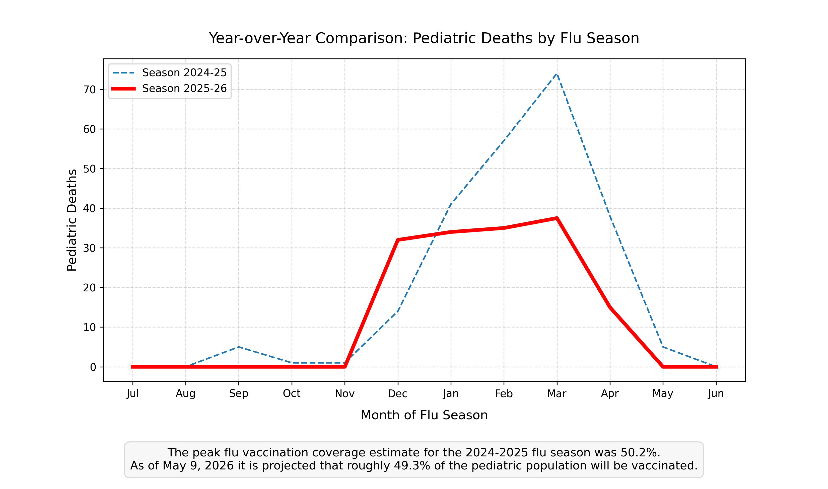
2025-2026 Preliminary Data Trends
2 Different Outcomes
Despite similar vaccination coverage, there are much fewer pediatric deaths in 2026.
How?
Two Primary factors:
Virus strain matters. Years when H1N1 and H3N2 are the dominant strain deaths tend to be higher.
The flu vaccine is different each year with variable effectiveness.
Data scraped from CDC FluView weekly reports https://www.cdc.gov/fluview
Flu Vaccine Effectiveness | IS362 Final Project

Slide 6
Who Was Correct?
RESOLUTION
Senator Bennet was correct in his statements the 2025 flu season saw the most flu related pediatric deaths within the past 15 years while also hitting a 15 year low in flu vaccination coverage.
Even though it is true that the flu vaccine can have low efficacy some years, HHS Secretary RFK Jr., did not take into account data demonstrating that the flu vaccine is effective at consistently lowering pediatric mortality rates.
During the April 2026 Finance Committee hearing with HHS Secretary Robert F. Kennedy Jr., Sen. Bennet noted that 89% of children who died from the flu during the 2025 flu season were unvaccinated, and the flu vaccine should be recommended for children.
HHS Secretary Robert F. Kennedy Jr., defended his decision to remove flu vaccine recommendations from the HHS website because the vaccine has an efficacy as low as 20%.
The data shows that the flu vaccine lowers overall pediatric influenza deaths, and should be recommended for children.
Flu Vaccine Effectiveness | IS362 Final Project

Slide 7

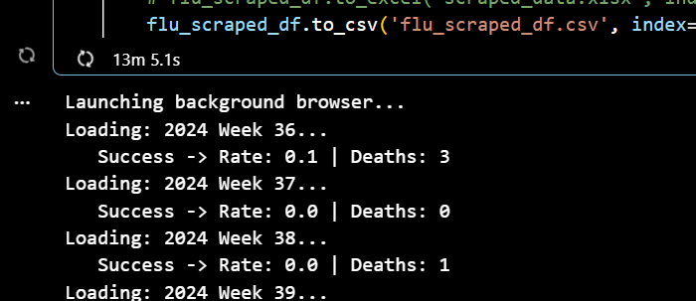
Primary Challenge: Scraping the CDC FluView weekly reports
PROJECT CHALLENGES
Client side rendering: The data for the FluView report pages load a template and then retrieve data using javascript. To fix this issue a selenium background browser is used to render the page and load the data, so that BeautifulSoup could scrape the data.
Page Inconsistencies:
Inconsistent phrasing, page format, and html structure made it difficult to target the correct element containing the data I wanted.
Older reports were rendered as a PDF, which BeautifulSoup could not parse.
Occasionally, the page would time out while attempting to retrieve data from the backend.
Slow Retrieval: Since a background browser had to load each page, it took roughly 20 minutes to scrape 2 years worth of data. Using async parallel processing would have helped, although there is probably a better solution out there.
Flu Vaccine Effectiveness | IS362 Final Project

Slide 8
Thank You!
QUESTIONS?
Project Github: https://github.com/TheMartinCrabtree/is362-final-project-flu-vaccine-data-analysis
Flu Vaccine Effectiveness | IS362 Final Project

