Slide 1

Synthetic Word Embeddings for downstream NLP Applications
Pytorch
NLP
</>
GloVE
Project ID: SCSE20-1118
Presenter: Hoang Viet
Supervisor: A/P Chng Eng Siong
Examiner: A/P Li Boyang

Slide 2
Overview
Overview
Objective: For a given unknown word, synthesize an embedding that is semantically similar to the unknown word
Existing approaches: What are the existing ways that tackle the problem of unknown words in NLP model?
Proposed Approach: Using insights from existing approaches to develop a fast and extensible framework to synthesize embedding for unknown word
</1>

Slide 3
TABLE OF CONTENTS
01.
Introduction
02.
Existing approaches
03.
System DESIGN
04.
Experiments and results
05.
Extension to ROBERTA
06.
Future Work & Conclusion
</2>

Slide 4
01.
Synthetic W0rd Embeddings
Introduction
NLP
</3>

Slide 5
01. Introduction
Word Embeddings
Word Embedding is the representation of words in the form of a real-valued vector that encodes the meaning of the word.
Words that are closer in this vector space are expected to be similar in meaning.
</4>

Slide 6
01. Introduction
Progress Timeline
1988
2003
2013
2018
Latent Semantic Analysis (LSA)
Probabilistic
Latent Dirichlet Allocation
(PLDA)
Distributional Semantics
(word2vec)
Contextual
Representation
(BERT)
</5>
Notes:
Scott Deerwester, Susan Dumais, George Furnas, Richard Harshman, Thomas Landauer, Karen Lochbaum, and Lynn Streeter were granted a patent in 1988
LDA was applied in machine learning by David Blei, Andrew Ng and Michael I. Jordan in 2003
Word2vec tomas mikolov
Jacob devlin

Slide 7
01. Introduction
Why is Word Embeddings important?
Word Embedding is how NLP model encode human text and is the input to most tasks. Its relatively low dimensionality in capturing text allow better input features to the neural model.
</6>

Slide 8
01. Introduction
Current Issues
Most NLP models have a fixed size vocabulary that is expensive to modify and expand. Unknown words are treated as out-of-vocabulary (OOV). Therefore, when new words and concepts arise, the models are unable to deal with this concept effectively.
It has been a topic of great interest in the field. ^{[1][2][3]}
1. Chen et al, 2019. Federated Learning Of Out-Of-Vocabulary Words. Retrieved from https://arxiv.org/abs/1903.10635
2. Yang, 2020. Out-of-Vocabulary Embedding Imputation with Grounded Language Information by Graph Convolutional Networks. Retrieved from https://arxiv.org/abs/1906.03753
3. Buck, 2021. Retrieved from Trajectory-Based Meta-Learning for Out-Of-Vocabulary Word Embedding Learning. Retrieved from https://arxiv.org/abs/2102.12266
</7>

Slide 9




01. Introduction
Issues
New concepts and phenomena such as
Covid-19, Pfizer, etc.
New terms, acronyms, and entities such as WFH, HBL, etc.
</8>

Slide 10
01. Introduction
Issues
It is also of practical importance that we can update the NLP model to learn concepts in specific domains.
For example:
Chatbot serving MCCY should know what is ComCare, ECDA, etc.
</9>

Slide 11
Existing approaches
</>
Subwords
We explore different existing approaches in tackling the issues of unknown words/out-of-vocabulary (OOV)
Word2vec
</10>

Slide 12
02. Existing Approaches
Motivation
Objective: For a given unknown word, give it a representation that the model can understand
</11>

Slide 13
02. Existing Approaches
Existing Approaches
In academia, there are more novel approaches involving Knowledge Graph^{[1]}, Federated Learning^{[2]} and Meta-Learning^{[3]}
The industry approach tend to focus on sub-word embeddings^{[4]}
1. Speer, Chin, 2016. An ensemble method to produce high-quality word embeddings. Retrieved from https://arxiv.org/pdf/1604.01692.pdf
2. Chen et al, 2019. Federated Learning Of Out-Of-Vocabulary Words. Retrieved from https://arxiv.org/pdf/1903.10635.pdf
3. Buck, 2021. Trajectory-Based Meta-Learning for Out-Of-Vocabulary Word Embedding Learning. Retrieved from https://arxiv.org/pdf/2102.12266.pdf
4. Seinrich,Haddow and Birch, 2015. Neural Machine Translation of Rare Words with Subword Units. Retrieved from https://arxiv.org/pdf/1508.07909v5.pdf
</12>
Notes:
1. Speer, Chin, 2016. An ensemble method to produce high-quality word embeddings. Retrieved from https://arxiv.org/pdf/1604.01692.pdf
2. Chen et al, 2019. Federated Learning Of Out-Of-Vocabulary Words. Retrieved from https://arxiv.org/pdf/1903.10635.pdf
3. Buck, 2021. Retrieved from Trajectory-Based Meta-Learning for Out-Of-Vocabulary Word Embedding Learning. Retrieved from https://arxiv.org/pdf/2102.12266.pdf

Slide 14
02. Existing Approaches
Subword Embeddings
Decompose an unknown words into meaningful subwords
For example: beautifully → beauty + #ful + #ly
Popular methods: BPE, Sentencepiece
Many have studied the efficacy of BPE in handling unknown words ^{[1][2]}
✔ Good for morphologically related words
❌ Bad for other OOV
Kudo, 2018. Subword Regularization: Improving Neural Network Translation Models with Multiple Subword Candidates. Retrieved from https://arxiv.org/pdf/1804.10959.pdf
Shapiro, 2018. BPE and CharCNNs for Translation of Morphology: A Cross-Lingual Comparison and Analysis. Retrieved from https://arxiv.org/pdf/1809.01301.pdf
</13>
Notes:
Kudo, 2018. Subword Regularization: Improving Neural Network Translation Models with Multiple Subword Candidates. Retrieved from https://arxiv.org/pdf/1804.10959.pdf
Shapiro, 2018. BPE and CharCNNs for Translation of Morphology: A Cross-Lingual Comparison and Analysis. Retrieved from https://arxiv.org/pdf/1809.01301.pdf

Slide 15
02. Existing Approaches
Knowledge Graph
Introduced by Robyn Speer and Joshua Chin, ConceptNet 5.5 uses open-source knowledge graph to derive new embedding for unknown words
</14>

Slide 16
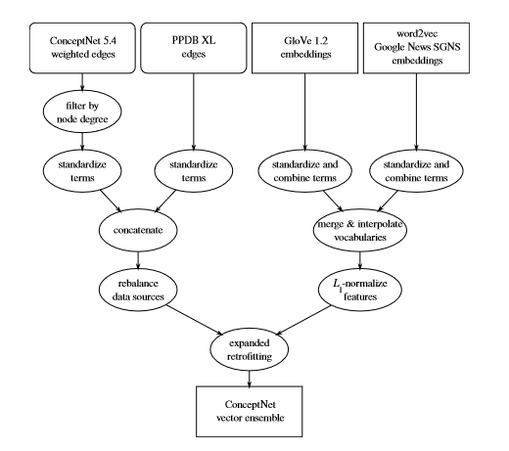
02. Existing Approaches
</15>
Reference: Speer, Chin, 2016. An ensemble method to produce high-quality word embeddings. Retrieved from https://arxiv.org/pdf/1604.01692.pdf
Notes:
Our goal is to create a 300-dimensional vector space that represents terms based on a combination of GloVe and word2vec’s downloadable embeddings, and structured data from ConceptNet andPPDB. The resulting vector space allows information to be shared among these various representations, including words that were not in the vocabulary of the original representations.
KG – ConceptNet and PPDB edges:
“retrofitting”, which combines embeddings learned from the distributional semantics of unstructured text with a source of structured connections between words.

Slide 17
02. Existing Approaches
Knowledge Graph
Introduced by Robyn Speer and Joshua Chin, ConceptNet 5.5 uses open-source knowledge graph to derive new embedding for unknown words
✔ High in interpretability
❌ Complex to implement in practical settings
</16>

Slide 18
02. Existing Approaches
Recursive neural network
Introduced by Thang Luong, Richard Socher, and Christopher Manning, the RNN build representations for morphologically complex words from their morphemes.
The architecture is also called MorphoRNN
</17>

Slide 19
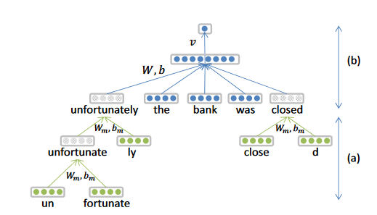
02. Existing Approaches
p= f(Wm[xstem; xaffix] + bm)
</18>
Reference: Luong, Socher and Manning, 2013. Better Word Representations with Recursive Neural Networks for Morphology https://aclanthology.org/W13-3512/
Notes:
the morphological RNN, which constructs representations for words from theirmorpheme
he word-based neural language which optimizes scores for relevant ngrams

Slide 20
02. Existing Approaches
Recursive neural network
Introduced by Thang Luong, Richard Socher, and Christopher Manning, the RNN build representations for morphologically complex words from their morphemes.
✔ Systematic way of estimating rare words
❌ Context-sensitivity is not done in morphoRNN
</19>

Slide 21
02.
Our approach
Studies show skip-gram vectors exhibit linear additive compositionality^{[1]}
Words are defined by their neighbors (word2vec paradigm)
→ Use a neural network to compose the new meaning of a word using neighboring words
</20>
[1] Seinrich, Haddow and Birch, 2015. Skip-Gram – Zipf + Uniform = Vector Additivity. Retrieved from https://arxiv.org/pdf/1508.07909v5.pdf

Slide 22
02.
Our Approach
Objective: for a given unknown word, synthesize a word embedding that is semantically similar
Application: yield a better representation for a given word for different NLP models
Methodology: use a feed forward neural network that input context words’ embeddings and output the target word’s embedding
</21>

Slide 23
System Design
//
Pytorch
</22>

Slide 24
03. System Design
Synthetic Embedding Generation System
Implementation
Architectural Choices
Training
Generation
Embedding Type
Data Corpus
Network Architecture
</23>

Slide 25
03. System Design
Design - Training
For a given unknown word:
Define target words that are semantically similar
Gather context words from existing corpus
Train the neural network in word2vec manner
</24>

Slide 26
03. System Design
Design - Generation
Gather context words from online corpus
Use the trained model to synthesize the synthetic embedding for this given OOV
</25>

Slide 27
03. System Design
Embedding Choice
There are multiple embedding choices, such as BERT, GloVe and their variants
GloVe 100 was chosen for its ease of implementation, and remarked by Abigail See in Stanford NLP Master Course CS244n that it is “largely useful for most practical cases”
</26>

Slide 28
03. System Design
Data Corpus
The chosen corpus are:
Wiki-Text
Gigaword
This was inspired by the fact that GloVe was trained on these two corpora.
</27>

Slide 29
03. System Design
Network Architecture
The model has the following specifications:
Input: n x embed_size
Output: 1x embed_size
Therefore, 1D Convolution Neural Network (CNN) or Feed Forward Neural Network (FFNN) are suitable candidates. For this project, FFNN was chosen.
</28>

Slide 30
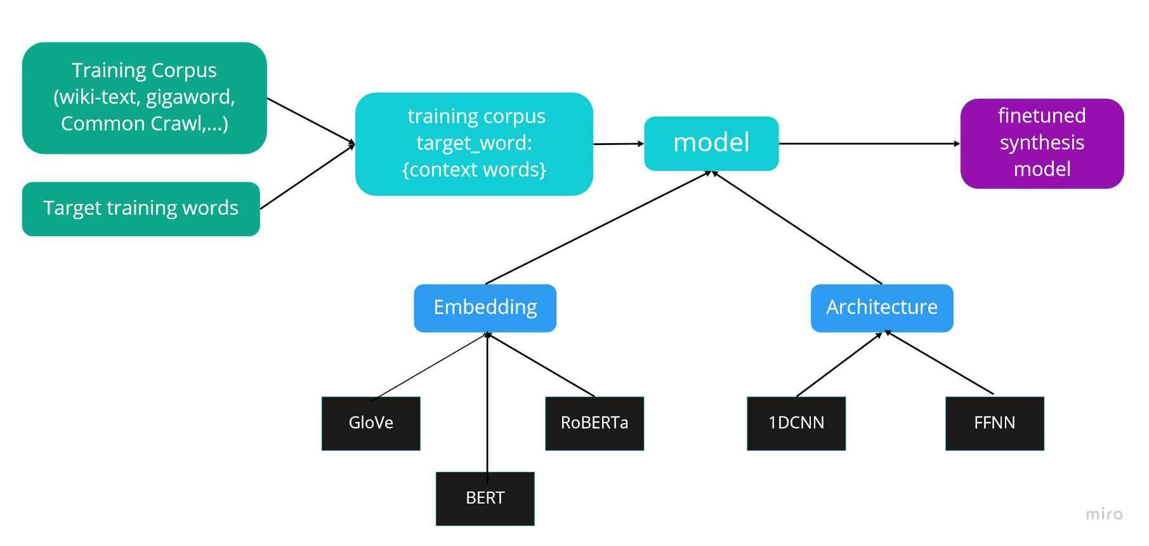
03. System Design
Training Pipeline
</29>

Slide 31
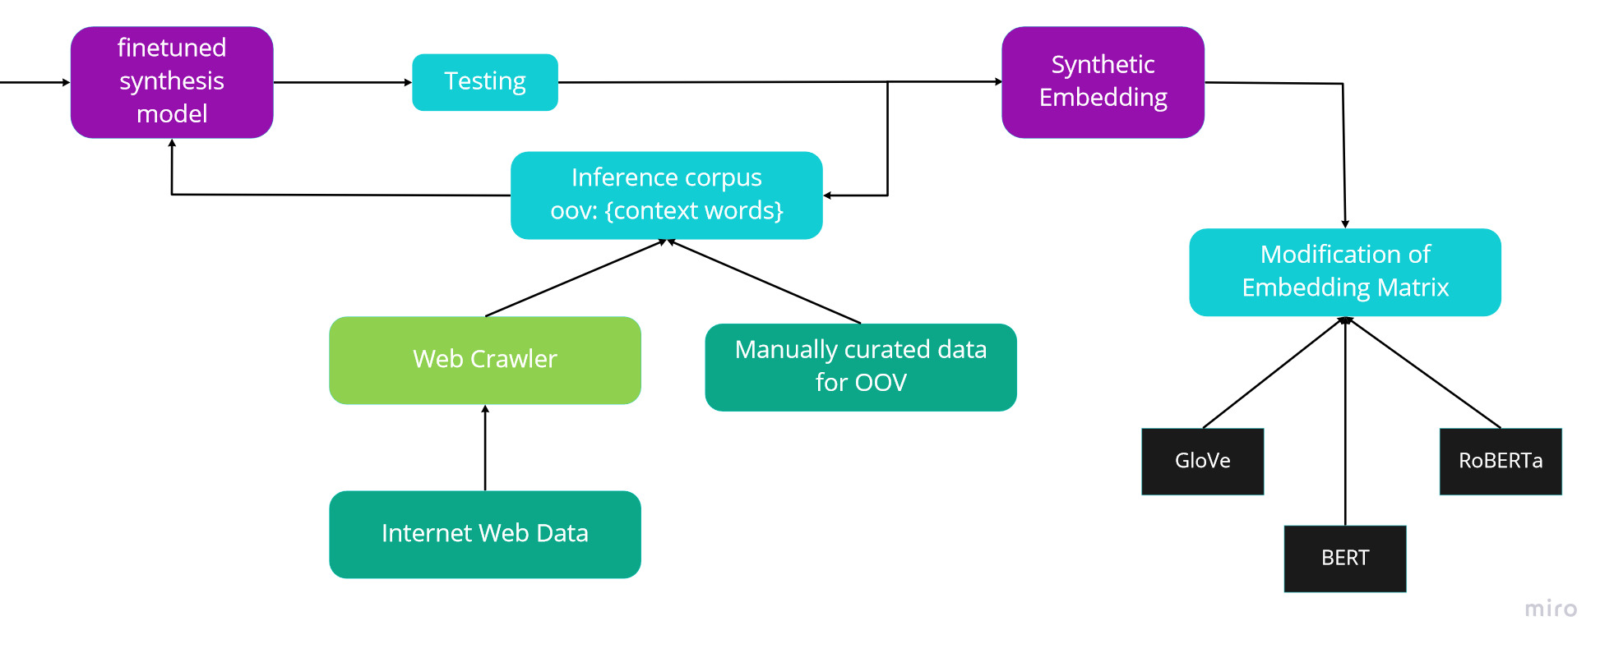
03. System Design
Deployment Pipeline
</30>

Slide 32
03. System Design
Training Parameters
Architecture | Fully Connected
Number of layers | 2
Input and Output dimension | Parameterized
Context Length | 10
Optimizer | SGD
Learning Rate | 0.0005
Batch size | 64
Epoch | 50
</31>
Notes:
Many of the parameters were advised by the MICL people. Many thanks to Ly and Nga

Slide 33
03. System Design
Framework Used
Code
PyTorch
Data
Local Hosting
Monitoring
WandB
</32>

Slide 34
Experiments Results
</33>

Slide 35
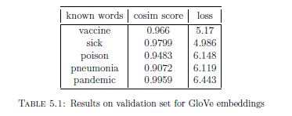
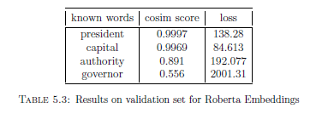
04. Experiments Results
Analogy Results on new concepts
COVID-19
Diseases, illnesses, infection, virus, cancer
Pfizer
Vaccine, vaccines, vaccination, polio, flu
</34>

Slide 36
04. Experiments Results
Efficiency
Data preprocessing takes 1 hour on WikiText and 2 hours on Gigaword
Training Time takes on average 15 minutes per experiment, with hyperparameter as specified earlier
</35>

Slide 37
04. Experiments Results
Practicality in Production settings
Light-weight ✔ - all experiments are run on personal computer
Extensible ✔ - embedding size is parameterized
Fast ✔ - whole training pipeline takes less than a day
</36>

Slide 38
04. Experiments Results
Limitations
It is assumed that existing corpus has sufficient training data
Training target was limited and has to be manually specified
Lack of cross-lingual capability
</37>

Slide 39
Extension to Roberta
</>
HTML
</>
SYN
C++
ROBERTA
</38>

Slide 40
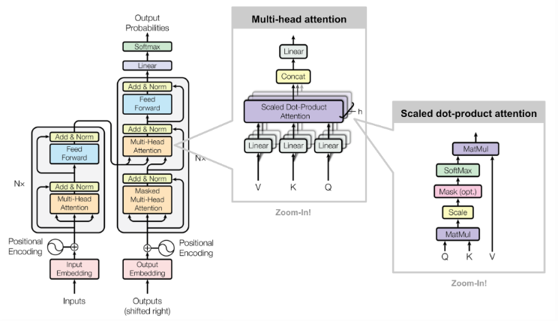
05. RoBERTa Extension
</39>

Slide 41
05. RoBERTa Extension
Modification Pipeline
Store a copy of the Embedding Weights
Add the new word into the tokenizer
Resize the embedding layer
Overwrite the embedding weights with (existing weights ⊕ synthetic embedding)
Save the new model
</40>

Slide 42
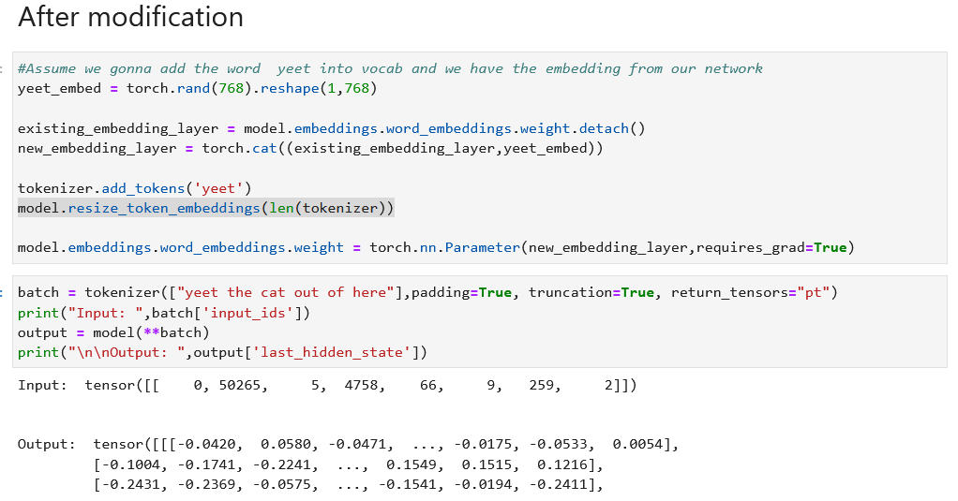
05. RoBERTa Extension
</41>

Slide 43
Future work & Conclusion
</42>

Slide 44
06. Future Works and Conclusion
Summary
✔ Create a lightweight framework to synthesize embedding for unknown words
✔ Demonstrate its capability in a Proof-of-concept scope
</43>

Slide 45
06. Future Works and Conclusion
Future Work
🔍 Improve the data selection process and data volume
🔍 Explore Cross-lingual properties of the synthetic embeddings
</44>

Slide 46
06. Future Works and Conclusion
Takeaways
🙇 Identify and scope a problem that is affecting NLP applications in production, hypothesize and brainstorm the solution to that problem
🙇 Explore the various candidate for each aspect of the solution framework and select the most viable option
🙇 Create a minimum-viable-product for that solution
</45>

Slide 47
Thank you!
QnA

Slide 48
ICONS

