Slide 1
Introduction to Java Variables and Data Types

Slide 2
Student Learning Objectives
TClark

Slide 3
TClark
Student Learning Objectives
By the end of this lesson, you should be able to:
Explain what a data type is
Declare variables using meaningful identifiers
Be familiar with Java’s 8 primitive data types
Invoke printf passing different data types as arguments
Know 62 ASCII values

Slide 4
TClark
Variables in Java
A variable is a storage location for a specified type of value.
Every variable must be declared before it is used.
Java is a strongly typed language and as such we can’t haphazardly intermix types in Java.
A Java variable can only store the declared type of data.
4 general categories – Instance Variables, Class Variables, Local Variables and Parameters.
Notes:
Variables are bound to specific data types in Java.

Slide 5
TClark
What is a Variable?
int speedLimit = 75;
double salesTax = 8.25;
char grade;
grade = 'A';
speedLimit
salesTax
grade
75
8.25
‘A’
Notes:
A variable is a storage location for a value.
Primitive data types store the value in that location.
Standard Java Naming Conventions
The list below outlines the standard Java naming conventions for each identifier type:
Packages: Names should be in lowercase. With small projects that only have a few packages it's okay to just give them simple (but meaningful!) names: package pokeranalyzer package mycalculator In software companies and large projects where the packages might be imported into other classes, the names will normally be subdivided. Typically this will start with the company domain before being split into layers or features: package com.mycompany.utilities package org.bobscompany.application.userinterface
Classes: Names should be in CamelCase. Try to use nouns because a class is normally representing something in the real world: class Customer class Account
Interfaces: Names should be in CamelCase. They tend to have a name that describes an operation that a class can do: interface Comparable interface Enumerable Note that some programmers like to distinguish interfaces by beginning the name with an "I": interface IComparable interface IEnumerable
Methods: Names should be in mixed case (Lower CamelCase). Use verbs to describe what the method does: void calculateTax() string getSurname()
Variables: Names should be in mixed case (Lower CamelCase). The names should represent what the value of the variable represents: string firstName int orderNumber Only use very short names when the variables are short lived, such as in for loops: for (int i=0; i<20;i++) { //i only lives in here }
Constants: Names should be in uppercase. static final int DEFAULT_WIDTH static final int MAX_HEIGHT

Slide 6
TClark
Identifiers
Everything we refer to in a program must have a name. For example, variables, classes, objects, methods, etc., must all have names. Those names are officially called identifiers.
An identifier is used to identify something.
public class Student{ }
int weight = 150;
double gpa = 4.0;
[a-zA-Z_$£¥€] [a-zA-Z_$£¥€0-9]*
Notes:
Everything we refer to in a program, such as variables, classes, objects, and the like have names assigned to them. Those names are called identifiers, and identifiers must follow certain rules to be considered a legal identifier.
An identifier can be composed of any number of Unicode letter characters, e.g: a..z, any number of Unicode digits characters, e.g: 0..9, any number of dollar signs: $, and any number of the special character underscore: _. However; an identifier cannot start with a digit. Note that Java makes use of Unicode for identifier names so that identifiers can be named using a non-ASCII (non-English) alphabet.
You cannot use java keywords and identifiers are case sensitive.

Slide 7
TClark
Identifiers
Properties of valid identifiers | Properties of invalid identifiers
Unlimited length | Starts with a digit [0-9]
Starts with a letter [a-zA-Z], a currency sign or an underscore [ _ ] | Same as a reserved word
Can use a digit(not at start) | Uses special characters(i.e. !, @, #, %, ^, etc.)
Can use a currency sign: $, £, ¥, € etc.
Can use an underscore at any spot
Notes:
Use identifier names that are clear and informative.
The name totalPay seems to indicate the variable will store the total pay amount for someone or something.
double nationalDebt;
char firstLetterOfLastName;
long buildingHeight;
public class BlinkyBall{}
public class BlackJack{}

Slide 8
TClark
Legal or !Legal?
Which of the following identifiers are
legal and which or not legal?
hourlySalary
Legal
3inchDisc
!Legal
Cannot begin with numbers
bike4Sale
Legal
Spring Sale
!Legal
Cannot contain spaces
Spring_Cleaning
Legal
$System_Var
Legal
class
!Legal
Cannot use keywords
Cypress-Ranch
!Legal
Cannot contain a hyphen –
Only letters, digits, $, and _

Slide 9
TClark
Primitive Data Types
A data type consists of a set of values and the operations permissible on those values
Java has 8 built-in primitive data types that are predefined in the language and named by a reserved word
Variable types that can store integers – byte, short, int and long
Variable types that can store real numbers – float and double
character type - char
boolean type - boolean
Notes:
When defining a variable, a data type must be provided. The data type describes what will be stored in the variable. A variable can be thought of as a box where things will be stored. The data type states what kind of things can be placed in the box.
byte, short, int, and long can store non-decimal positive numbers, zero, and negative numbers (integers).
float and double can store decimal positive numbers, zero, and negative numbers (real numbers).
What do I mean primitive or built-in data types? Every object in Java is a child of java.lang.Object. However, everything in Java is NOT an object, contrary to what you might hear. The following lists the entities in Java that are not (currently) objects:
primitives and references
fields (the fields themselves not the contents)
local variables and parameters
generic classes (that may change in Java 8)
methods (that will change in Java 8)
blocks of code (that will change in Java 8)
The primitive or built-in data types are defined as simple data types (non-objects) to reduce the overhead in working with them during “normal” program execution. However, sometimes we have to work with primitive types as objects (for example while using a generic method). In those cases, we use the wrapper classes for the primitive data types (Byte, Short, Integer, Long, Float, Double, Character, and Boolean).

Slide 10
TClark
Range of Primitive Data Types
Type | Bits | Range
byte | 8 | -128 to 127
short | 16 | -32768 to 32767
int | 32 | -2147483648 to 2147483647
long | 64 | -9223372036854775808 to +9223372036854775807
float | 32 | 1.40129846432481707e-45 to 3.40282346638528860e+38 (positive or negative)
double | 64 | 4.94065645841246544e-324 to 1.79769313486231570e+308 (positive or negative)
char | 16 uns | 0 to 65535
boolean | JVMD | true or false
Notes:
Not only does the data type specify the TYPE of data the variable can store, but also the AMOUNT of that type of data the variable can store. You should familiarize yourself with the data types and their ranges.
The number of bits each primitive data type uses is shown in the table with the exception of the Boolean data type, which is Java Virtual Machine dependent. The JVM may use 1 bit, 1 byte, one word, or a double-word. Most likely, it takes the basic word size of the underlying hardware (32 or 64 bits). The reason for this is that it is easier (and thus quicker) for the JVM to manipulate a word, than it is to extract a bit and process it.

Slide 11
Integer Data Types
TClark

Slide 12
TClark
Integer Data Types
Integers
byte
short
int
long
1 byte
2 bytes
4 bytes
8 bytes

Slide 13
TClark
Integers
byte score = 95;
short trip = 250;
int population = 2_000_000;
long bezosWorth = 65_000_000_000L;
out.printf("%d\n", score);
out.printf("%d\n", trip);
out.printf("%d\n", population);
out.printf("%d\n", bezosWorth);
95
250
2000000
65000000000
Notes:
Java treats all numeric constants (hard-coded numbers) that don’t have decimal points as integers. If you attempt to specify a numeric constant that is greater than Integer.MAX_VALUE (2147483647 in our case), you must tell Java the numeric constant is a long not an integer, otherwise you will receive a integer number too large error.
You must append an L or l (lowercase L) to an integer that is larger(positive or negative) than an int. Please don’t use the lowercase variety as this is extremely difficult to distinguish from a 1.

Slide 14
TClark
Integers
Integer types can store integer values only.
Integer types cannot store fractional / decimal values. Attempting to assign fractional / decimal values to an integer type results in a loss of precision compile error.
int weight = 155.5;
out.println(weight);
Error: incompatible types: possible lossy conversion from double to int

Slide 15
Real Data Types
TClark

Slide 16
TClark
Real Data Types
Floating Point
float
double
4 bytes
8 bytes
Notes:
Real data types can receive real (decimal numbers) or integer numbers. When you print out a real data type a decimal point is included by default. You can drop the decimal point using printf, or by casting the real to an integer prior to printing it, but by default a decimal point will appear.
Java treats all numeric constants (hard-coded numbers) that have decimal points as doubles. If you attempt to assign a double to a float variable, you will receive a loss of precision error (LOP Error). You must cast the number prior to the assignment, for example (float) 92.78, or add a f to the end of the number 92.78f.

Slide 17
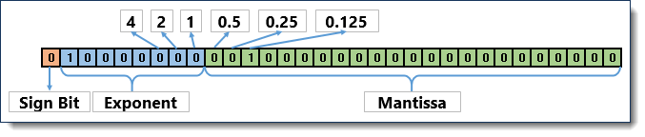
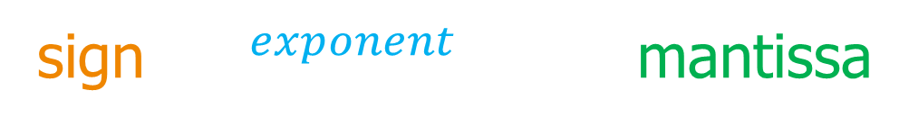
TClark
Real Data Types
sign * $2^{exponent−127}$ * mantissa

Slide 18
TClark
Real Data Types
float gpa = 3.9f;
float score = 98.7F;
double avg = 88.3;
double pi = 3.14d;
double sci_notation = 1.2345e3;
out.printf("%f\n", gpa);
out.printf("%.2f\n", score);
out.printf("%.2f\n", avg);
out.printf("%.2f\n", pi);
out.println(sci_notation);
3.900000
98.70
88.30
3.14
1234.5
Notes:
Real / decimal types (float, double) can store non-decimal values as well as decimal values.
double example = 456;
example = 456.323;
We can add the suffix d or D to end the floating type value but it’s redundant and nobody does. That is, both 19.67 and 19.67d are the same.
What’s the difference between a double and float ?
double has 2x more precision then float and takes 2x more memory
float has 7 decimal digits of precision and requires 3 bytes.
double has 15 decimal digits of precision and requires 4 bytes.
double is the default

Slide 19
Character Data Type
TClark

Slide 20
TClark
Character Data Type
The data type is a single 16-bit unicode character. It has a minimum value of 0 (‘\u0000’) and a maximum value of 65,535 (‘\uffff’)
char grade = 'A';
char alt = 65;
char lower = 'a';
char low_alt = 97;
char zero = '0', zero_alt = 48;
out.printf("%c %c\n", grade, alt);
out.printf("%c %c\n", lower, low_alt);
out.printf("%c %c\n", zero, zero_alt);
A A
a a
0 0
Notes:
A character data type is used to store a single character (a Unicode character). Character data types can store an unsigned integer value in the range 0 through 65535. You can use a character data type to store integer numbers within that range if, for some crazy reason, you wanted to do so, but when you print a character out, the equivalent Unicode character will be printed, not the integer (unless of course you cast the character to an integer before printing it).
In 1996, a surrogate character mechanism was implemented in Unicode 2.0, so that Unicode was no longer restricted to 16 bits. This increased the Unicode codespace from 65,536 code points to 1,112,064 code points, which allowed for the encoding of many historic scripts (e.g. Egyptian Hieroglyphs) and thousands of rarely used or obsolete characters that had not been anticipated as needing encoding in the original Unicode specification. This created the need for a variable length encoding scheme (for efficiency) in which, most of the time (about 98%), Unicode characters are encoded with 16 bits in Plane 0 (the Basic Multilingual Plane or BMP), and the other two percent of the time, Unicode characters are encoded with two chars (32 bits, in which 11 bits are unused, or used by the encoding scheme for purposes other than character mapping) in one of the other 16 planes - mostly in planes 1 and 2 (planes 3-13 are unused, plane 14 is for supplementary special purposes, and planes 15 and 16 are for private use). For additional information on Mapping of Unicode Characters, visit this link: http://en.wikipedia.org/wiki/Mapping_of_Unicode_graphic_characters

Slide 21
TClark
Character Data Type
grade has a 16 bit pattern 0000000001000001
char upper = 65;
char lower = 97;
char zero = 48;
String f = "'%c'- %d\n";
printf("VALUES to KNOW\n");
printf(f, upper, (int)upper);
printf(f, lower, (int)lower);
printf(f, zero, (int)zero);
printf("62 in total\n");
VALUES to KNOW
'A'- 65
'a'- 97
'0’- 48
62 in total
Notes:
Everything in a computer is stored as 1’s and 0’s (even the characters displayed on the screen). Each character in Java is represented by a 16-bit unsigned integer. That makes it possible to store 65535 unique characters in each of Unicode’s character encodings.
For Geeks Only:
UTF-8 is most common on the web. UTF-16 is used by Java and Windows. UTF-8 and UTF-32 are used by Linux and various Unix systems. The conversions between all of them are algorithmically based, fast and lossless. This makes it easy to support data input or output in multiple formats, while using a particular UTF for internal storage or processing.
In Java, Strings are stored in UTF-16 format with a BOM (Byte order Mark of FE FF (254, 255)). The first two bytes of every string in Java contain 254, 255. You have to convert the string to a byte array and specify UTF-16 encoding in order to see the first two bytes. I can provide you some code to do so if you are interested.
UTF-16 is better where ASCII is not predominant, it uses 2 bytes per character primarily and is capable of encoding all 1,112,064 possible codpoints. Do what???, yeah I know. If you want to use characters outside of the BMP (Basic Multilingual Plane 0000-FFFF) UTF-16 can use two 16-bit code units to represent characters, giving 32 bits, but D800 thru DFFF are reserved as the surrogate pair (to allow a smaller space to store more characters), thus we end up with the ability to encode the entire Unicode codespace as characters (code points in the range 0_{hex} to 10FFFF_{hex} or 1,114,112 characters; however we loose 2048 possible characters to the surrogate pair). But you may be asking if 32-bits can store over 4 billion characters, why not just use a straight 32-bit encoding scheme? Read the UTF-8 description below to find out why. Originally Java used UCS-2, which was a nice fixed-length 16-bits. Of course, 16bit turned out not to be enough, so the Java gods retrofitted UTF-16 in on top. UTF-16 extends UCS-2, using one 16-bit unit for the characters that were representable in UCS-2 and two 16-bit units (4 × 8 bit) to handle each of the additional characters.
UTF-8 will start to use 3 or more bytes for the higher order characters where UTF-16 remains at just 2 most of the time. UTF-32 will cover all possible characters in 4 bytes each which makes it pretty bloated; there is no advantage to using it.
UTF-8
The design of UTF-8 was proposed by Dave Prosser and subsequently modified (on the back of a placemat in a diner) by Ken Thompson and Rob Pike.
The UTF-8 spec in non-geek English:
First byte starts with 110 (indicating start of a two byte sequence), second byte starts with 10 (indicating a continuation byte)
110xxxxx 10xxxxxx 11 bits (the x’s) represent bits (up to 2047 unique characters) 2¹¹ - 1 = 2047
If you want more than 2047 characters - add a third byte:
First byte starts with 1110 (indicating start of a three byte sequence), second, and third bytes start with 10 (indicating a continuation byte)
1110xxxx 10xxxxxx 10xxxxxx 16 bits (the x’s) represent bits (up to 65535 characters) 2¹⁶ - 1 = 65535
If you want more than 65535 characters - add a fourth byte and so on.
The UTF-8 spec allows you to go all the way to:
1111110x (indicating start of a six byte sequence), which provides 6x5 + 1 = 31 bits (up to 2,147,483,647 characters) 2³¹ - 1 = 2147483647
The spec ensures:
1. Backwards compatibility with ASCII
2. Efficiency (only uses the number of bytes per character needed)
3. We never send 8 zeros in a row (which indicates communication termination in old systems - null)
UTF-16
UTF-16 is a 16-bit encoding form that encodes characters either as a single 16-bit code unit or as a pair of 16-bit code units, as follows:
Codepoint range Number of UTF-16 code units
U+0000..U+D7FF one
U+D800..U+DFFF none (reserved—no characters assignable)
U+E000..U+FFFF one
U+10000..U+10FFFF two: one high surrogate followed by one low surrogate
Every implementation of the Java platform is required to support the following standard charsets.
Charset Description
US-ASCII Seven-bit ASCII, a.k.a. ISO646-US, a.k.a. the Basic Latin block of the Unicode character set
ISO-8859-1 ISO Latin Alphabet No. 1, a.k.a. ISO-LATIN-1
UTF-8 Eight-bit UCS Transformation Format
UTF-16BE Sixteen-bit UCS Transformation Format, big-endian byte order
UTF-16LE Sixteen-bit UCS Transformation Format, little-endian byte order
UTF-16 Sixteen-bit UCS Transformation Format, byte order identified by an optional byte-order mark (Java uses this internally to convert byte streams into characters)
Java 6 (and later) implementations are only required to support six encodings (US-ASCII; ISO-8859-1; UTF-8; UTF-16BE; UTF-16LE; UTF-16). In practice, they tend to support many more.

Slide 22
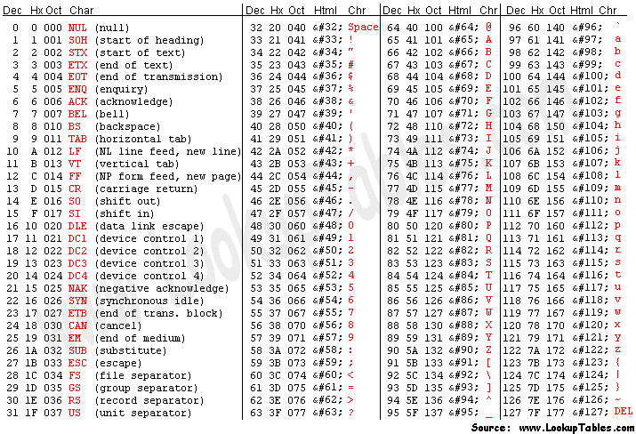
TClark
ASCII Character Set
Notes:
A more readable ASCII chart (for people not comfortable reading Hex).
The following is a more detailed description of the first 32 ASCII characters, often referred to as control codes. For a more detailed discussion of control codes, visit this link: http://www.cs.tut.fi/~jkorpela/chars/c0.html.
NUL (null)
SOH (start of heading)
STX (start of text)
ETX (end of text)
EOT (end of transmission) - Not the same as ETB
ENQ (enquiry)
ACK (acknowledge)
BEL (bell) - Caused teletype machines to ring a bell. Causes a beep in many common terminals and terminal emulation programs.
BS (backspace) - Moves the cursor (or print head) move backwards (left) one space.
TAB (horizontal tab) - Moves the cursor (or print head) right to the next tab stop. The spacing of tab stops is dependent on the output device, but is often either 8 or 10.
LF (NL line feed, new line) - Moves the cursor (or print head) to a new line. On Unix systems, moves to a new line AND all the way to the left.
VT (vertical tab)
FF (form feed) - Advances paper to the top of the next page (if the output device is a printer).
CR (carriage return) - Moves the cursor all the way to the left, but does not advance to the next line.
SO (shift out) - Switches output device to alternate character set.
SI (shift in) - Switches output device back to default character set.
DLE (data link escape)
DC1 (device control 1)
DC2 (device control 2)
DC3 (device control 3)
DC4 (device control 4)
NAK (negative acknowledge)
SYN (synchronous idle)
ETB (end of transmission block) - Not the same as EOT
CAN (cancel)
EM (end of medium)
SUB (substitute) ESC (escape)
FS (file separator)
GS (group separator)
RS (record separator)
US (unit separator)
So why does ASCII start with control codes, instead of just having character 0 be a capital A? ASCII developed from telegraphic codes. Its first commercial use was as a seven-bit teleprinter code promoted by Bell data services. It was more important to control the device than to get the message correct because without control, there is no message; so apparently the engineers were focused on control codes, not letter codes. Work on the ASCII standard began on October 6, 1960, with the first meeting of the American Standards Association's (ASA) X3.2 subcommittee. Compared to earlier telegraph codes, the proposed Bell code and ASCII were both ordered for more convenient sorting (i.e., alphabetization) of lists and added features for devices other than teleprinters. ASCII includes definitions for 128 characters: 33 are non-printing control characters (many now obsolete) that affect how text and space is processed and 95 printable characters, including the space (which is considered an invisible graphic).

Slide 23
TClark
Character Data Type
char uppercaseA = 'A';
char lowercaseA = (char)(uppercaseA + 32);
out.printf("%c\n", uppercaseA);
out.printf("%c\n", lowercaseA);
out.println(upperCaseA + 32);
// char plus an int generates an int
A
a
97
Notes:
Since character data is actually stored in memory as an integer, we can perform integer arithmetic on character data. This comes in handy in some cases, (e.g. sorting alphanumeric data).
The statement System.out.println(uppercaseA + 32); generates 97 as its output. If you want to print a character, you can cast the result to a character. System.out.println((char) (uppercaseA + 32)); will generate an a as its output.
The Java language specification lists the rules for determining an expressions type at compile time.

Slide 24
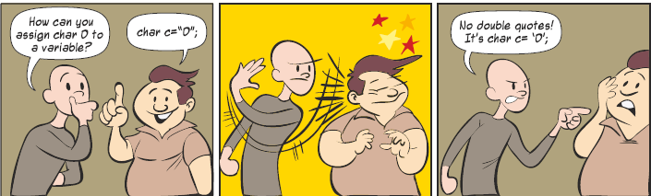
TClark
Characters
Characters are always enclosed in single quotes.

Slide 25
Boolean Data Type
TClark

Slide 26
TClark
Boolean Data Type
Has only 2 values – use for flags and to track conditions.
boolean stop = false;
boolean go = true;
out.printf("%b\n", stop);
out.printf("%b\n", go);
out.println("%b\n", stop == go);
false
true
false
Notes:
Printing a Boolean variable will generate either true or false as the output. Internally Booleans COULD be stored in one bit (normally 0 meaning false and 1 meaning true). However, it is inefficient for JVMs (Java Virtual Machines) to manipulate single bit entities, so Booleans are usually stored in 32 bits or 64 bits depending on the word size of the underlying hardware.
The JVM uses a 32-bit stack cell, used to hold local variables, method arguments, and expression values. Primitives that are smaller than 1 cell are padded out, primitives larger than 32 bits (long and double) take 2 cells. This technique minimizes the number of opcodes, but does have some peculiar side-effects (such as the need to mask bytes).
Primitives stored in arrays may use less than 32 bits, and there are different opcodes to load and store primitive values from an array. Boolean and byte values both use the baload and bastore opcodes, which implies that boolean arrays take 1 byte per element.

Slide 27
Data Types
Variables and Identifiers
ASCII
printf

